Slide 1

Matlab and Simulink Creation and Animation of X3D Graphics in Web-Based Simulation
YuanPin Cheng and Don Brutzman
Modeling, Virtual Environments, Simulation (MOVES) Institute, Naval Postgraduate School
20 June 2015

Slide 2
Agenda
Introduction
Project Content
Construction Flow Chart
High-Fidelity Engineering Model
Simulink Animation
Future work
Questions

Slide 3
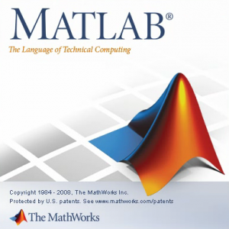

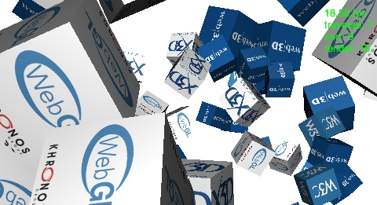
Introduction
Matlab - A powerful tool to compute high-fidelity engineering model and plot the result in figures.
Simulink -Implemented .m code into block diagrams and flow charts to execute the simulation.
X3D – Web-Based 3D model object so we can apply it into web-based animation in future work.
X3DOM -(pronounced X-Freedom) is an open-source framework and runtime for 3D graphics on the Web

Slide 4
Multiple Solutions
Matlab and Simulink to Web-Based Simulation Application Flow Chart
HUMUSoft
VRML Player
VRML
.wrl
Matlab
.m
Matlab
.fig
Simulink
Simulation
Key:
HUMUSoft HTML (Modified X3DOM)
Convert
Load
Live Event Link
X3D

Slide 5
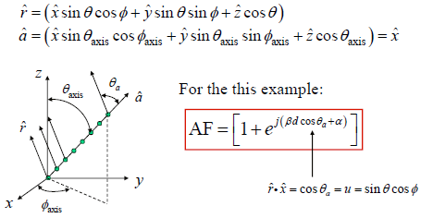

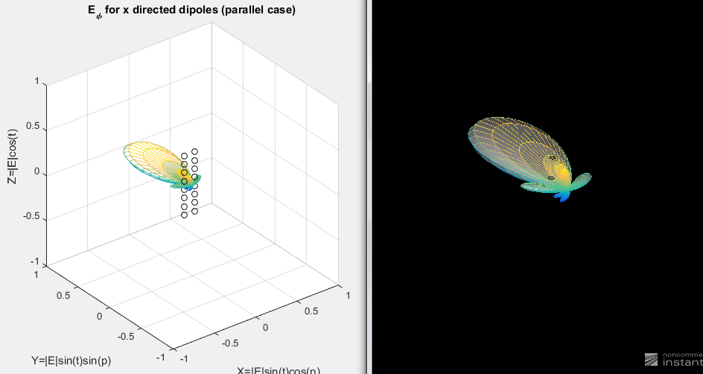
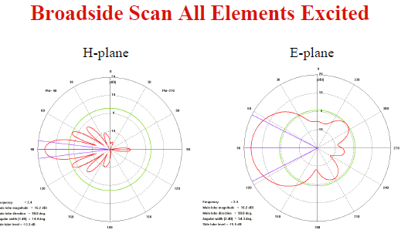

High-Fidelity Engineering Model
Phased Array Antenna Model
2D, ugh~
3D,

Slide 6
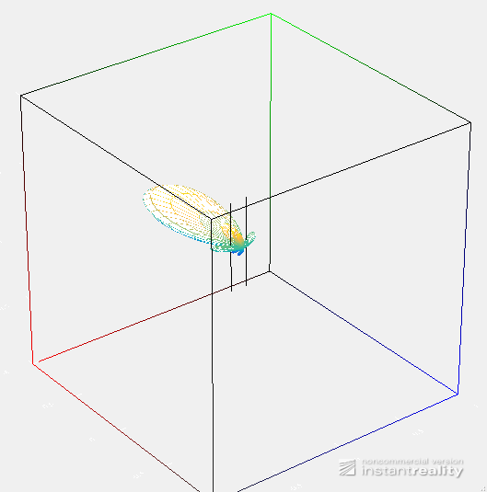
High-Fidelity Engineering Model
Original Phased Array Antenna Model in Matlab.m converted to .x3d and VRML .wrl and X3DOM .xhtml
Online at http://x3dgraphics.com/examples/X3dForAdvancedModeling/Matlab

Slide 7
Multiple Solutions
Matlab and Simulink to Web-Based Simulation Application Flow Chart
HUMUSoft
VRML Player
VRML
.wrl
Matlab
.m
Matlab
.fig
Simulink
Simulation
Key:
HUMUSoft HTML (Modified X3DOM)
Convert
Load
Live Event Link
X3D

Slide 8
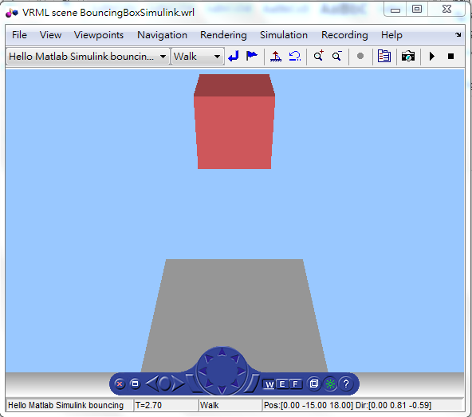
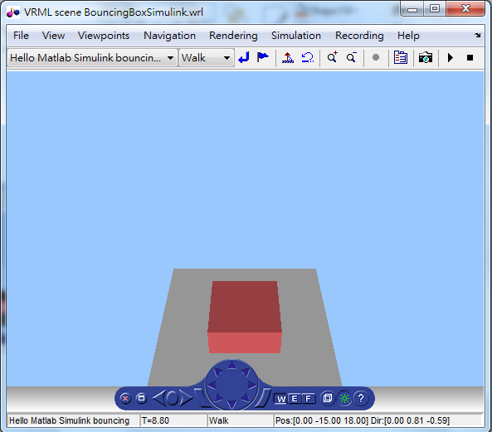
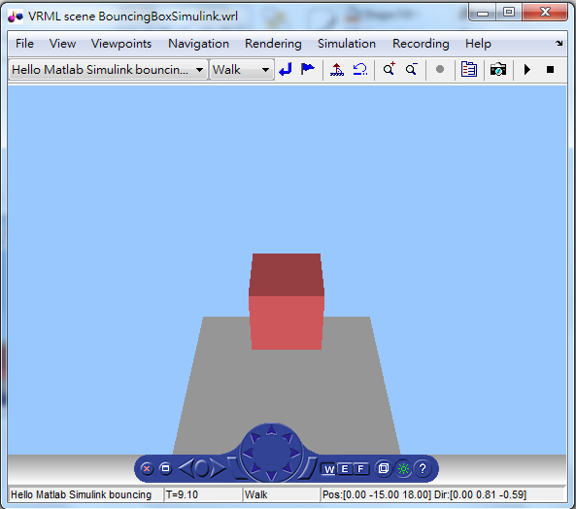
Simulink Animation
Simulink block diagrams computing the movement of red cube by Free Fall Equations
Hooks Law to represent the resilient force
Free Fall Compressed Post-Bounce

Slide 9
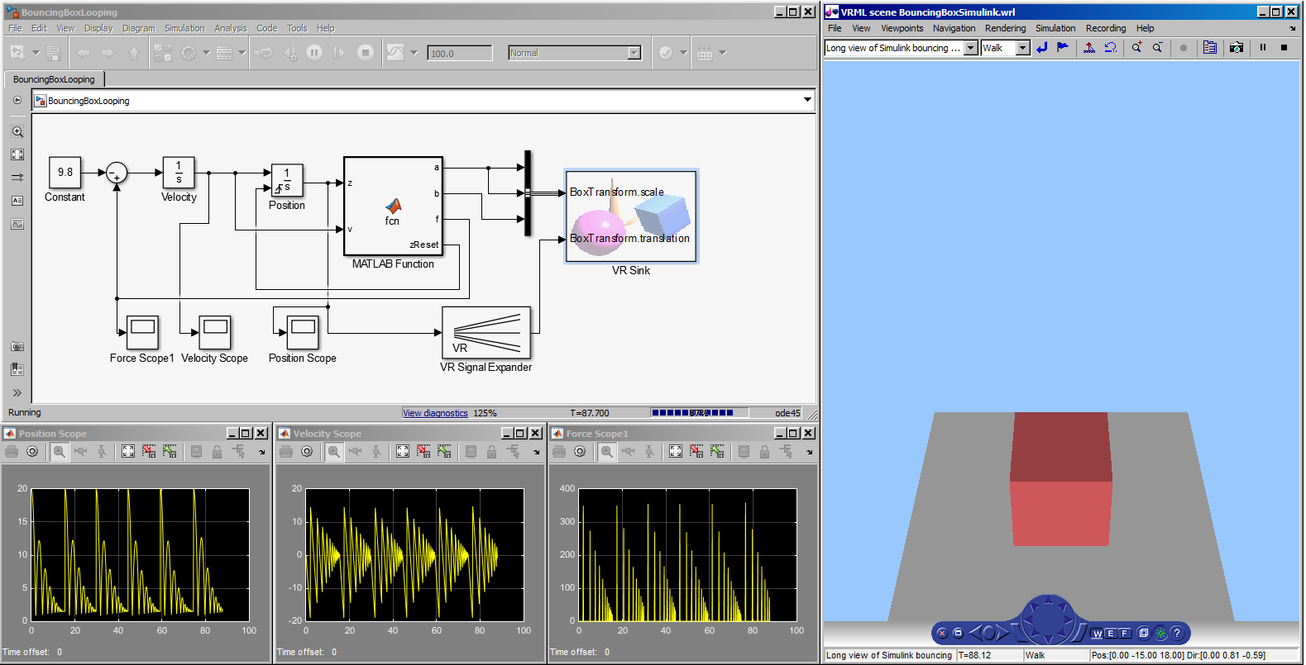
Simulink Animation
Block Diagrams of Simulink Implementation
X3DOM engine
http://localhost:8123
No Attenuation Example
Position Velocity Force Variation

Slide 10
Future Work
It has wide variety of application for engineering, education,
scientific visualization etc
It has wide variety of application for engineering, education, scientific visualization etc.
Questions?

