Slide 1
Visual Verification of Texture Mapping for Various Geometries in Multiple X3D Browsers
12 DEC 2017 ~ 22 DEC 2017
Sungmin Kwon
Don Brutzman

Slide 2
Motivation and Availability
Texture mapping is important but hard to check.
X3D has a variety of similar geometry nodes with slight differences that deserve close scrutiny.
Visual verification of multiple examples at one time can provide thorough confirmation of correctness.
Test scenes and imagery can be maintained in version control for regular review and updates.
Online at
X3D Example Archives: X3D for Advanced Modeling, Texture Mapping
http://X3dGraphics.com/examples/X3dForAdvancedModeling/TextureMapping
Texture Map Comparisons Cylinder and Texture Map Comparisons Rectangle

Slide 3
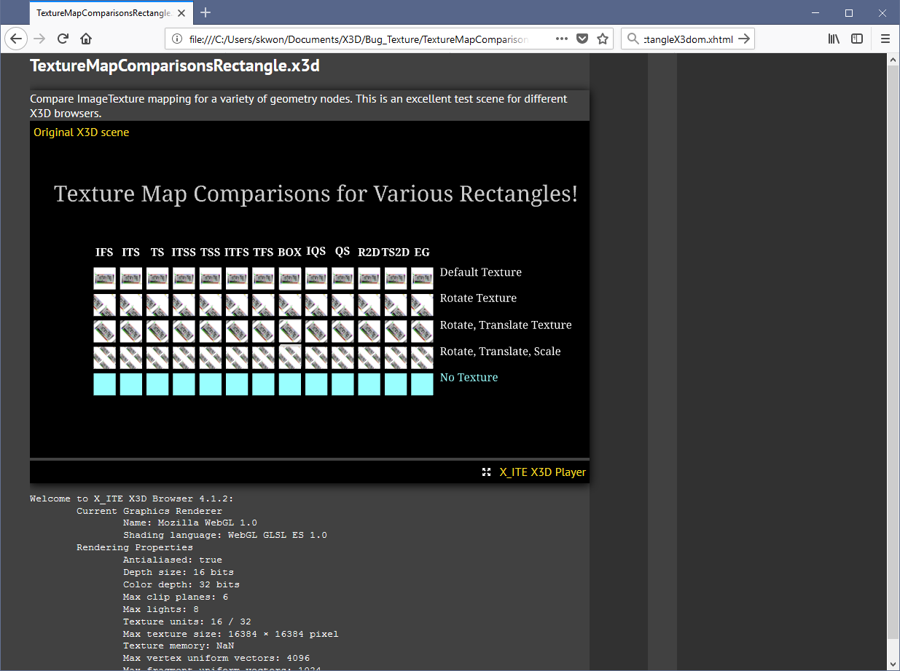
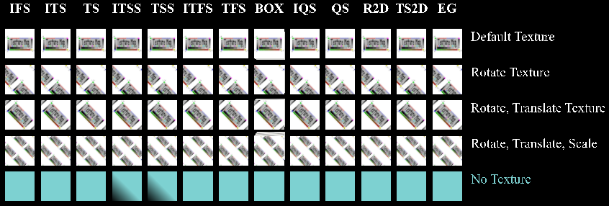
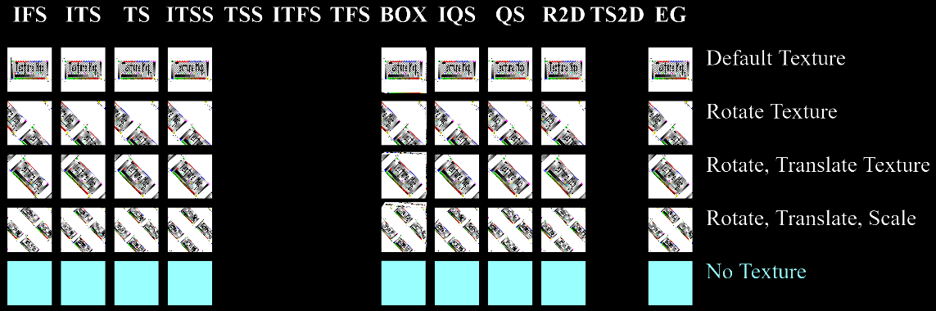
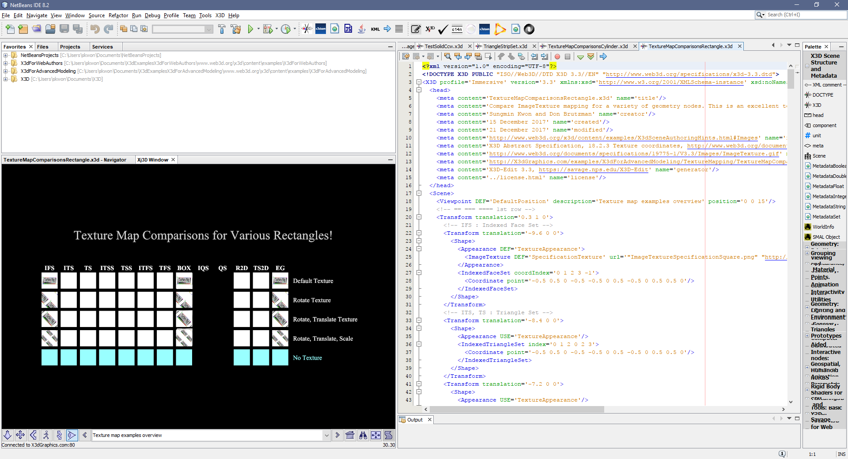
Texture map comparison for various Rectangles
X_ITE
Instant Reality
X3DOM
Old Xj3D Viewer

Slide 4
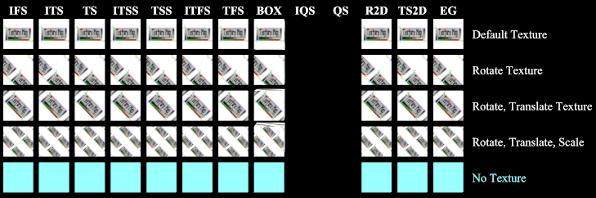
Texture map comparison after bugfix of Xj3D Viewer
X_ITE = Base Line
Old Xj3D Viewer
New Xj3D Viewer

Slide 5
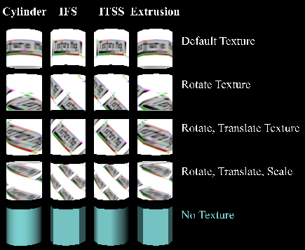
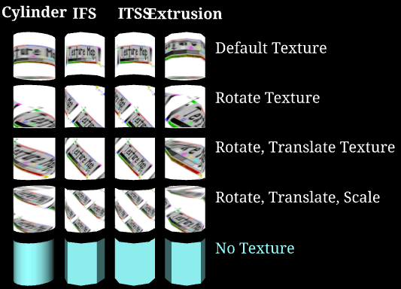
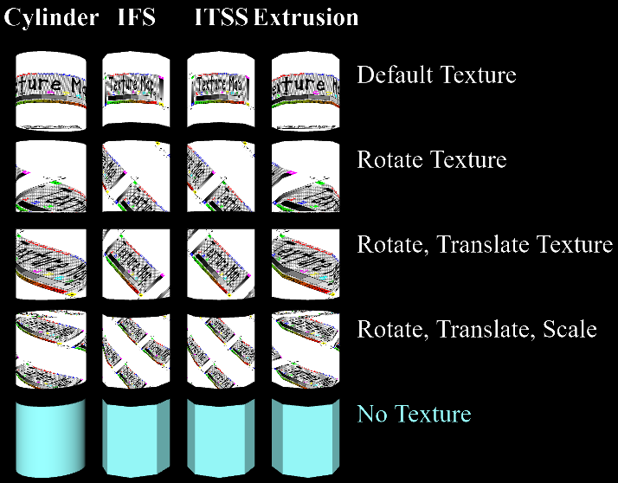
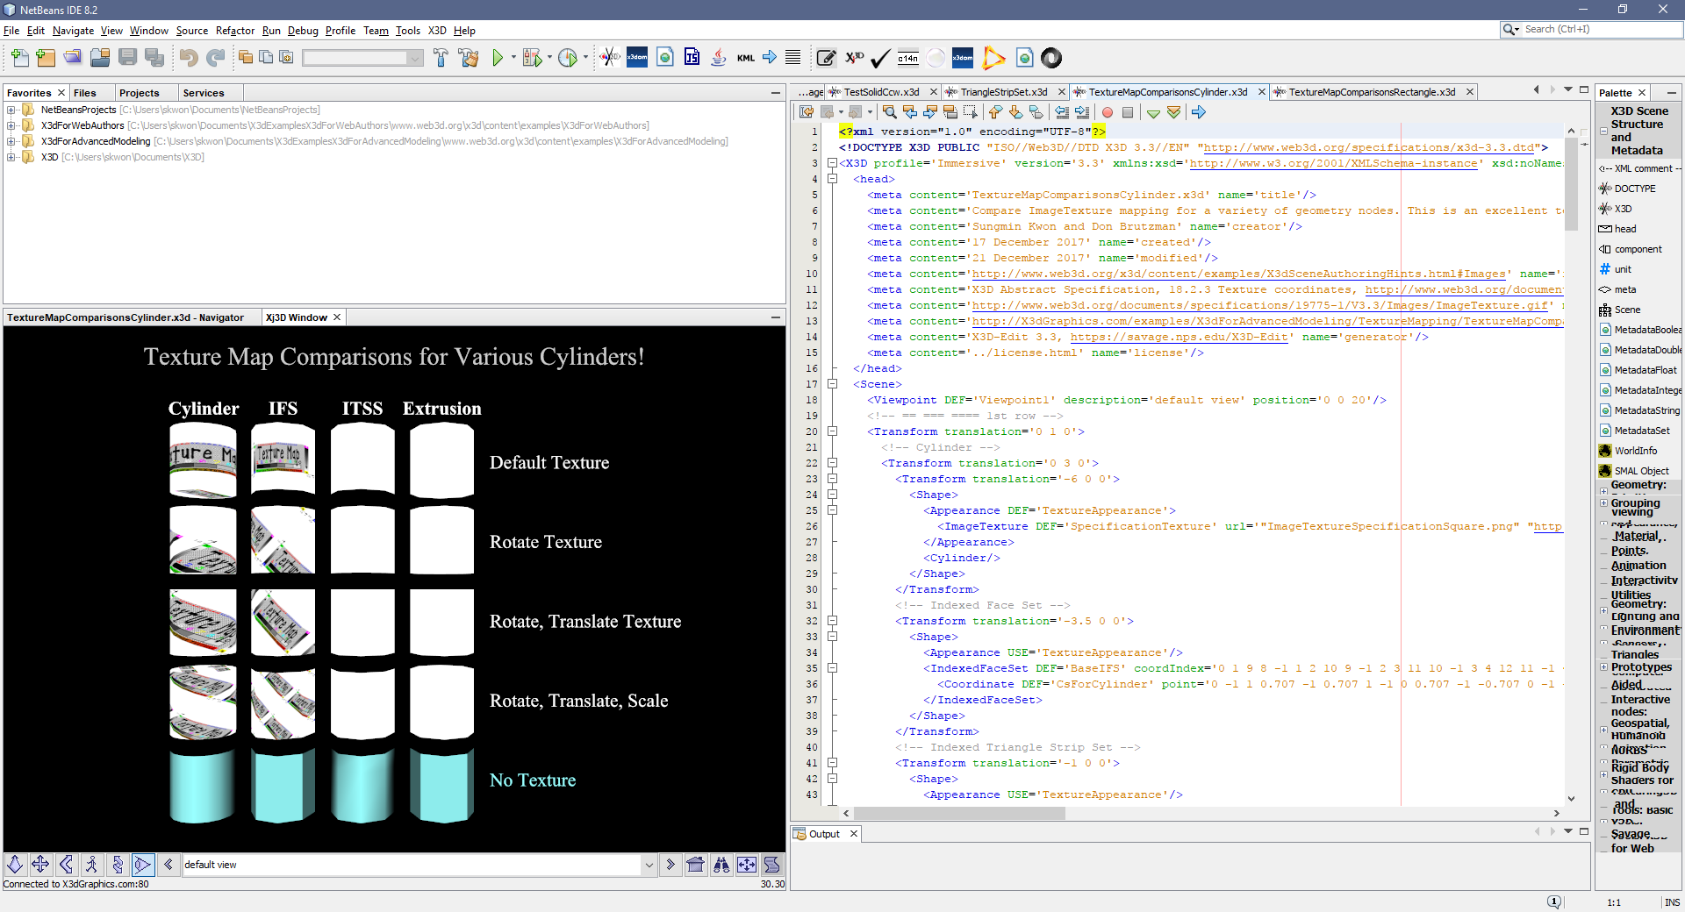
Texture map comparison for various Cylinders.
Instant Reality
X_ITE
X3DOM
Old Xj3D Viewer

Slide 6
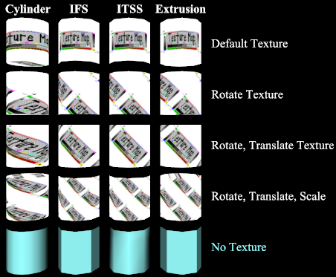
Texture map comparison after bugfix of Xj3D Viewer
Old Xj3D Viewer
New Xj3D Viewer

