Slide 1
XMP Metadata Support for X3D Models
Don Brutzman, Jakub Flotyński and Vince Marchetti
Web3D Consortium Working Groups:
X3D Semantic Web and CAD Design Printing Scanning
8 June 2021

Slide 2
X3D models have two kinds of metadata
Document metadata for each file
Top-level head/meta section, just like HTML
Terms for meta tags are derived from Dublin Core
Scene metadata
Can appear anywhere in X3D scene, retained with the scene graph
Strongly typed nodes and values, enabling strict validation of triples
MetadataSet allows construction of arbitrary metadata structures

Slide 3
Background: XMP
XMP design goals (Wikipedia summary)
XMP origin and genesis
Adobe support
ISO standardization
Note RDF basis, which permits Semantic Web querying of metadata
Experimenting with 2 approaches for mapping/encoding XMP in X3D
X3D4 terse encoding (with X3D4-X3D3 conversion ability via X3dTidy.xslt)
X3D3 more-verbose encoding (alternative experimentation by Vince)
Example use

Slide 4
Motivations: X3D inclusion of XMP metadata
Either “sidecar” XML metadata file or embedded X3D metadata possible, compatibly, each with respective strengths and benefits
Complete XMP metadata inclusion within X3D models is possible, includes compatible Semantic Web query capability.
External sidecar XMP files matching equivalent embedded X3D MetadataSet structures are excellent compatible use cases.
Includes ability to retain provenance information directly with model,
Readable by X3D engine (or HTML DOM) at display time,
Security features include archivable canonicalization, digital signature authentication and privacy-preserving encryption.
Current focus is to produce thorough examples

Slide 5
Initial encodings of XMP in X3D
First design pattern for correspondences by Vince
Second design pattern by Don, Jakub, Dick
Additional Wikipedia XMP example available
Adding transformation rules in X3dToTurtle.xslt stylesheet in order to provide XMP RDF triples complementing X3D Ontology form
Motivation: enable flexible queries using either XMP or X3D ontologies
Continuing example investigations, possibly divergent
Exploration is healthy! We are exploring potential best practices
Upcoming comparisons will help illuminate design choices

Slide 6
Design considerations, XMP to X3D MetadataSet
Precise and terse if using X3D4 XML encoding, compatible with X3D3 encoding
avoid containerField='metadata' wherever possible, note X3D4 XML schema
literal XMP values wherever possible, lossless
avoid nested quotes/apostrophes by using MetadataString name/value pairs
map XMP parent elements to MetadataSet, otherwise have typed Metadata* values wherever possible
push shared attributes such as xml:lang='en' as high as possible in hierarchy, since it applies to all children
assumptions: unquoted MFString values equal a single SFString array element, default Metadata* nodes are always containerField='value' for XMP info
(only XMP-specific metadata, no X3D-specific metadata explaining contained metadata)

Slide 7
Example X3D MetadataSet for XMP
https://x3dgraphics.com/examples/X3dForWebAuthors/Chapter15Metadata/XmpMetadataEmbeddedIndex.html
Special-case example by Vince Marchetti
Basis for terseness are X3D4 (refinements for XML encoding)
Once pattern is set, show equivalent (more verbose) X3D3 as XML too

Slide 8
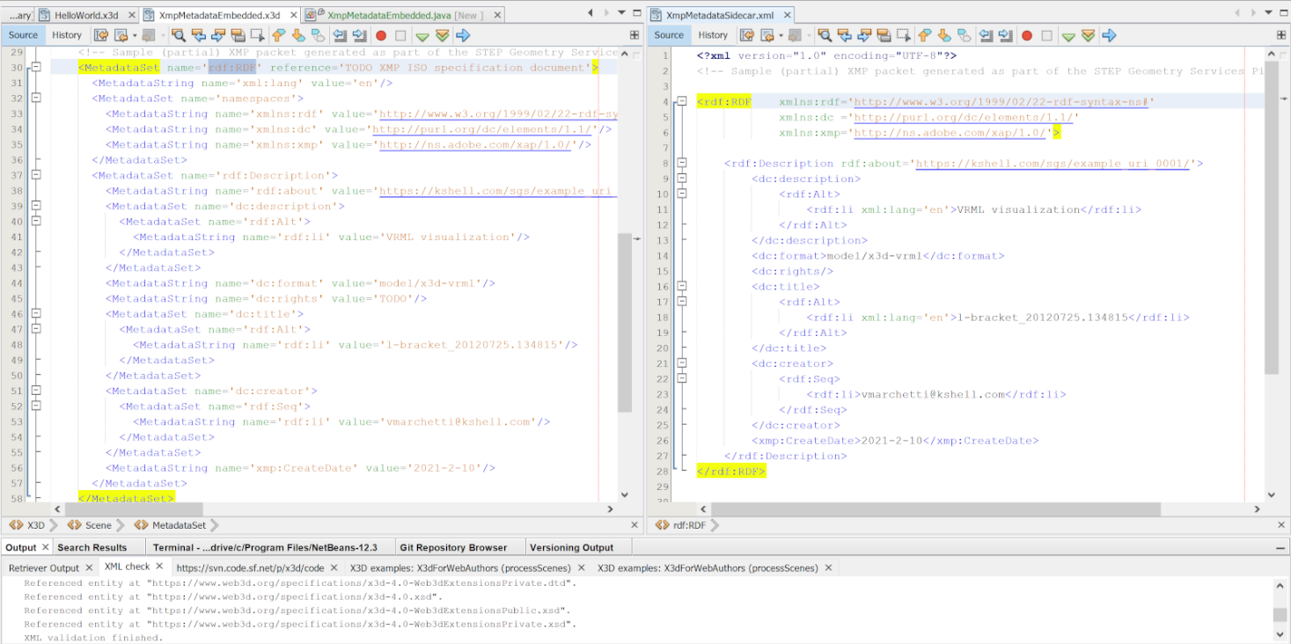
Correspondence between X3D Metadata nodes and RDF form

Slide 9
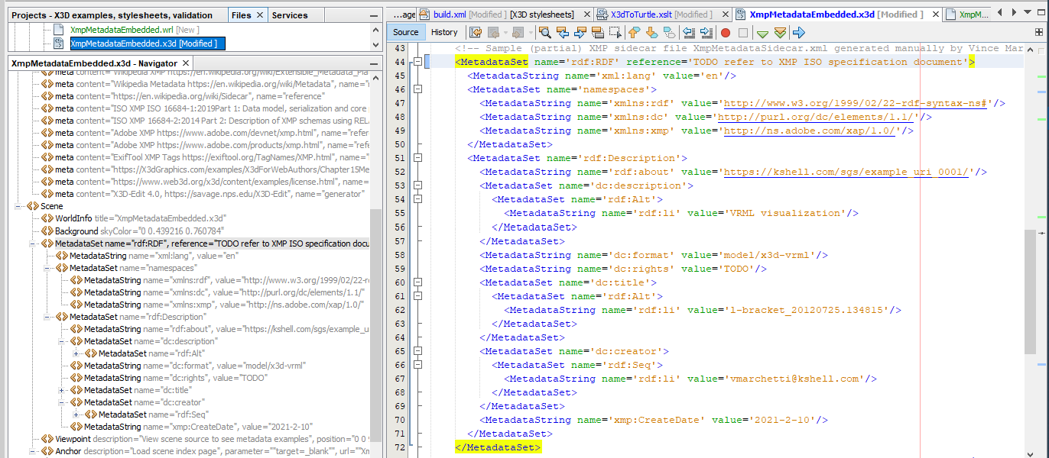
MetadataSet XML tree and corresponding X3D source

Slide 10
Conversions TODO #1
In progress: converting .x3d to .ttl using X3dToTurtle.xslt stylesheet
Already converts to Turtle using x3do: X3D Ontology
Confirm namespace prefixes preserved succinctly/exactly with string values
Look for (any) RDF, add RDF turtle to the output, include both by default.
Carefully support known constructs for RDF, Dublin Core, etc.
Determine validation rules to confirm minimum/nominal expected metadata
Consider SHACL pattern for validating satisfactory RDF metadata collection
Future work: new stylesheet XmlMetadataToX3dMetadataSet.xslt
Convert RDF XML in sidecar file into X3D MetadataSet structures
General use, any XML RDF and not just XMP?
Add importers to X3D-Edit, Java X3DJSAIL, Python X3DPSAIL

Slide 11
Conversions TODO #2
Dublin Core
Dublin Core ontology
https://www.dublincore.org/specifications/dublin-core/dcmi-terms/dublin_core_terms.ttl
https://www.dublincore.org/specifications/dublin-core/dcmi-terms/dublin_core_terms.rdf
Need X3D examples demonstrating similar correspondence with Dublin Core?
Is this a general pattern we should emulate, providing matching sets of triples for flexible query, in X3dToTurtle.xslt?
Shouldn’t we be writing equivalence rules in OWL/RDF as well?
What is the nature of Protégé identification of Dublin Core values as AnnotationProperties?

Slide 12
Questions
Where is ontology for XMP? Listed in XMP standard?
Ontology for Media Resources 1.0, Table 5.2.2.17 XMP comparison
https://www.w3.org/TR/mediaont-10/#xmp-table

Slide 13
Upcoming test case from Wikipedia
https://en.wikipedia.org/wiki/Extensible_Metadata_Platform#Example
More detailed, stable with public scrutiny

Slide 14
Contact
Don Brutzman, Ph.D.
brutzman@nps.edu
http://faculty.nps.edu/brutzman
Code USW/Br, Naval Postgraduate School
Monterey California 93943-5000 USA

Slide 15
Contact
Jakub Flotyński, Ph.D.
flotynski@kti.ue.poznan.pl
https://www.kti.ue.poznan.pl/en/jakub_flotynski.html
Poznań University of Economics and Business
Al. Niepodległości 10
61-875 Poznań, Poland

Slide 16
Contact

