Slide 1



X3D Ontology for Querying 3D Models on the Semantic Web
Author Information – Name, Email, Affiliation
WEB 3D 2020
The 25th International ACM Conference on 3D Web Technology
November 9-13, 2020, Virtual Conference, Seoul, Korea
Don Brutzman Naval Postgraduate School (NPS) Monterey, CA, USA brutzman@nps.edu | Jakub Flotyński Poznań University of Economics and Business, Poznań, Poland flotynski@kti.ue.poznan.pl

Slide 2
Topics
X3D Semantic Web Working Group
Motivations for semantic 3D content
X3D Ontology and semantic models
Queries to semantic X3D models
Conclusions and future works

Slide 3
Motivation: Semantic Web
"The proof of the pudding is in the eating." Wiktionary
"Trying to use the Semantic Web without SPARQL is like trying to use a relational database without SQL." Tim Berners-Lee
"The answer to your question is the response to the query." Jim Hendler and Dean Allemang
What if you can ask, and answer, any question?

Slide 4
Motivation: all 3D on the Web
Many models are being produced through authoring tools, scanners, conversions etc.
How do we keep track of this information?
Diverse data formats, irregular metadata
How do we search for models of interest?
Common-denominator representation: X3D
Consistent, coherent metadata vocabularies
Unlock Semantic Web tools via X3D Ontology

Slide 5
Motivation: 3D/VR/AR on Web
Interestingly, all forms of presentation then have a consistent basis for query
Content formats Extensible 3D (X3D) v4
Integrating 3D/VR/AR with web browsers
Wide access, collaborative environments
Programming libraries, e.g., WebGL, Blender, Java, Python, JavaScript, others
Device Interfaces, e.g., WebXR
3D printed models might be similarly accessed

Slide 6
Semantic Web
Global database linking structured content with semantic descriptions
Ontologies and knowledge bases
Applicable to any domain and enables
Content description at arbitrary specification level
Reasoning
Queries
W3C Standards: RDF, RDFS, OWL, SPARQL
No common integration for 3D/VR/AR and Semantic Web

Slide 7
X3D Semantic Web Working Group
Maximize interoperability with Semantic Web standards for greatest possible reuse and integration of 3D with the web
Efficient indexing, search, comparison, and analysis of X3D models through the advanced use of metadata and semantics
Create and partially autogenerate X3Dv4 OWL ontology from the X3D Unified Object Model (X3DUOM) using best-practice design patterns
Support various Web3D Working Groups including Computer-Aided Design (CAD), 3D printing/scanning, Medical, Cultural and Natural Heritage, Humanoid Animation (HAnim) design work may consider other potential domains such as Building Information Models (BIM), etc.
Build and maintain a list of domain-specific ontologies that are suitable for use in concert with the X3D Ontology.

Slide 8
Motivations for Semantic 3D Content
Compliant with the current web evolution (semantic web)
Facilitates
Management (indexing, searching)
Exploration (reasoning, queries)
Modeling (non-IT-specialists)
of 3D content
Independent of particular 3D formats and presentation platforms
Different levels of specificity (3D and application/domain)
Declarative content representation

Slide 9
Semantics of 3D Content: examples
Semantic description of a 3D scene enables answers to semantic reasoning and queries about the scene
Reasoning and queries may cover properties of 3D objects
At the 3D and domain levels of specificity
Related to different content features
Geometry, e.g.,
What is the type of a shape? (3D-specific)
What is the category of a car based on its shape? (domain-specific)
Structure, e.g.,
How many polygons does a 3D model have? (3D-specific)
What are components of a virtual car? (domain-specific)
Presentation, e.g.,
Which objects in a scene use a common texture? (3D-specific)
Which objects in a scene are made of wood? (domain-specific)
Behavior, e.g.,
What scripts describe the behavior of an object? (3D-specific)
What is the exercise performed by an avatar? (domain-specific)
Combining specificity levels by ontology mapping, e.g., virtual museum ontology to 3D ontology

Slide 10
Semantic Web3D
Current work of the working group
Application of the semantic web to 3D technologies intended to support
Development
Management
Use
of 3D content on the semantic web

Slide 11
X3D Ontology
Semantic representation of the X3D format
Automatically generated from the X3D schema (XSLT)
Encoded in TTL (match RDF, RDFS, OWL)
Queryable with SPARQL
Enables reasoning by concept combination

Slide 12
X3D Ontology
Up-to-date representation of various 3D features
Geometry
Structure
Presentation
Animation
Automatic generation of semantic X3D repositories upon the available content
Reasoning and querying over the available X3D content

Slide 13
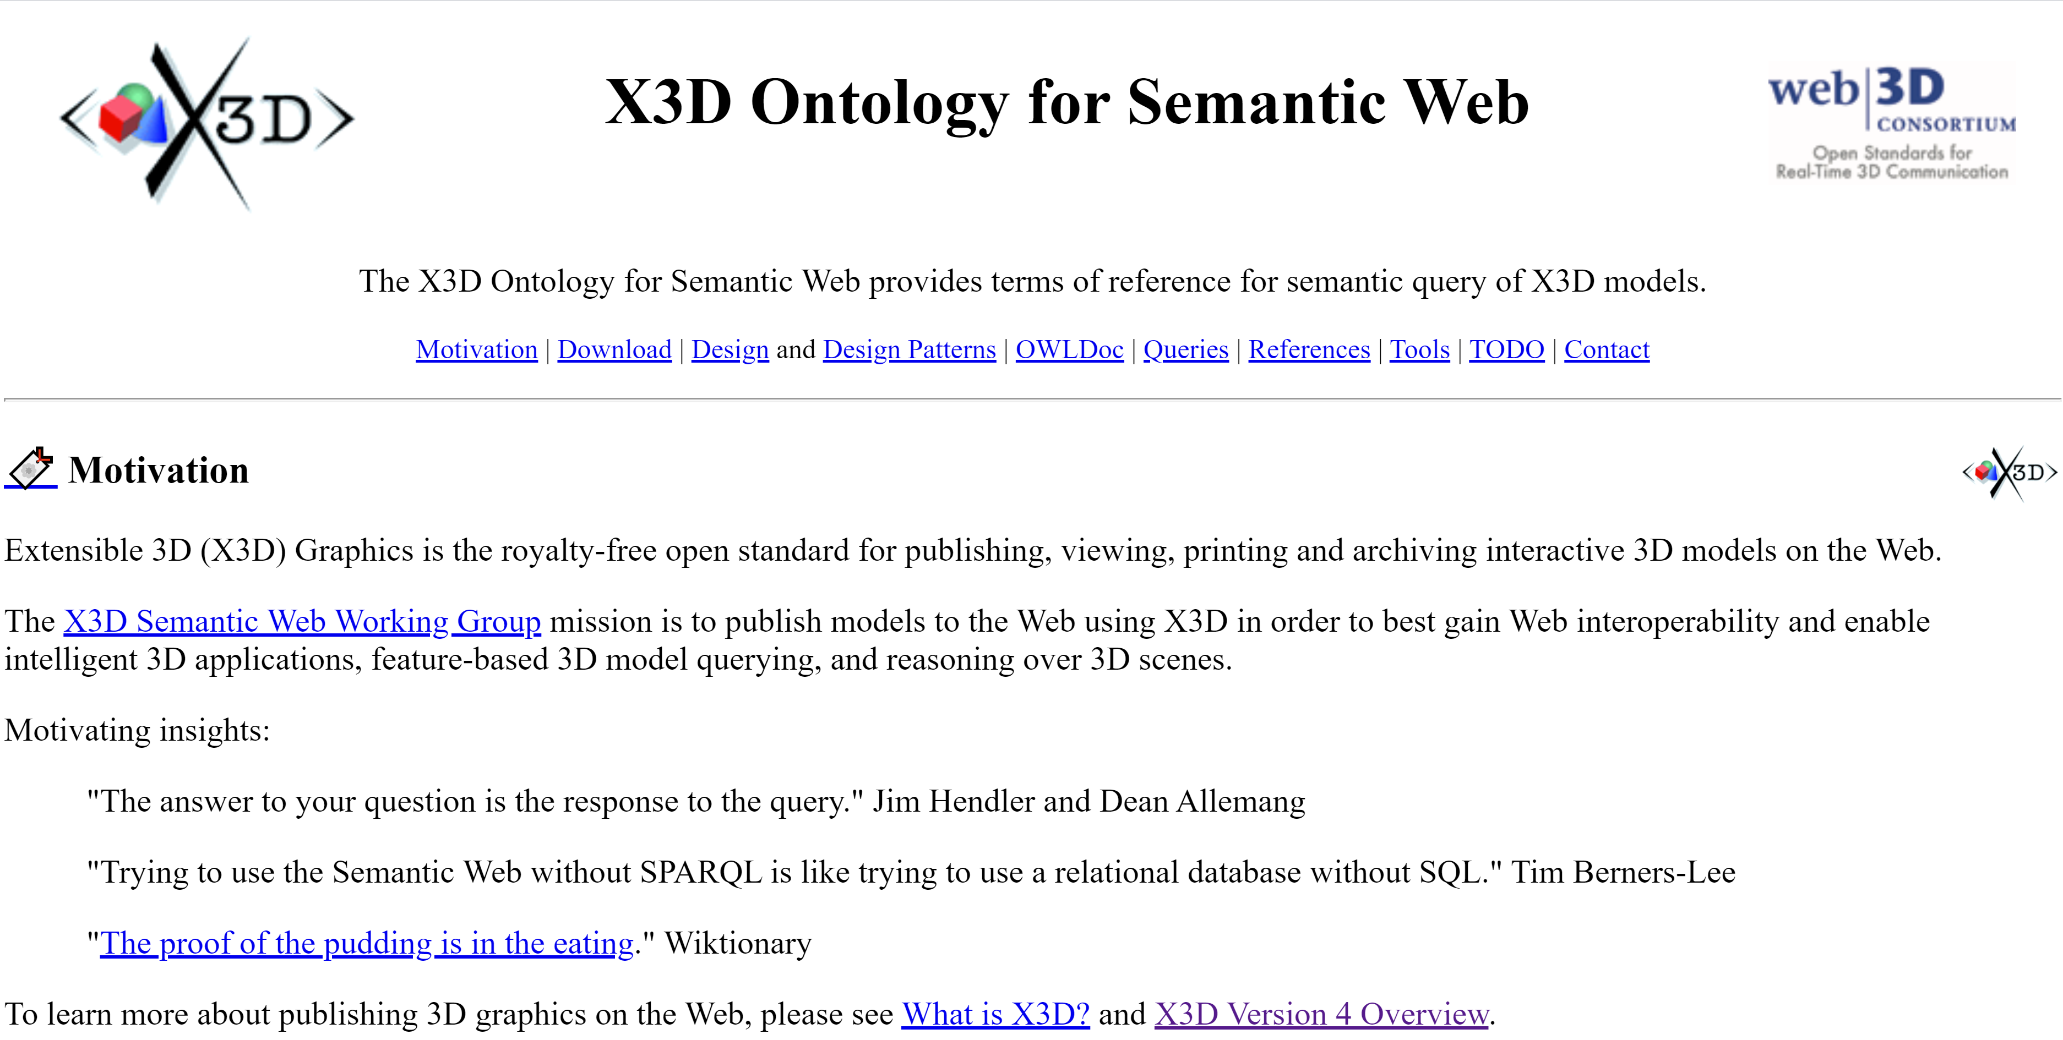
X3D Ontology website availability
https://www.web3d.org/x3d/content/semantics

Slide 14
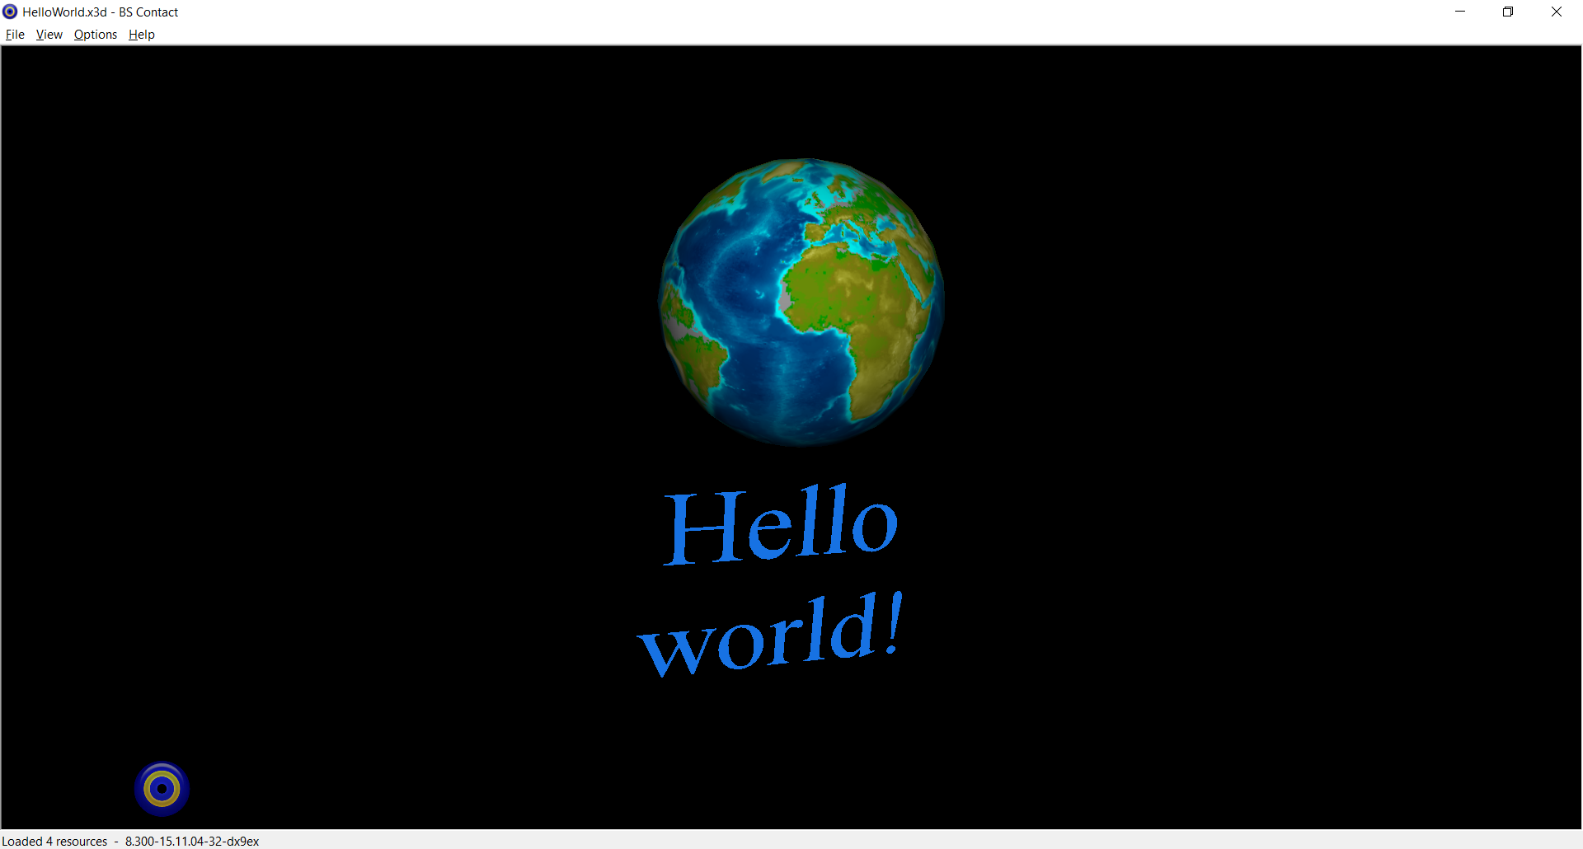
Queries to Semantic X3D Models

Slide 15
Semantic Version of X3D Model

Slide 16
Queries to Semantic X3D Models
now https://

Slide 17
Advanced query: ROUTE validity
Test that event animation chains are fully connected with correct type, accessType
Future possible queries:
detect problems with missing triggers or connections, identify animation fragments
Infer cause-and-effect relationships in model storyboard or User Experience (UX)

Slide 18
Areas of active future work
Metadata and ontology correspondences
ISO SC24 work on Geometry Ontology
Shape recognition terms of reference
3D Printing metadata for materials, sizes, production, fit for purpose, etc. etc.
Metadata for model format conversions, and X3D scene-graph format correspondences, to facilitate cross-format model search

Slide 19
Conclusions and Future Work
Advantages of the presented approach
Integration of the semantic web and 3D
Up-to-date with X3D4
Automatic transformation
3D representation for queries and reasoning rather than rendering
Future work topics are numerous
Integration with achievements of other Web3D WGs
Transformation of other 3D formats (DFDL)
Mapping to domain ontologies

Slide 20
X3D Ontology for Querying 3D Models
on the Semantic Web
Thank you for your attention
Don Brutzman, Jakub Flotyński
semantics@web3d.org

Slide 21


WEB 3D 2020
3D for a Hyperconnected World
The 25th International ACM Conference on 3D Web Technology
November 9-13, 2020, Virtual Conference, Seoul, Korea

