Slide 1
Preservation, Access, and Reuse: Advancing 3D and VR Strategy in the Research Library
Jamie Wittenberg
jvwitten@Indiana.edu
CC-BY 4.0

Slide 2
Overview and Goals
Form holistic knowledge from normally siloed areas of 3D/VR
01
Develop best practices to support 3D/VR throughout the research lifecycle
02
Establish guidelines that can serve multiple research contexts and use cases that libraries may need to support as researchers increasingly adopt 3D/VR as a research tool.
03
Develop strategies that libraries can use for creating policies and workflows for providing 3D/VR related research services.
04
Notes:
Crosswalks and access between standards align with the strengths of libraries while supporting research and education aligns with the mission

Slide 3
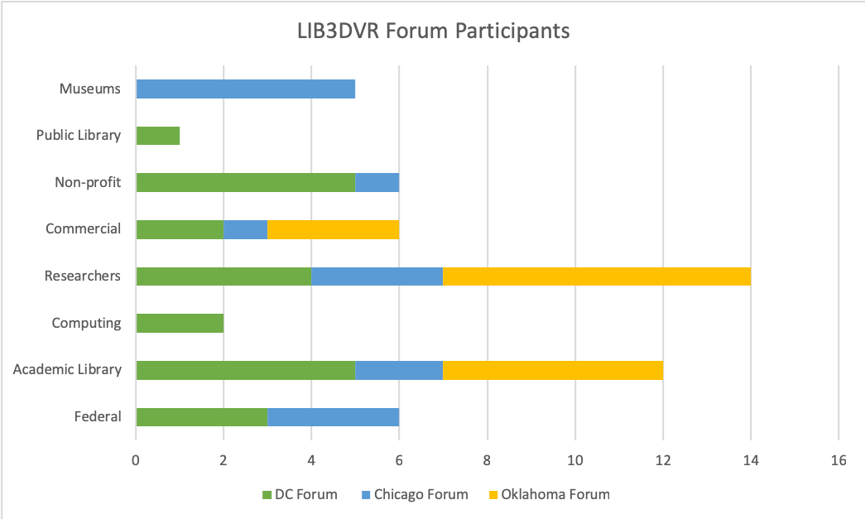

Slide 4
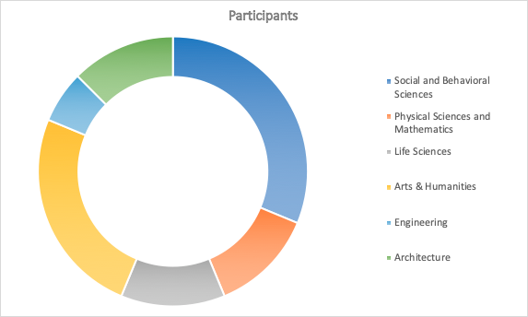

Slide 5
High Level Overview of Forums
Washington DC Forum: 3D/VR Content Creation and Publishing: 3D scanning and modeling. Storage, access, and management. Integration of 3D data into existing research and scholarly communication services. Metadata requirements
Oklahoma Forum: 3D/VR Visualization and Analysis: 3D/VR tools, Using VR to support other library services, human centered issues of 3D/VR technology use. Modifying/repurposing 3D models
Chicago Forum: 3D/VR Repository Practices and Standards: National Repository and Preservation Efforts. 3D/VR repository policies and practices. Implications for different levels of library support. Implications for existing digital preservation models and practices

Slide 6
Forum 1
Content Creation and Publishing

Slide 7
Forum 1 Concerns
Program Planning and Resources for Reuse
Cost, Value, and Challenges of CT/volumetric capture
Resources for storage, access, and management
Research Data Quality
Citation Practices and Indexing
Existing Infrastructures, Practices, and Cultures
“Evolving” Licensing Agreements
Respecting Cultural Protocols
Unclear Legal Status of 3D Data

Slide 8
Forum 1 Findings
Providing Sustainable Archiving Infrastructure
Archiving and Describing 3D/VR
Providing Tools to Researchers

Slide 9
Forum 2
3D/VR Visualization and Analysis

Slide 10
Forum 2 Findings
Good documentation practices
Ethics & Licensing
Transparency & reproducibility

Slide 11
Forum 3
3D/VR Repository Practices and Standards

Slide 12
Forum 3 Findings
Searchability
Ownership & security
Streaming & download capacity

Slide 13



Intellectual Property
Notes:
There is a significant amount of confusion and misinformation related to copyright and intellectual property related to 3D and VR. Some experts agree that 3D scanning may not result in copyrightable IP - especially if it is a ‘slavish copy’ - a term characterizing non-transformative scans in the 1999 Bridgeman Art Library v. Corel Corp. case. (Michael Weinberg’s 2017 whitepaper, ‘3D Scanning: A World Without Copyright’ ‘‘https://www.shapeways.com/blog/wp-content/uploads/2016/05/white-paper-3d-scanning-world-without-copyright.pdf’ Kyle Courtney and Melissa Levine presented on this issue at the Community Standards for 3D Preservation meeting in St. Louis. In early 2018. They highlighted the complexity of the question and have been working since on a whitepaper.

Slide 14
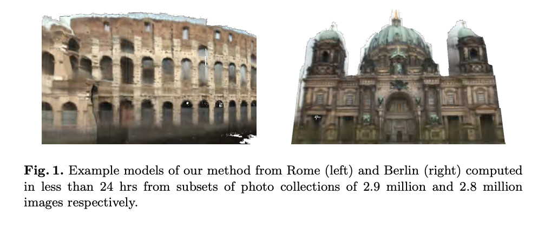
Building Rome on a Cloudless Day
Frahm, J.-M., Fite-Georgel, P., Gallup, D., Johnson, T., Raguram, R., Wu, C., … Pollefeys, M. (2010). Building Rome on a Cloudless Day. In K. Daniilidis, P. Maragos, & N. Paragios (Eds.), Computer Vision – ECCV 2010 (pp. 368–381). Springer Berlin Heidelberg.
Notes:
LIB3DVR participants throughout the three forums expressed uncertainty about the IP status of 3D models, replica, and printed objects and the implications of that uncertainty for organizations working to archive and disseminate the models. In particular, the issue of models derived from hundreds of crowdsourced images, all with different licenses, poses a problem.
Here is an example: In 2010, the University of North Carolina in partnership with ETH-Zurich developed technology that allowed them to stitch together millions of Flickr images to create 3D models of landmarks and cities. The project and accompanying paper, “Building Rome on a Cloudless Day” uses the city of Rome as a prototype for this kind of crowdsourced modeling. The authors write: “Our method efficiently combines 2D appearance and color constraints with 3D multi-view geometry constraints to estimate the geometric relationships between millions of images.” So they are using millions of individual images on Flickr as source data for this model. There could be any number of licenses applied to those images. This is the kind of scale that comes into play in a discussion of intellectual property and 3D.

Slide 15

tinyurl.com/y2e6l4bv
jvwitten@Indiana.edu

