Slide 1
Python X3D Implementation Progress
Don Brutzman
X3D Working Group, Web3D Consortium
brutzman@nps.edu
26 August 2019

Slide 2
Motivation
Create fully functional support for X3D Graphics using the Python programming language.
As with other X3D language bindings, capabilities include the requirements of X3D Scene Access Interface (SAI) ISO/IEC 19775-2.
We openly design, implement, evaluate and specify all aspects of this work using Web3D Consortium Standards Adoption Process.
When initial implementation and complete draft specification exist, Web3D reviews suitability for New Work Item Proposal (NWIP).
Package designers include Loren Peitso, John Carlson, Masaki Aono, Myeong Won Lee, and Don Brutzman.

Slide 3
Background: X3DJSAIL + Pyjnius efforts
Given a number of unique features in Python, creating a 19777-6 draft requires a working implementation to resolve a number of design issues.
Much effort has occurred over the past 18 months, with a long developmental period using X3DJSAIL and Pyjnius to implement X3D Python using Java. However we only achieved 80% success, primarily due to difficulties getting two codebases to align successfully.
The X3DJSAIL-Pyjnius approach is no longer considered a viable potential path for implementation.

Slide 4
Design
X3D Unified Object Model (X3DUOM) is used to autogenerate the entire x3d.py package, ensuring that it is always up-to-date with the latest X3D Architecture.
The current implementation strives to follow first principles of python package design, being as "pythonic" as possible.
Python is exceedingly rigorous regarding design and implementation, demands crisp readability and often leads to a single best approach for each programming task.
Python is deliberately different than imperative languages such as Java, C++ etc. Thus different approaches pertain (no getters/setters, etc. etc.)
A single well-constructed open-source Python X3D implementation might serve all Python distributions and programmers well.

Slide 5
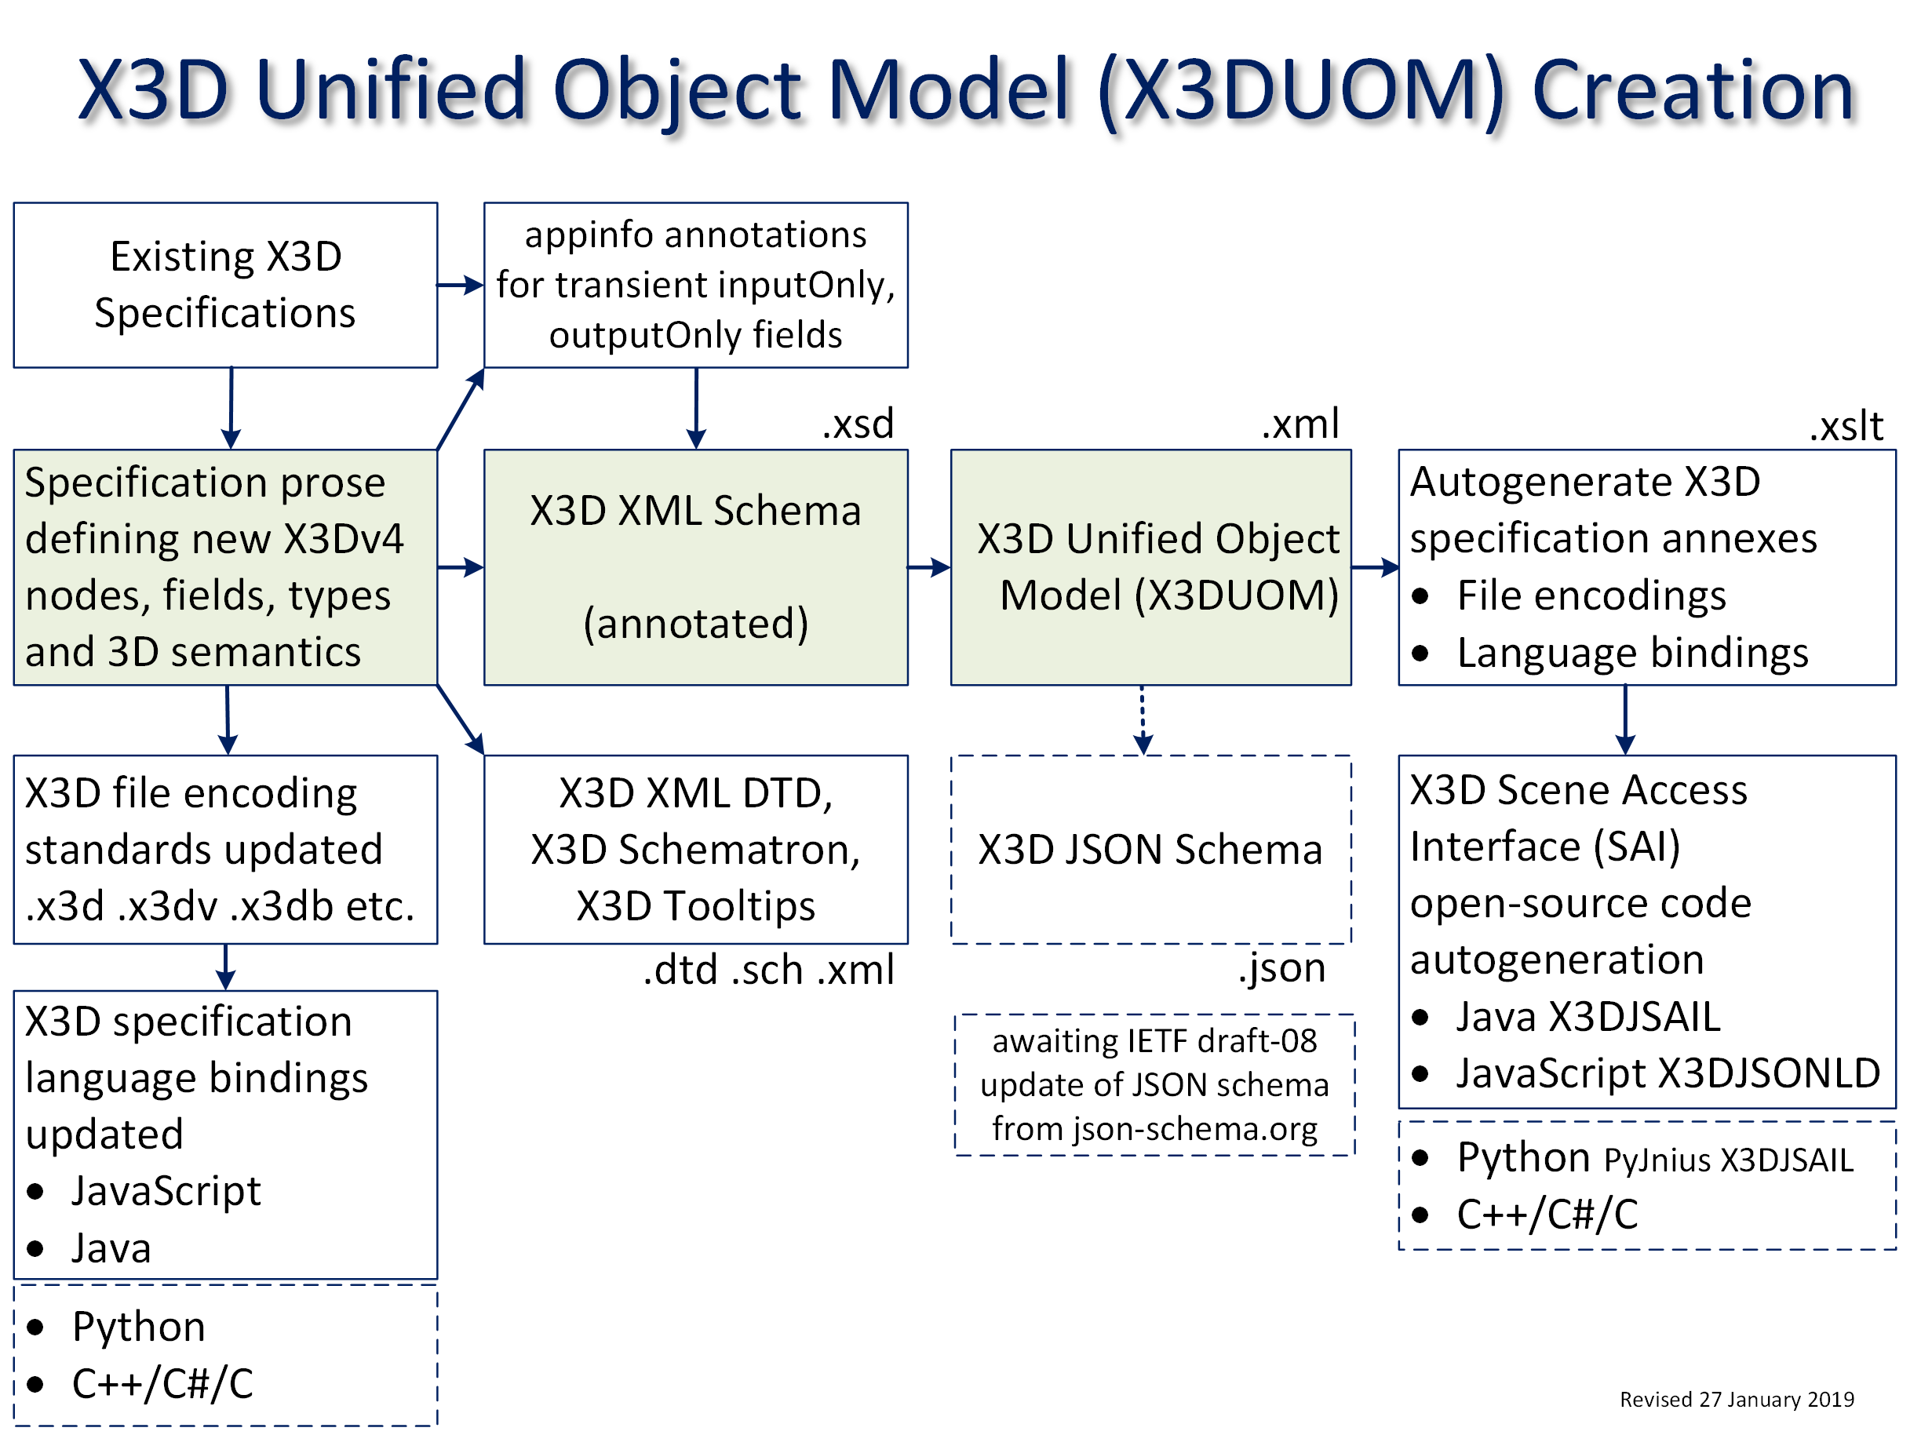

Slide 6
Renewed Progress
The perhaps-obvious insight “let Python be Python” has led to a native Python X3D implementation that requires no external package dependencies.
Best practices are followed throughout, hopefully leading to a widely used package across multiple Python distributions for many users.
Because the X3D Unified Object Model (X3DUOM) is used as the basis for source-code autogeneration, all interfaces in the x3d.py package are rigorous and complete for X3Dv4.
This open-source work is published on Python Package Index (PyPi) for simple deployment support by Python programmers.

Slide 7
Demonstrated Examples
Conversion routines have produced over 3500 self-validating programs that demonstrate models in the X3D Example Archives.
Round-trip conversions and testing are formally demonstrating correctness and completeness.
Smoke tests confirm basic functionality during development.
Unit testing on a systematic basis is especially important for Python since errors are only reported at run time.

Slide 8
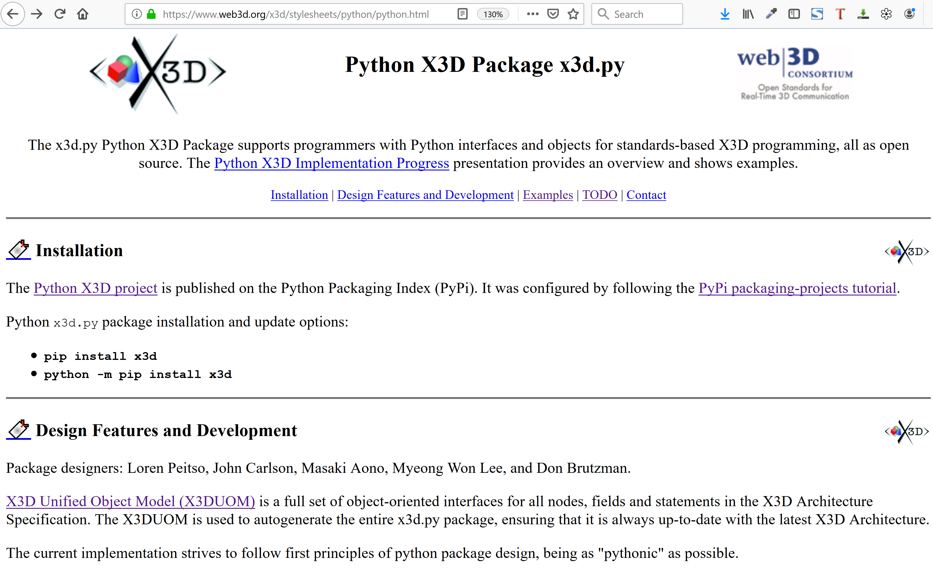

Slide 9
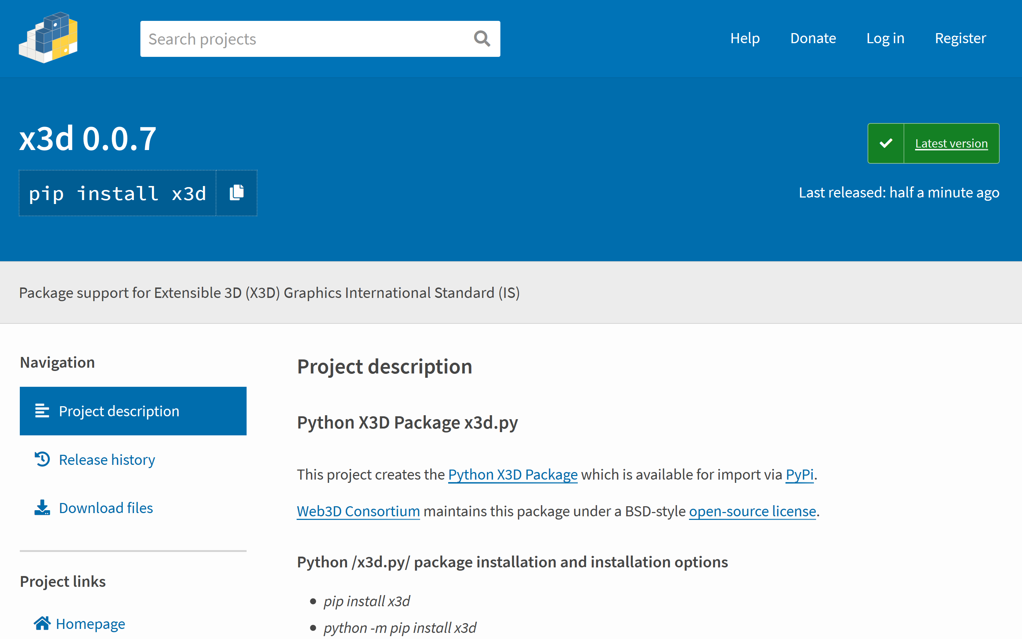

Slide 10
X3D Resources, Examples: Scene Archives for X3D
https://www.web3d.org/x3d/content/examples/X3dResources.html#Examples
A simple example test scene is HelloWorld.x3d provided in a variety of X3D encodings: .x3d XML .x3dv ClassicVRML, .wrl VRML97, .html listing, .html X_ITE, .xhtml X3DOM, .java Java source, .json JavaScript Object Notation, .py Python source (experimental), .x3db compression, C14N canonicalization, and .png image
https://www.web3d.org/x3d/stylesheets/python/HelloWorld.py
https://www.web3d.org/x3d/content/examples/HelloWorld.html

Slide 11
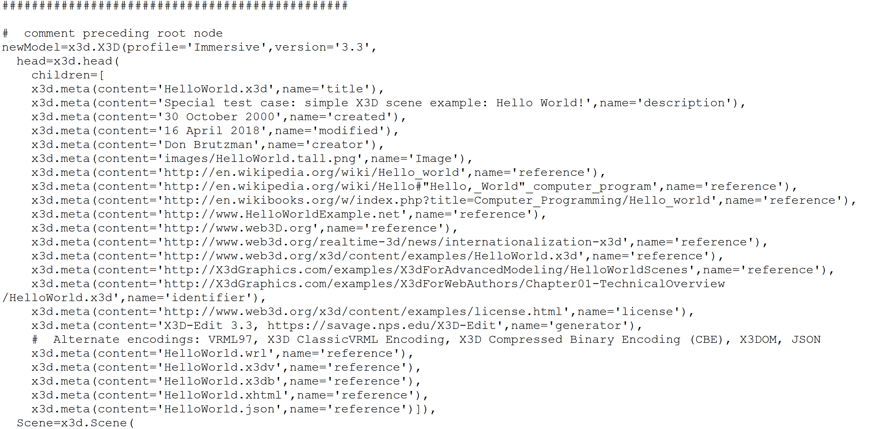
Python source example, part 1

Slide 12
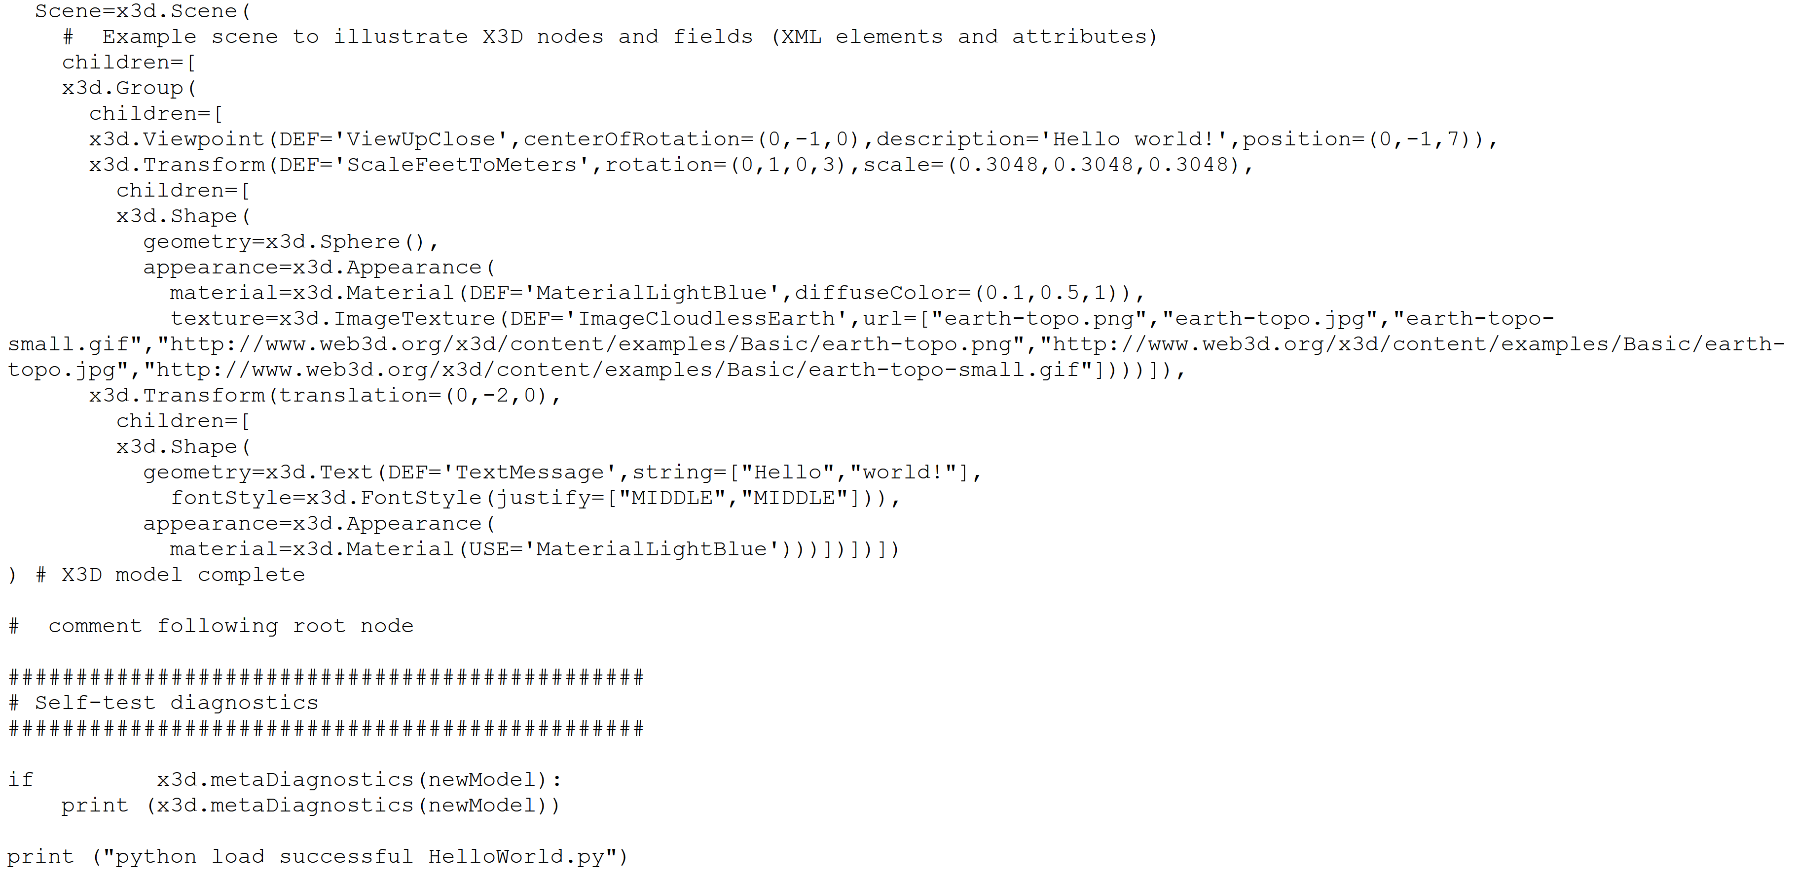
Python source example, part 2

Slide 13
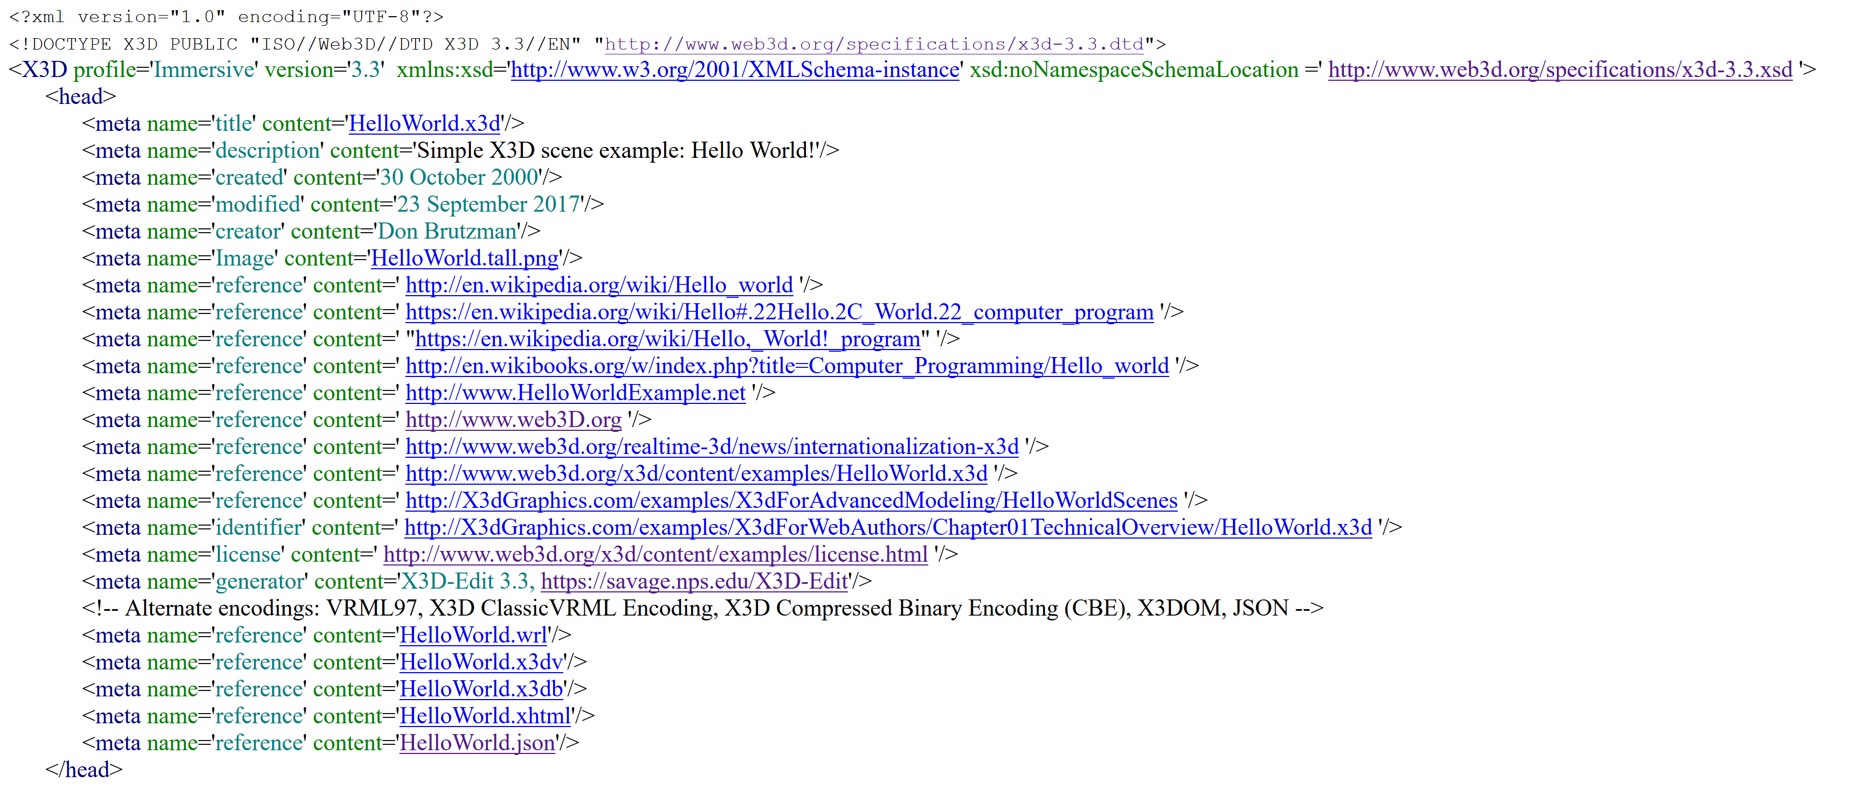
X3D XML source example, part 1

Slide 14
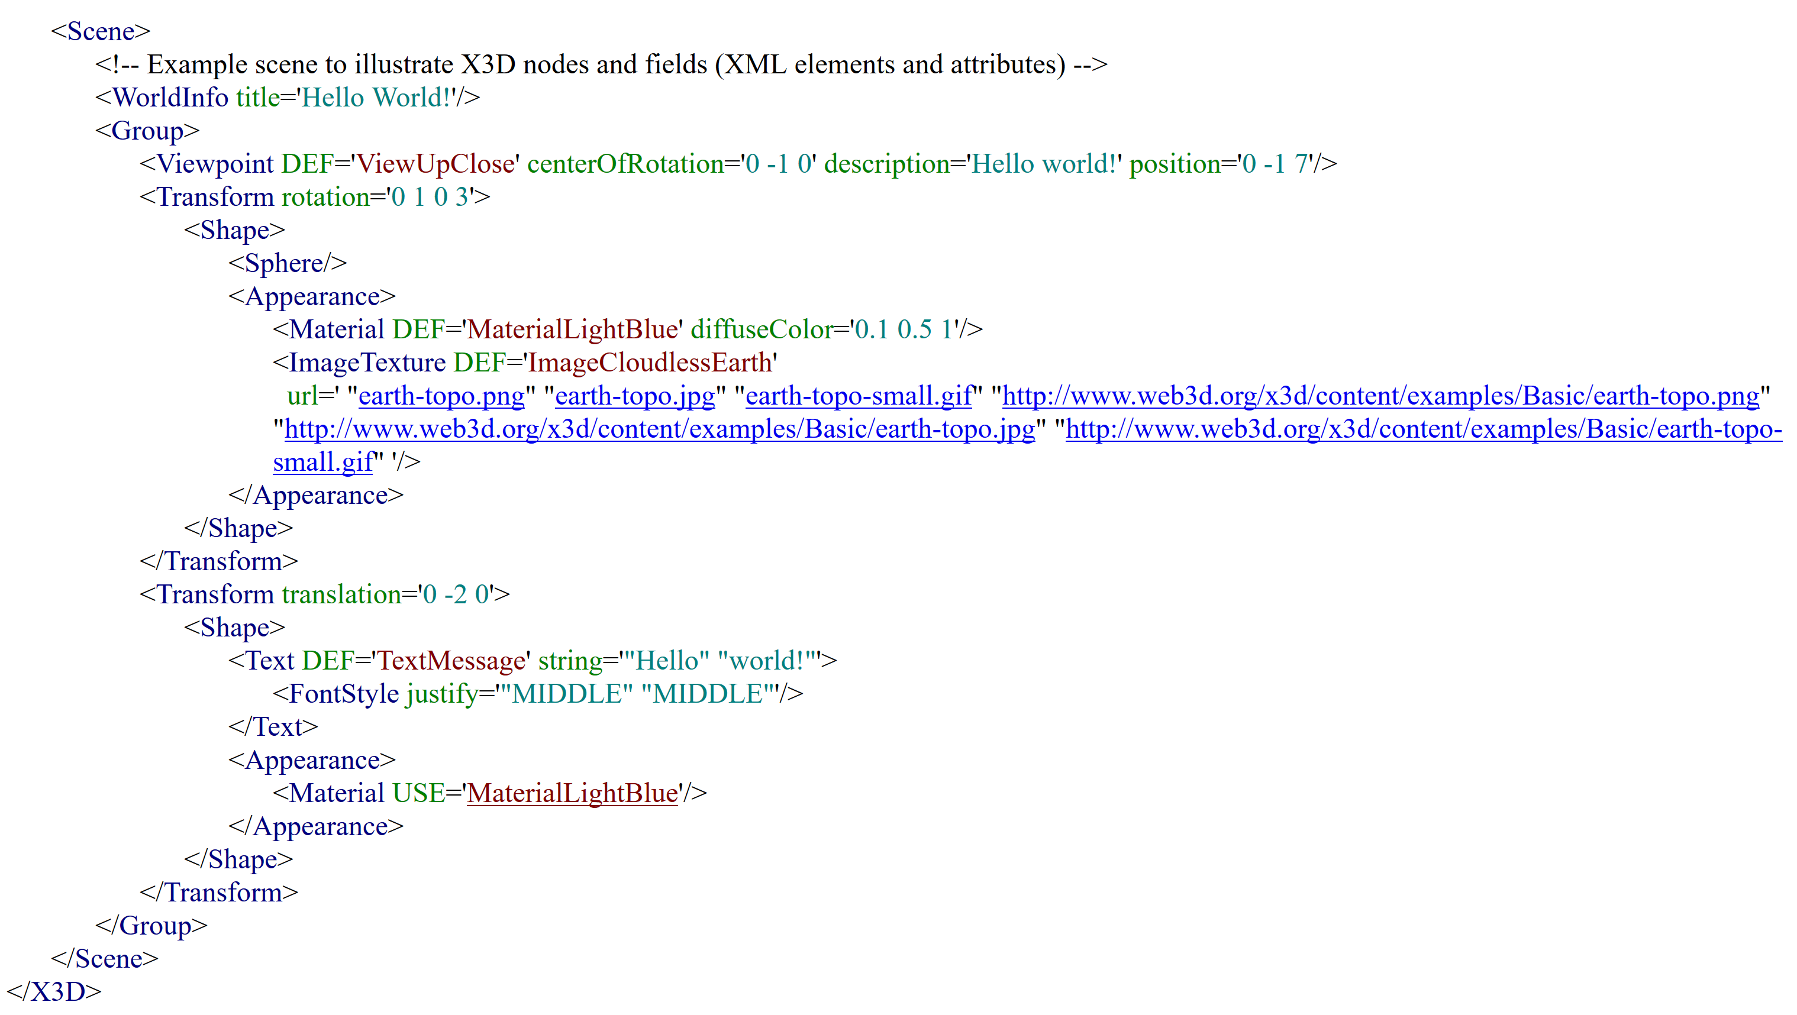
X3D XML source example, part 2

Slide 15
Next Steps
Python X3D Package x3d.py is functional and undergoing active development.
All work has been discussed and performed publicly on x3d-public@web3d.org
Can our ISO colleagues who also work on a Python encoding comment on this work? Improvements in design patterns are easy to integrate to produce “best of breed” results.
Good discussions on merging designs are in progress! Myeong Won Lee and Masaki Aono have draft NWIP, independent implementation and viewer.
Once Python X3D is fully complete and stable, further deployment is expected for Jupyter Notebook, Apache Zeppelin, and Anaconda distributions of Python.
Because of this thorough and rigorous approach to producing a native Python X3D implementation, it is likely that the general Web3D requirement for multiple independent implementations will be relaxed in this case.
Availability of both Python x3d.py package and Java X3DJSAIL library are each expected to “open the door” for use of both X3D and HAnim models as part of Big Data workflows using Apache Hadoop, Apache Spark, and other Data Science approaches.

Slide 16
Contact
Don Brutzman, Ph.D.
brutzman@nps.edu
http://faculty.nps.edu/brutzman
Code USW/Br, Naval Postgraduate School
Monterey California 93943-5000 USA
1.831.656.2149 work
1.831.402.4809 cell

