Slide 1

Get on Track Workshop

Slide 2
Goals of this slideshow
To clarify what probation is,
How to improve your standing with the College,
To identify factors that can positively and negatively impact your academic success.

Slide 3

PROBATION
What is it?
It is a warning system used to alert
students that they are not in good academic standing.

Slide 4

PROBATION
There are TWO types of probation:
ACADEMIC – based on cumulative (overall) GPA
PROGRESS – based on excessive I’s (incomplete), NP’s (no pass), & W’s (withdrawals)

Slide 5

ACADEMIC PROBATION
You will be placed on academic probation when you
  have attempted 12 units
  have a cumulative grade point average (GPA) below 2.0 (C)

Slide 6
Example of Academic Probation
English 3 units W
Math 4 units C
Reading 3 units C
Art 3 units D
1.7 GPA
13 units attempted
10 units completed

Slide 7

PROGRESS PROBATION
You will be placed on progress probation when you
  have attempted 12 units
  have accumulated 50% or more units (overall) of “W”, “I” or “NP”

Slide 8
Incomplete Academic Work (“I”)
Students may request from their instructor an “I”
on their records at the end of the term due to unforeseeable, emergency and justifiable reasons.
If in agreement, the instructor will state the work to be completed and grade to be assigned if the student fails complete assigned work.
The instructor will file the form with A&R and student will be given a copy.
The “I” must be made up no later than one year following the end of the term in which it was assigned (a time extension may be requested for unusual circumstances).
The student may not re-enroll in a class for which an “I” was assigned.

Slide 9
Example of Progress Probation
English 3 units W
Math 4 units W
Reading 3 units C
Art 3 units C
2.0 GPA
13 units attempted
6 units completed

Slide 10
REMOVAL FROM PROBATION
TO BE TAKEN OFF PROBATION STATUS:
  Academic probation - when the student’s cumulative GPA in all units completed is 2.0 or higher
  Progress probation – when the percentage of units for which a “W”, “I”, “NC” or “NP” drops below 50% of all units for which the student has enrolled at the college.
  Students on both academic and progress probation, will need to satisfy both of the above criteria to be completely removed from probation.

Slide 11
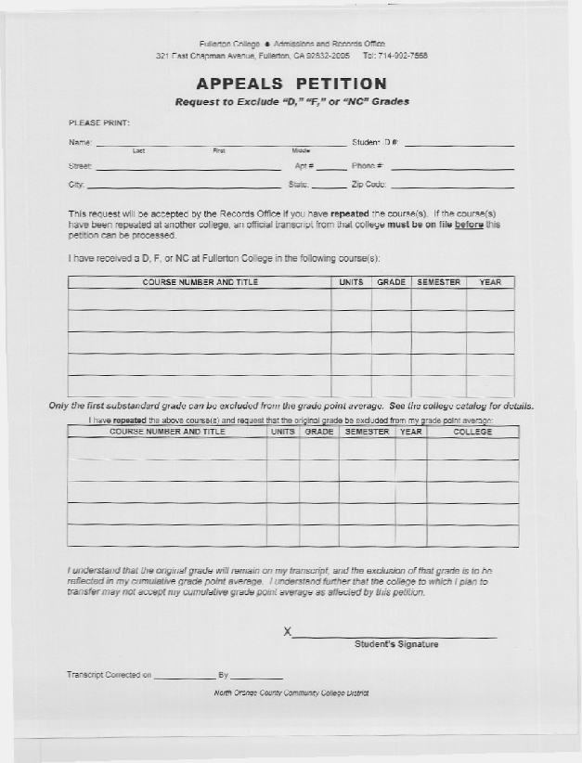
WHAT TO DO ABOUT
PROBATION
Consult with a counselor to discuss the best course of action for your situation
Possible considerations:
  Repeat courses with substandard grades (i.e. D, F, NP), and complete an “Appeals Petition”
  Apply for Academic Renewal (if applicable)

Slide 12
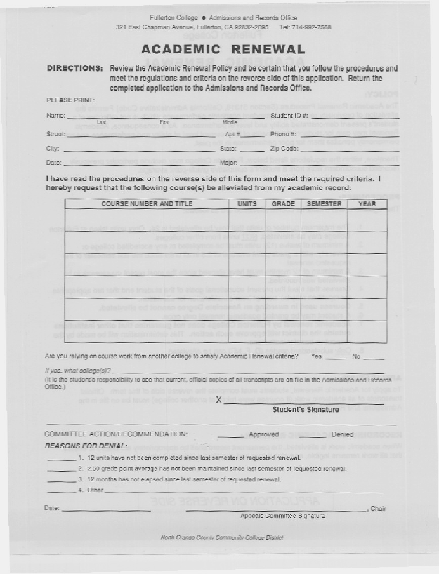
ACADEMIC RENEWAL
ACADEMIC RENEWAL is a process which permits the alleviation of prior grades not reflective of a student’s present ability. But there are eligibility requirements and limitations to renewal.

Slide 13
ACADEMIC RENEWAL
ACADEMIC RENEWAL may be granted only once.
A minimum of 12 months must have elapsed since the most recent coursework to be alleviated was recorded
The student must have completed a minimum of 12 units from an accredited college or university, with a minimum GPA of 2.5 in all units since the most recent course to be alleviated was recorded.
Please see a counselor for additional eligibility requirements and renewal limitations.

Slide 14
CONSEQUENCES OF REMAINING ON PROBATION
Unable to graduate or transfer
(all transcripts need to be submitted when transferring to another college)
Jeopardize eligibility in programs such as EOPS, Financial Aid & athletics
Unit enrollment limits
(if reinstated after a dismissal)
Scholastic Dismissal

Slide 15
STANDARDS FOR DISMISSAL
Dismissals take place only after Spring term
The types of dismissal are:
Academic Dismissal - student on academic probation and earning a cumulative GPA of less than 1.75 for two consecutive semesters shall be subject to scholastic dismissal.
Progress Dismissal - student on progress probation for two consecutive semesters shall be subject to scholastic dismissal.

Slide 16
Readmission Process
You will receive a letter of dismissal in July.
Complete and return to Admissions and Records the “Petition for Readmission” form ASAP.
A committee will review your “Petition for Readmission”.
You will be notified by mail of the committee’s decision.

Slide 17

FACTORS THAT CAN HELP YOU BE A SUCCESSFUL STUDENT
Meet with Academic Counselor at least 2 times per semester regarding scholastic progress
Follow through with Counselor recommendations
Learn how to manage your time effectively
Seek ways to improve your study techniques
Utilize College and community resources
Learn how to set clear and realistic goals

Slide 18
FACTORS THAT CAN
HELP YOU BE A SUCCESSFUL STUDENT
Meet with your instructor during office hours
Enroll in classes that promote success
Attend classes regularly
STUDY! STUDY! STUDY!

Slide 19
SOME LAST MINUTE REMINDERS…
Though at times you may need to withdraw from classes to avoid substandard grades, do so sparingly because excessive W’s can effect your standing with the College (e.g. progress probation), may limit your access to certain classes, or impact your financial aid eligibility.
Remember that at FC, students are allowed to re-take courses in which substandard grades are earned (i.e. D, F or NP). The maximum number of times a course can be taken/repeated is 3 times (i.e. first enrollment plus up to 2 repeats) - W’s will now count toward the 3 attempts. Also, if you took an equivalent course at Cypress College (and received a D, F, NP, or W), that class will also count toward the maximum 3 attempts.

Slide 20
SOME LAST MINUTE REMINDERS…
Low grades and excessive W’s may also impact your eligibility for various forms of financial aid – please refer to the Financial Aid Office home page for additional information: http://financialaid.fullcoll.edu/
Balance school and work schedules (see pg 39 of the Student Handbook).

Slide 21
SOME LAST MINUTE REMINDERS…
To be successful, plan to study at least 2 hours for each hour in the classroom.
Each semester check the calendar in the Schedule of Classes for important deadlines (please refer to the example in your handouts).
Be aware that in cases of academic renewal or successful course repetition, though W’s and substandard grades (D’s and F’s) are excluded from the GPA computation, they are never erased from the transcripts (which are legal and permanent documents!) and may be used to calculate your financial aid eligibility.

Slide 22

CAMPUS RESOURCES
Tutoring
Skills Center
Writing Center
Math Labs
Cadena/Transfer Center
Counseling Center
Career/Life Planning Center
Financial Aid
Disability Support Services
Workforce Center
Health Center
Computer Labs

Slide 23

YOU CAN DO IT!

