Slide 1
Welcome To
Group Advising
Our primary purpose is to help you develop strategies to choose your 1st semester classes.

Slide 2
What will be covered?
HOW TO SELECT CLASSES
HOW TO READ THE CLASS SCHEDULE
HOW TO REGISTER ON MYGATEWAY
HOW TO INTERPRET TEST SCORES
COURSES THAT PROMOTE SUCCESS
REGISTRATION PLANNING

Slide 3
SELECT CLASSES FROM
BASIC SKILLS
GENERAL EDUCATION
STUDENT SUCCESS COURSES
THE OPEN COURSE LIST
COURSES THAT INTEREST YOU

Slide 4
BASIC SKILLS CLASS PLACEMENT
SEE TEST SCORES
ENGLISH 039 F, 059 F, 060 F, 100 F
ESL 080 F, 081 F, 082 F, 083 F, 184 F, 185 F, 186 F
MATH 010F, 015 F, 020 F, (030 F), 040 F, over 100 F (depends on your major)
READING 036 F, O56 F, 096 F, 142 F

Slide 5
IF YOU FEEL YOU HAVE BEEN PLACED IN THE WRONG BASIC SKILLS CLASS, YOU HAVE THE FOLLOWING OPTIONS:
Wait 90 days and re-test by appt only.
OR Bring HS transcripts to General Info Counselor
  The counselor will review and make a recommendation.
Test scores are valid for 2 years.

Slide 6
IMPORTANT:
English, Math, Reading and ESL classes are intended to be taken in sequential order, so finding your correct starting points for these subjects will be very important to the timely completion of your academic goals.
If you feel that you’ve been placed into the wrong course or are thinking about enrolling in a lower level course we would strongly recommend that you consult with a counselor as soon as possible to discuss recommendations.

Slide 7
Balancing School and Work
Definitions:
Full time status = enrolled in 12 or more units
Part time (or half time) status = enrolled in 6-11 units
Notes:
When putting together your class schedule, it’s important to also consider the amount of time you work. For example:
A 3 unit class will generally require a commitment of at least 9 hours each week
(i.e. 3 hours for class meeting + 6 hours of study = 9 hours per week).
If you’re working 20 hours per week, take no more than 12 units.
If you’re working 40 hours per week, take no more than 6 units.

Slide 8
Stay on track!
Students’ good standing depends on…
Academic Performance
  Have a cumulative GPA of 2.0 (C) or higher
Course Completion (Progress)
  Successfully complete more than 50% of units attempted
Continued poor performance will result in dismissal
Refer to Schedule of Classes for important dates
  Drop deadlines, “W” not posted to transcript
  Drop deadlines, “W” posted to transcript

Slide 9
Financial Aid Eligibiliy
Students receiving Financial Aid must successfully complete at least 75% of their units attempted.
Failure to do so will result in disqualification.

Slide 10
General Education CLASSES
Select from an approved pattern:
    AA/AS
    CSU
    IGETC

Slide 11
CHOOSING A MAJOR
IS IMPORTANT!
See MAJOR GUIDE SHEETS
        IN COUNSELING CENTER
AND WWW.ASSIST.ORG
OR COLLEGE CATALOG
        FOR CERTIFICATES AND/OR
        AA/AS MAJORS
        www.fullcoll.edu

Slide 12
IF YOU ARE UNDECIDED…
If you are undecided about your major or course of study, please visit the Career / Life Planning Center in the 2000 Building or call (714)992-7121.

Slide 13
COURSES THAT PROMOTE STUDENT SUCCESS AT FC
COUN 060 F Academic Success & College Survival
COUN 101 F The College Experience
COUN 110 F Teaching as a Career
COUN 140 F Educational Planning
COUN 141 F Career Exploration
COUN 144 F Career Motivation & Self Confidence
COUN 151 F Career/Life Planning
COUN 163 F Personal Growth & Life Transitions
    (HANDOUT)

Slide 14
PLANNING FOR REGISTRATION
HOW TO READ THE CLASS SCHEDULE
  PREREQUISITE/COREQUISITE?
  CSU/UC Transferable?
MyGateway

Slide 15
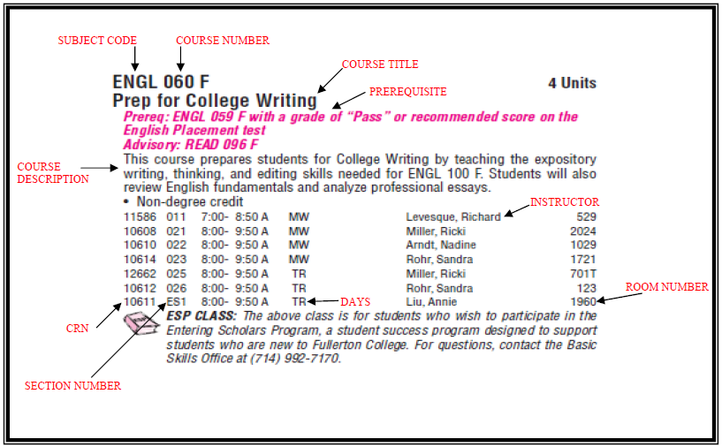
The Class Schedule

Slide 16
Registering for Classes
MyGateway
Registration Appointment Day & Time
  Student ID @######## OR SS#
  PIN number (this is your 6 digit birthdate, in MMDDYY format.)
Pay for Classes (within 72 hours or you may be dropped)
  If you will be receiving financial aid, contact the Financial Aid office ASAP to confirm that all your documentation have been received.
Fee reduction for Qualified Non-Residents (AB540)
Attend the First Class Meeting or You May be Dropped
Prepare for Parking Challenges
For additional Registration info:
Visit the A & R website and
see the Schedule of Classes

Slide 17
WHAT IF CLASS IS CLOSED?
Classes fill and may be closed when you try to register. What should you do?
  See open course list through MyGateway.
  Consider getting on the class waitlist if available
  Check availability on open course list every day until the 1st day of school.
  Check your MyGateway account daily, for your waitlist status.
  Consider similar classes offered at Cypress College.
  Go to 1st class meeting and try to get an Add Authorization Number (i.e. Add Code) from the instructor. If you’re able to get an Add Code, go online and register for the class.
  Locations: F=Fullerton, C=Cypress, AN=Anaheim, LH=La Habra

Slide 18
If you cannot get a class this semester, you must reapply to Fullerton College for the following semester.
  Fall semester, apply March 1
  Spring semester, apply Oct 1

Slide 19
FUTURE SEMESTER PLANNING
When should you meet with a counselor to continue your educational planning?
  For Fall semester:
    September & October
  For Spring semester:
    February & March

Slide 20
QUESTIONS?
Contact us at: http://onlinecounseling.fullcoll.edu

Slide 21
Good luck!!!
Revised 11/17/2011 sk

