Slide 1
Form design and DATABASE CONNECTIVITY

Slide 2
Work flow
start
Invalid data
valid data
Form design
index.php
Data validation
Database connected
db_connect.php
Data fatched
Form_submit.php
End

Slide 3
Component used
Component | Purpose
HTML | Basic structure
CSS | Control Presentation, Formatting, and Layout
JS | Control the behavior of different elements
WAMP Server | Apache, MySQL, PHP

Slide 4
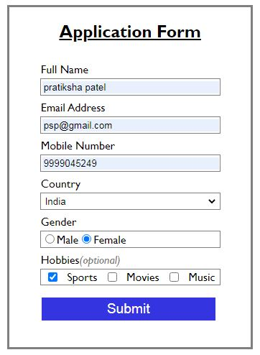
FORM DESIGN
localhost/index.php
style.css is attached.

Slide 5
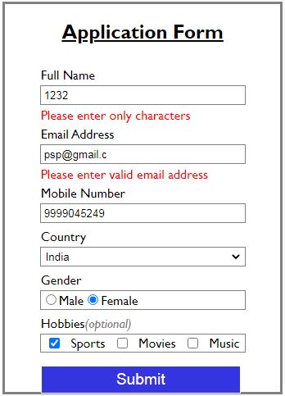
Data Validation
Data Validation implemented with custom.js on index.php.
Validation in form design only.
Server side validation can be added through php, if required.

Slide 6
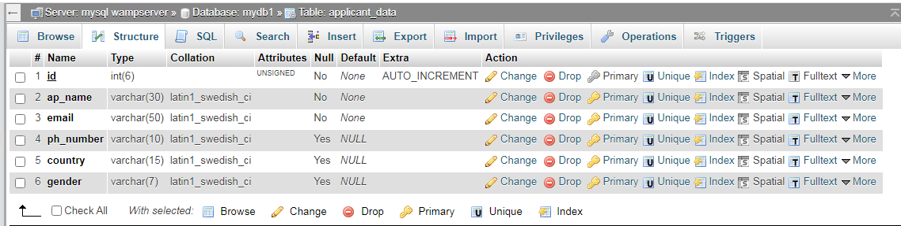

Database Connectivity
PHP
MYSQL
Connect database with db_connect.php
From index.php data sent through post method
Form_submit.php

Slide 7
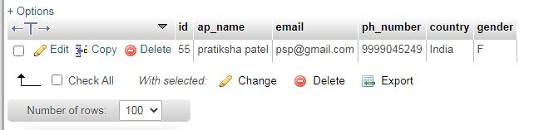
Form data in DB

Slide 8
THANK YOU

