Slide 1
Water cover changes of wetlands between 1984-2018 on the Danube-Tisza Interfluve
András Gulácsi, Ferenc Kovács
Department of Physical Geography and Geoinformatics, University of Szeged, Hungary

Slide 2

Introduction
Wetlands and saline lake ecosystems are vulnerable to changes in water availability (e.g. hydrological drought)
In the last decades, a climate change induced aridification process has begun in Hungary impact on wetlands
Climate model prediction: drought frequency and severity will likely increase in the Carpathian Basin (Mezősi et al. 2016)
Reduction of spring-time precipitation is the main problem!

Slide 3
Research goals
To implement a method for a Sentinel-1 radar-based surface water cover mapping
To detect long-term changes (1984-2012) in water availability on wetlands using mainly Landsat 5 TM surface reflectance data (plus Sentinel-2 and Landsat 8 data)
Short-term monitoring from Oct 2014
Long-term monitoring from 1984 to 2012

Slide 4
Data used – Sentinel & Landsat
Sentinel-1 C-band (5.405 GHz) synthetic aperture radar (SAR)
  Interferometric Wide (IW) swath mode (250 km in width)
  Dual polarization: VV+VH polarisation over land
  Revisiting time is 6 days, geometric resolution is 10 * 10 m
Landsat surface reflectance data (Landsat 5 TM, Landsat 8 OLI), and Sentinel-2 MSI
  Resolutions: 30 m/16 days (Landsat), 10-20 m/5 days (Sentinel-2)
  We used water index calculated from cloud-filtered refl. data

Slide 5
Methods – Google Earth Engine
Satellite data was processed using Google Earth Engine (GEE) which is a cloud-based platform for planetary-scale environmental data analysis (cloud computing)
Cloud computing emerged in the early 2010s; it is the delivery of computer services (servers, databases, softwares, etc.) over the Internet (the „cloud”)
GEE is accessed via a JavaScript API (advanced programming interface) in the browser (very powerful, fast, and efficient)

Slide 6
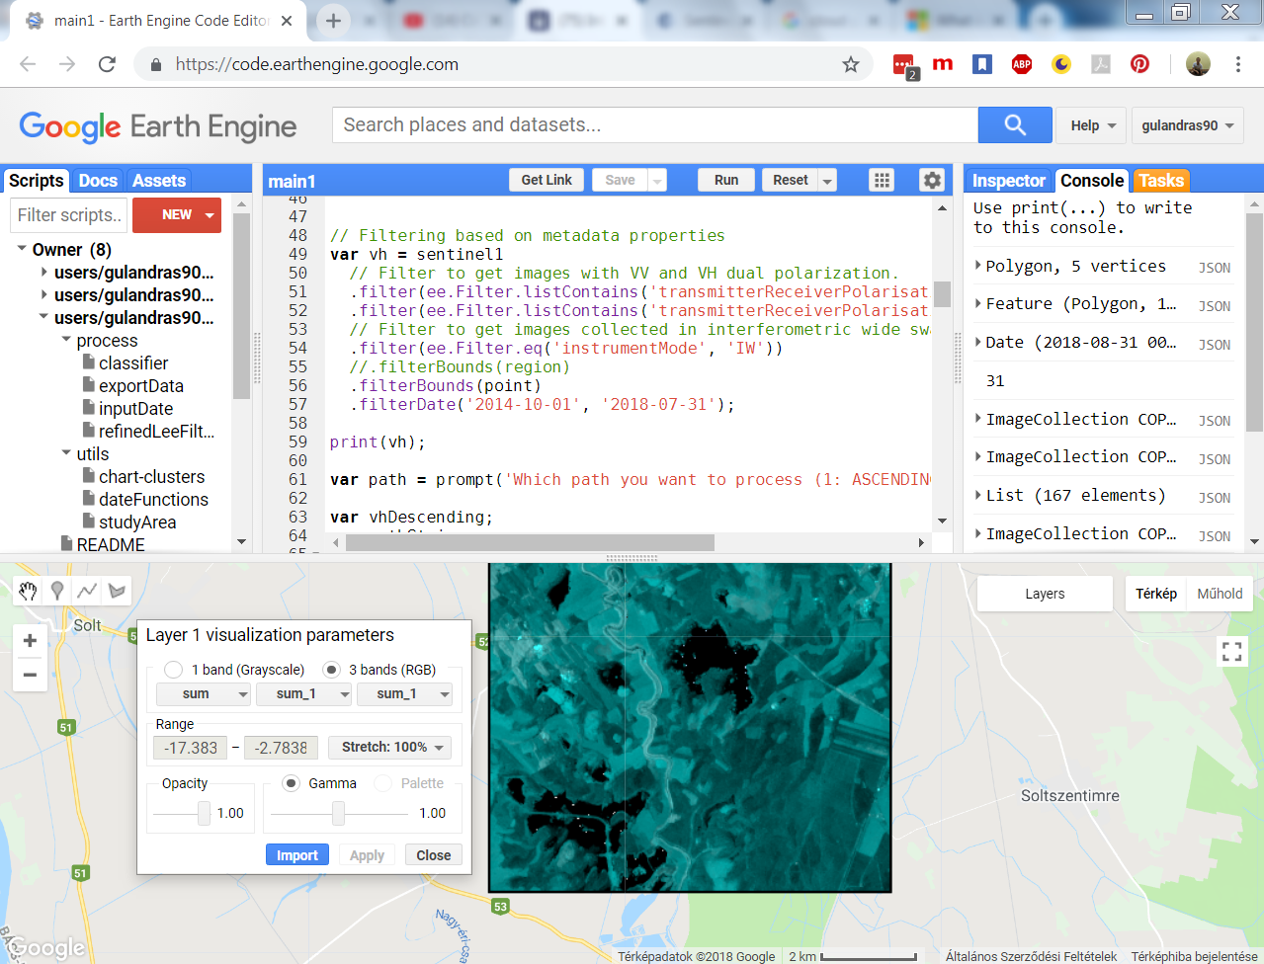
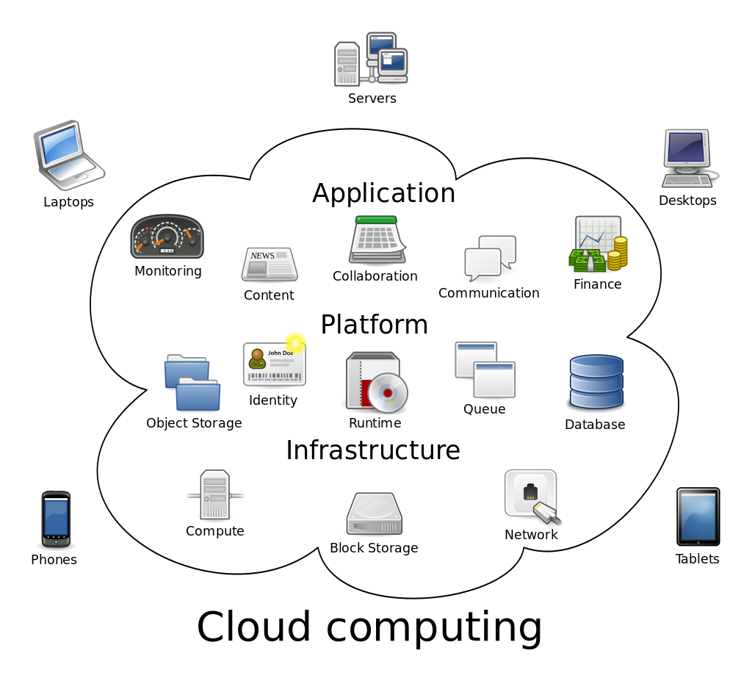

Slide 7
Sentinel-1 radar processing
It consists a lot of pre-processing steps (done by Google):
1. | Apply orbit file (using restituted orbits)
2. | Thermal noise removal: uses noise vectors to remove dark strips near scene edges with invalid data
3. | Radiometric calibration: computes backscatter intensity using sensor calibration parameters in the GRD metadata
4. | Terrain correction (orthorectification): converts data from ground range geometry, which does not take terrain into account, to σ° using the SRTM 30 meter DEM
5. | The unitless backscatter coefficient is then converted to dB
6. | Values are clamped to the 1st and 99th percentile, and quantized to 16 bits

Slide 8
Additional S-1 processing steps
7. Normalize backscatter values with the incidence angle (cosine correction, Ulaby et al. 1982)
8. Eliminate wind-induced surface roughening (waves on water surface) by masking out areas where wind speed was above 1 m/s. (Data: CFSV2: NCEP Climate Forecast System Version 2, 6-Hourly Products)
9. Speckle filtering was applied to remove granular noise from image (caused by interference at the radar antenna): Refined Lee filter (Lee 1980, 1981)
10. Calculate monthly median composites (VV/VH polarizations)

Slide 9
Landsat processing
We removed cloud-affected pixels from all images (Cloud cover < 20% and using the QA band)
From surface reflectance data, we calculated Modified Normalized Difference Water Index (MNDWI, Xu 2007)
MNDWI = (G – SWIR) / (G + SWIR)
G: visible green band, and SWIR 1: short-wave infrared band at 2.1 microns

Slide 10
Landsat processing, ROC
We used a treshold-based binary classifier on MNDWI data (Gulácsi A. 2017 unpublished results)
We used receiver operator characteristics (ROC) to find the best classifier which has the highest TPR (true positive rate) and the lowest FPR ( false positive rate) at the same time
For reference we used high-resolution (< 1 m) Pléiades and WorldView-3 images (Google Earth)
L8 MNDWI >= 0.625 (AUC); S2 MNDWI >= 0.570 (AUC)

Slide 11
Cluster analysis of data
For the S-1 radar data, we used the wekaKmeans clustering algorithm (type: hard, kmeans, random sample)
We used Euclidean distance function
Number of clusters: 15, VH and VV pol. Band
According to our experience, water clusters have class means <= -17-18 dB
Still water features have a very smooth surface / very low roughness → backscattering is low → very dark features on radar images; GEE implementation, Arthur & Vassilvitskii 2007

Slide 12
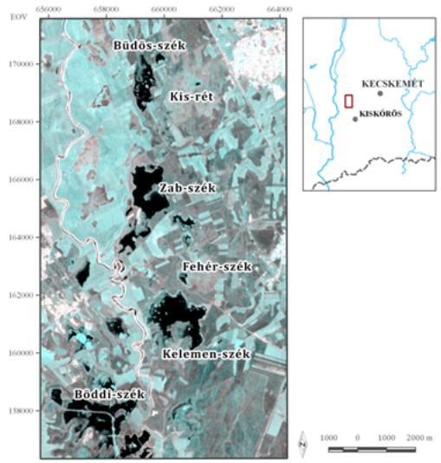
Study Areas

Slide 13
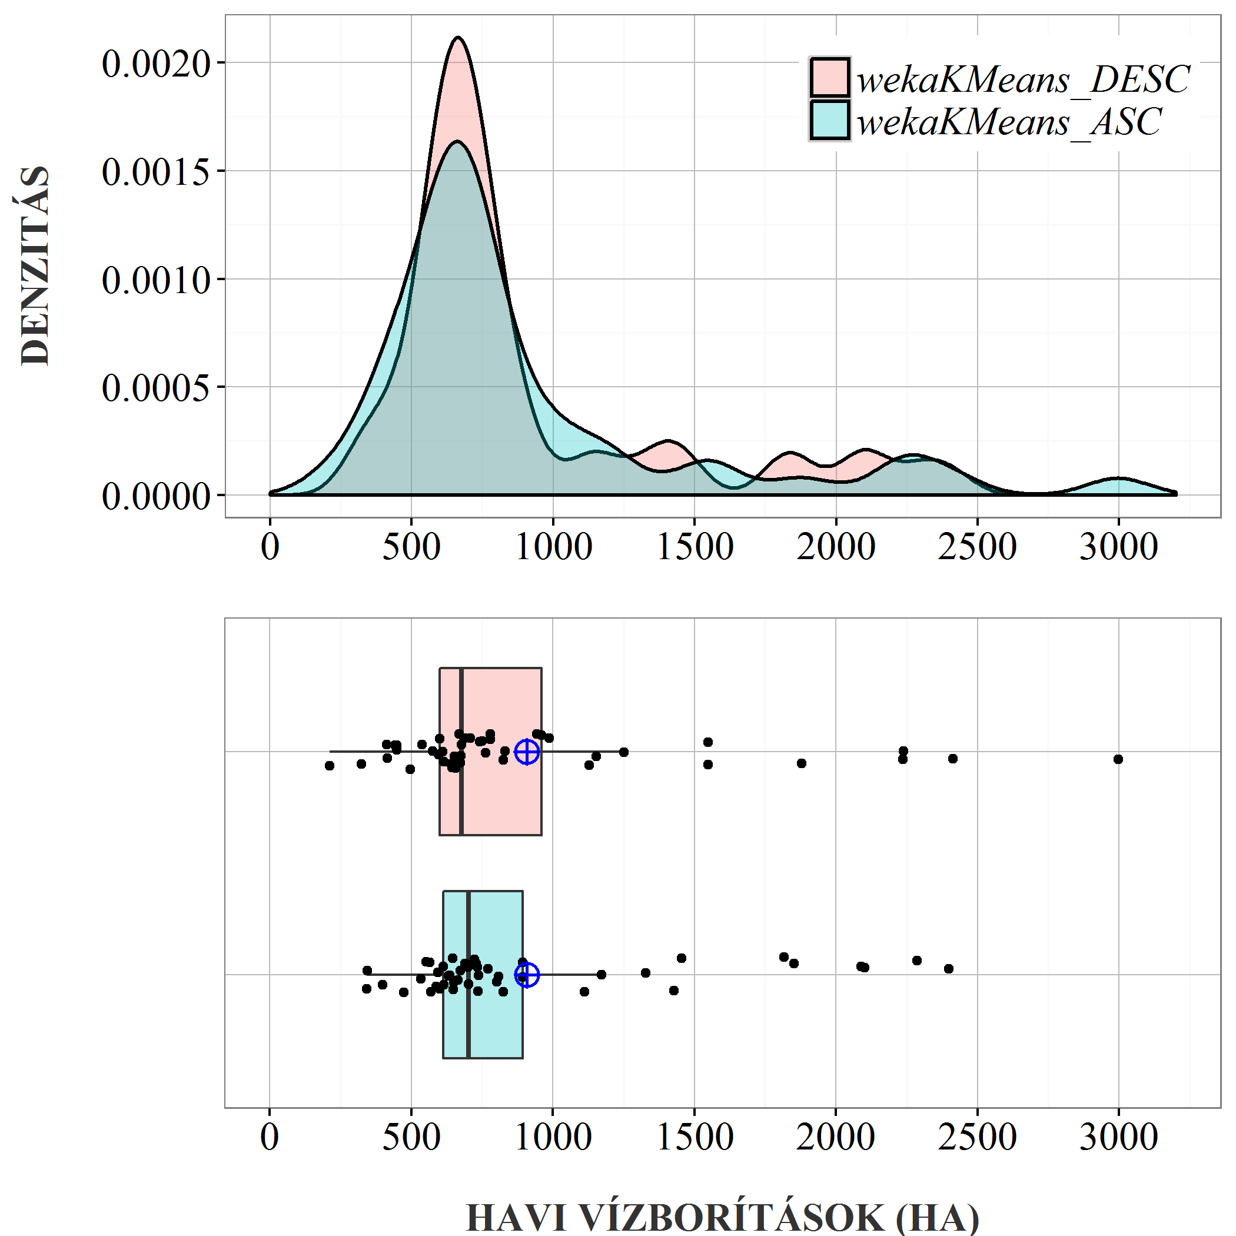
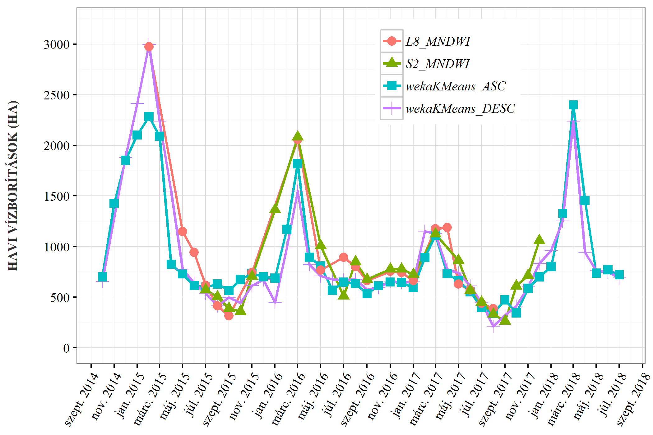
Results

Slide 14
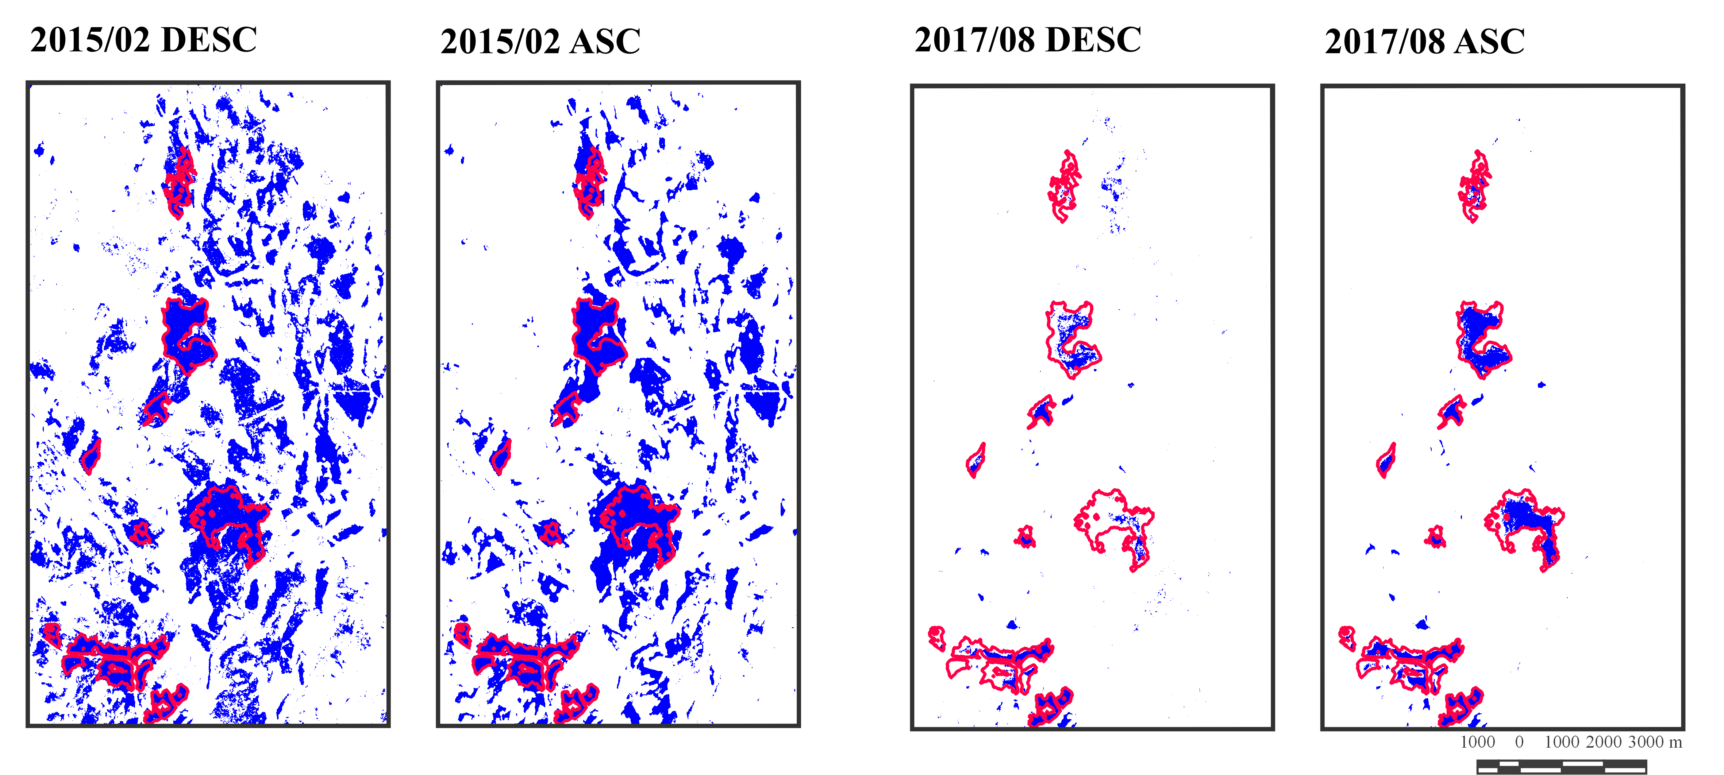
Results

Slide 15
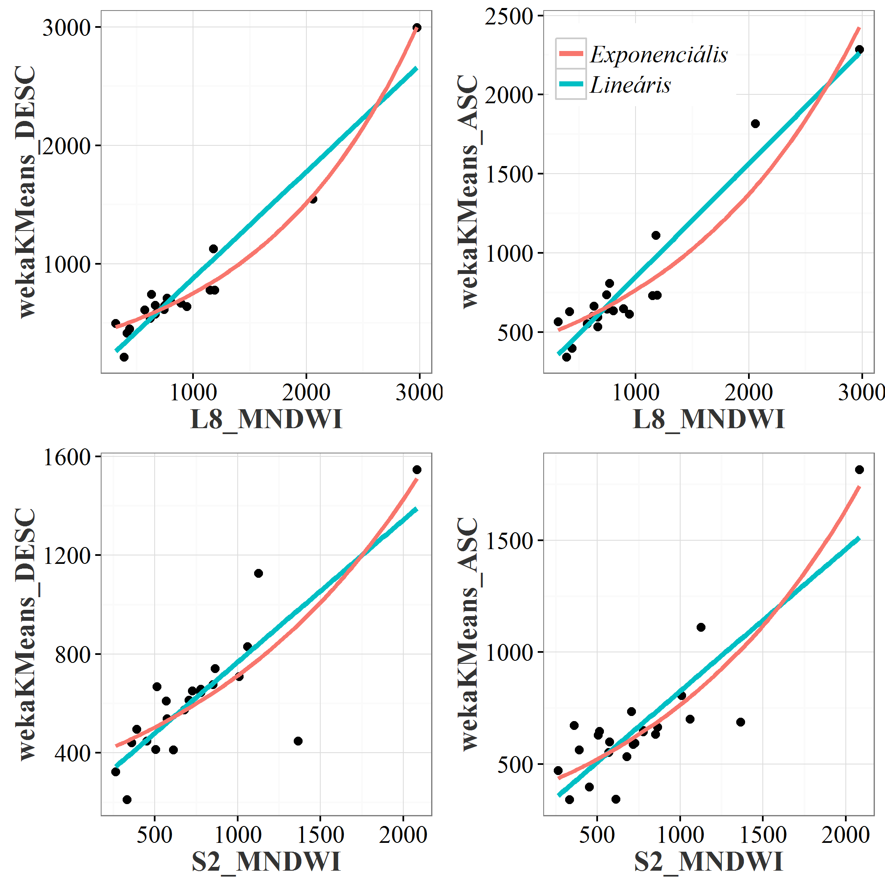
Verification of results
Statisztikai kapcsolatok | Lineáris regresszió
 | Pearson-féle R-érték | Spearman-féle ρ-érték
wekaKMeans_DESC ~ L8_MNDWI | 0,96*** | 0,88***
wekaKMeans_DESC ~ S2_MNDWI | 0,83*** | 0,77***
wekaKMeans_ASC ~ L8_MNDWI | 0,96*** | 0,79***
wekaKMeans_ASC ~ S2_MNDWI | 0,85*** | 0,80***

Slide 16
Discussion and conclusion
We developed a S1 C-SAR-based surface water detection method on wetlands, and verficated with L8 and S2 MNDWI data
We conclude that our method is applicable and reliable, but we need field survey data as reference to validate or results
There is no significant difference btwn ascending path (ASC) and descending path (DESC)
The distribution of monthly water cover is not normal – extreme coverages in spring

Slide 17
How is this connected to Nat. Hazards?
The S-1 radar-based water cover detection can be used to detect inland excess water (in Hungarian: belvíz), which is a local phenomenon in the Plains, that causes significant losses to argiculture by damaging the crops mostly in spring-time
The Water Directorates can use our methodology to delineate inland excess water patches (> 100 m²) on the fields
Plus, they can also validate our results with field survey data
Retention of inland excess water in some places? Treat it as a water resource (useful in drought conditions in the summer)

Slide 18
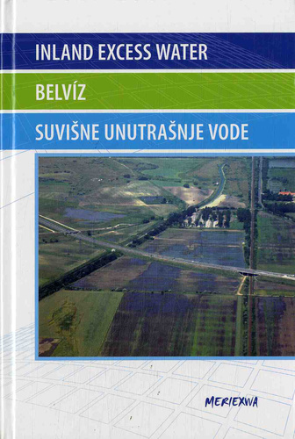
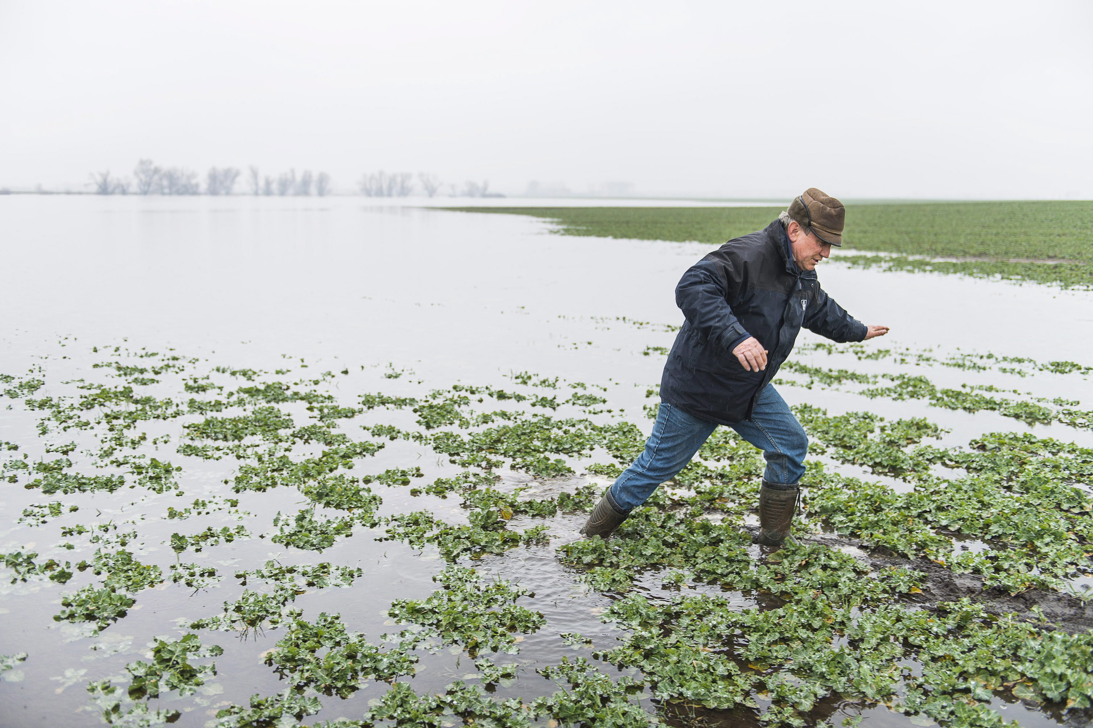
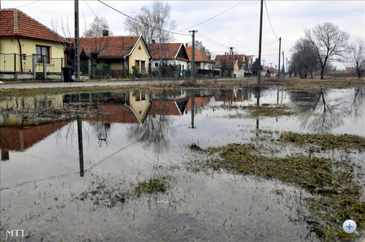
Inland excess water
Measurement, monitoring, management and risk assessment of inland excess water in South-East Hungary and North Serbia
by Szatmári, J. and Boudewijn van Leeuwen (eds.) (2013)

Slide 19
Thank you for listening! Any questions?
My GitHub repository

