Slide 1
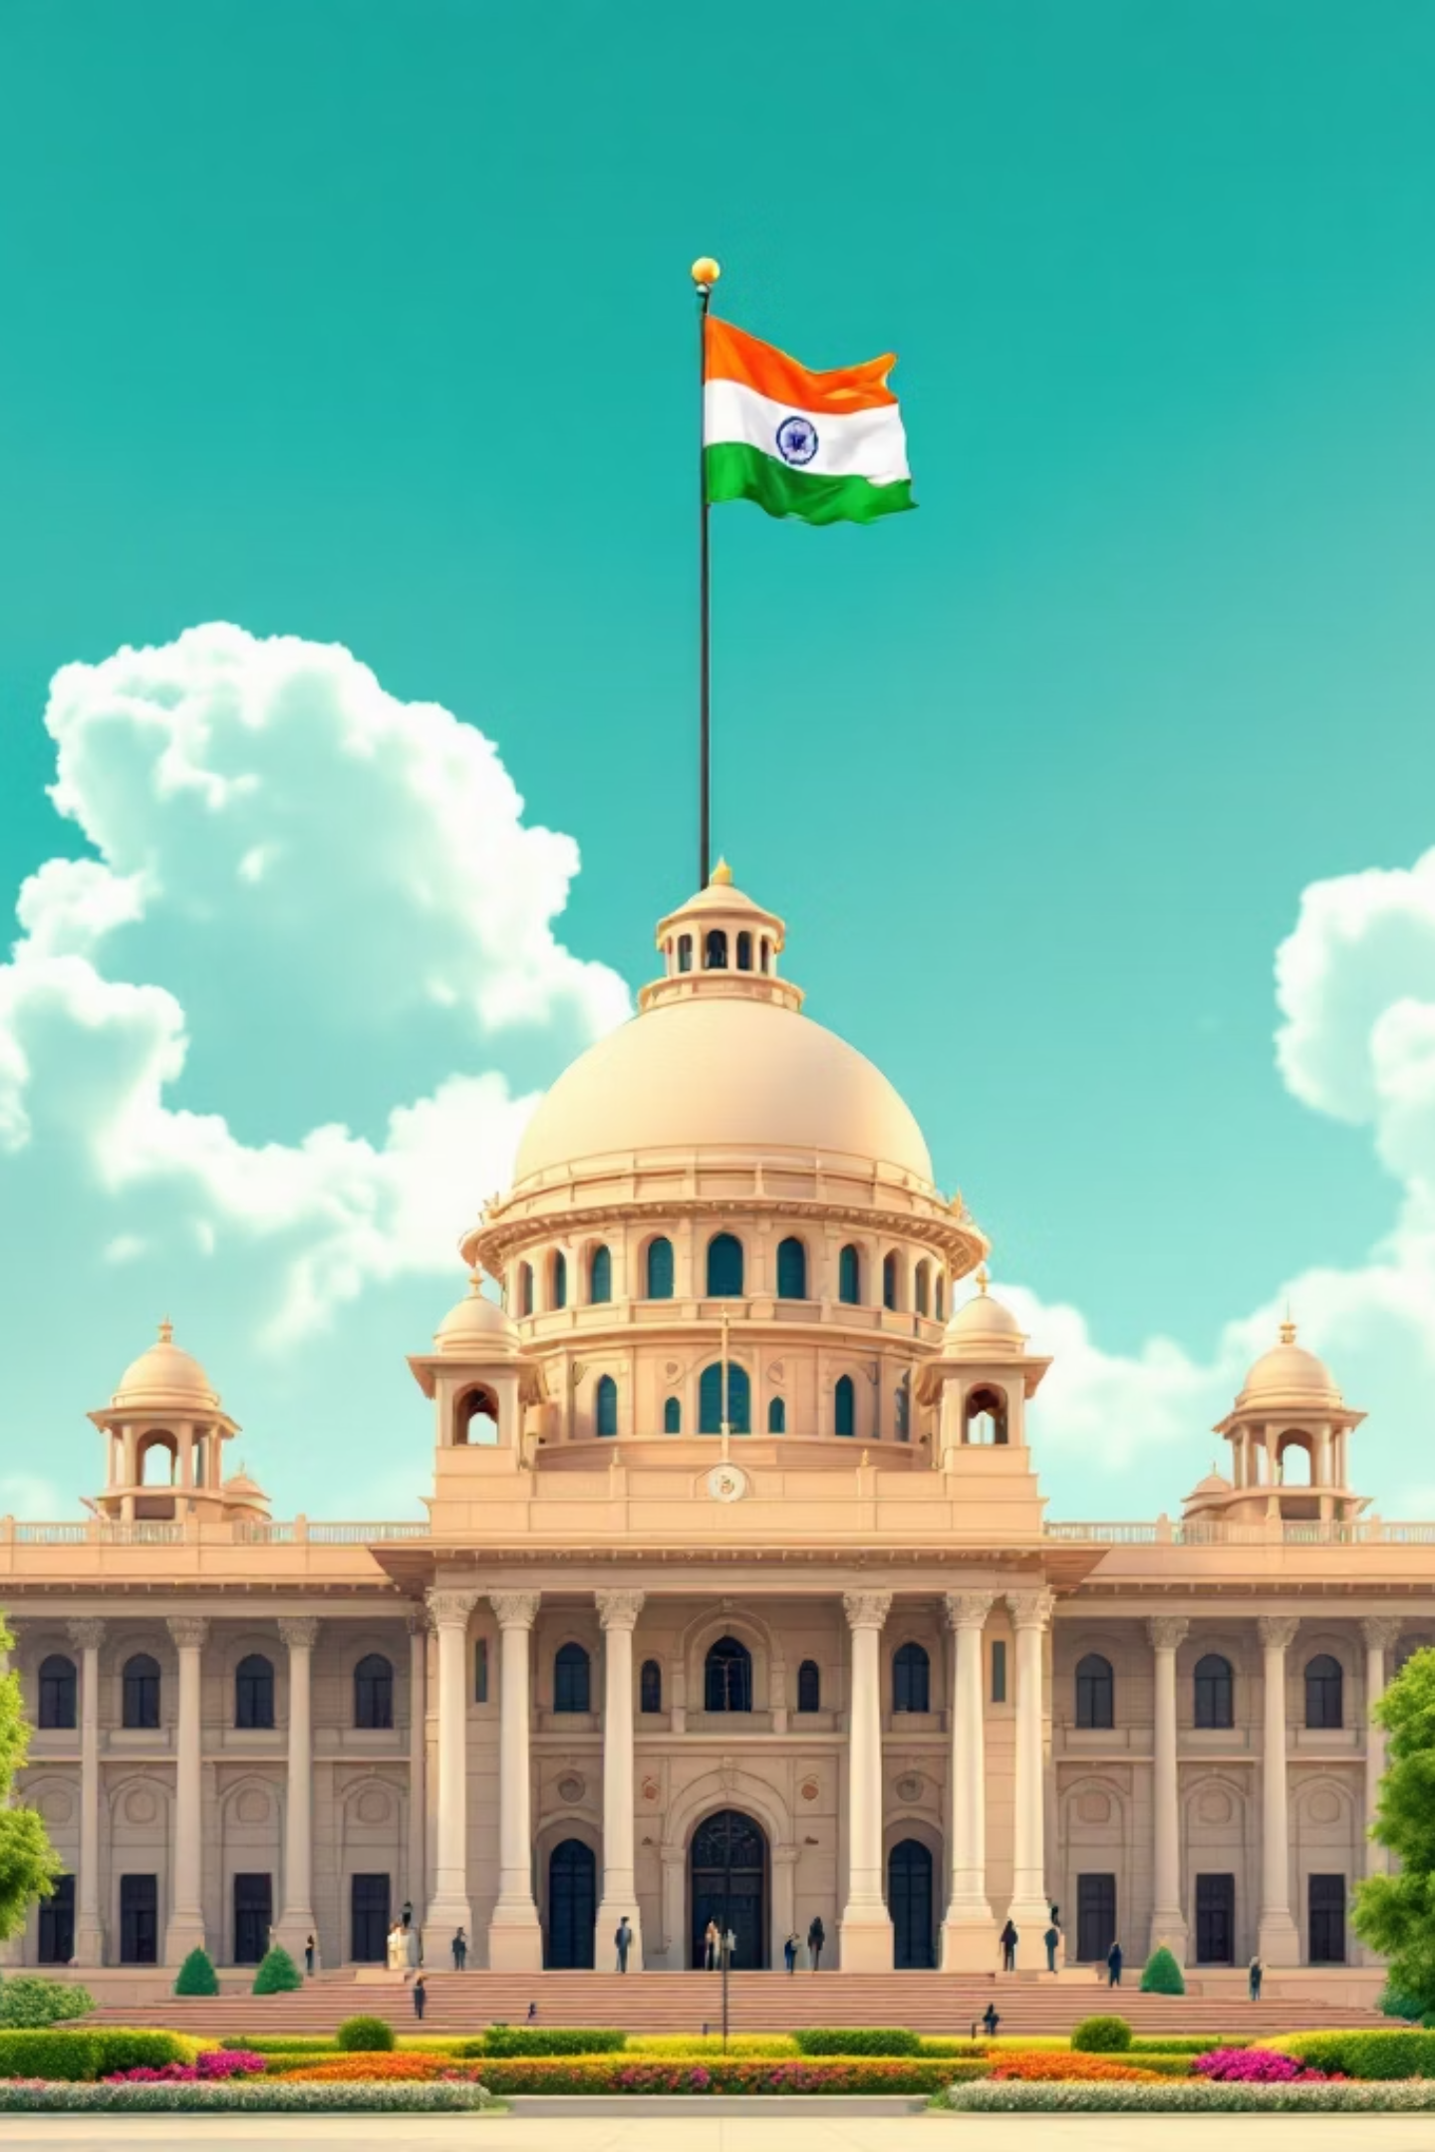
Understanding Elections: The Foundation of Democracy
Elections are the cornerstone of democratic governance, enabling citizens to choose their representatives and shape their nation's future.

Slide 2

Why Elections Are Essential
Large Population
Representation
With over 1.4 billion citizens, India cannot practise direct democracy. Elections provide a practical solution.
Ensures every voice is heard through elected representatives who speak for their constituents.
Government Formation
Accountability
Creates stable governments at both national and state levels through democratic mandate.
Leaders remain answerable to citizens, facing re-election based on their performance.

Slide 3
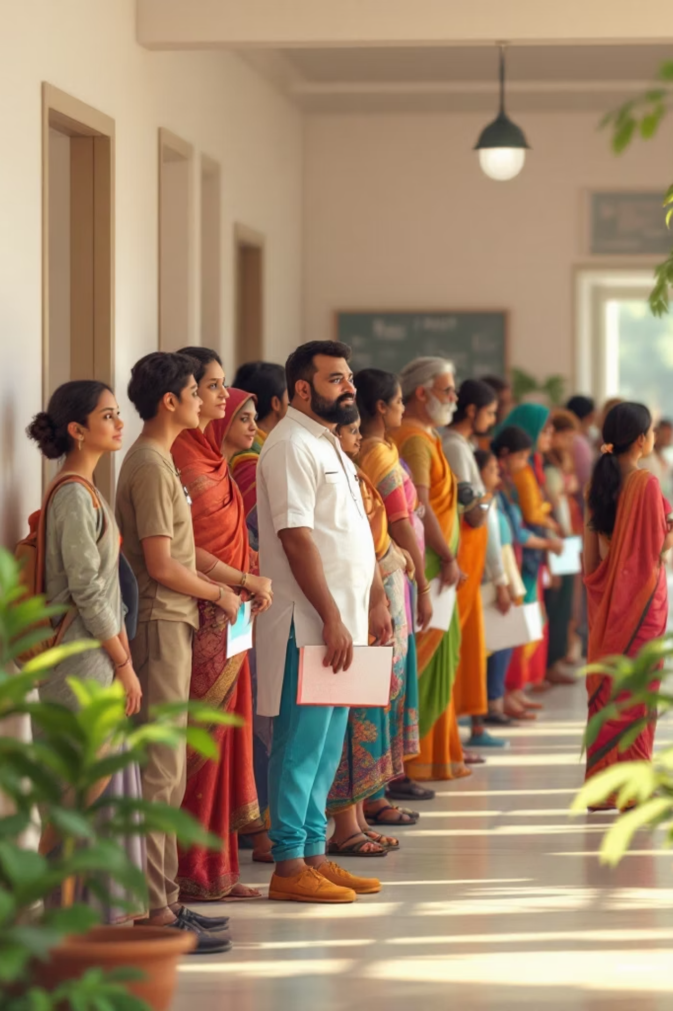
India: The World's Largest Democracy
968M
1.4B
28
Eligible Voters
Total Population
States
Over 968 million people eligible to vote in national elections
World's most populous democracy since 2023
State-level elections ensure regional representation

Slide 4
Core Democratic Concepts
1
2
3
Democracy
Electorate
Universal Adult Franchise
Government of the people, by the people, and for the people. Citizens exercise power through voting and participation in political processes.
The entire body of eligible voters in a country or area. Every citizen who meets the voting age qualification forms part of the electorate.
Every citizen aged 18 and above has the right to vote without discrimination based on caste, religion, gender, or economic status.

Slide 5

Universal Adult Franchise: Equal Voting Rights
Key Principles
Every citizen above 18 years can vote
No discrimination permitted
Equal value for every vote
Secret ballot ensures freedom
This principle ensures that democracy truly represents all sections of society, regardless of their background or social status.

Slide 6




How Elections Shape Government
Citizens Vote
Eligible voters cast their ballots for preferred candidates
Results Declared
Votes are counted and winners are announced
Government Formed
Winning parties form government at central or state level
Peaceful Transfer
Power transitions peacefully based on people's mandate

Slide 7
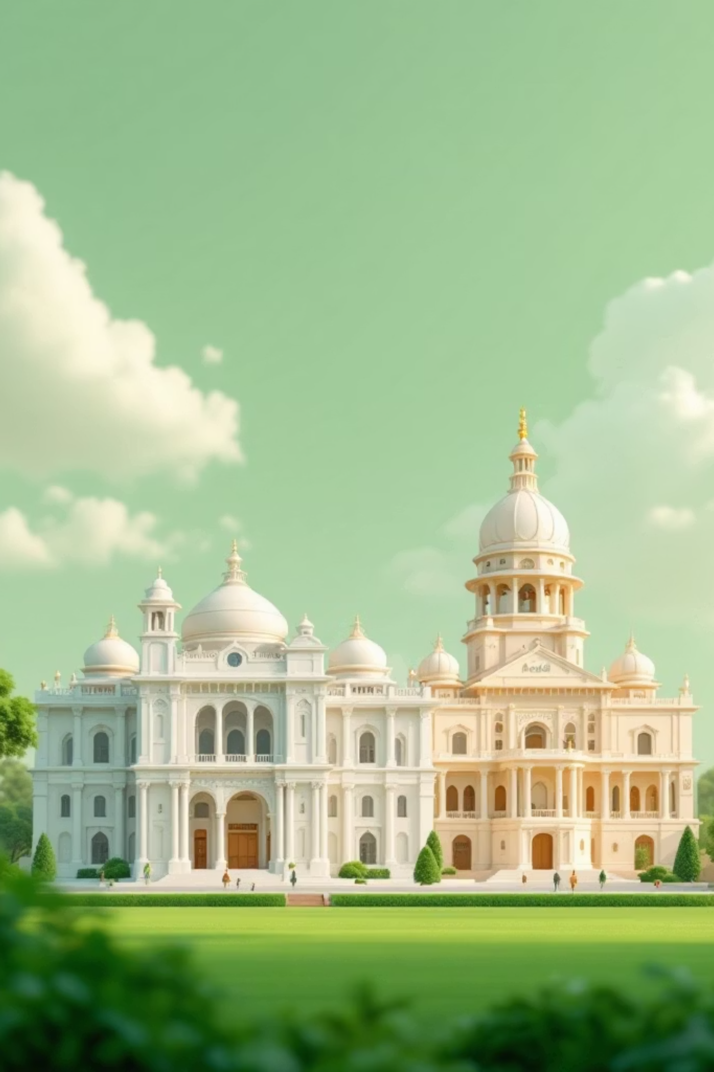
Levels of Government Formation
Central Government
Lok Sabha elections determine members of Parliament who form the national government in New Delhi.
State Governments
State Legislative Assembly elections elect representatives who form state governments and govern regional affairs.

Slide 8

The Lok Sabha Election Process
Every Five Years
General elections to the Lok Sabha, India's lower house of Parliament, are conducted every five years unless dissolved earlier.
846 million voters participated in 2019
Over 1 million polling stations nationwide
Electronic Voting Machines used everywhere
Nomination
Voting
Candidates file papers
Days of polling
1
2
3
4
Campaigning
Counting
Parties present manifestos
Results announced

Slide 9



Real Impact: 2019 Lok Sabha Elections
67%
2300+
91M
Voter Turnout
Political Parties
First-Time Voters
Record participation across 543 constituencies
Competing for seats in the world's largest democratic exercise
Young citizens exercising their democratic right

Slide 10
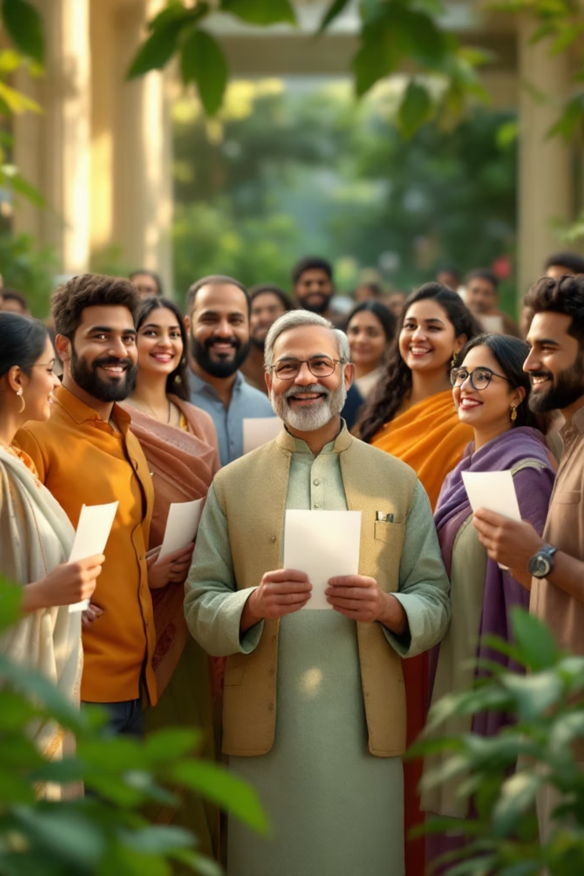
Key Takeaways
01
Foundation of Democracy
Elections enable citizens to choose representatives and form governments
02
Practical Necessity
With 1.4 billion people, elections provide the only feasible method of governance
03
Universal Franchise
Every citizen aged 18+ can vote without discrimination
04
Peaceful Transfer
Ensures stable, accountable government through democratic mandate

