Slide 1
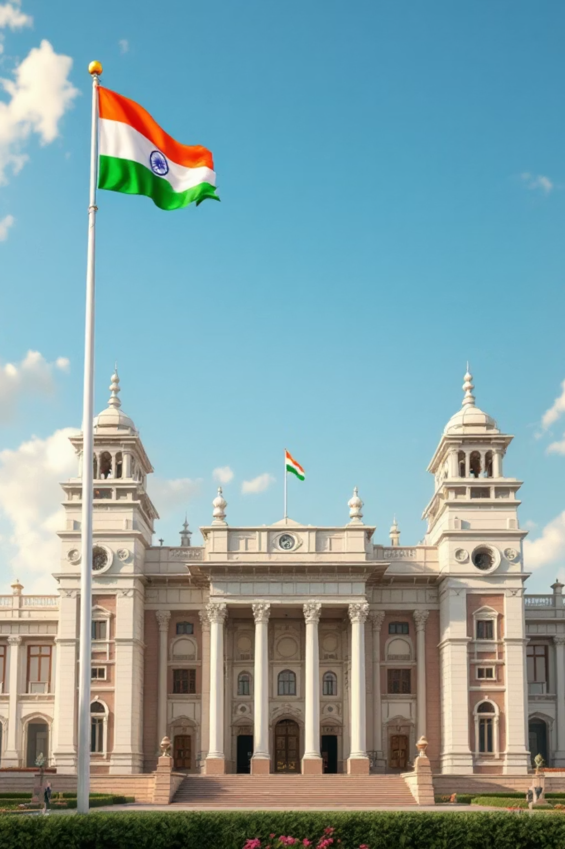
Election Commission of India
An autonomous constitutional authority safeguarding India's democratic foundation through free and fair elections since 1950.

Slide 2
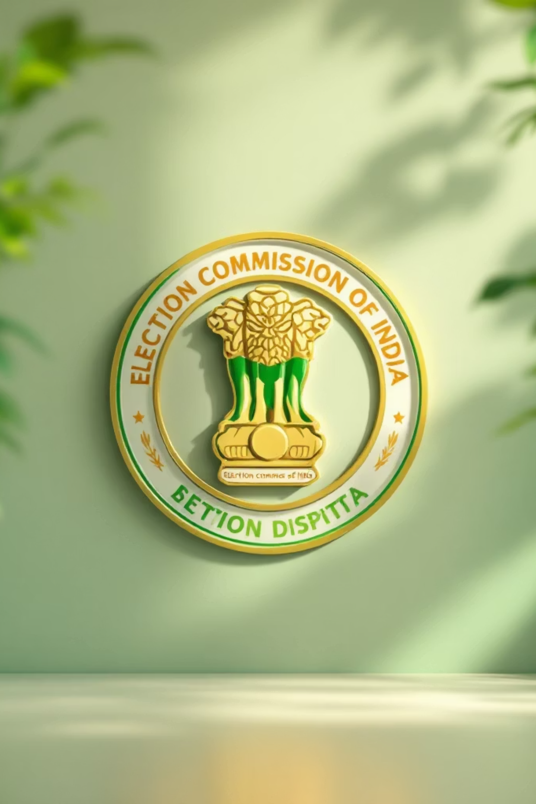
What is the Election Commission?
The Election Commission of India is an autonomous constitutional body established on 25th January 1950, three days before India became a republic. It operates independently of government control to oversee the entire electoral process across the nation.

Slide 3
Organisational Structure
Chief Election Commissioner
1
Head of the Commission with ultimate authority
Other Election Commissioners
2
Supporting members appointed as needed
Secretariat
3
Administrative staff and support personnel
State Election Commissions
4
Regional offices across all states and union territories

Slide 4

Chief Election Commissioner
Role & Authority
The CEC leads the Election Commission and ensures all elections are conducted fairly and transparently across India.
Tenure Details
Commissioners serve for 6 years or until age 65, whichever comes first. This fixed tenure protects independence from political pressure.

Slide 5

Core Powers & Functions
Conduct Elections
Prepare Electoral Rolls
Announce Election Schedule
Oversees polls for Lok Sabha, Rajya Sabha, state assemblies, President, and Vice President
Maintains updated voter lists and ensures accurate registration of eligible citizens
Declares polling dates, phases, and timelines for each electoral cycle

Slide 6
Additional Key Functions
01
02
03
Monitor Political Parties
Implement Model Code of Conduct
Declare Results
Supervises party activities, funding, and compliance with regulations
Officially announces and certifies election outcomes across all constituencies
Enforces ethical guidelines for candidates and parties during campaigns

Slide 7

Types of Functions
Administrative Functions
Advisory Functions
Provides guidance to government on electoral matters and constitutional provisions
Day-to-day management of election logistics, staff coordination, and operational planning
Quasi-Judicial Functions
Acts as a judicial authority for election disputes, complaints, and enforcement actions

Slide 8
Why the ECI Matters
Ensures Fairness
Controls Malpractices
Maintains Democracy
Maintains level playing field for all political parties and candidates through impartial oversight
Prevents electoral fraud, booth capturing, and corrupt practices through strict monitoring
Upholds democratic values by ensuring citizens' votes translate into legitimate representation

Slide 9






Election Process Overview
Notification
Election dates announced
Nomination
Candidates file papers
Campaigning
Election campaigns conducted
Polling
Voters cast ballots
Counting
Votes counted
Results
Winners declared

Slide 10
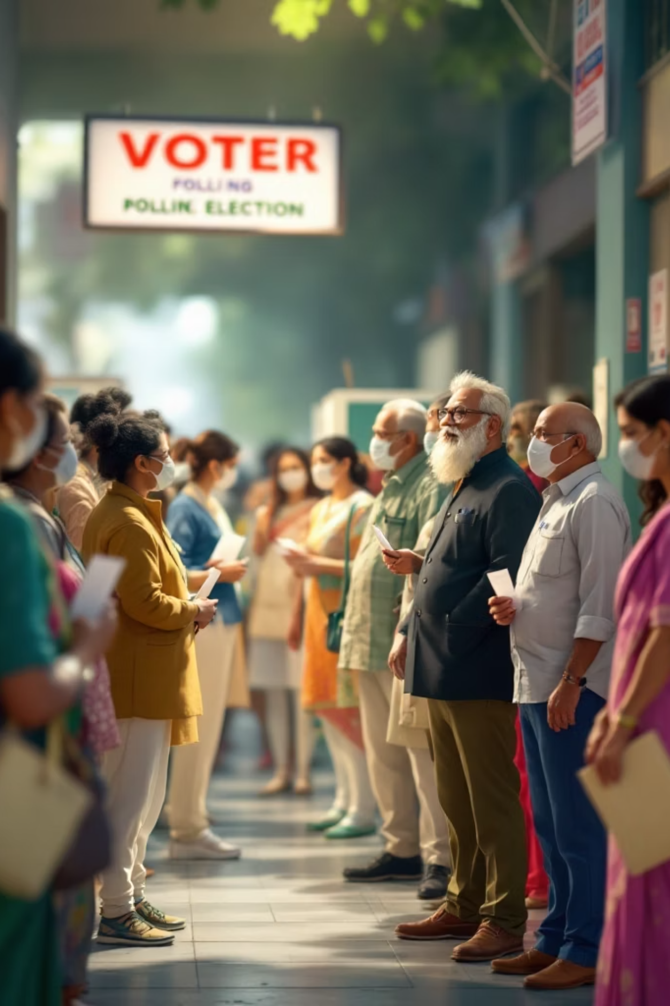
Guardians of Indian Democracy
The Election Commission of India stands as the cornerstone of the world's largest democracy, ensuring that every citizen's voice is heard and every vote counts towards shaping the nation's future.

