Slide 1
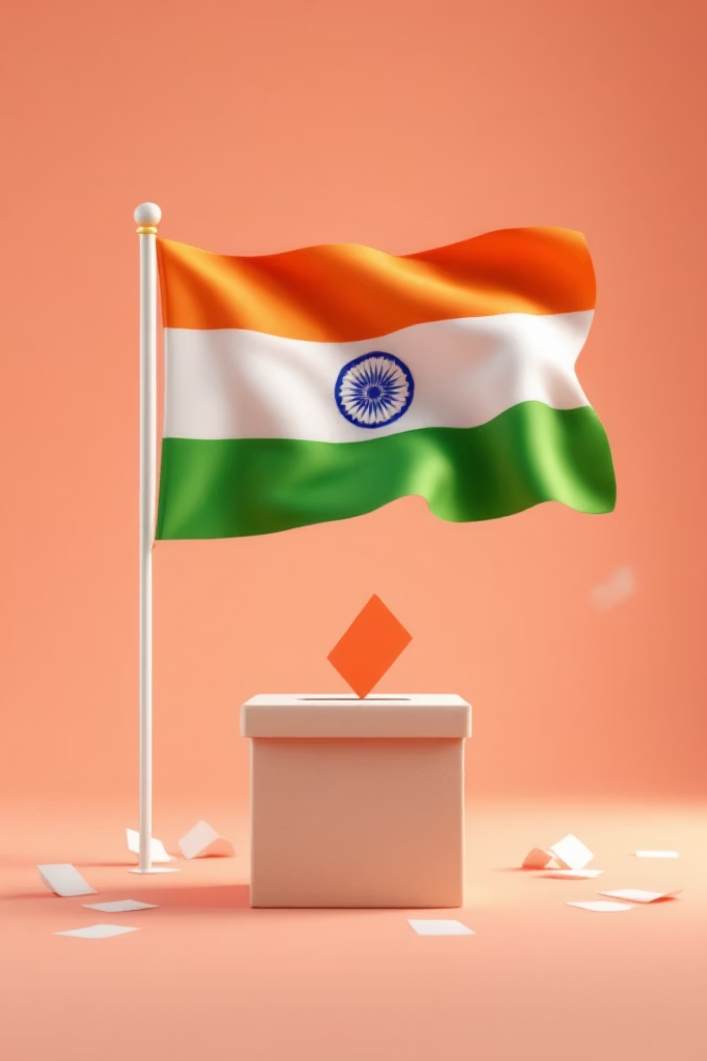
Political Parties & the Model Code of Conduct
Understanding the framework that ensures fair and democratic elections in India

Slide 2

Political Parties: The Foundation of Democracy
Political parties are organized groups that contest elections to represent citizens' interests. They play a crucial role in shaping policies, mobilising voters, and forming governments.
Each party must follow strict rules and regulations set by the Election Commission of India to maintain transparency and fairness in the democratic process.

Slide 3

Party Recognition System
The Election Commission grants recognition to political parties based on their performance in elections. This recognition determines the party's status and privileges.
State Party
National Party
Recognised in a particular state based on electoral performance within that state's boundaries
Recognised across India based on vote percentage and seats won in multiple states

Slide 4


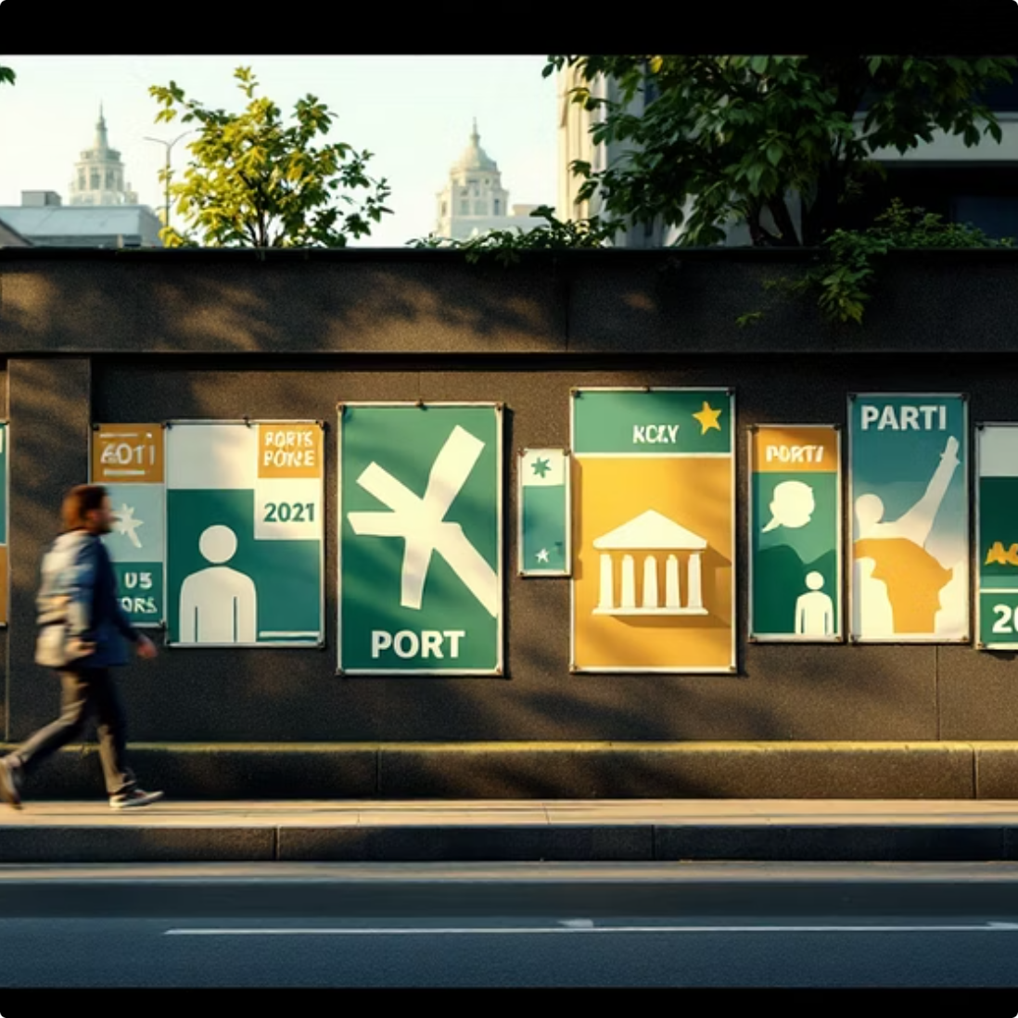
Election Symbols: Identifying Your Choice
Official Allocation
Universal Recognition
Campaign Tool
The Election Commission assigns unique symbols to each recognised party, ensuring easy identification
Symbols help voters, especially those who cannot read, easily identify and select their preferred party
Parties use their symbols extensively in campaigns, making them instantly recognisable to the electorate

Slide 5
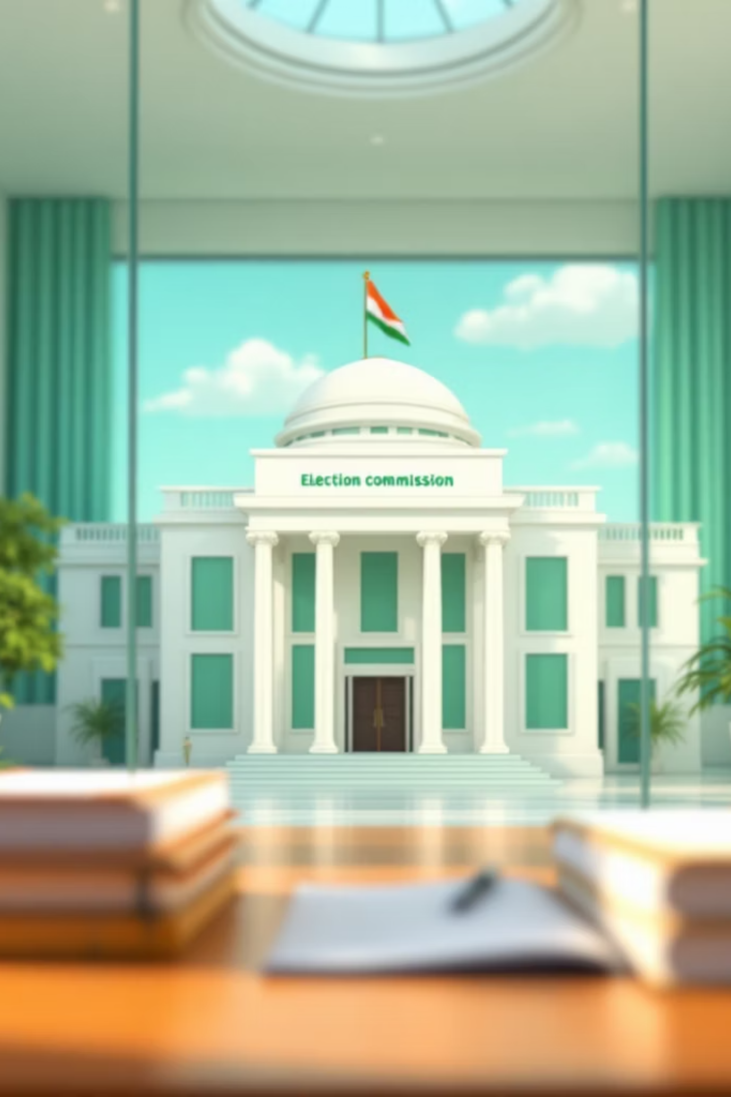
Model Code of Conduct: The Rulebook for Fair Elections
The Model Code of Conduct (MCC) is a comprehensive set of guidelines established by the Election Commission to ensure free, fair, and peaceful elections. It comes into effect as soon as the election schedule is announced.
All political parties, candidates, and government officials must strictly adhere to these rules throughout the election period.

Slide 6
Key Rules of the Model Code of Conduct
1
2
3
No Religious or Caste Appeals
No Personal Attacks
No Voter Bribing
Candidates cannot use religion, caste, or community to influence voters or make appeals based on these identities
Political discourse must remain issue-based without resorting to character assassination or personal mudslinging
It is illegal to offer money, gifts, or any form of inducement to influence a voter's decision
4
5
No Government Misuse
Restricted Area Campaigning
Government resources and machinery cannot be used for campaign purposes during elections
Campaigning is prohibited in certain sensitive areas and must follow location-specific guidelines

Slide 7

Campaign Rules and Time Limits
Time Management
48-Hour Silence Period
Sound Regulations
Campaigning is allowed only during specified hours, typically from 6 AM to 10 PM, ensuring voters can focus on genuine issues.
No campaigning is permitted 48 hours before polling begins, giving voters time to reflect without external pressure.
Loudspeakers and public address systems require permission and must follow decibel limits to avoid noise pollution.

Slide 8
Why the Model Code of Conduct Matters
Fair Competition
Prevents Power Abuse
Ensures all parties compete on equal terms without unfair advantages or misuse of resources
Stops incumbent governments from misusing state machinery for electoral gains
Maintains Order
Builds Trust
Keeps political campaigns peaceful, issue-focused, and within legal boundaries
Increases voter confidence in the electoral process and its outcomes

Slide 9

Enforcement and Compliance
Monitoring Mechanism
The Election Commission deploys observers and monitoring teams to ensure compliance with the MCC across all constituencies.
Complaint System
Voters and parties can file complaints against violations, which are promptly investigated by the Election Commission.
Penalties
Violations can result in warnings, campaign restrictions, or even disqualification of candidates in severe cases.

Slide 10
Key Takeaways
1
Political parties must follow Election Commission rules
2
Election symbols help voters identify parties easily
Recognition as state or national party depends on electoral performance
Unique symbols assigned by Election Commission ensure universal recognition
3
Model Code of Conduct ensures fair elections
4
Campaign time is limited with 48-hour silence period
Key rules prevent misuse of religion, caste, government resources, and personal attacks
Strict enforcement maintains discipline and fairness throughout elections

