Slide 1
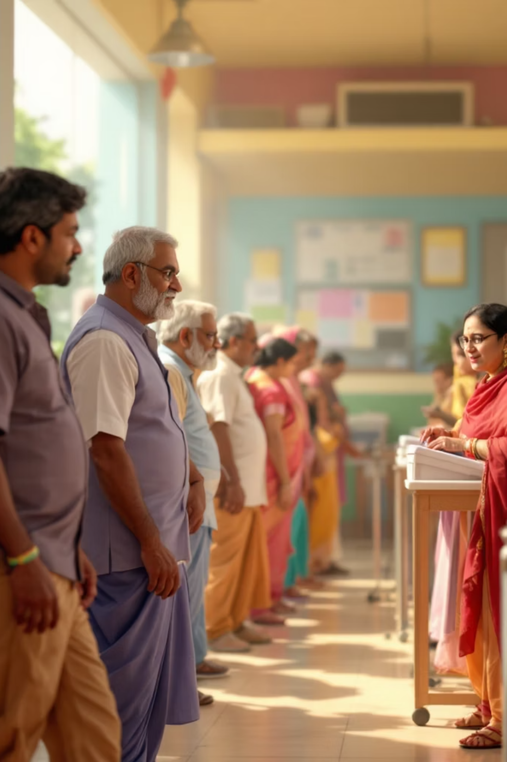
Understanding the Polling Process & Voting Mechanism
A comprehensive guide to how elections are conducted, from announcement to result declaration, ensuring fair and transparent democratic participation.

Slide 2
The Eight Stages of an Election
Elections follow a structured timeline to ensure fairness, transparency, and orderly conduct from nomination to result declaration.
01
02
Announcement
Nomination
Election Commission announces official schedule and key dates
Candidates file nomination papers to contest the election
03
04
Scrutiny
Withdrawal
Verification and validation of all nominations
Candidates exercise option to withdraw from contest
05
06
Campaigning
Polling
Political parties actively promote their candidates
Voting takes place at designated polling stations
07
08
Counting
Result Declaration
Collected votes are systematically counted
Winner is officially declared

Slide 3

Polling Day: Rules & Procedures
Peaceful Voting Environment
Law enforcement ensures order and security at all polling locations throughout voting hours.
No Campaigning Zone
Strict prohibition on campaigning within 100 metres of polling booths to maintain neutrality.
Identity Verification
Voters must present valid photo identification before casting their ballot.
Secret Ballot System
Private voting booths protect voter privacy and prevent coercion or influence.

Slide 4
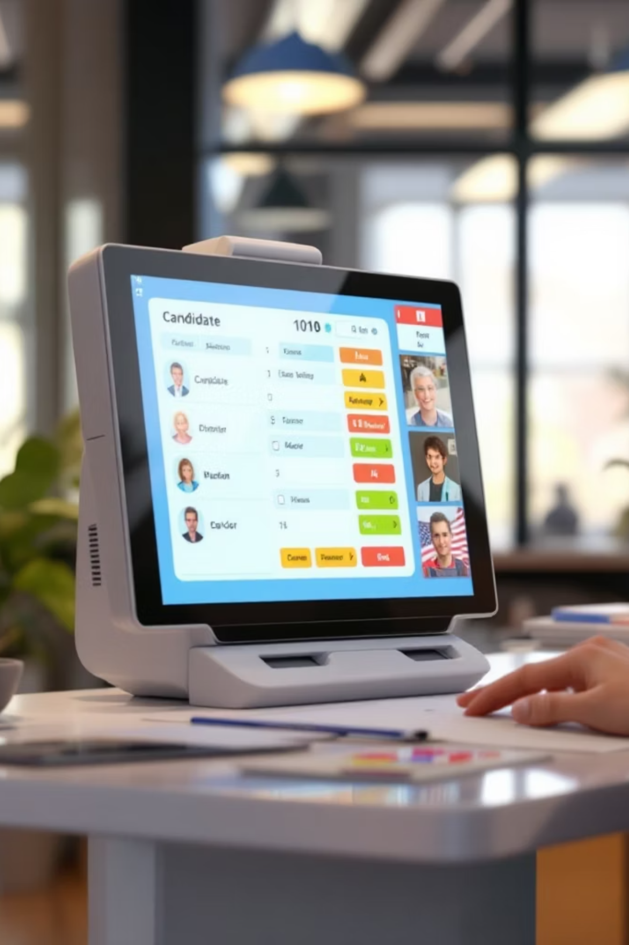

Electronic Voting Machines (EVM)
Speed & Efficiency
EVMs process votes instantly, significantly reducing counting time compared to paper ballots.
Accuracy & Reliability
Digital recording eliminates human errors in vote counting and tabulation processes.
Fraud Prevention
Secure design and tamper-proof mechanisms reduce ballot stuffing and electoral fraud.
Voter Accessibility
Simple button interface makes voting accessible to all, including elderly and differently-abled voters.

Slide 5
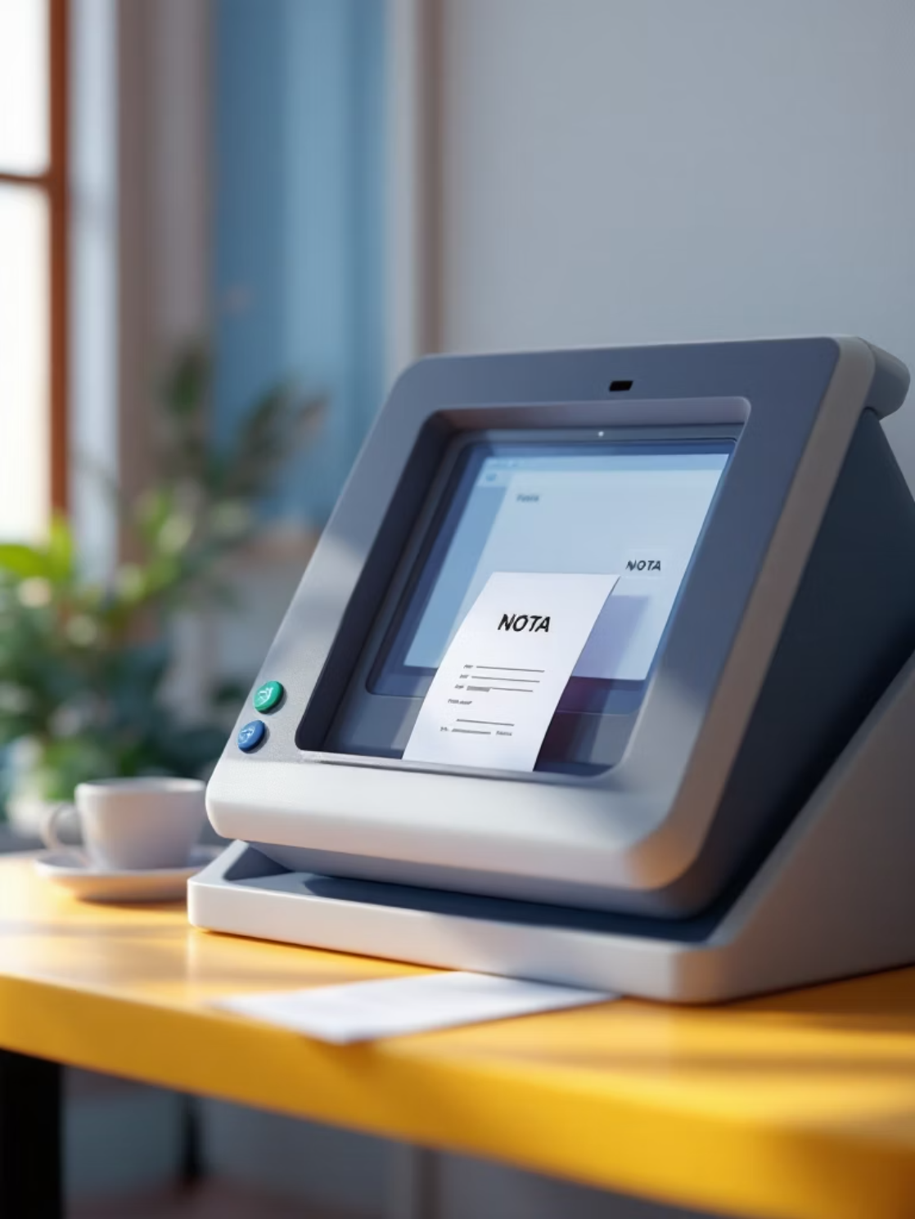
NOTA: None of the Above
Empowering Voter Choice
Introduced in 2013, NOTA provides voters with a democratic option to reject all candidates if none meet their expectations or standards.
Significance of NOTA
Expresses dissatisfaction with available candidates
Maintains voter's right to reject
Encourages political parties to field better candidates
Records voter sentiment without affecting electoral outcome
Important: NOTA votes do not influence who wins the election, but they serve as a powerful indicator of voter dissatisfaction.

Slide 6

Election Officials: Ensuring Fair Conduct
Presiding Officer
Senior official in charge of entire polling station, responsible for overall conduct and resolving disputes during voting.
Polling Officers
Assist Presiding Officer with voter verification, queue management, and operational support at polling stations.
Election Observers
Independent monitors deployed to oversee polling and counting processes, ensuring compliance with electoral laws.

Slide 7
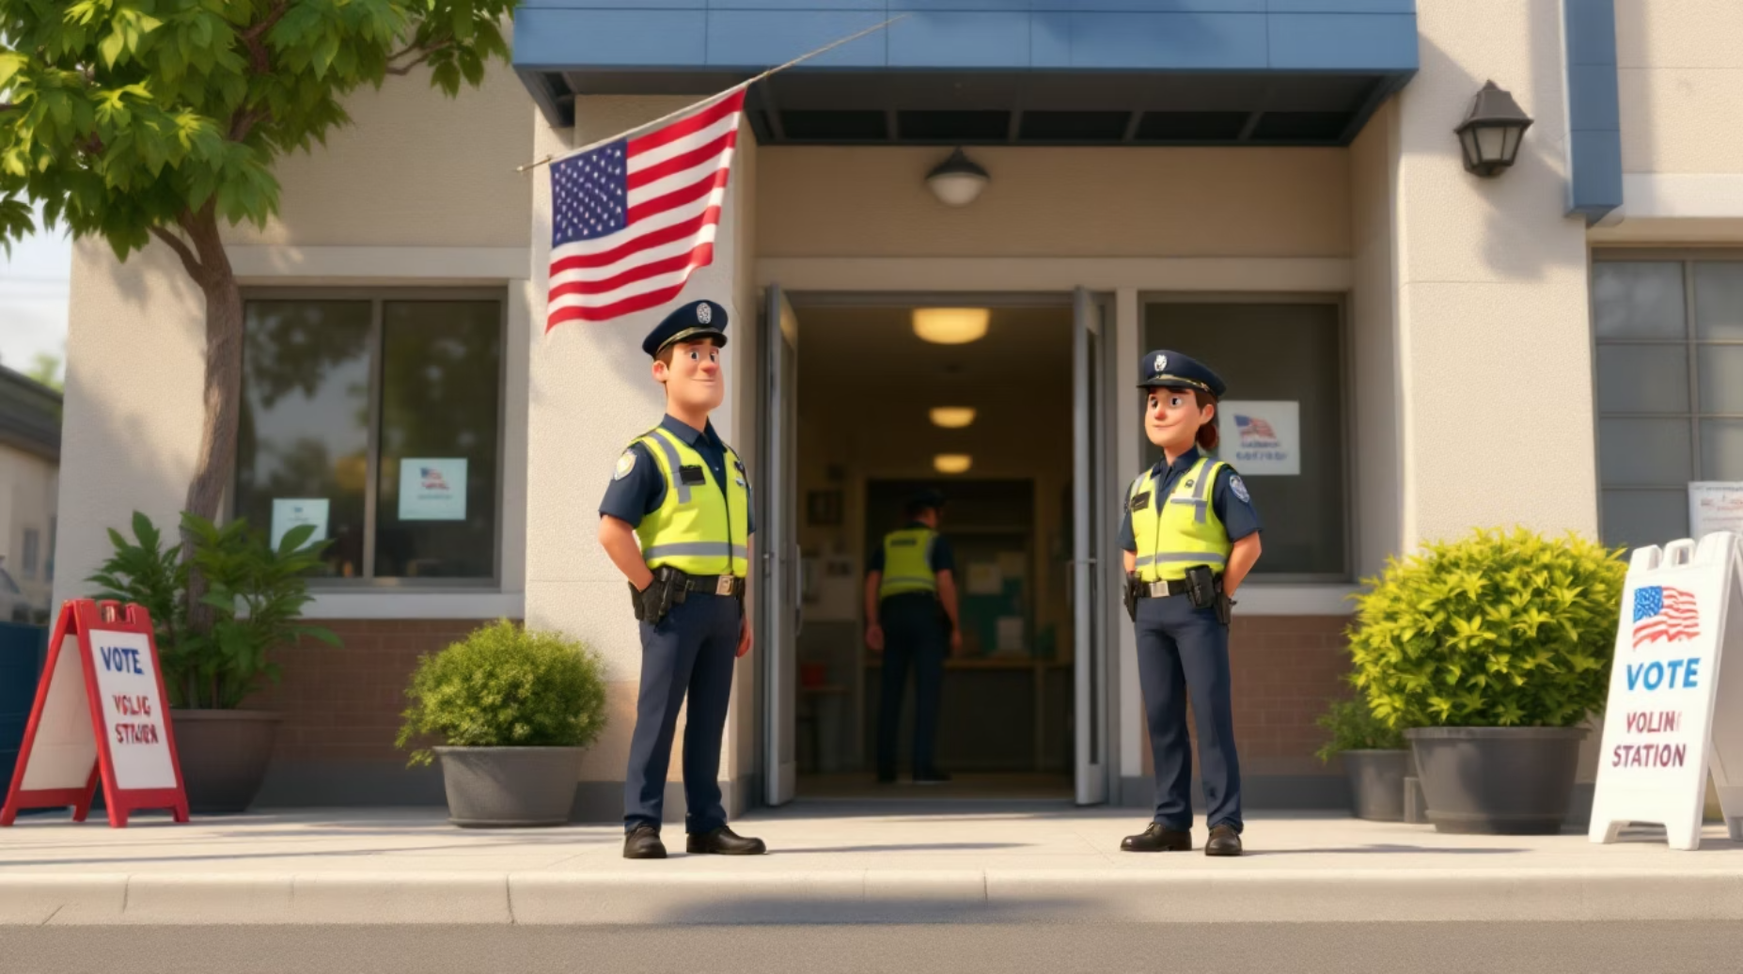
Ensuring Fairness & Transparency
Security Arrangements
Law enforcement deployed to prevent violence, intimidation, and electoral malpractice at polling locations.
Election Commission Monitoring
Central and state election commissions continuously monitor processes through surveillance and reporting systems.
Media Accreditation
Accredited journalists and media persons allowed to report from polling stations within prescribed guidelines.
Additional Safeguards
VVPAT (Voter Verifiable Paper Audit Trail) for random verification
Candidates and agents allowed to observe polling
Sealing of EVMs with multiple layers of security
Video surveillance at sensitive polling stations

Slide 8
The Complete Election Timeline
From announcement to result, the election process follows a carefully orchestrated sequence to ensure democratic integrity.
Week 1: Announcement
1
Election Commission releases official notification and schedule
2
Week 2-3: Nomination
Candidates submit papers; scrutiny committee reviews eligibility
Week 4: Withdrawal
3
Last date for candidates to withdraw nominations
4
Week 5-7: Campaigning
Intensive election campaigns across constituencies
Week 8: Polling
5
Voting conducted at designated polling stations
6
Week 9: Counting
Simultaneous counting at counting centres
Week 9: Results
7
Winners declared and results published

Slide 9
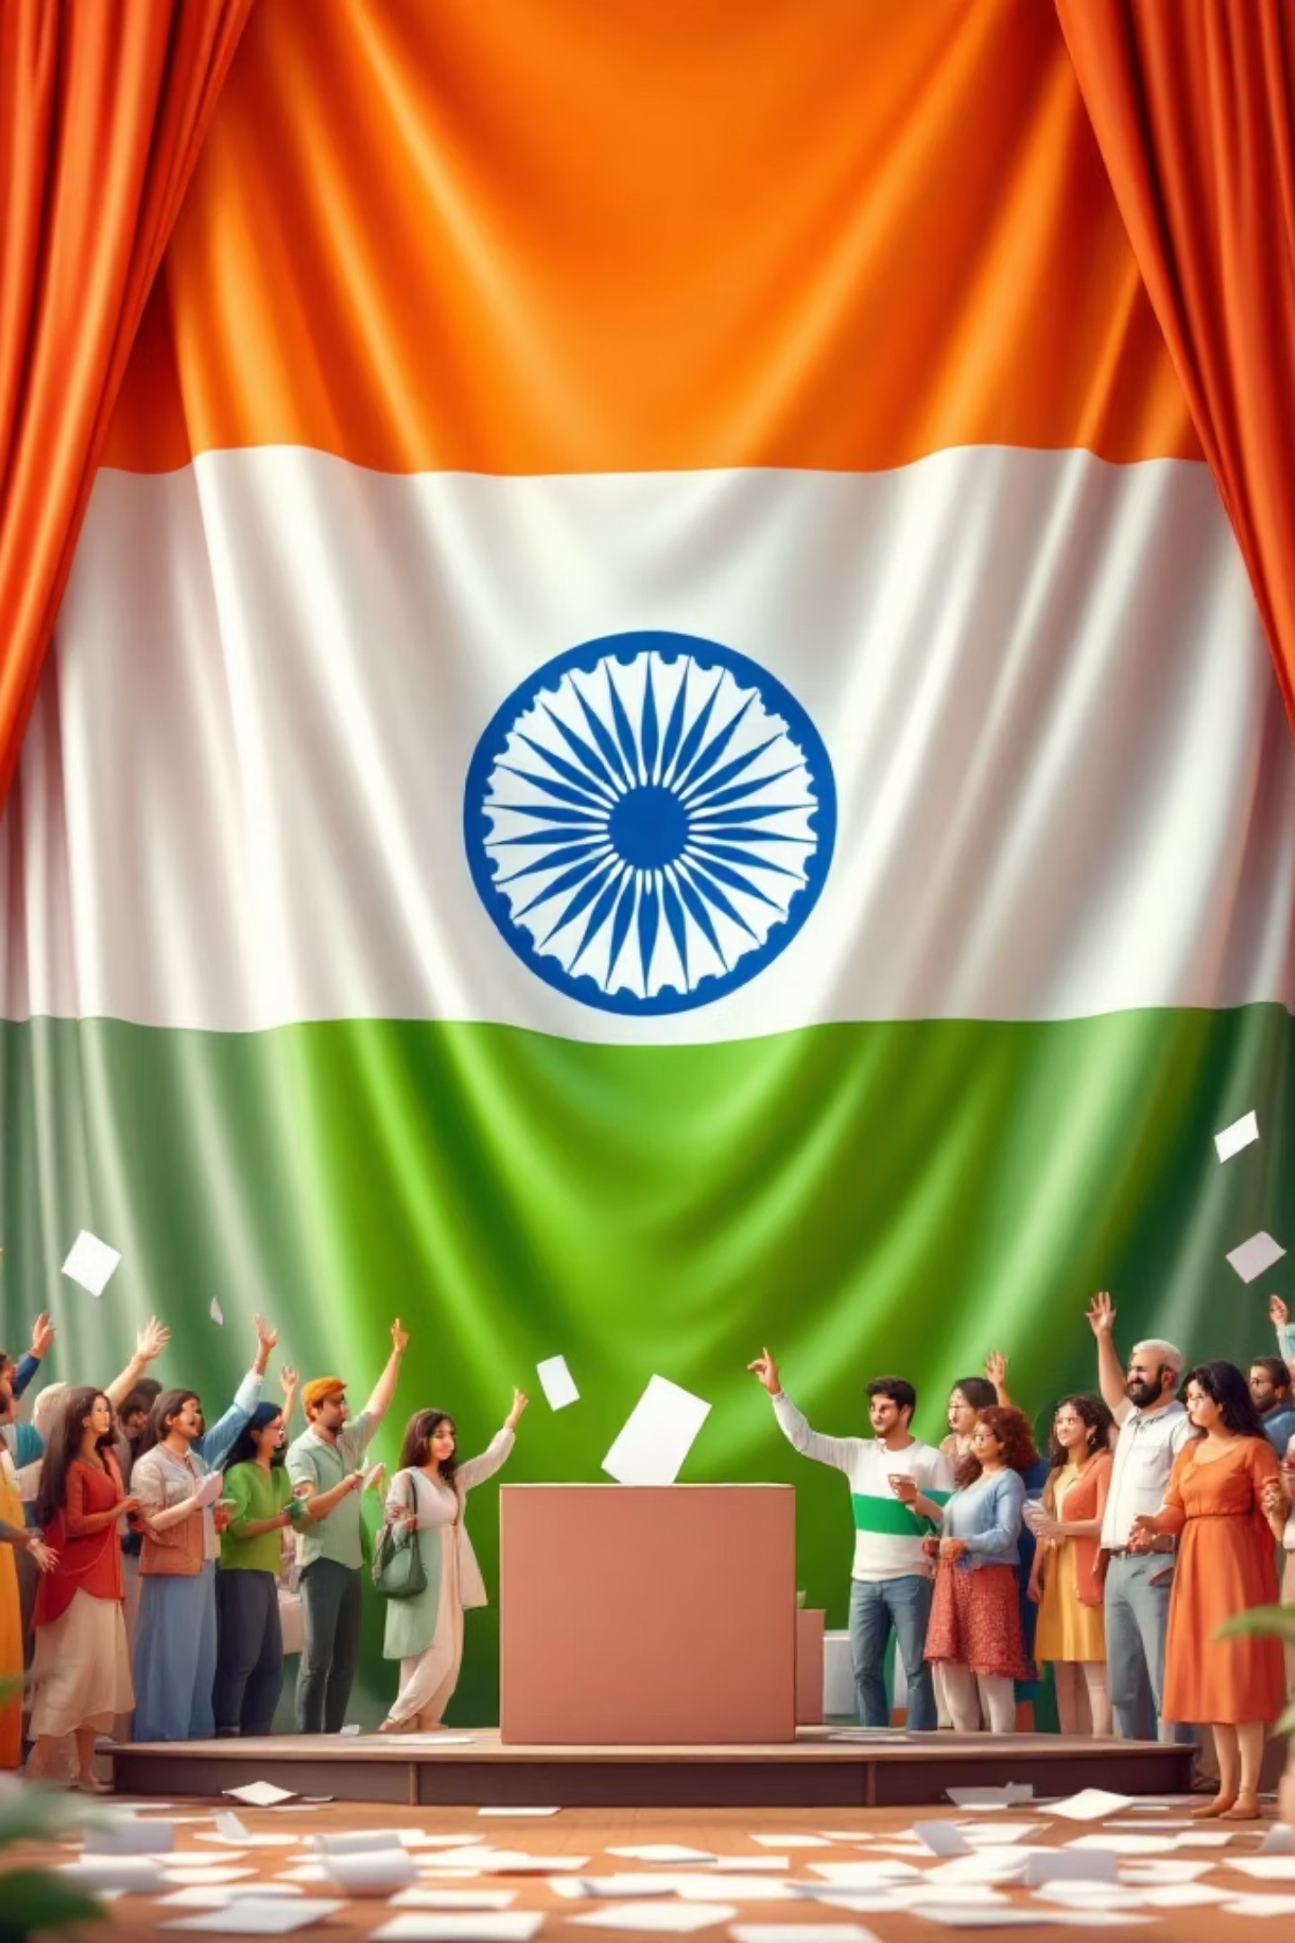
Key Takeaways
Structured Process
Eight distinct stages ensure systematic and transparent election conduct from start to finish.
Technology & Security
EVMs combined with robust security measures guarantee accurate, fraud-resistant voting.
Democratic Rights
NOTA and secret ballot empower voters with choice and privacy protection.
Official Oversight
Multi-layered monitoring by officials, observers, and commissions ensures fairness.

Slide 10

Your Role as an Informed Voter
Stay Informed
Verify polling station location and timings
Carry valid photo identification
Understand candidate manifestos and credentials
Know your rights at polling stations
Participate Responsibly
Exercise your franchise without influence
Maintain peace at polling locations
Respect election officials and procedures
Report any malpractice to authorities
Every Vote Matters
Your participation shapes democracy. Register, verify eligibility, and vote to influence the future of your constituency and nation.

