Slide 1
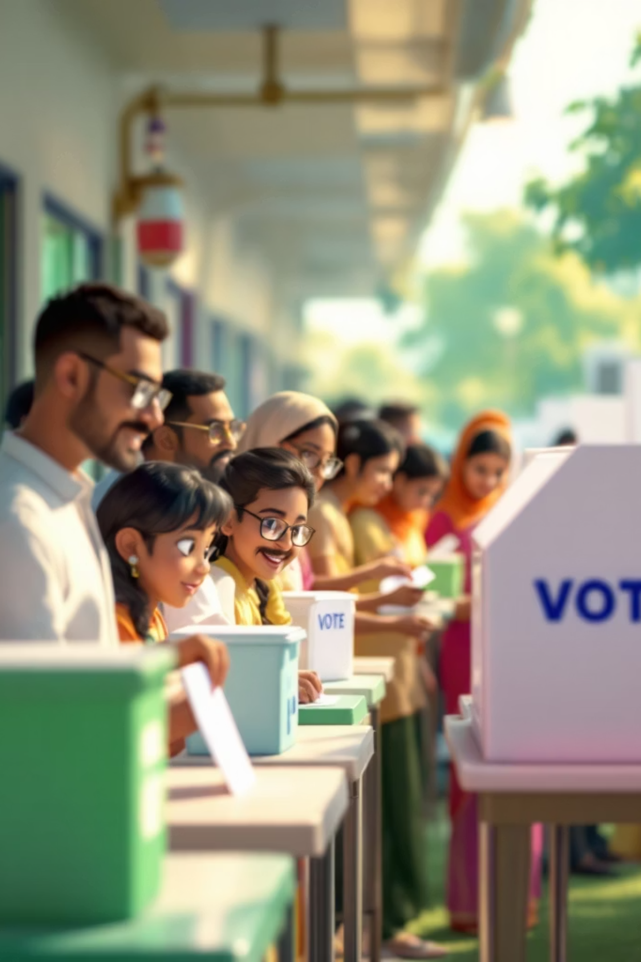
Electoral Reforms: Strengthening India's Democracy
Building trust, transparency, and fairness in the world's largest democracy

Slide 2

Why Electoral Reforms Matter Now
India's democratic fabric faces unprecedented challenges. From shadowy campaign financing to criminal elements infiltrating politics, the integrity of our electoral process is under threat. Without urgent reforms, the very foundation of representative democracy—citizen choice—risks erosion.
These reforms aren't merely technical adjustments; they're essential safeguards ensuring every vote counts and every voice matters.

Slide 3

Four Critical Challenges
Corruption & Money Power
Criminal Candidates
Illicit funds flood campaigns, enabling wealthy candidates to outspend ethical opponents and skew electoral outcomes
Politicians with serious charges exploit loopholes, undermining public trust in governance and rule of law
Vote Buying
Lack of Transparency
Systematic distribution of cash and gifts manipulates voter decisions, particularly affecting economically vulnerable communities
Opaque party financing and expenditure reporting obscure funding sources and actual campaign costs

Slide 4
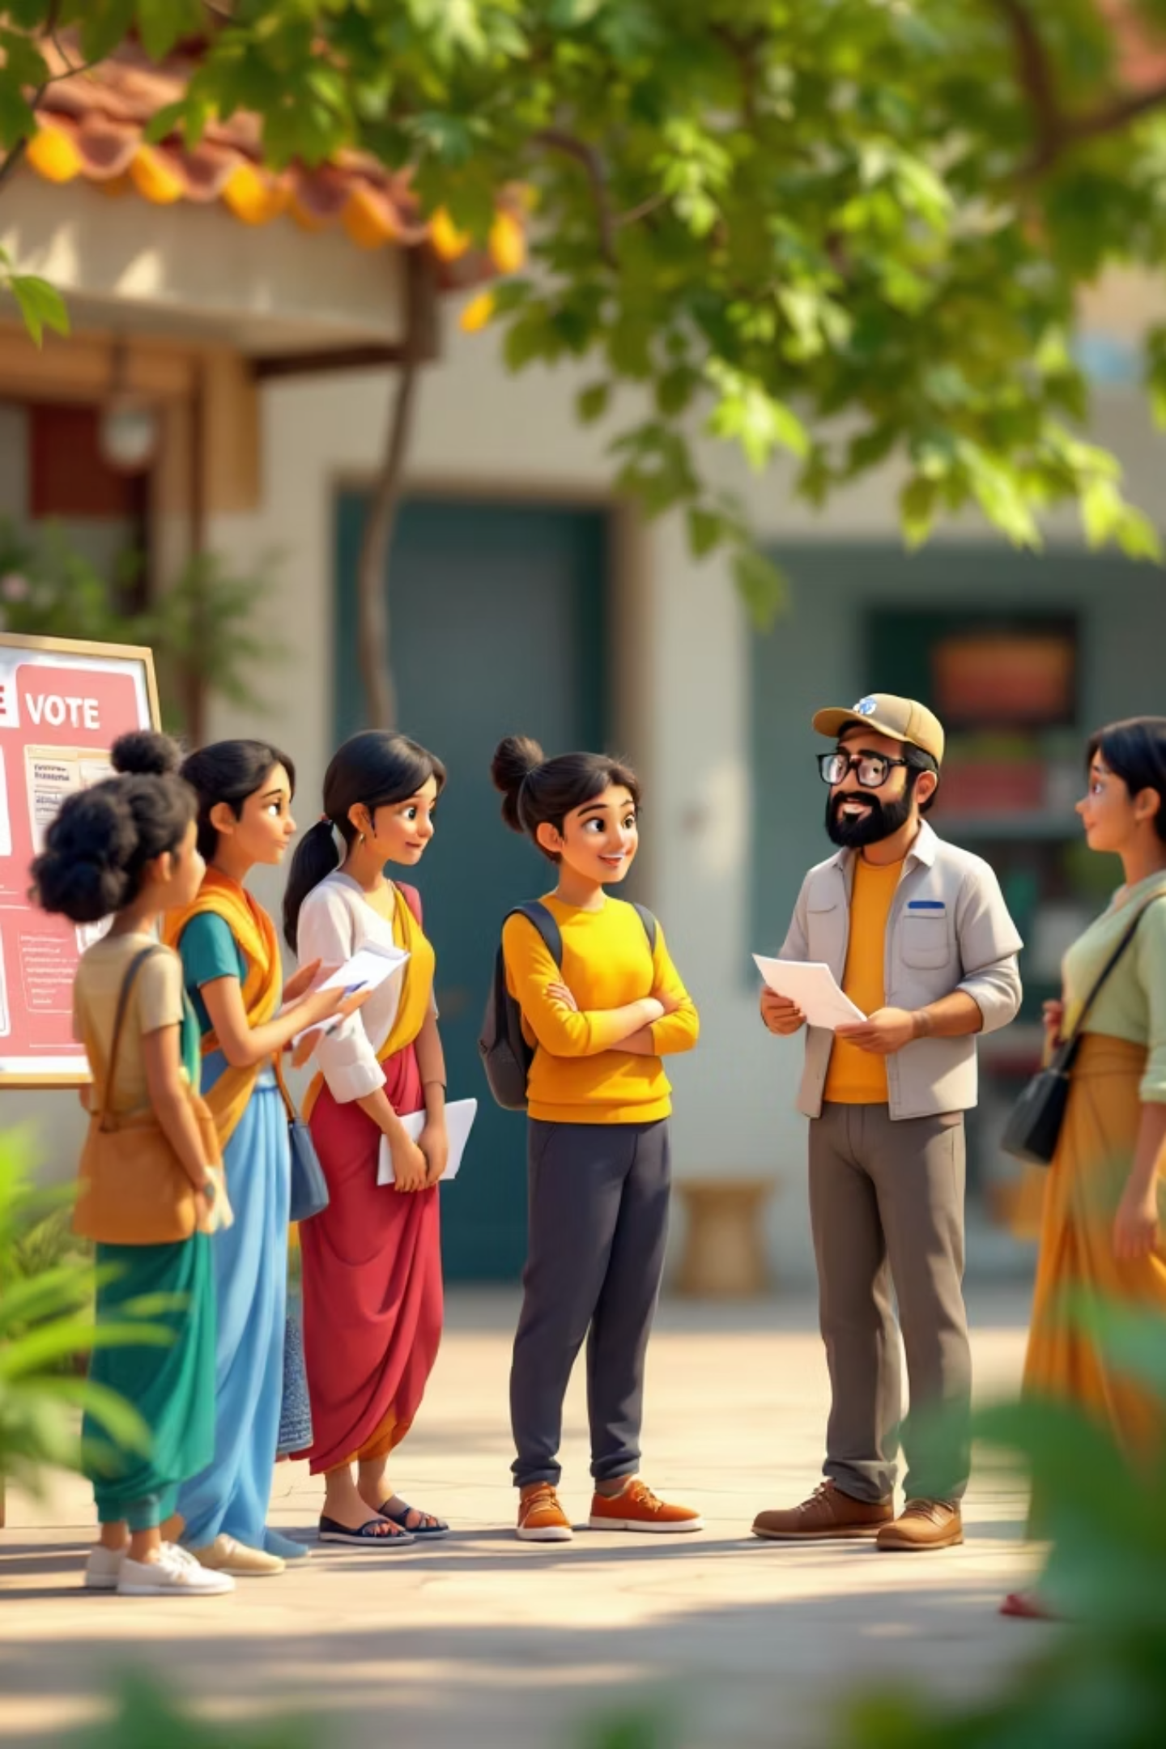
Key Reform Proposals
01
Transparency in Political Funding
Mandatory disclosure of donors above threshold, stringent audit requirements, and public access to party finances
02
Strict Laws for Criminal Elements
Immediate disqualification upon charges framed, expedited trials for sitting MPs/MLAs, and barred candidacy for serious offences
03
Cap on Election Expenses
Enforceable spending limits with rigorous monitoring, severe penalties for violations, and public scrutiny mechanisms
04
Enhanced Voter Awareness
Civic education programmes, candidate background disclosures, and media campaigns highlighting informed voting importance

Slide 5
Landmark Court Judgments
The judiciary has played a crucial role in strengthening electoral integrity through progressive rulings:
1
2
3
Right to Know (PUCL v. Union of India, 2003)
NOTA Introduction (People's Union v. Union, 2013)
VVPAT Verification (2013 onwards)
Candidates must declare criminal records, assets, education, and pending cases. Voters' right to information recognised as fundamental under Article 19(1)(a)
Supreme Court mandated negative voting option, empowering voters to reject all candidates if none meet ethical standards
Order for Voter Verifiable Paper Audit Trail machines, enabling physical confirmation of electronic votes cast, ensuring electoral transparency and accountability

Slide 6

Postal Ballot: Ensuring Every Vote Counts
Who Can Vote by Post?
Government employees on election duty in other constituencies
Armed forces personnel deployed during polling
Government officials serving outside India
Persons with disabilities or illness preventing physical polling attendance
Individuals under preventive detention
How It Works: Eligible voters receive ballot papers by post, mark their choice confidentially, and return sealed ballots. This remote voting mechanism ensures no citizen is disenfranchised by geographical or service-related constraints.

Slide 7
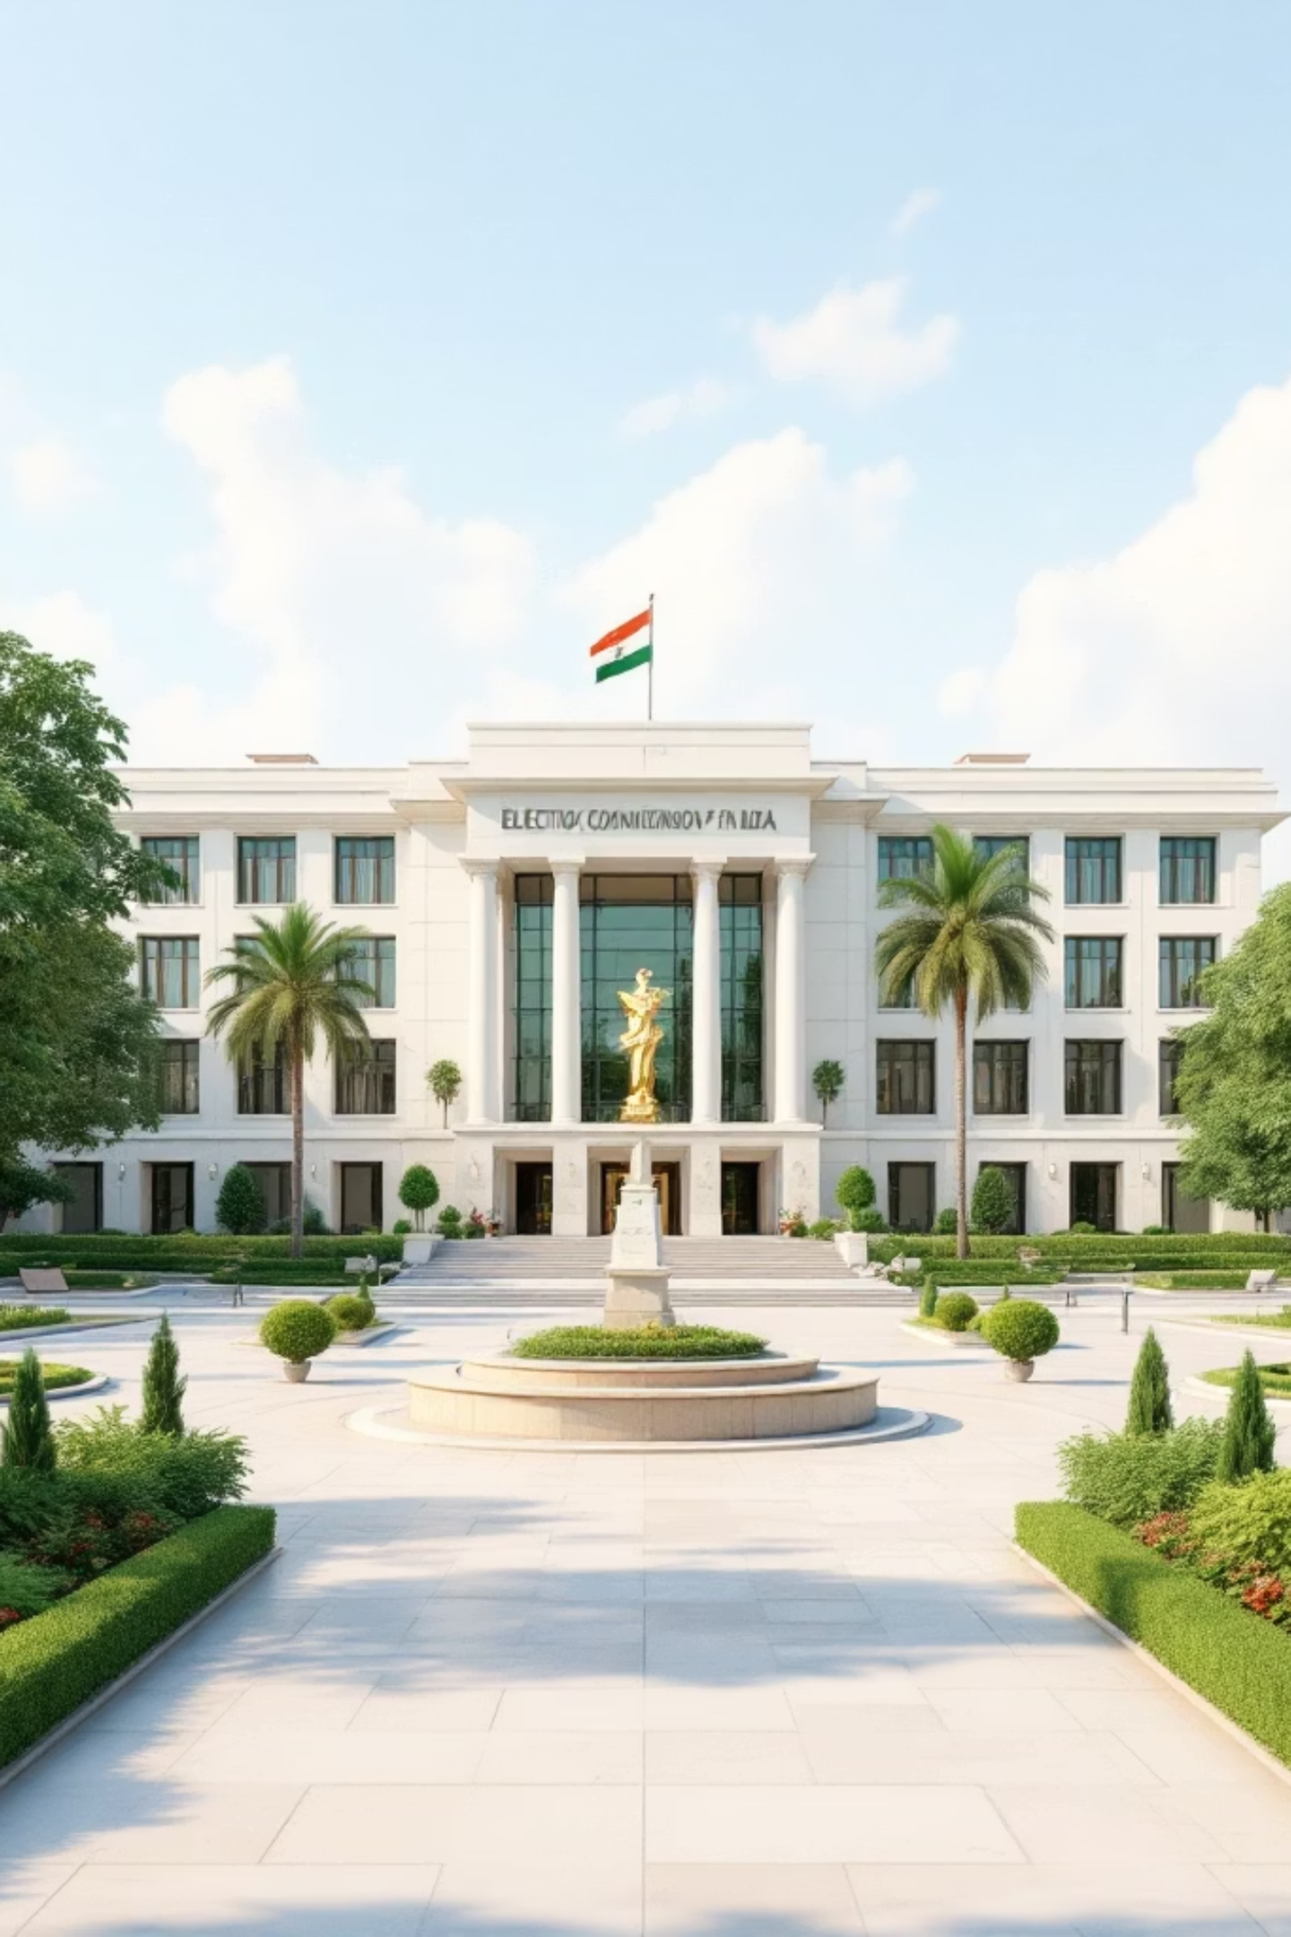



Cancellation of Elections: Last Resort
When Can Elections Be Cancelled?
Grounds for Cancellation
The Election Commission possesses constitutional authority under Article 324 to countermand polls if malpractice severely compromises fairness.
Systematic rigging or booth capturing
Widespread bribery or intimidation
Criminal interference with polling process
Failure of electoral machinery
Evidence Gathering
EC monitors complaints and verifies malpractice allegations
Decision
EC exercises discretionary power under Article 324
Re-conduction
Fresh elections conducted to ensure genuine democratic mandate

Slide 8

Citizens: The True Guardians
Responsible Voting
Exercise franchise judiciously, researching candidate backgrounds, policy positions, and track records before casting votes
Continuous Awareness
Stay informed through credible sources, verify facts, challenge misinformation, and educate family and community members
Reject Corruption
Vote against candidates with criminal charges, oppose unethical practices, and demand accountability from elected representatives
Active Participation
Engage in democratic discourse, join electoral reform movements, petition authorities, and hold institutions accountable

Slide 9

Progress Made: Celebrating Reforms
100%
100%
100%
EVM Coverage
VVPAT Integration
NOTA Availability
Electronic Voting Machines deployed across all polling stations since 2019 general elections
Physical verification system linked with EVMs, enabling audit trail for every vote cast
Negative voting option operational in all elections, empowering voter choice to reject
These milestones demonstrate India's commitment to electoral integrity, though much work remains in addressing corruption, money power, and criminalisation of politics.

Slide 10
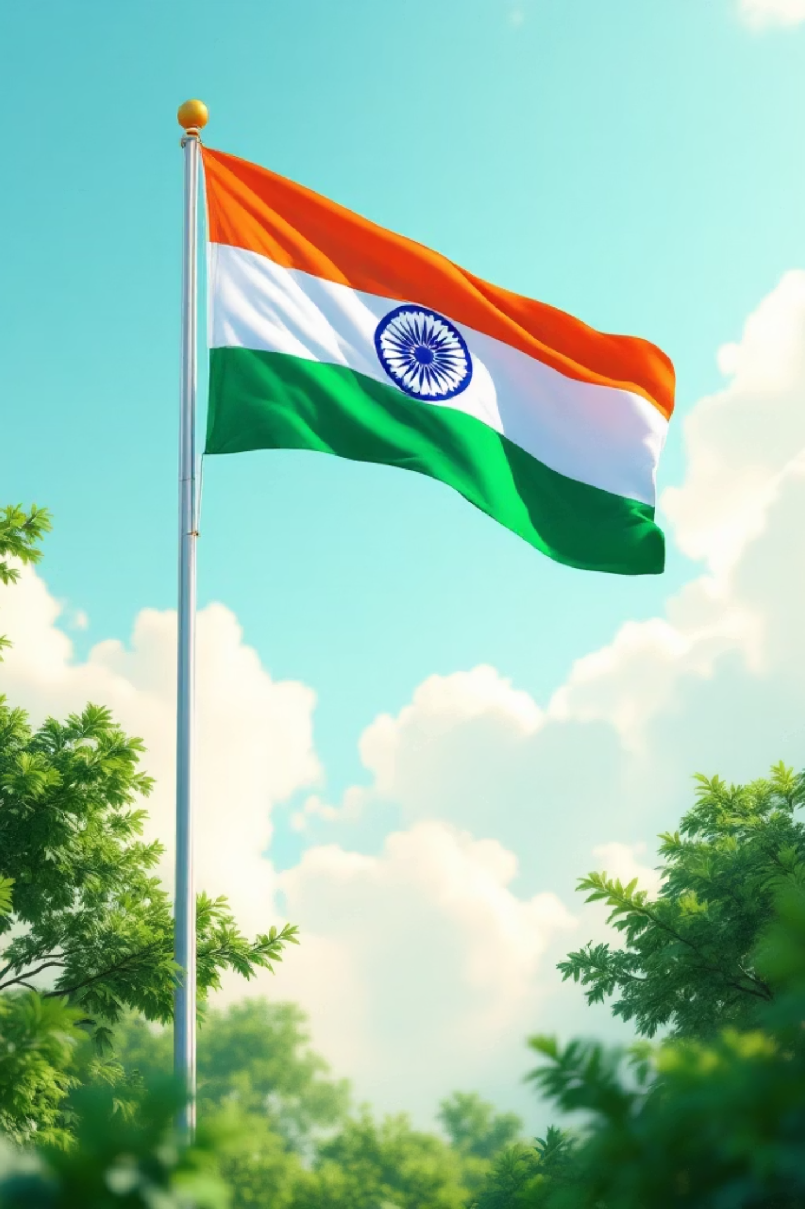
Free and Fair Elections: Democracy's Foundation
Every vote cast in freedom, every voice heard without coercion, every candidate judged on merit—these are the pillars of genuine democracy. Electoral reforms aren't mere policy adjustments; they're the very safeguard ensuring India's democratic promise remains unbroken for generations to come.
Together, citizens and institutions must champion transparency, reject corruption, and protect the sanctity of the ballot. Our democracy's strength lies not in perfection, but in our collective will to continually improve it.

