Slide 1
WEB BASED GAMES
Submitted in the partial fulfillment for the award of the degree of
BACHELOR OF ENGINEERING
IN
CSE-IOT
Submitted by:
ABHISHEK SINGH
19BCS4508
Under the Supervision of:
DR. MONICA LUTHRA
Department of AIT-CSE
DISCOVER . LEARN . EMPOWER

Slide 2
Outline
Introduction to Project
Problem Formulation
Objectives of the work
Methodology used
Results and Outputs
Conclusion
Future Scope
References

Slide 3
Introduction to Project
Problem Definition
Games are a great way to relax and let loose after a long and hard day. Everyone knows the different ways playing a game can put your mind at ease and be helpful after a hard day.
The problem arises when people try to play them. An instance of this can be a person who has a non windows computer, where they have no way of enjoying a little to relax and play games other than on their smartphone which can also bring up a lot of other problems like having an underpowered hardware. The same problem can also arise in case of a computer because traditional computer or phone games require good hardware to even run properly.

Slide 4
Problem Definition
In some cases, the operating system that a person is using can pose a lot of problems in case they want to enjoy some games. There are not a lot of free and light weight games available for MacOS and Linux in the market and there are very few companies or people who try to counter this problem.

Slide 5
Project Overview and Specifications
The problem that we are trying to counter is quite a unique one indeed. What we are trying to achieve is an idea of a free game collection consisting of classic games that can run on any computer regardless of computing abilities given that it supports a graphical web browser and can run simple JavaScript code.
We thought of providing a cross platform solution to this simple yet significant problem and we ended up studying a lot about how different OSs differ from each other in the way that creates problems or hinders the cross-platform development in the first place. We ended up allocating a lot of time to the prior information collection regarding the problem before we started with the development phase of the project.

Slide 6
Project Overview and Specifications
Hardware Specifications:
A computer
A keyboard
A mouse
Software Specifications:
A graphical OS.
A modern web browser.

Slide 7
Problem Formulation
Computer games have become a large part of the entire industry and people play a lot of games in the present world, i.e.
Games are a big part of today’s lifestyle.
People use different types of dedicated hardware and software to play games.
The traditional approach follows the following steps:
Identify which games you like to play.
Look for a medium that can run them properly.
Buy dedicated hardware and software to play them properly.

Slide 8
There are quite a few problems with the traditional approach. To put it in perspective, let us look at them one by one:
Researching for what games to play and what hardware to buy can be tiresome and sometimes useless for a normal person who just wants to play a game to relax for a bit.
Hardware and software required to play games might be expensive in some cases:
An Xbox or a PlayStation costs around USD 500.
A gaming PC can cost anywhere from 1000 to 5000 USD.
Another problem is Cross platform compatibility, which is one of the biggest issues in existence. Even big corporations do not pay much attention to this issue. This issue is very important and there is not much work being done about it by many people.

Slide 9
Objectives
To understand and explore various types of operating software like LINUX, WINDOWS AND MAC.
To study and analyze various game making techniques that are suitable for different types of operating software.
To design and develop the technique for web-based games.
To verify and validate the proposed system.

Slide 10
Methodology
Detailed study of operating software, their types and impact of application’s code on different operating software will be done.
Installation of web development tools like, VS CODE and hand on experience on existing approaches of HTML, CSS AND JAVASCRIPT applicable for web development will be done. Relative pros and cons will be identified.
HTML framework will be created, which will provide us with the structure of an application. Then designing of the application will be done by using CSS, it is done to make website more attractive and at last with the help of JAVA SCRIPT we will provide various instructions to the application that how it will work and how can a user can access the games.

Slide 11
Methodology
Different UI techniques will be analyzed to make the application more and more user friendly and easy to access.
An approach will be developed for web-based games.
Various parameters will be identified to evaluate the proposed system.
Comparison of new implemented approach with exiting approaches will be done.

Slide 12
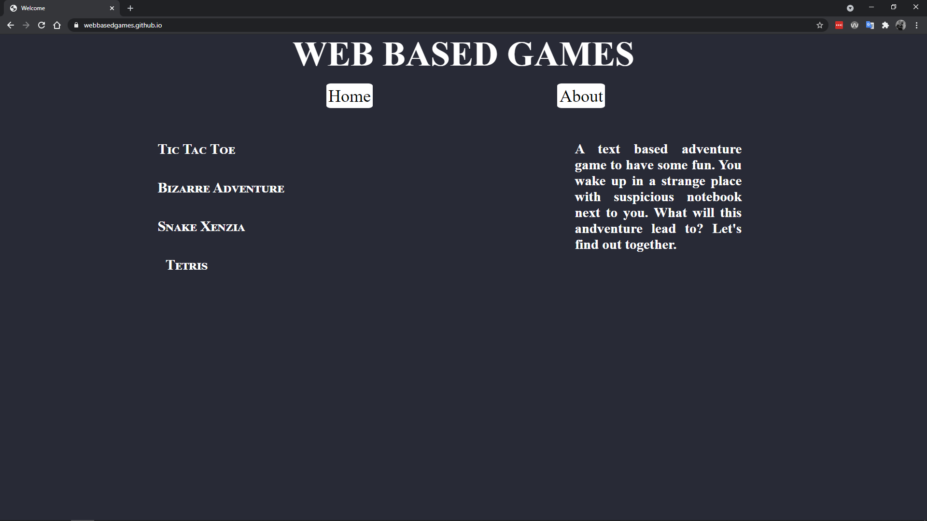
Results and Outputs Home page:

Slide 13
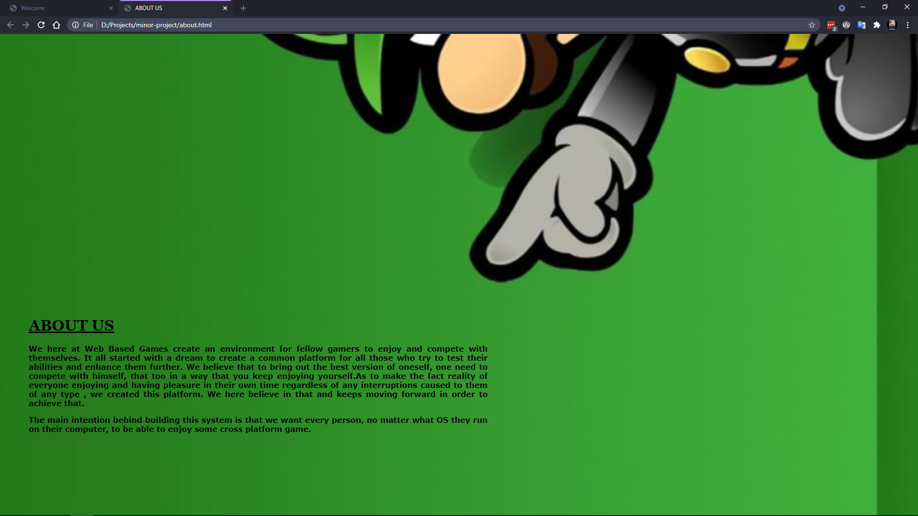
About Us page

Slide 14
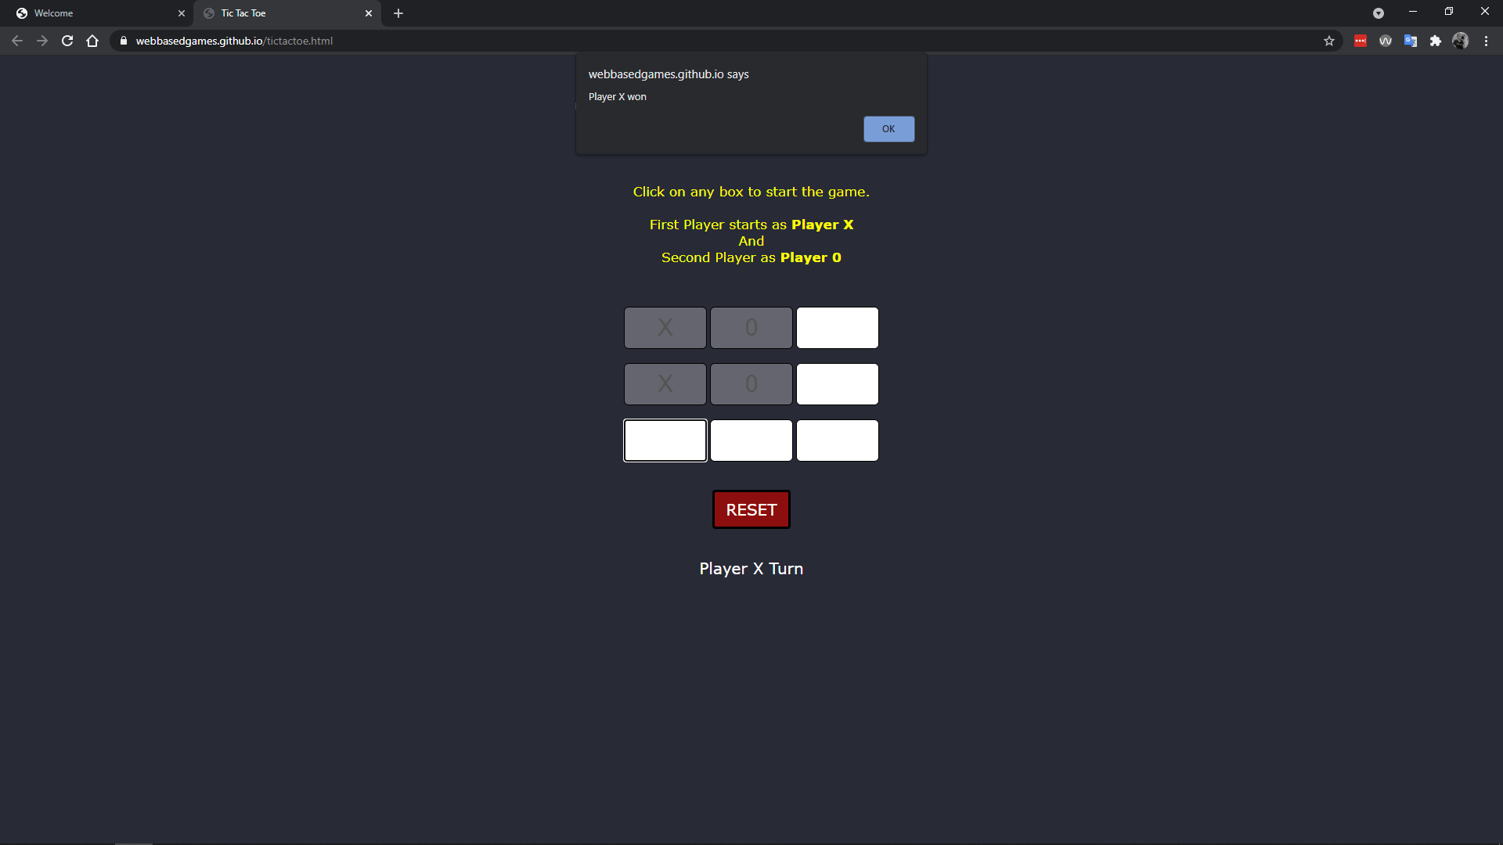
Tic Tac Toe

Slide 15
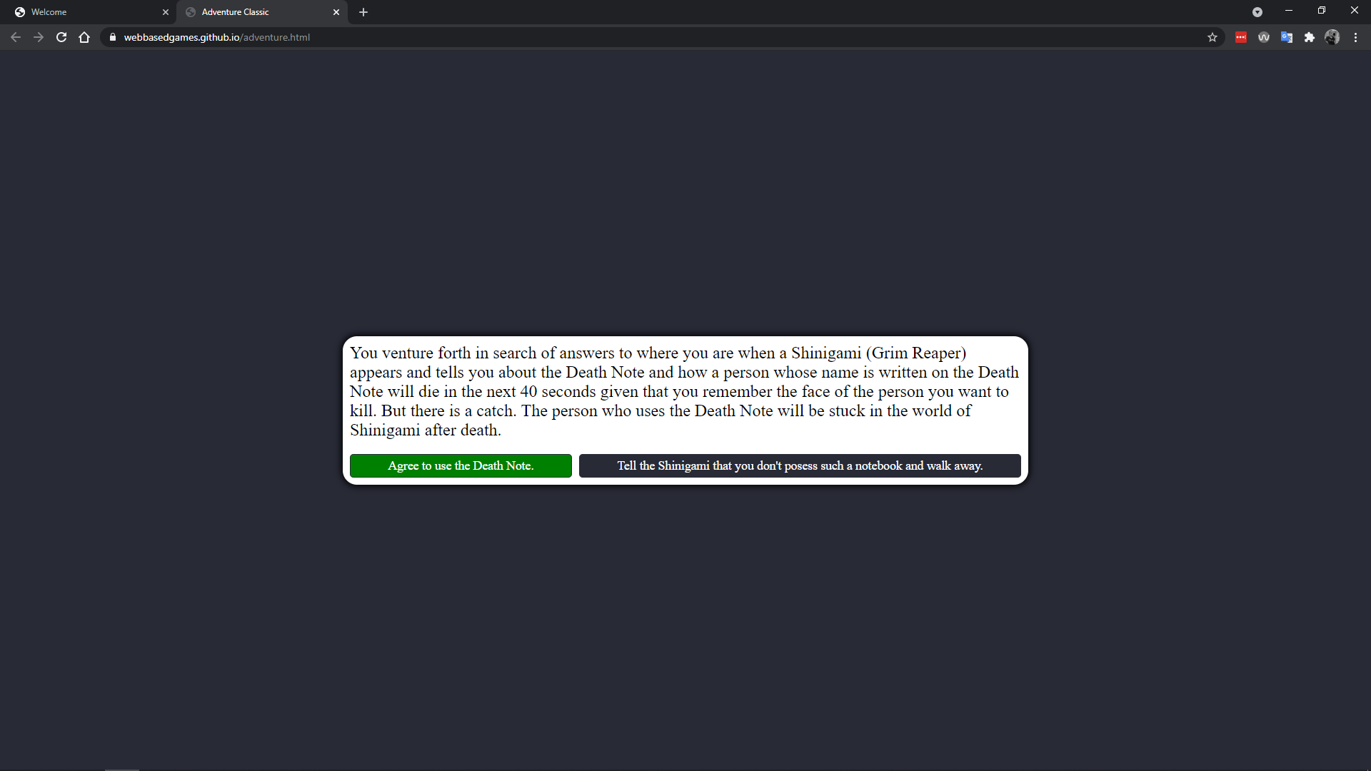
Bizarre Adventure

Slide 16
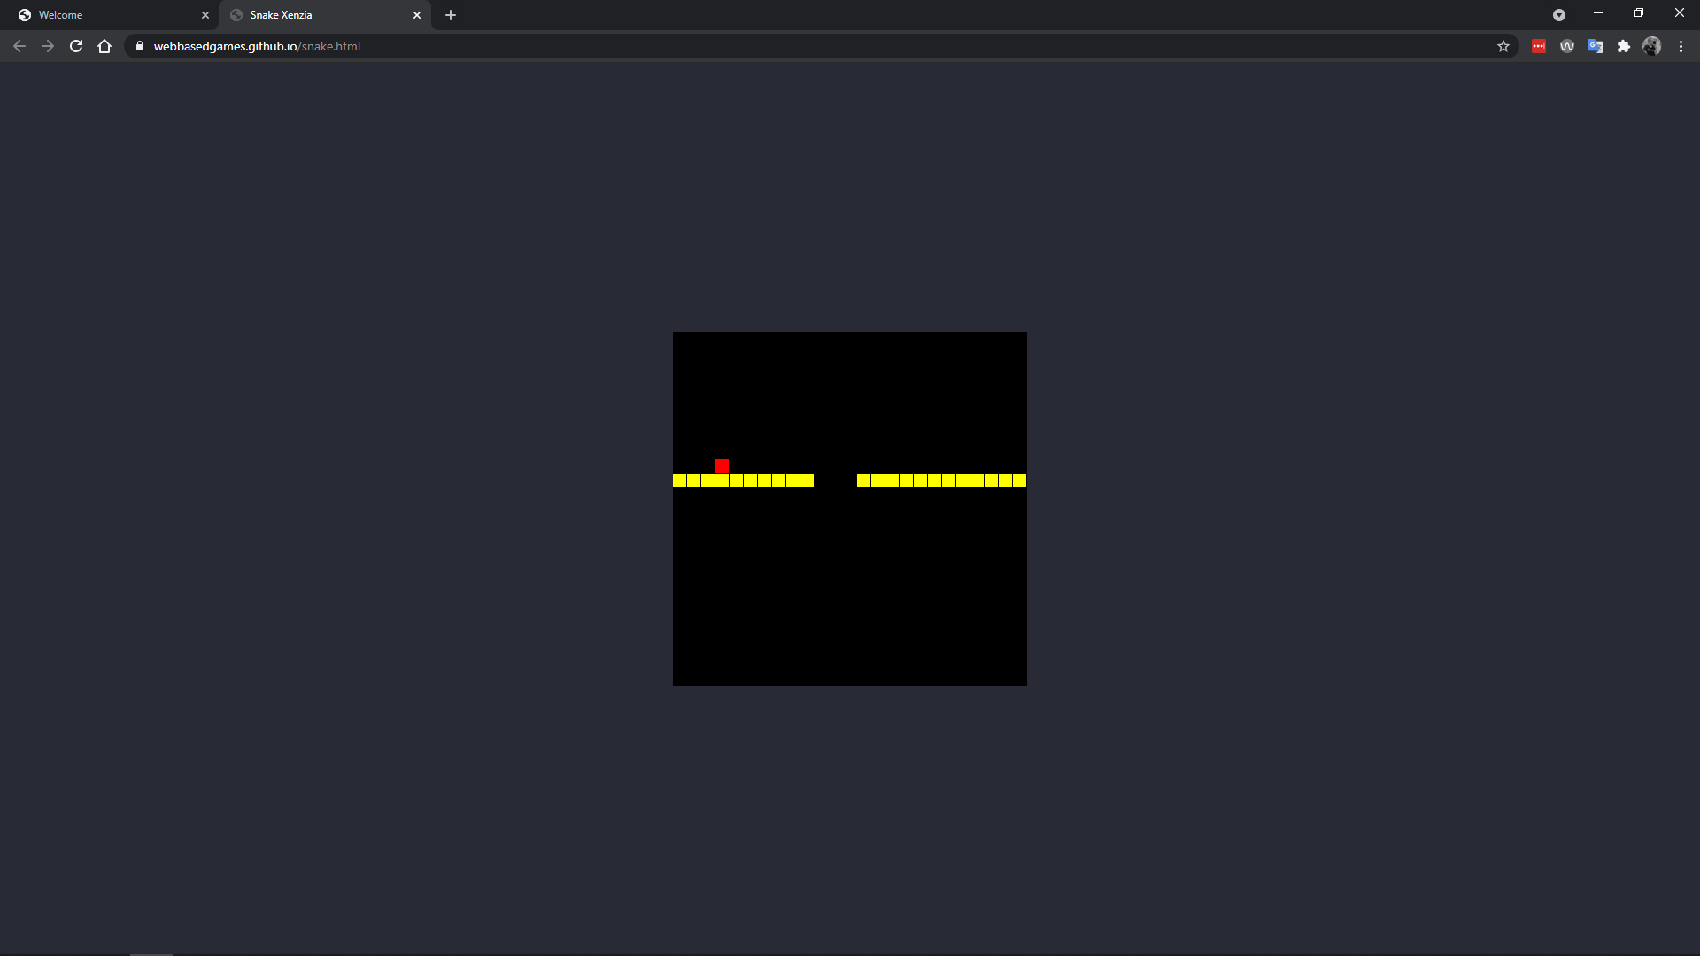
Snake Xenzia

Slide 17
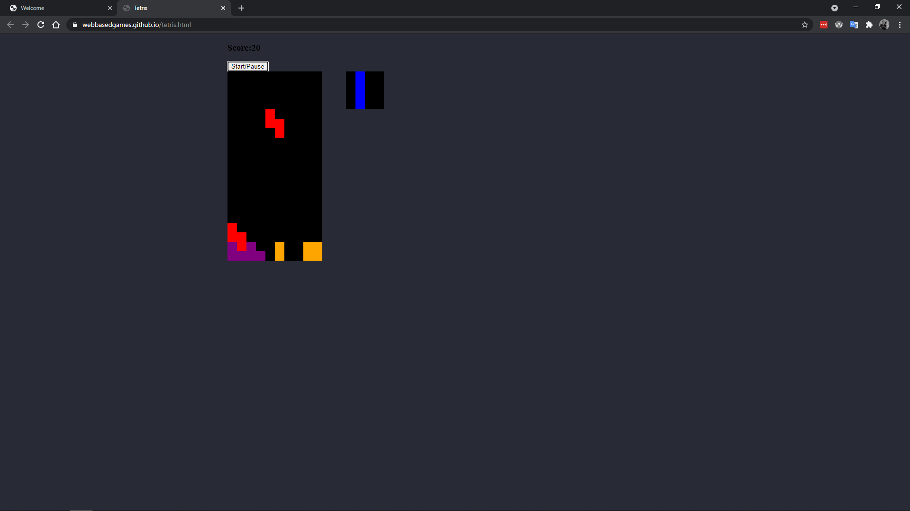
Tetris

Slide 18
Conclusion
We think that we have achieved the initial phase of the solution to the problem we were trying to address. Sure, there are some places that can be improved, but we will keep improving the product in the future depending on the performance and risk vs reward ratio.

Slide 19
Future Scope
The future of the project depends on how well it performs in this phase and if it is worth continuing will be determined by us after observing the analytics of the website in the long run.

Slide 20
References
[1] Death note anime, Directed by Tetsurō Araki in the year 2006.
[2] Web Dev Simplified, YouTube channel, https://www.youtube.com/channel/ UCFbNIlppjAuEX4znoulh0Cw

