Slide 1
Introduction to Data Science using Python
Abhijit Dasgupta, PhD
Plans for this workshop
We’re meeting today and tomorrow 1:30 - 3:00 pm

Slide 2
Plans for this workshop
Day 1 | Day 2
Why Python for Data Science? | Data visualization
A Python Primer | Statistical modeling
Pandas for data munging | Machine learning

Slide 3
Scope
Obviously we are going to cover each topic at a high level, given time constraints. I intend to give you a taste for what is possible
There are much more detailed resources available as Jupyter notebooks.
https://github.com/districtdatalabs/Brookings_Python_DS
Topic | Notebook
Python primer | 00_python_primer
Numpy and the data science stack (not covered) | 01_python_tools_ds
Pandas for data munging | 02_python_pandas
Data visualization | 03_python_vis
Statistical modeling | 04_python_stat
Machine learning | 05_python_learning

Slide 4
Running notebooks on Binder
Binder is a free service that allows Python resources to be run on the web from Github repositories.
Binder demo

Slide 5
Why Python for Data Science?

Slide 6
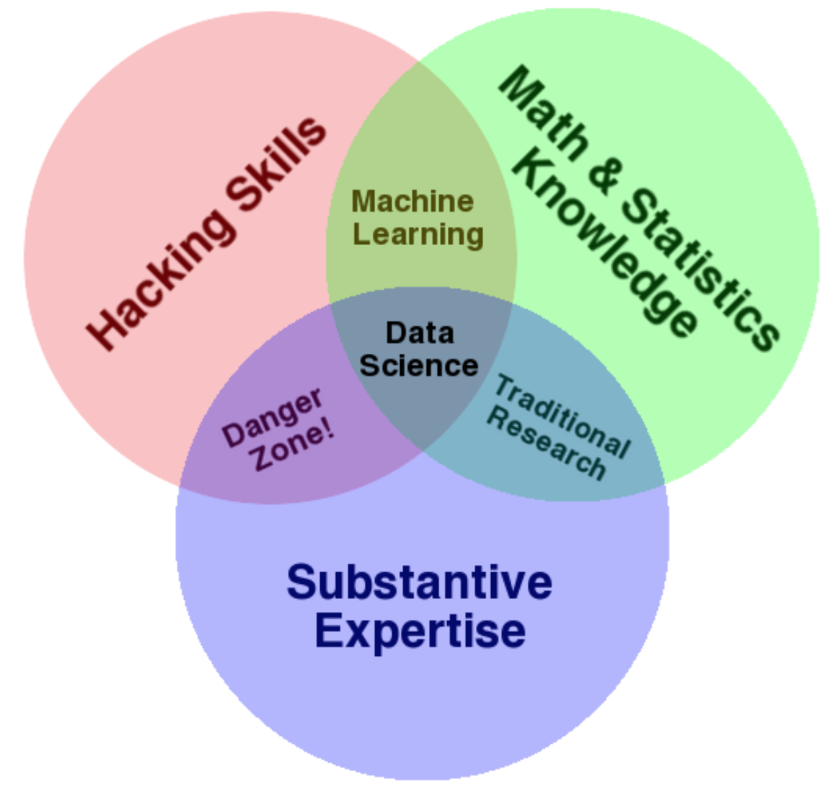
Who is a data scientist?
One definition
It’s the confluence of statistics, computer science, domain knowledge
You need all three to make this work
We’ll be talking more about stat/CS than domain expertise here
Unclear definition
Statistician
Computer scientist
Database engineer
Software engineer
Data engineer
Mathematician
Some of the best ones I know are neurobiologists and physicists
A broad umbrella
Anyone who wants to work with data to solve problems within particular domains

Slide 7
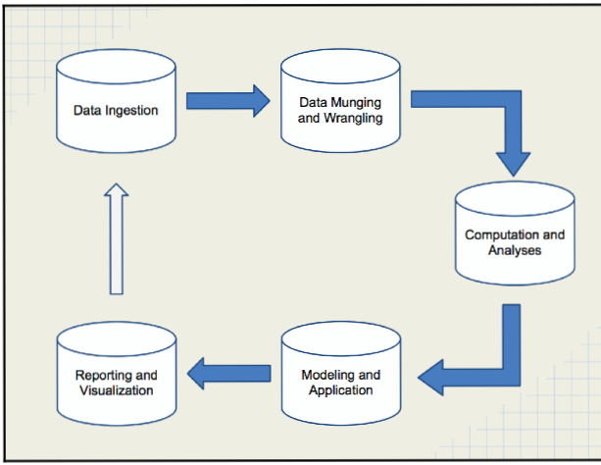
What it involves

Slide 8
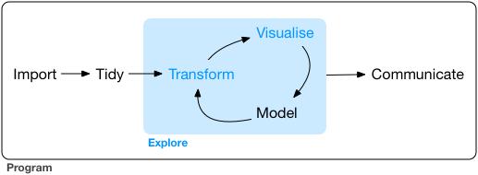
What it involves

Slide 9
What it involves
Managing and cleaning data
Interest in exploring relationships between things, informed by domain knowledge
Statistical know-how
Computational skills
Tools

Slide 10
We’re here for the tools
The main two tools are
Python (https://www.python.org)
R (https://www.r-project.org)
There is a perpetual flame war between the two camps
That is not important

Slide 11
Why Python?

Slide 12
Pros
Very popular general purpose programming language
Strong ecosystem through packages (over 230K projects)
Succint syntax
Reasonably fast while also relatively easy to program
Computational time vs Developer time
Self-documenting
Easier to integrate into production pipelines that already use Python
Web frameworks (Django, Flask, …)
Workflow managers (Luigi, …)
Increasingly strong Data Science Stack

Slide 13
Cons
Not a rich-enough ecosystem for some purposes
More computer science-y, less statistical
Poorer frameworks for display and dissemination of information
These are areas where R tends to shine.

Slide 14
Python data science stack

Slide 15
Contributed packages over past 30 years
To emulate Matlab
Numpy
Scipy
Matplotlib
To emulate Maple
Sympy
To add statistics/data science
Pandas
Various data visualization packages
seaborn
plotly
Many more user-contributed packages

Slide 16
The basic philosophy has been to concentrate on a few monolithic comprehensive packages
statsmodels (Statistics)
scikit-learn (Machine Learning)
pillow (Image analysis)
nltk (Natural Language Processing)
tensorflow & PyTorch (Deep learning)
PyMC3 (Bayesian learning)

Slide 17
Many more user-contributed packages
The basic philosophy has been to concentrate on a few monolithic comprehensive packages
statsmodels (Statistics)
scikit-learn (Machine Learning)
pillow (Image analysis)
nltk (Natural Language Processing)
tensorflow & PyTorch (Deep learning)
PyMC3 (Bayesian learning)

Slide 18
Python as glue

Slide 19
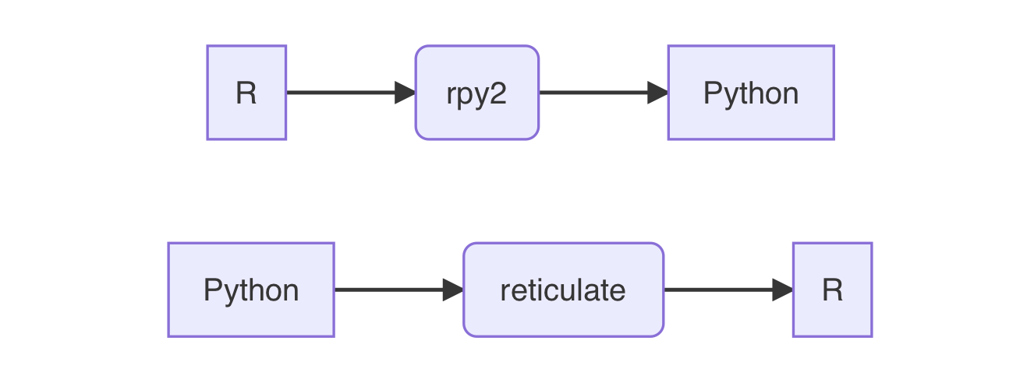
The rpy2 Python package is not developed on Windows
The reticulate R package actually works quite well

Slide 20
Data I/O
We can read data from a variety of formats into Python
Some proprietary
R, SAS, Stata, SQL, Parquet, JSON
There are ways of running R, SAS, others from within Python
The Jupyter sub-ecosystem allows the same interface for many languages
R, SAS, Julia, Haskell, Javascript

Slide 21
A Python Primer

Slide 22
Python is a popular, general purpose scripting language. The TIOBE index ranks Python as the third most popular programming language after C and Java, while this recent article in IEEE Computer Society says
“Python can be used for web and desktop applications, GUI-based desktop applications, machine learning, data science, and network servers. The programming language enjoys immense community support and offers several open-source libraries, frameworks, and modules that make application development a cakewalk.” (Belani, 2020)

Slide 23
Python is a modular language
Python is not a monolithic language but is comprised of
a base programming language
numerous modules or libraries that add functionality to the language.

Slide 24
Python is a scripting language
Using Python requires typing!!
You write code in Python
that is then interpreted by the Python interpreter
to make the computer implement your instructions.

Slide 25
Your code is like a recipe that you write for the computer.
Python is a high-level language in that the code is English-like and human-readable and understandable, which reduces the time needed for a person to create the recipe.
It is a language in that it has nouns (variables or objects), verbs (functions) and a structure or grammar that allows the programmer to write recipes for different functionalities.

Slide 26
Scripting can be frustrating in the beginning. You will find that the code you wrote doesn’t work “for some reason”, though it looks like you wrote it fine. The first things I look for, in order, are
One thing that is important to note in Python: case is important!. If we have two objects named data and Data, they will refer to different things.
Did I spell all the variables and functions correctly
Did I close all the brackets I have opened
Did I finish all the quotes I started, and paired single- and double-quotes
Did I already import the right module for the function I’m trying to use.
Do I have the right indentations in my code.
These may not make sense right now, but as we go into Python, I hope you will remember these to help debug your code.

Slide 27
An example
Let’s consider the following piece of Python code:
# set a splitting point split_point = 3 # make two empty lists lower = []; upper = [] # Split numbers from 0 to 9 into two groups, # one lower or equal to the split point and # one higher than the split point for i in range(10): # count from 0 to 9 if i <= split_point: lower.append(i) else: upper.append(i) print("lower:", lower)
print("upper:", upper)

Slide 28
split_point = 3
This takes the number 3 and stores it in the variable split_point.
Variables are just names where some Python object is stored. It really works as an address to some particular part of your computer’s memory, telling the Python interpreter to look for the value stored at that particular part of memory. Variable names allow your code to be human-readable since it allows you to write expressive names to remind yourself what you are storing.
The rules of variable names are:
Variable names must start with a letter or underscore
The rest of the name can have letters, numbers or underscores
Names are case-sensitive

Slide 29
The next piece of code initializes two lists, named lower and upper.
lower = []; upper = []
The semi-colon tells Python that, even though written on the same line, a particular instruction ends at the semi-colon, then another piece of instruction is written.
Lists are a catch-all data structure that can store different kinds of things, In this case we’ll use them to store numbers.

Slide 30
for i in range(10): # count from 0 to 9 if i <= split_point: lower.append(i) else: upper.append(i)
This is a for-loop.
State with the numbers 0-9 (this is achieved in range(10))
Loop through each number, naming it i each time
Computer programs allow you to over-write a variable with a new value
If the number currently stored in i is less than or equal to the value of split_point, i.e., 3 then add it to the list lower. Otherwise add it to the list upper

Slide 31
for i in range(10): # count from 0 to 9 if i <= split_point: lower.append(i) else: upper.append(i)
Note the indentation in the code. This is not by accident. Python understands the extent of a particular block of code within a for-loop (or within a if statement) using the indentations.
In this segment there are 3 code blocks:
The for-loop as a whole (1st indentation)
The if statement testing if the number is less than or equal to the split point, telling Python what to do if the test is true
The else statement stating what to do if the test in the if statement is false

Slide 32
The last bit of code prints out the results
print("lower:", lower)
print("upper:", upper)
The print statement adds some text, and then prints out a representation of the object stored in the variable being printed. In this example, this is a list, and is printed as
lower: [0, 1, 2, 3] upper: [4, 5, 6, 7, 8, 9]
We will expand on these concepts in the next few sections.

Slide 33
Some general rules on Python syntax
Comments are marked by #
A statement is terminated by the end of a line, or by a ;.
Indentation specifies blocks of code within particular structures. Whitespace at the beginning of lines matters. Typically you want to have 2 or 4 spaces to specify indentation, not a tab ( character. This can be set up in your IDE.
Whitespace within lines does not matter, so you can use spaces liberally to make your code more readable
Parentheses (()) are for grouping pieces of code or for calling functions.

Slide 34
Data types
Numbers
Floats (decimal numbers) : float
Integers : int
Operation | Result
x + y | The sum of x and y
x - y | The difference of x and y
x * y | The product of x and y
x / y | The quotient of x and y
- x | The negative of x
abs(x) | The absolute value of x
x ** y | x raised to the power y
int(x) | Convert a number to integer
float(x) | Convert a number to floating point

Slide 35
x = 3; y = 5 (2*x) - (5 * y**2)
-119

Slide 36
strings
first_name = 'Abhijit' last_name = "Dasgupta" 'jit' in last_name
False

Slide 37
String operations
first_name + last_name
'AbhijitDasgupta’
first_name*3
'AbhijitAbhijitAbhijit’
"gup" in last_name
True

Slide 38
truthiness
Truthiness means evaluating the truth of a statement. This typically results in a Boolean object, which can take values True and False, but Python has several equivalent representations. The following values are considered the same as False:
None, False, zero (0, 0L, 0.0), any empty sequence ([], '', ()), and a few others
All other values are considered True. Usually, we’ll denote truth by True and the number 1.

Slide 39
Operation | Result
x < y | x is strictly less than y
x <= y | x is less than or equal to y
x == y | x equals y (note, it’s 2 = signs)
x != y | x is not equal to y
x > y | x is strictly greater than y
x >= y | x is greater or equal to y

Slide 40
We can chain these comparisons using Boolean operations
Operation | Result
x | y | Either x is true or y is true or both
x & y | Both x and y are true
not x | if x is true, then false, and vice versa
x = 5 (x < 3) | (x <= 7)
True

Slide 41
Variables are like individual ingredients in your recipe. It’s mis en place or setting the table for any operations (functions) we want to do to them.
Variables are like nouns,
which will be acted on by verbs (functions).
In the next section we’ll look at collections of variables. These collections are important in that it allows us to organize our variables with some structure.

Slide 42
Data Structures

Slide 43
Data structures
Lists ([])
Tuples (())
Dictionaries or dicts ({})

Slide 44
Lists are baskets that can contain different kinds of things. They are ordered, so that there is a first element, and a second element, and a last element, in order. However, the kinds of things in a single list doesn’t have to be the same type.
Tuples are basically like lists, except that they are immutable, i.e., once they are created, individual values can’t be changed. They are also ordered, so there is a first element, a second element and so on.
Dictionaries are unordered key-value pairs, which are very fast for looking up things. They work almost like hash tables. Dictionaries will be very useful to us as we progress towards the PyData stack. Elements need to be referred to by key, not by position.

Slide 45
test_list = ["apple", 3, True, "Harvey", 48205] test_tuple = ("apple", 3, True, "Harvey", 48205) test_list[0]
'apple'

Slide 46
index | 0 | 1 | 2 | 3 | 4
element | ‘apple’ | 3 | True | ‘Harvey’ | 48205
counting backwards | -5 | -4 | -3 | -2 | -1

Slide 47
contact = { "first_name": "Abhijit", "last_name": "Dasgupta", "Age": 48, "address": "124 Main St", "Employed": True, }

Slide 48
contact['first_name’]
'Abhijit’
contact['address’]
'124 Main St’
contact.keys()
dict_keys(['first_name', 'last_name’,
'Age', 'address', 'Employed’])
contact.values()
dict_values(['Abhijit', 'Dasgupta', 48, '124 Main St', True])

Slide 49
Operations

Slide 50
Loops
Pseudocode
Start with a list of datasets, one for each state for each state compute and store fraction of votes that are Republican compute and store fraction of votes that are Democratic

Slide 51
for i in range(len(test_list)): print(test_list[i])
apple 3 True Harvey 48205
for u in test_list: print(u)
apple 3 True Harvey 48205
test_list2 = [1, 2, 3, 4, 5, 6, 7, 8, 9, 10] mysum = 0 for u in test_list2: mysum = mysum + u print(mysum)
55

Slide 52
enumerate automatically creates both the index and the value for each element of a list.
L = [0, 2, 4, 6, 8] for i, val in enumerate(L): print(i, val)
0 0 1 2 2 4 3 6 4 8

Slide 53
zip puts multiple lists together and creates a composite iterator. You can have any number of iterators in zip, and the length of the result is determined by the length of the shortest iterator.
first = ["Han", "Luke", "Leia", "Anakin"] last = ["Solo", "Skywalker", "Skywaker", "Skywalker"] types = ['light','light','light','light/dark/light'] for val1, val2, val3 in zip(first, last, types): print(val1, val2, ' : ', val3)
Han Solo : light Luke Skywalker : light Leia Skywaker : light Anakin Skywalker : light/dark/light

Slide 54
List comprehensions
test_list2 = [1,2,3,4,5,6] squares = [u**2 for u in test_list2] squares
[1, 4, 9, 16, 25, 36]

Slide 55
Conditional evaluation
if Condition 1 is true then do Recipe 1 else if (elif) Condition 2 is true then do Recipe 2 else do Recipe 3

Slide 56
x = [-2, -1, 0, 1, 2, 3, 4, 5, 6, 7, 8, 9, 10] y = [] # an empty list for u in x: if u < 0: y.append("Negative") elif u % 2 == 1: # what is remainder when dividing by 2 y.append("Odd") else: y.append("Even") print(y)
['Negative', 'Negative', 'Even', 'Odd', 'Even', 'Odd', 'Even', 'Odd', 'Even', 'Odd', 'Even', 'Odd', 'Even']

Slide 57
Functions
def my_mean(x): y = 0 for u in x: y += u y = y / len(x) return y

Slide 58
A Python function must start with the keyword def followed by the name of the function, the arguments within parentheses, and then a colon. The actual code for the function is indented, just like in for-loops and if-elif-else structures. It ends with a return function which specifies the output of the function.
def my_mean(x): """ A function to compute the mean of a list of numbers. INPUTS: x : a list containing numbers OUTPUT: The arithmetic mean of the list of numbers """ y = 0 for u in x: y = y + u y = y / len(x) return y
help(my_mean)
Help on function my_mean in module __main__: my_mean(x) A function to compute the mean of a list of numbers. INPUTS: x : a list containing numbers OUTPUT: The arithmetic mean of the list of numbers

Slide 59
Pandas (Python Data Analysis)

Slide 60
Data ingestion
Data cleaning and transformation
Data can be passed on to modeling and visualization packages

Slide 61
Activating packages for use
Use the import command
Maybe provide an alias for the package
import numpy as np import pandas as pd

Slide 62
Data import
Format type | Description | reader | writer
text | CSV | read_csv | to_csv
 | Excel | read_excel | to_excel
text | JSON | read_json | to_json
binary | Feather | read_feather | to_feather
binary | SAS | read_sas
SQL | SQL | read_sql | to_sql

Slide 63
mtcars = pd.read_csv('data/mtcars.csv')
One of the big differences between a spreadsheet program and a programming language from the data science perspective is that you have to load data into the programming language. It’s not “just there” like Excel. This is a good thing, since it allows the common functionality of the programming language to work across multiple data sets, and also keeps the original data set pristine. Excel users can run into problems and corrupt their data if they are not careful.

Slide 64
Exploring data

Slide 65
Creating a DataFrame

Slide 66
rng = np.random.RandomState(25) d2 = pd.DataFrame(rng.normal(0,1, (4, 5)), columns = ['A','B','C','D','E'], index = ['a','b','c','d']) d2
A B C D E a 0.228273 1.026890 -0.839585 -0.591182 -0.956888 b -0.222326 -0.619915 1.837905 -2.053231 0.868583 c -0.920734 -0.232312 2.152957 -1.334661 0.076380 d -1.246089 1.202272 -1.049942 1.056610 -0.419678
A DataFrame has (mutable)
An index (row names)
A column (column names)‘
d2.columns
Index(['A', 'B', 'C', 'D', 'E'], dtype='object')
d2.index
Index(['a', 'b', 'c', 'd'], dtype='object')

Slide 67
df = pd.DataFrame({ 'A':3., 'B':rng.random_sample(5), 'C': pd.Timestamp('20200512'), 'D': np.array([6] * 5), 'E': pd.Categorical(['yes','no','no','yes','no']), 'F': 'NIH'}) df
A B C D E F 0 3.0 0.481343 2020-05-12 6 yes NIH 1 3.0 0.516502 2020-05-12 6 no NIH 2 3.0 0.383048 2020-05-12 6 no NIH 3 3.0 0.997541 2020-05-12 6 yes NIH 4 3.0 0.514244 2020-05-12 6 no NIH
You can also use a dict to create a DataFrame. If elements aren’t of the same size, errors will be thrown, unless it is a single element. Then it will be repeated.

Slide 68
Slicing and dicing a DataFrame
df['B']
0 0.481343 1 0.516502 2 0.383048 3 0.997541 4 0.514244 Name: B, dtype: float64
df.B
0 0.481343 1 0.516502 2 0.383048 3 0.997541 4 0.514244 Name: B, dtype: float64

Slide 69
There are two extractor functions in pandas:
loc extracts by label (index label, column label, slice of labels, etc.
iloc extracts by index (integers, slice objects, etc.
df.loc[1:3, 'C']
1 2020-05-12 2 2020-05-12 3 2020-05-12 Name: C, dtype: datetime64[ns]

Slide 70
You can also extract rows by condition (filter)
df = pd.DataFrame(np.random.randn(5, 3), index = ['a','c','e', 'f','g'], columns = ['one','two','three']) # pre-specify index and column names df['four'] = 20 # add a column named "four", which will all be 20 df['five'] = df['one'] > 0 df
one two three four five a -1.286215 0.093702 1.623661 20 False c 1.353548 0.401061 -0.092705 20 True e 0.133152 0.911319 1.837882 20 True f -0.179330 -0.523315 1.288316 20 False g -0.202790 0.711928 0.614842 20 False
df[(df.one > 1) & (df.three < 0)]
one two three four five c 1.353548 0.401061 -0.092705 20 True

Slide 71
Replacing values

Slide 72
#df2.replace(0, -9) # replace 0 with -9 df.replace({'one': {5: 500}, 'three':{0:-9, 8:800}})
one two three four five a -1.286215 0.093702 1.623661 20 False c 1.353548 0.401061 -0.092705 20 True e 0.133152 0.911319 1.837882 20 True f -0.179330 -0.523315 1.288316 20 False g -0.202790 0.711928 0.614842 20 False

Slide 73
Joins
There are basically four kinds of joins
pandas | R | SQL | Description
left | left_join | left outer | keep all rows on left
right | right_join | right outer | keep all rows on right
outer | outer_join | full outer | keep all rows from both
inner | inner_join | inner | keep only rows with common keys

Slide 74
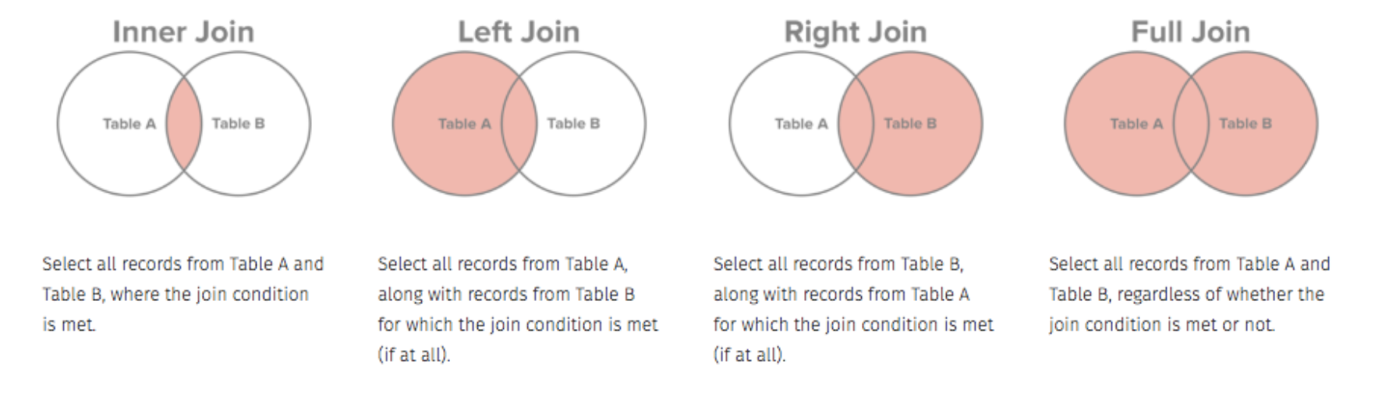
Joins

Slide 75
survey = pd.read_csv('data/survey_survey.csv') visited = pd.read_csv('data/survey_visited.csv')

Slide 76
pd.merge(survey, visited, left_on = 'taken’, right_on = 'ident', how = 'left') # survey.merge(visited, left_on = 'taken', right_on = 'ident', how = 'left')
taken person quant reading ident site dated 0 619 dyer rad 9.82 619 DR-1 1927-02-08 1 619 dyer sal 0.13 619 DR-1 1927-02-08 2 622 dyer rad 7.80 622 DR-1 1927-02-10 3 622 dyer sal 0.09 622 DR-1 1927-02-10 4 734 pb rad 8.41 734 DR-3 1939-01-07 5 734 lake sal 0.05 734 DR-3 1939-01-07 6 734 pb temp -21.50 734 DR-3 1939-01-07 7 735 pb rad 7.22 735 DR-3 1930-01-12 8 735 NaN sal 0.06 735 DR-3 1930-01-12 9 735 NaN temp -26.00 735 DR-3 1930-01-12 10 751 pb rad 4.35 751 DR-3 1930-02-26 11 751 pb temp -18.50 751 DR-3 1930-02-26 12 751 lake sal 0.10 751 DR-3 1930-02-26 13 752 lake rad 2.19 752 DR-3 NaN 14 752 lake sal 0.09 752 DR-3 NaN 15 752 lake temp -16.00 752 DR-3 NaN 16 752 roe sal 41.60 752 DR-3 NaN 17 837 lake rad 1.46 837 MSK-4 1932-01-14 18 837 lake sal 0.21 837 MSK-4 1932-01-14 19 837 roe sal 22.50 837 MSK-4 1932-01-14 20 844 roe rad 11.25 844 DR-1 1932-03-22

Slide 77
Here, the left dataset is survey and the right one is visited.
Since we’re doing a left join, we keed all the rows from survey and add columns from visited, matching on the common key, called “taken” in one dataset and “ident” in the other.
Note that the rows of visited are repeated as needed to line up with all the rows with common “taken” values.

Slide 78
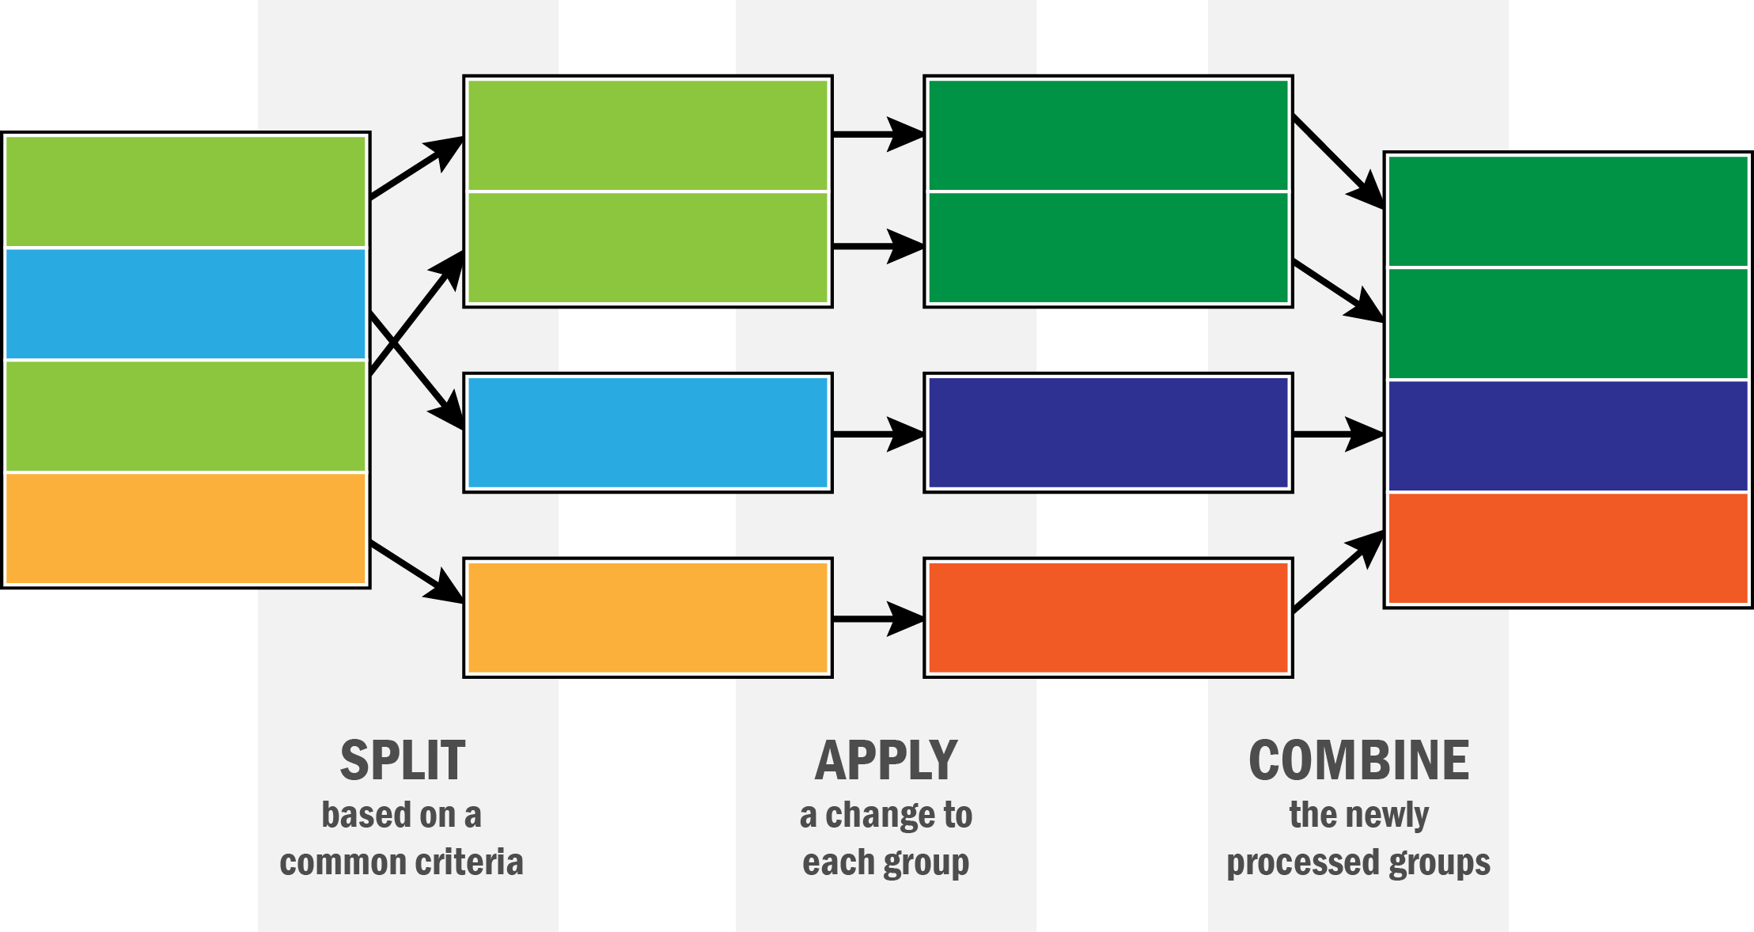
Data aggregation and split-apply-combine

Slide 79
gapminder = pd.read_csv('data/gapminder.tsv’, sep = '\t') gapminder.head()
country continent year lifeExp pop gdpPercap 0 Afghanistan Asia 1952 28.801 8425333 779.445314 1 Afghanistan Asia 1957 30.332 9240934 820.853030 2 Afghanistan Asia 1962 31.997 10267083 853.100710 3 Afghanistan Asia 1967 34.020 11537966 836.197138 4 Afghanistan Asia 1972 36.088 13079460 739.981106

Slide 80
gapminder.groupby('country')['lifeExp'].mean()
country Afghanistan 37.478833 Albania 68.432917 Algeria 59.030167 Angola 37.883500 Argentina 69.060417 ... Vietnam 57.479500 West Bank and Gaza 60.328667 Yemen, Rep. 46.780417 Zambia 45.996333 Zimbabwe 52.663167 Name: lifeExp, Length: 142, dtype: float64

Slide 81
gapminder.groupby('country').get_group('United Kingdom’)
country continent year lifeExp pop gdpPercap 1596 United Kingdom Europe 1952 69.180 50430000 9979.508487 1597 United Kingdom Europe 1957 70.420 51430000 11283.177950 1598 United Kingdom Europe 1962 70.760 53292000 12477.177070 1599 United Kingdom Europe 1967 71.360 54959000 14142.850890 1600 United Kingdom Europe 1972 72.010 56079000 15895.116410 1601 United Kingdom Europe 1977 72.760 56179000 17428.748460 1602 United Kingdom Europe 1982 74.040 56339704 18232.424520 1603 United Kingdom Europe 1987 75.007 56981620 21664.787670 1604 United Kingdom Europe 1992 76.420 57866349 22705.092540 1605 United Kingdom Europe 1997 77.218 58808266 26074.531360 1606 United Kingdom Europe 2002 78.471 59912431 29478.999190 1607 United Kingdom Europe 2007 79.425 60776238 33203.261280

Slide 82
gapminder.groupby('continent').lifeExp.agg(np.median) # Medians
continent Africa 47.7920 Americas 67.0480 Asia 61.7915 Europe 72.2410 Oceania 73.6650 Name: lifeExp, dtype: float64

Slide 83
gapminder.groupby('year').agg({ 'lifeExp': np.mean, 'pop': np.median, 'gdpPercap':np.median}).reset_index()
year lifeExp pop gdpPercap 0 1952 49.057620 3943953.0 1968.528344 1 1957 51.507401 4282942.0 2173.220291 2 1962 53.609249 4686039.5 2335.439533 3 1967 55.678290 5170175.5 2678.334740 4 1972 57.647386 5877996.5 3339.129407 5 1977 59.570157 6404036.5 3798.609244 6 1982 61.533197 7007320.0 4216.228428 7 1987 63.212613 7774861.5 4280.300366 8 1992 64.160338 8688686.5 4386.085502 9 1997 65.014676 9735063.5 4781.825478 10 2002 65.694923 10372918.5 5319.804524 11 2007 67.007423 10517531.0 6124.371108

