Slide 1
Loops
Pseudocode
Start with a list of datasets, one for each state for each state compute and store fraction of votes that are Republican compute and store fraction of votes that are Democratic

Slide 2
for i in range(len(test_list)): print(test_list[i])
apple 3 True Harvey 48205
for u in test_list: print(u)
apple 3 True Harvey 48205
test_list2 = [1, 2, 3, 4, 5, 6, 7, 8, 9, 10] mysum = 0 for u in test_list2: mysum = mysum + u print(mysum)
55

Slide 3
enumerate automatically creates both the index and the value for each element of a list.
L = [0, 2, 4, 6, 8] for i, val in enumerate(L): print(i, val)
0 0 1 2 2 4 3 6 4 8

Slide 4
zip puts multiple lists together and creates a composite iterator. You can have any number of iterators in zip, and the length of the result is determined by the length of the shortest iterator.
first = ["Han", "Luke", "Leia", "Anakin"] last = ["Solo", "Skywalker", "Skywaker", "Skywalker"] types = ['light','light','light','light/dark/light'] for val1, val2, val3 in zip(first, last, types): print(val1, val2, ' : ', val3)
Han Solo : light Luke Skywalker : light Leia Skywaker : light Anakin Skywalker : light/dark/light

Slide 5
List comprehensions
test_list2 = [1,2,3,4,5,6] squares = [u**2 for u in test_list2] squares
[1, 4, 9, 16, 25, 36]

Slide 6
Conditional evaluation
if Condition 1 is true then do Recipe 1 else if (elif) Condition 2 is true then do Recipe 2 else do Recipe 3

Slide 7
x = [-2, -1, 0, 1, 2, 3, 4, 5, 6, 7, 8, 9, 10] y = [] # an empty list for u in x: if u < 0: y.append("Negative") elif u % 2 == 1: # what is remainder when dividing by 2 y.append("Odd") else: y.append("Even") print(y)
['Negative', 'Negative', 'Even', 'Odd', 'Even', 'Odd', 'Even', 'Odd', 'Even', 'Odd', 'Even', 'Odd', 'Even']

Slide 8
Functions
def my_mean(x): y = 0 for u in x: y += u y = y / len(x) return y

Slide 9
A Python function must start with the keyword def followed by the name of the function, the arguments within parentheses, and then a colon. The actual code for the function is indented, just like in for-loops and if-elif-else structures. It ends with a return function which specifies the output of the function.
def my_mean(x): """ A function to compute the mean of a list of numbers. INPUTS: x : a list containing numbers OUTPUT: The arithmetic mean of the list of numbers """ y = 0 for u in x: y = y + u y = y / len(x) return y
help(my_mean)
Help on function my_mean in module __main__: my_mean(x) A function to compute the mean of a list of numbers. INPUTS: x : a list containing numbers OUTPUT: The arithmetic mean of the list of numbers

Slide 10
Pandas (Python Data Analysis)

Slide 11
Data ingestion
Data cleaning and transformation
Data can be passed on to modeling and visualization packages

Slide 12
Activating packages for use
Use the import command
Maybe provide an alias for the package
import numpy as np import pandas as pd

Slide 13
Data import
Format type | Description | reader | writer
text | CSV | read_csv | to_csv
 | Excel | read_excel | to_excel
text | JSON | read_json | to_json
binary | Feather | read_feather | to_feather
binary | SAS | read_sas
SQL | SQL | read_sql | to_sql

Slide 14
mtcars = pd.read_csv('data/mtcars.csv')
One of the big differences between a spreadsheet program and a programming language from the data science perspective is that you have to load data into the programming language. It’s not “just there” like Excel. This is a good thing, since it allows the common functionality of the programming language to work across multiple data sets, and also keeps the original data set pristine. Excel users can run into problems and corrupt their data if they are not careful.

Slide 15
Exploring data

Slide 16
Creating a DataFrame

Slide 17
rng = np.random.RandomState(25) d2 = pd.DataFrame(rng.normal(0,1, (4, 5)), columns = ['A','B','C','D','E'], index = ['a','b','c','d']) d2
A B C D E a 0.228273 1.026890 -0.839585 -0.591182 -0.956888 b -0.222326 -0.619915 1.837905 -2.053231 0.868583 c -0.920734 -0.232312 2.152957 -1.334661 0.076380 d -1.246089 1.202272 -1.049942 1.056610 -0.419678
A DataFrame has (mutable)
An index (row names)
A column (column names)‘
d2.columns
Index(['A', 'B', 'C', 'D', 'E'], dtype='object')
d2.index
Index(['a', 'b', 'c', 'd'], dtype='object')

Slide 18
df = pd.DataFrame({ 'A':3., 'B':rng.random_sample(5), 'C': pd.Timestamp('20200512'), 'D': np.array([6] * 5), 'E': pd.Categorical(['yes','no','no','yes','no']), 'F': 'NIH'}) df
A B C D E F 0 3.0 0.481343 2020-05-12 6 yes NIH 1 3.0 0.516502 2020-05-12 6 no NIH 2 3.0 0.383048 2020-05-12 6 no NIH 3 3.0 0.997541 2020-05-12 6 yes NIH 4 3.0 0.514244 2020-05-12 6 no NIH
You can also use a dict to create a DataFrame. If elements aren’t of the same size, errors will be thrown, unless it is a single element. Then it will be repeated.

Slide 19
Slicing and dicing a DataFrame
df['B']
0 0.481343 1 0.516502 2 0.383048 3 0.997541 4 0.514244 Name: B, dtype: float64
df.B
0 0.481343 1 0.516502 2 0.383048 3 0.997541 4 0.514244 Name: B, dtype: float64

Slide 20
There are two extractor functions in pandas:
loc extracts by label (index label, column label, slice of labels, etc.
iloc extracts by index (integers, slice objects, etc.
df.loc[1:3, 'C']
1 2020-05-12 2 2020-05-12 3 2020-05-12 Name: C, dtype: datetime64[ns]

Slide 21
You can also extract rows by condition (filter)
df = pd.DataFrame(np.random.randn(5, 3), index = ['a','c','e', 'f','g'], columns = ['one','two','three']) # pre-specify index and column names df['four'] = 20 # add a column named "four", which will all be 20 df['five'] = df['one'] > 0 df
one two three four five a -1.286215 0.093702 1.623661 20 False c 1.353548 0.401061 -0.092705 20 True e 0.133152 0.911319 1.837882 20 True f -0.179330 -0.523315 1.288316 20 False g -0.202790 0.711928 0.614842 20 False
df[(df.one > 1) & (df.three < 0)]
one two three four five c 1.353548 0.401061 -0.092705 20 True

Slide 22
Replacing values

Slide 23
#df2.replace(0, -9) # replace 0 with -9 df.replace({'one': {5: 500}, 'three':{0:-9, 8:800}})
one two three four five a -1.286215 0.093702 1.623661 20 False c 1.353548 0.401061 -0.092705 20 True e 0.133152 0.911319 1.837882 20 True f -0.179330 -0.523315 1.288316 20 False g -0.202790 0.711928 0.614842 20 False

Slide 24
Joins
There are basically four kinds of joins
pandas | R | SQL | Description
left | left_join | left outer | keep all rows on left
right | right_join | right outer | keep all rows on right
outer | outer_join | full outer | keep all rows from both
inner | inner_join | inner | keep only rows with common keys

Slide 25
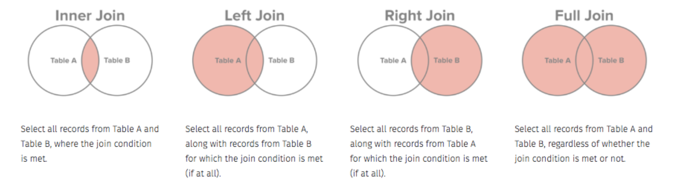
Joins

Slide 26
survey = pd.read_csv('data/survey_survey.csv') visited = pd.read_csv('data/survey_visited.csv')

Slide 27
pd.merge(survey, visited, left_on = 'taken’, right_on = 'ident', how = 'left') # survey.merge(visited, left_on = 'taken', right_on = 'ident', how = 'left')
taken person quant reading ident site dated 0 619 dyer rad 9.82 619 DR-1 1927-02-08 1 619 dyer sal 0.13 619 DR-1 1927-02-08 2 622 dyer rad 7.80 622 DR-1 1927-02-10 3 622 dyer sal 0.09 622 DR-1 1927-02-10 4 734 pb rad 8.41 734 DR-3 1939-01-07 5 734 lake sal 0.05 734 DR-3 1939-01-07 6 734 pb temp -21.50 734 DR-3 1939-01-07 7 735 pb rad 7.22 735 DR-3 1930-01-12 8 735 NaN sal 0.06 735 DR-3 1930-01-12 9 735 NaN temp -26.00 735 DR-3 1930-01-12 10 751 pb rad 4.35 751 DR-3 1930-02-26 11 751 pb temp -18.50 751 DR-3 1930-02-26 12 751 lake sal 0.10 751 DR-3 1930-02-26 13 752 lake rad 2.19 752 DR-3 NaN 14 752 lake sal 0.09 752 DR-3 NaN 15 752 lake temp -16.00 752 DR-3 NaN 16 752 roe sal 41.60 752 DR-3 NaN 17 837 lake rad 1.46 837 MSK-4 1932-01-14 18 837 lake sal 0.21 837 MSK-4 1932-01-14 19 837 roe sal 22.50 837 MSK-4 1932-01-14 20 844 roe rad 11.25 844 DR-1 1932-03-22

Slide 28
Here, the left dataset is survey and the right one is visited.
Since we’re doing a left join, we keed all the rows from survey and add columns from visited, matching on the common key, called “taken” in one dataset and “ident” in the other.
Note that the rows of visited are repeated as needed to line up with all the rows with common “taken” values.

Slide 29
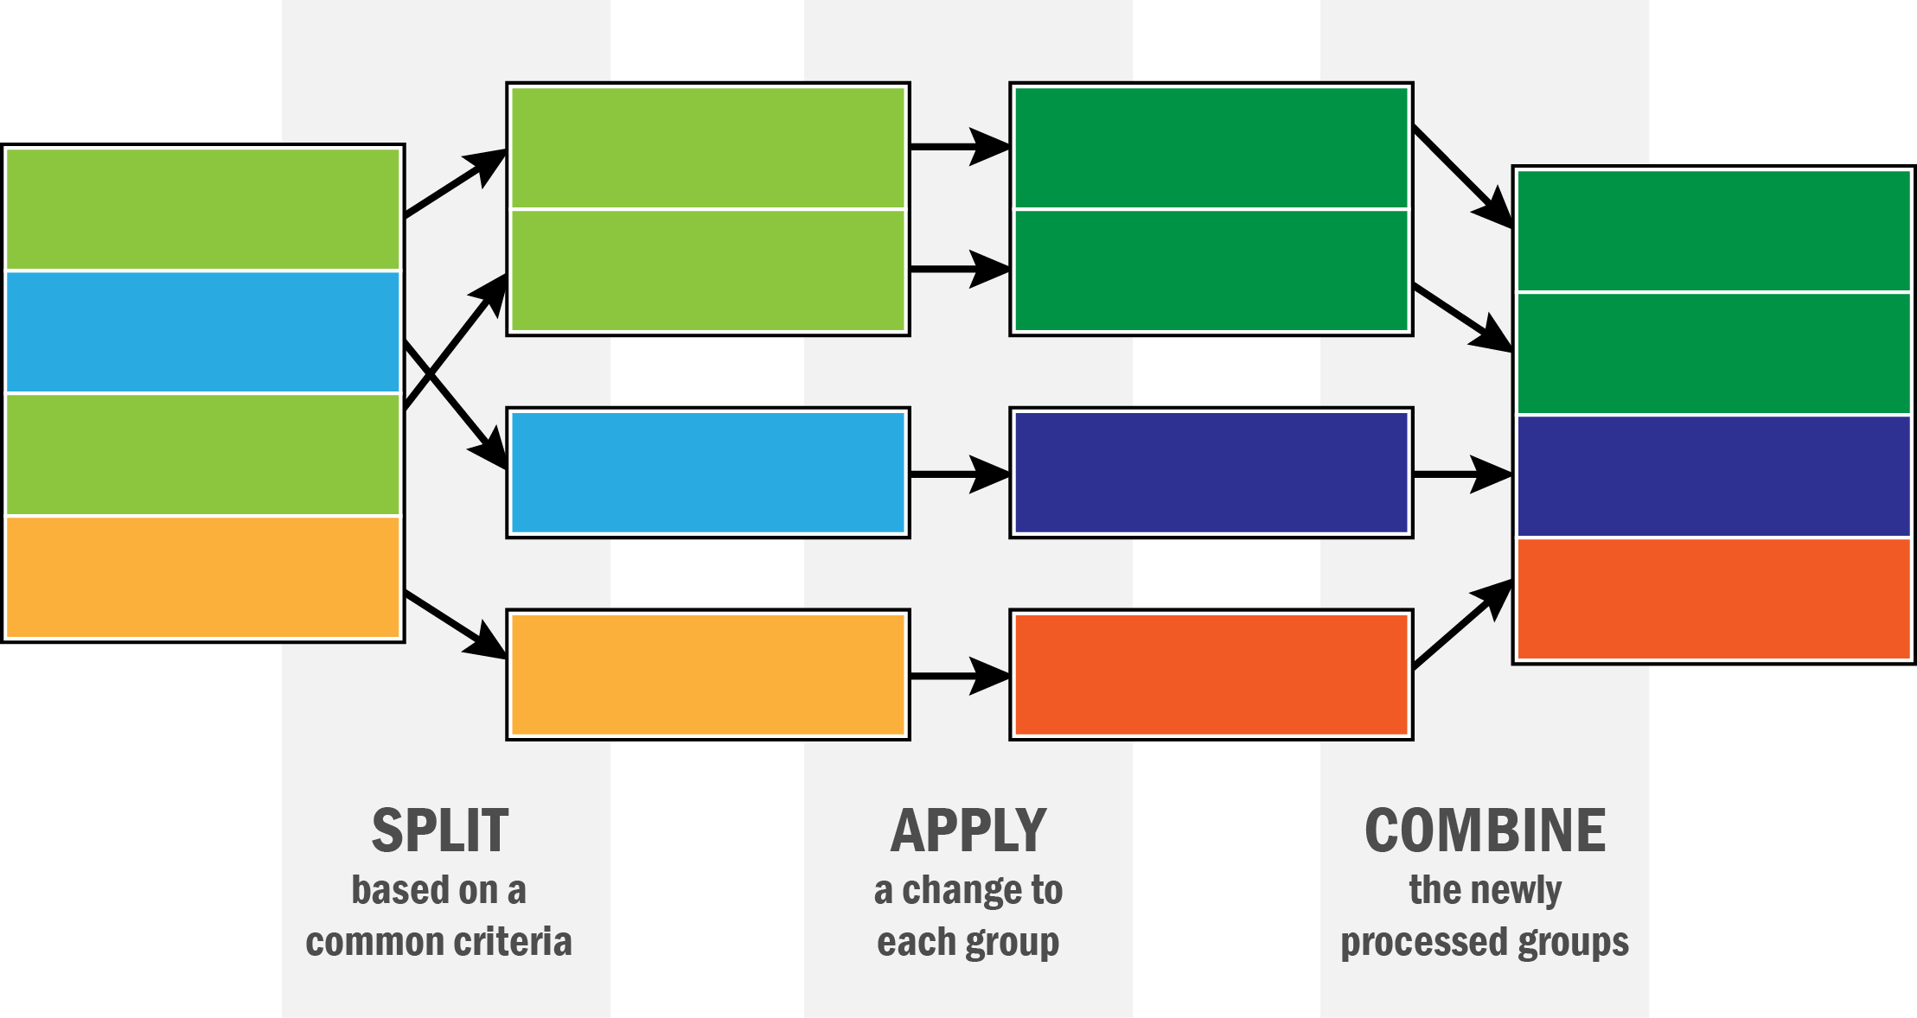
Data aggregation and split-apply-combine

Slide 30
gapminder = pd.read_csv('data/gapminder.tsv’, sep = '\t') gapminder.head()
country continent year lifeExp pop gdpPercap 0 Afghanistan Asia 1952 28.801 8425333 779.445314 1 Afghanistan Asia 1957 30.332 9240934 820.853030 2 Afghanistan Asia 1962 31.997 10267083 853.100710 3 Afghanistan Asia 1967 34.020 11537966 836.197138 4 Afghanistan Asia 1972 36.088 13079460 739.981106

Slide 31
gapminder.groupby('country')['lifeExp'].mean()
country Afghanistan 37.478833 Albania 68.432917 Algeria 59.030167 Angola 37.883500 Argentina 69.060417 ... Vietnam 57.479500 West Bank and Gaza 60.328667 Yemen, Rep. 46.780417 Zambia 45.996333 Zimbabwe 52.663167 Name: lifeExp, Length: 142, dtype: float64

Slide 32
gapminder.groupby('country').get_group('United Kingdom’)
country continent year lifeExp pop gdpPercap 1596 United Kingdom Europe 1952 69.180 50430000 9979.508487 1597 United Kingdom Europe 1957 70.420 51430000 11283.177950 1598 United Kingdom Europe 1962 70.760 53292000 12477.177070 1599 United Kingdom Europe 1967 71.360 54959000 14142.850890 1600 United Kingdom Europe 1972 72.010 56079000 15895.116410 1601 United Kingdom Europe 1977 72.760 56179000 17428.748460 1602 United Kingdom Europe 1982 74.040 56339704 18232.424520 1603 United Kingdom Europe 1987 75.007 56981620 21664.787670 1604 United Kingdom Europe 1992 76.420 57866349 22705.092540 1605 United Kingdom Europe 1997 77.218 58808266 26074.531360 1606 United Kingdom Europe 2002 78.471 59912431 29478.999190 1607 United Kingdom Europe 2007 79.425 60776238 33203.261280

Slide 33
gapminder.groupby('continent').lifeExp.agg(np.median) # Medians
continent Africa 47.7920 Americas 67.0480 Asia 61.7915 Europe 72.2410 Oceania 73.6650 Name: lifeExp, dtype: float64

Slide 34
gapminder.groupby('year').agg({ 'lifeExp': np.mean, 'pop': np.median, 'gdpPercap':np.median}).reset_index()
year lifeExp pop gdpPercap 0 1952 49.057620 3943953.0 1968.528344 1 1957 51.507401 4282942.0 2173.220291 2 1962 53.609249 4686039.5 2335.439533 3 1967 55.678290 5170175.5 2678.334740 4 1972 57.647386 5877996.5 3339.129407 5 1977 59.570157 6404036.5 3798.609244 6 1982 61.533197 7007320.0 4216.228428 7 1987 63.212613 7774861.5 4280.300366 8 1992 64.160338 8688686.5 4386.085502 9 1997 65.014676 9735063.5 4781.825478 10 2002 65.694923 10372918.5 5319.804524 11 2007 67.007423 10517531.0 6124.371108

