Slide 1
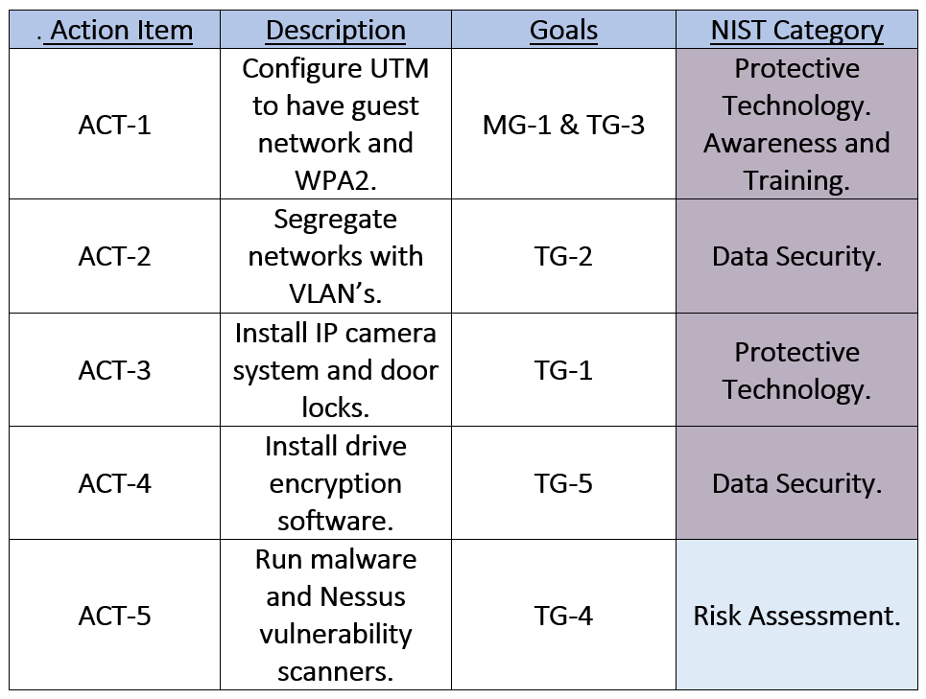
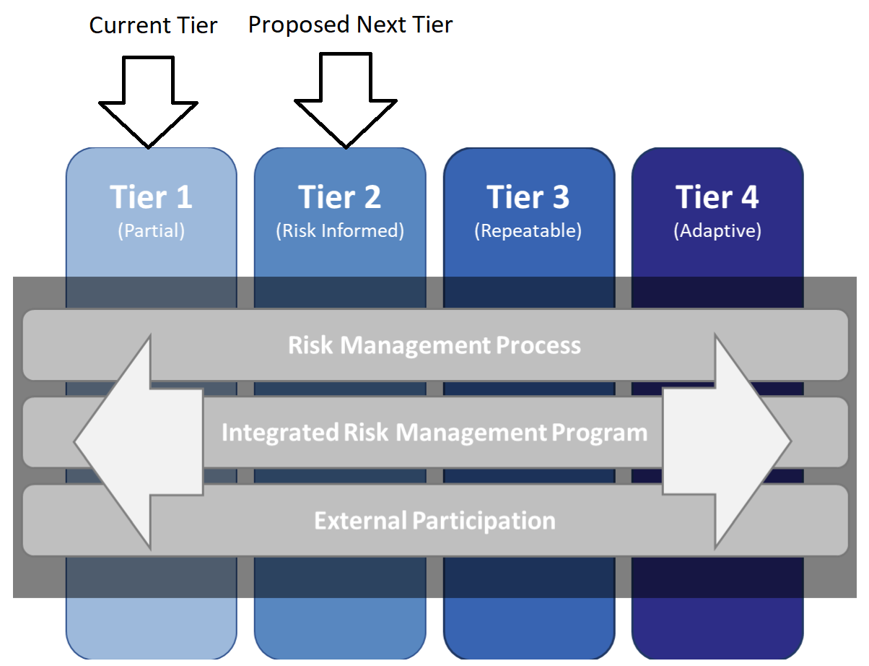
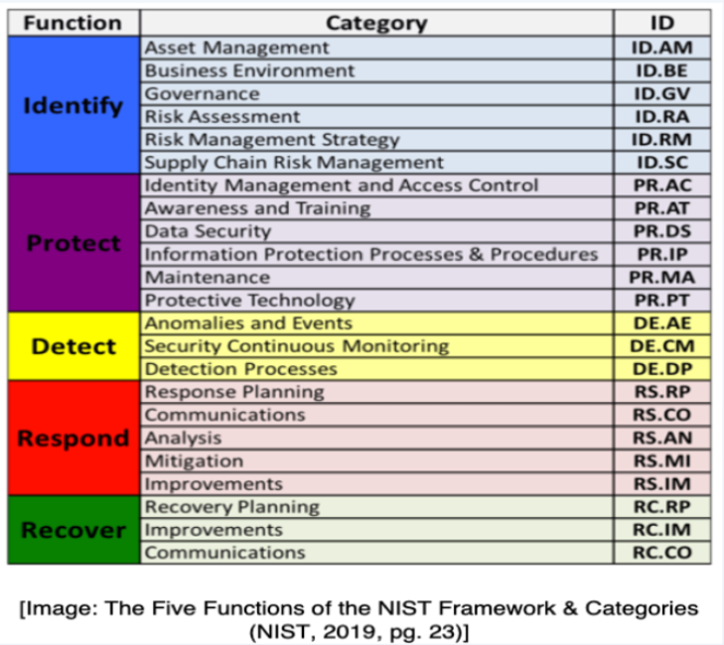
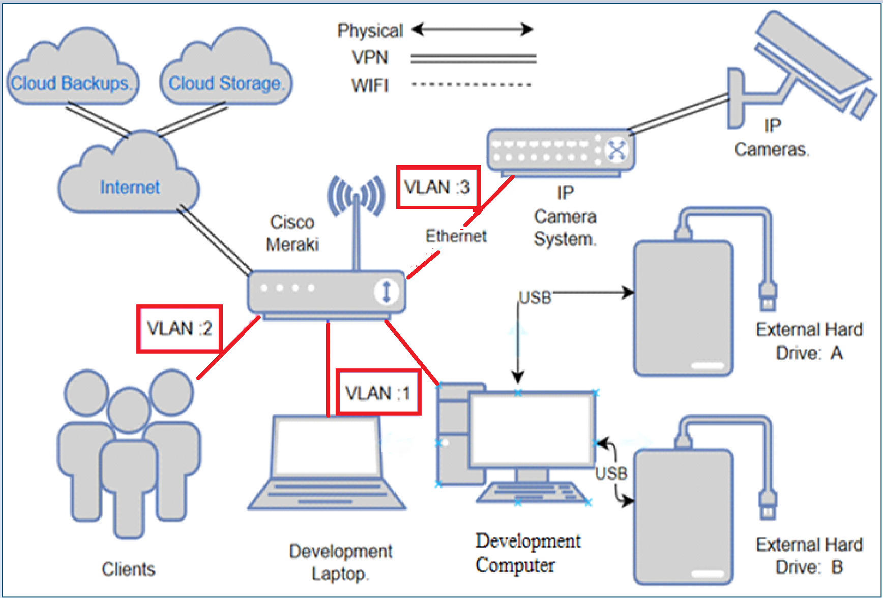
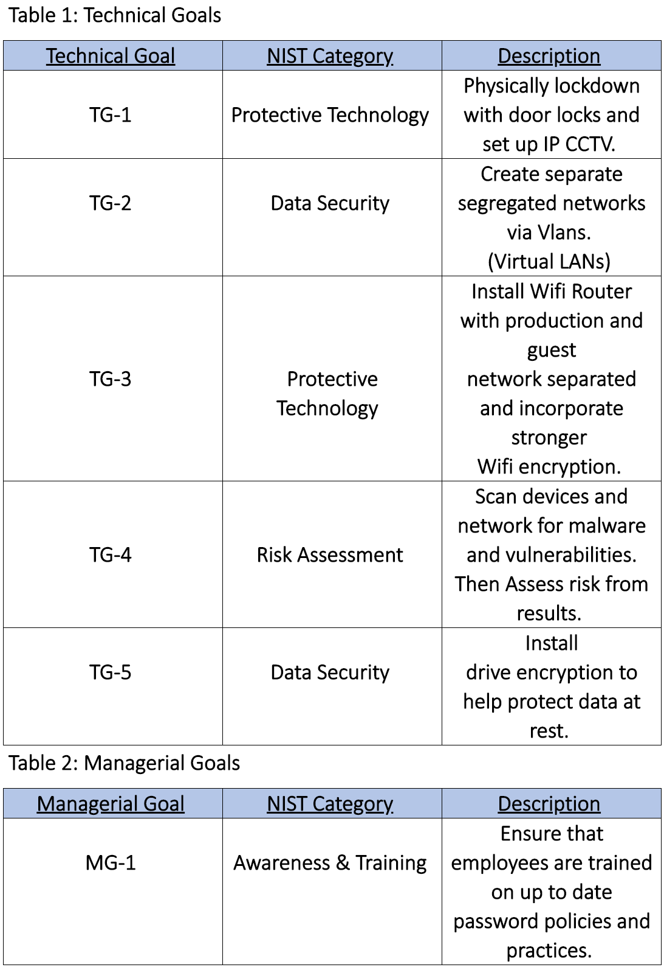
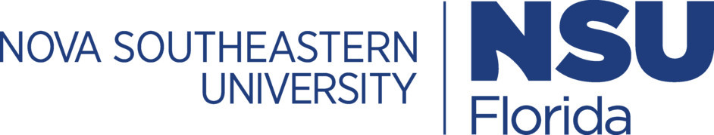
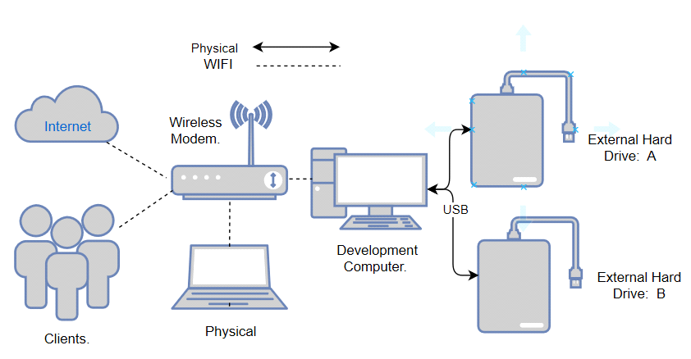
A Network hardening and data breach mitigation of an audio engineering studio Fall 2020
Team/Students: ISEC690 Team 1 | Babatunde Somade and Eric Webb | Business Advisor: Figgy, Z.| Professor: Dr. Yair Levy, Professor of IS & Cybersecurity
Introduction
Today’s business world lives off the production and manipulation of proprietary data, when information is the main product, it is imperative that it is kept safe (Leyshon, 2014). While keeping the product as secured as possible, businesses must still align themselves with best practices to mitigate risk (Jordan, 2012). Exposing company data or leaving it vulnerable to a breach could lead to a catastrophic business impact while simultaneously daunting the company's reputation. Loss of revenue and damage to reputation are some of the effects of a security breach. Gone are the days were small business were overlooked by bad actors, in fact, small business generates twice as much innovations and have more intellectual property than larger organization (Bhattacharya, 2015). This project will propose a more robust cybersecurity posture for an audio engineering company, with a focus on network security through newer technology and best practices.
Recognize and Define a Problem
For many audio engineering studio's, digital attacks are a serious risk (Leyshon, 2014). Many clients within these organizations depend on the security and privacy of their projects in order to be successful. Most audio studios are small businesses with limited resources, no dedicated skilled Information Technology (IT) staff, and basic to no security features (Bhattacharya, 2015). When compared to large businesses that have dedicated security teams, audio studios are more suspectable to data theft and network intrusion (Bhattacharya, 2015).
Organizational Facts
National Institute of Standards and Technology (NIST) Cybersecurity Framework discovered some vulnerabilities that could be easily exploited by bad actors if not properly remediated.
Physical Security Issues
Studio doors do not have locks on them. Office building door has lock but once in a perpetrator has access to recording equipment.
Production computer should be locked away. Guest/Customers should not have physical access to them.
No Security system in place to keep a record of access to the facility.
Network Security Issues
Business has a flat network for all traffic. Production network is the same as guest network, no segregation.
Guest connected to the WiFi can access the routers configuration.
Business uses WiFi Protected Access (WPA) for security.
Business does not use a Virtual Private Network (VPN) or Proxy.
No network firewall, Intrusion Detection System (IDS), or Intrusion Prevention System (IPS).
Computer Security Issues
Production computer does not encrypt proprietary data on its local machine.
Ports and Drives are not locked down from external hardware.
Operation Security Issues
Client only pushes backups to 3rd party but can only use as a restore point, cannot reference live data remotely. Can’t access data in a flash in case of an emergency.
Project Scopes and Goals
Recommended Action Plan
Risk Management Analysis (RMA)
Anticipated Results
Create segregated networks between production, guest, and IP camera system environments.
This increases security and mitigates guest accessing the production network or Closed Caption TV (CCTV) network.
Increase Security from WPA to WPA2
This increases security because WPA is relatively weak and can be cracked by a brute force attack. WiFi Protected Access 2 (WPA2) increases the WiFi security posture.
Increase Security for Communication to Outside World
This is done through the VPN and Proxying capabilities of the Meraki network appliance. This reduces the risk of eavesdropping and using the Proxy will mask the packets hops out to the world.
Data Encrypted on Local Machine
This also reduces the risk of data theft, if a bad actor were able to gain access to the computer. The files are encrypted and will be harder to retrieve without the decryption key.
Proposed Costs
Conclusion
This project focus was to harden the network and raise the cybersecurity posture of an audio engineering facility. Since there was little to no cybersecurity coordination, this audio engineering studio had a NIST Cybersecurity Framework (2014) Tier 1. Physical security can be increased with the installation of door locks and a private Internet Protocol (IP) camera network. Network security can be improved with the introduction of a Network Security Appliance (NSA), in this case being a Meraki all in one device. This will increase security through its abilities to provide a VPN, segregating networks, proxying capabilities, and improving WiFi security from WPA to WPA2. The operation security of this business will be further developed to include disk encryption software to protect data at rest and to also include encrypted connections to a hot cloud drive for more available content management. Once these objectives are completed, this business will then have a stronger cybersecurity posture and higher level of consciousness when it comes to their cyber awareness. It will also provide enough resources to adequately accommodate their cybersecurity needs. After these changes have been made this audio engineering studio will have a new higher proposed NIST Cybersecurity Framework (2014) Tier 2.
References
Bhattacharya, D. (2015, September). Evolution of cybersecurity issues in small businesses. In Proceedings of the 4th Annual ACM Conference on Research in Information Technology (pp. 11- 11).
Jordan, S. (2012). Defense in depth: Employing a layered approach for protecting federal government information systems.
Leyshon, A. (2014). Reformatted: Code, networks, and the transformation of the music industry. Oxford University Press, USA.
Lihong, Y., & Zhiguo, W. (2018, September). Research and design of multi dimension protection system for data security in cloud computing environment. Proceedings of the 2018 International Conference on Information Hiding and Image Processing (pp. 12-15).
Ma, S., Lee, K. H., Kim, C. H., Rhee, J., Zhang, X., & Xu, D. (2015, December). Accurate, low cost and instrumentation-free security audit logging for windows. Proceedings of the 31st Annual Computer Security Applications Conference (pp. 401-410).
McDermid, D. C., Mahncke, R. J., & Williams, P. A. (2009). Challenges in improving information security practice in Australian general.
Monshizadeh, M., Naldurg, P., & Venkatakrishnan, V. N. (2014, November). Mace: Detecting privilege escalation vulnerabilities in web applications. Proceedings of the 2014 ACM SIGSAC Conference on Computer and Communications Security (pp. 690-701).
National Institute of Standards and Technology. (2018). Framework for improving critical infrastructure
cybersecurity Version1.1. US Department of Commerce. https://nvlpubs.nist.gov/nistpubs/CSWP/NIST.CSWP.04162018.pdf
Xie, R., & Gamble, R. (2013, January). An architecture for cross-cloud auditing. Proceedings of the Eighth Annual Cyber Security and Information Intelligence Research Workshop (pp. 1-4).
Current NIST Tier Level is: 1
Although this organization showed some limited knowledge about cybersecurity there was little to no cybersecurity coordination. Making it quite accessible and starting it at a NIST Tier 1.
Proposed Target NIST Tier Level is: 2
Within this network security overhaul, this organization will contain management approved processes for deployment of security constructs, will have a somewhat high level of awareness of its own security posture, and have enough digital and physical resources to maintain a loosely coordinated security posture. Raising it to a NIST tier level to a Tier 2.
Table 3: Action Plan
 | Item/Service | Who Installs | ACT# | Number of Items | Total
CCTV | Reolink IP Camera System with door locks | Contractor | ACT3: IP Camera System | 1 | $1500
Data Encryption | Mac OS Utility Tool | Internal | ACT4: Encryption tool | 1 | $100
Scanning | Security Audit | Contractor | ACT5: Malware and vulnerability scanner | 1 | $300
Network Implementation | Cisco Meraki MX450 | Contractor | ACT1&2: UTM | 1 | $4000
GRAND TOTAL: $5900
Network Topology
This network is originally a flat network by design with no segregation of data in between (See Figure 1). With the new proposed project, the network will incorporate smart switching capabilities along with added confidentiality by a VPN (See Figure 2).
Figure 1: Current Topology
Figure 2: Proposed Topology After Implementation of the Project
Table 4: Risk Management Analysis
The main goal of this project is to help harden the company’s network security. This proposal will cover the current network topology and the proposed remediation for this audio engineering studio. The topics covered includes the Local Area Network (LAN), Data storage (in transit and at rest), along with a malware and vulnerability scanner to determine risk. By following the principle of layered security and defense in depth (Jordan, 2012), the proposed solution will ensure Confidentiality, Integrity, and Availability of the business network infrastructure and intellectual property. The goals can be broken into the following categories, the first being Technical Goals. This involves Installing a new Unified Threat Management (UTM) device and physical security controls and is illustrated by Table 1: Technical Goals. The second type of goals being Managerial Goals. These educate employees of top IT security practices to help reduce the risk of security incidents. This is illustrated by Table 2: Managerial Goals.
Risk Rank | Risk Type | Risk Description | Likelihood of Occurrence | Impact of Organization | Proposed Action Item
1 | Data Breach | Financial loss due to intellectual property stolen resulting from data breach | High | High | ACT1: Configure UTM access control policy to help prevent unauthorized users from accessing data.
2 | Network Breach | Loss of availability due to compromised network | High | High | ACT2: Using the UTM device, set up a VLAN for guest and production network traffic. Use a captive portal for guest access. Configure VPN for all traffic.
3 | Physical Breach | Financial losses due to assets stolen or employees harmed | Medium | High | ACT3: Install IP camera system and door locks to help prevent unauthorized access and provide a record of physical access.
4 | Lack of Encryption | Loss of confidentiality due to seized unencrypted files | Medium | High | ACT4: Install encryption software on all workstations and backup the key.
5 | Vulnerabilities | Loss of Integrity due to malware or other vulnerabilities exist | Medium | High | ACT5: UTM subscription includes malware scanning software for workstations. Scan network for vulnerabilities using Nessus and assess risk.
Center for Information Protection, Education, and Research (CIPhER) https://InfoSec.nova.edu/
College of Computing
And Engineering (CCE)

