Slide 1
Kalman Filtering for Stock Value Estimation
Omar Riaz
ML5644

Slide 2
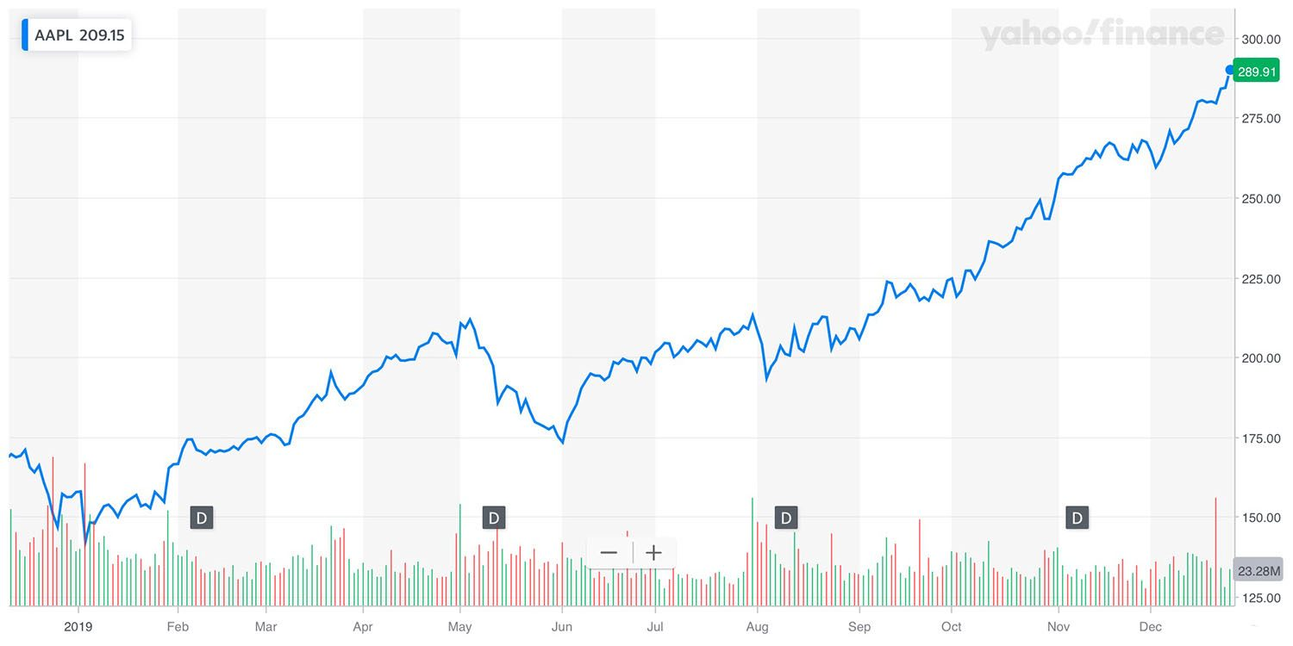
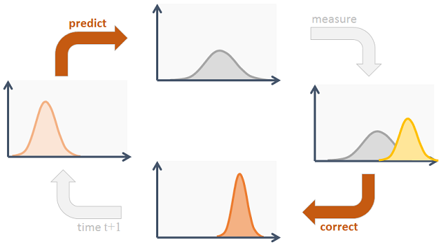
Kalman Filter Background
Kalman filter is a recursive state estimation algorithm used on noisy time series data
Canonical application is location tracking with noisy sensors
Each state is assumed Gaussian
Two steps:
Predict state
Update prediction based on measurement
Raghavan, 2019

Slide 3


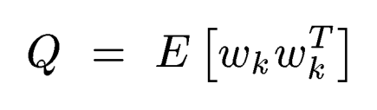

Defining the State Space
recursive state transition model
x: stock’s intrinsic value at time k
z: observed market price at time k
w: random stock influence
v: random market noise
state-observation connection
transition error matrix
observation error matrix

Slide 4






Defining the Filter
Initial state estimates:
Mean
Covariance
Error matrices:
Transition error
Observation Error
Process Models:
State-Transition Model
Observation Model
recursive state transition model
state-observation connection
transition error matrix
observation error matrix

Slide 5

Defining the Filter
Initial state estimates:
Covariance of past 10 days price
Error matrices:
Cov btw today and yesterday price
Bid ask spread of 1/8th tick size
Process Models:
1 day stock momentum
Identity
recursive state transition model
state-observation connection
transition error matrix
observation error matrix

Slide 6
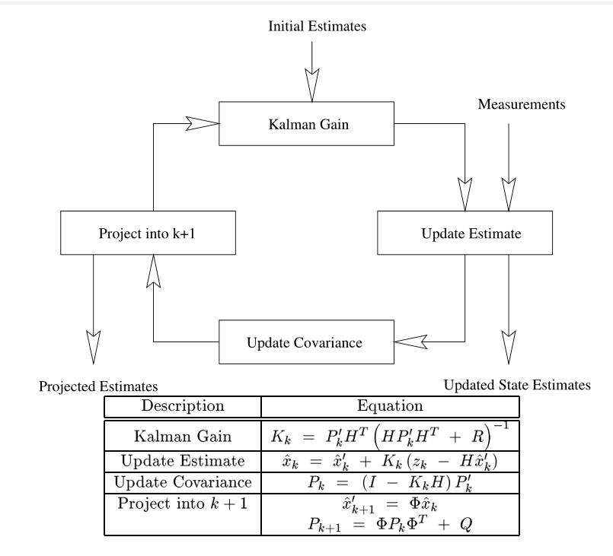
From Course Material (Lxxx_SupA_KalmanFilterDerivation)

Slide 7
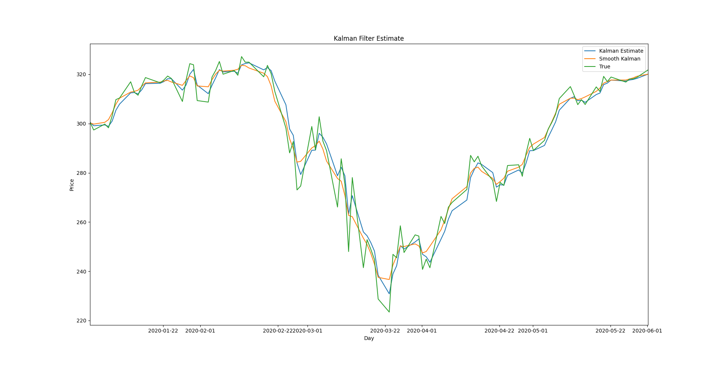
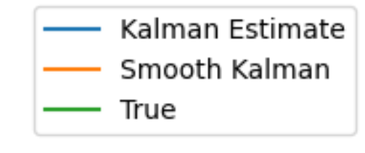
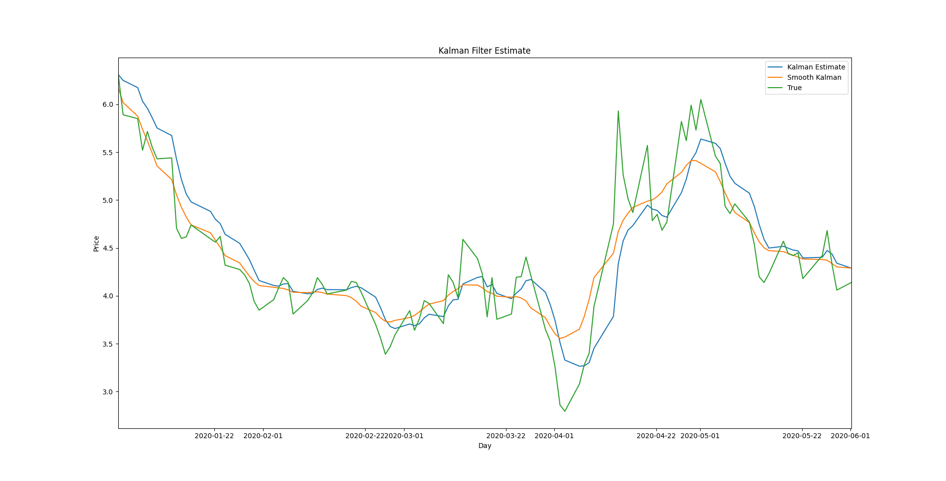
Results
Initial parameters are shown to heavily impact filter performance throughout recursion
Higher initial and transition covariance in GME stock
Smooth Kalman updates past estimates based on recent observations
Data from Alpaca API, 2020-01-01:2020-06-01
AAPL
GME

Slide 8
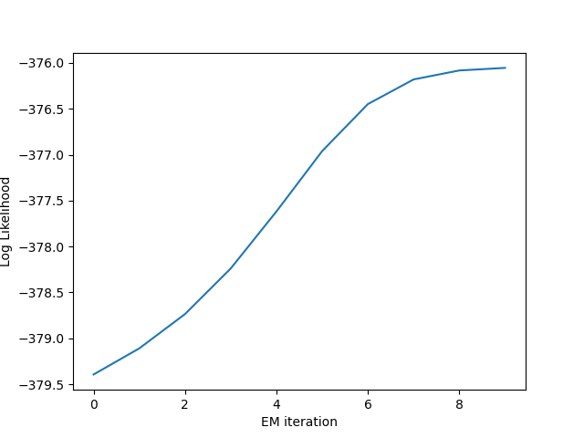
Optimizing Parameters with EM
Transition covariance, observation covariance, and initial covariance
Maximize probability of observations given initial parameters

Slide 9
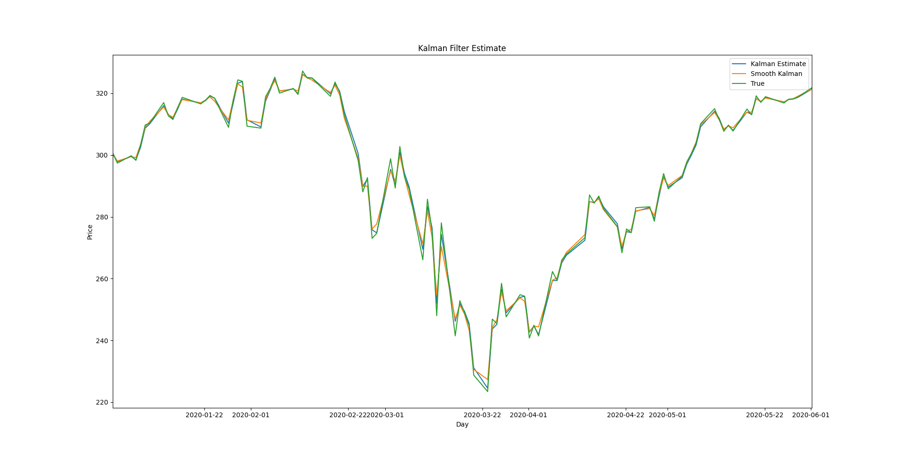
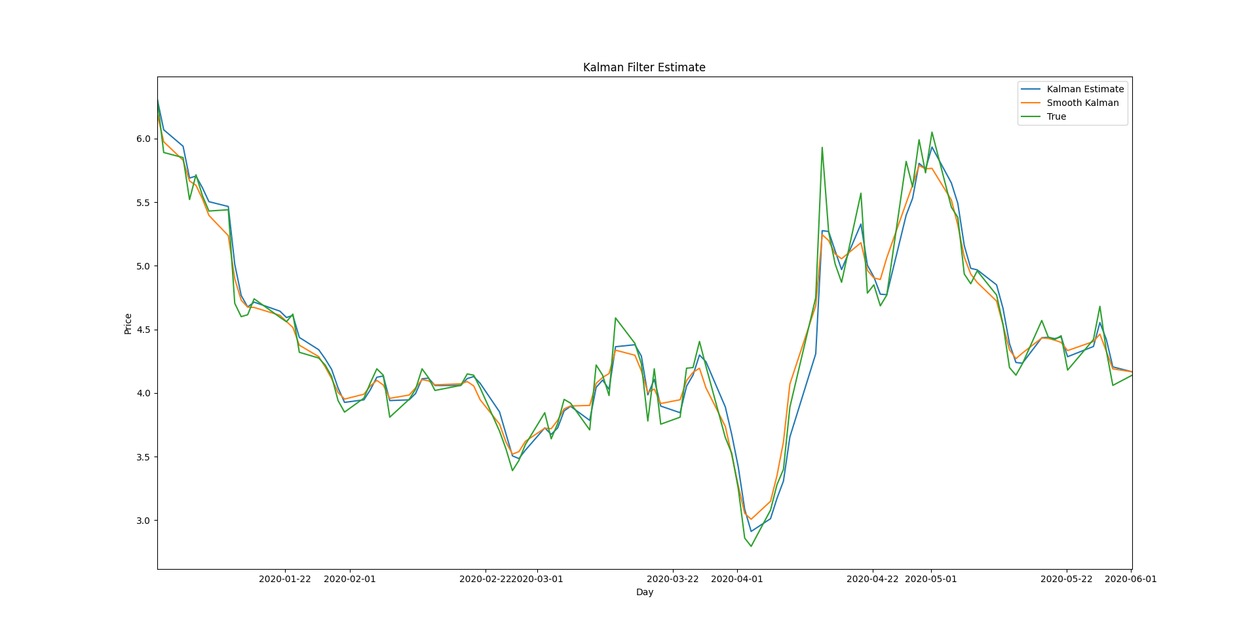
Results
Kalman filter loses usability when covariance is too large
It loses “confidence”
In this case, likelihood of measurement itself is maximized
AAPL
GME

Slide 10
Learnings
Kalman Filter initial parameter estimates define its usability
So understanding the process you’re trying to model is important
Error of a hidden variable has no definition
Implementing risk minimization requires a concrete metric
Gained familiarity with databases, manipulating time series data, and financial data API’s
Implementing ML techniques to novel applications is hard
And in practice requires a lot of preparatory research

Slide 11
Future Considerations
Calculate error relative to discounted cash flow models
Try alternative Bayesian recursive filtering such as particle filters
Combine with fundamental techniques, employing Kalman filter as alternative to moving average which doesn’t depend on window size

Slide 12
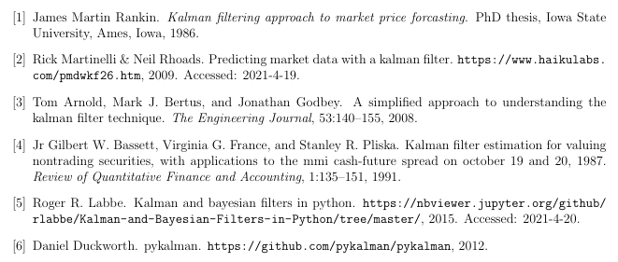
Thanks for listening!
Sources:
ML 5644 Course Material from Deniz Erdogmus, and

