Slide 1

ADVANTEST
Homework

Slide 2
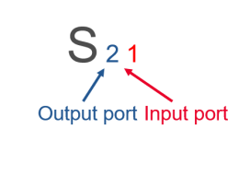
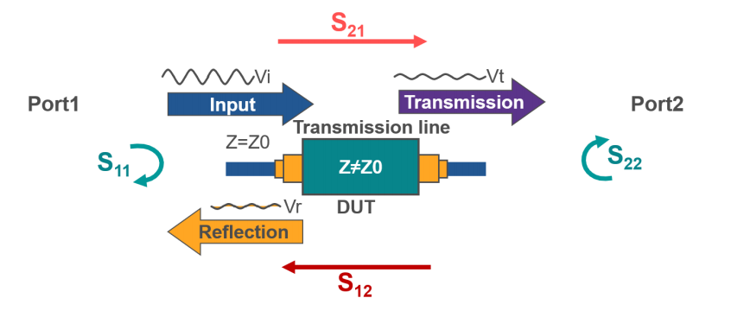
S-Parameters
S-parameters (or Scattering parameters) describes the input-output relationships between ports in an electrical system.
The word “scattering” is a general term that refers to reflection back to the source and transmission to other directions.
S-parameters are usually displayed in a matrix format, with the number of rows and columns equal to the number of ports. For the S-parameter S_{ij}, the j subscript stands for the port that is excited (the input port), and the "i" subscript is for the output port.

Slide 3

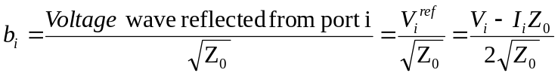
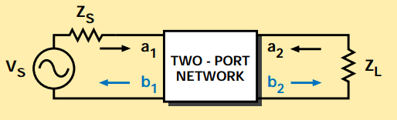


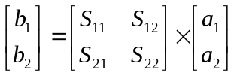





S-Parameters
The independent variables a_{i} normalized incident voltages, as follows:
Dependent variables b_{i} normalized reflected voltages:
Input reflection coefficient with
the output port terminated by a
matched load (Z_{L}=Z₀ sets a₂=0)
Output reflection coefficient
with the input terminated by a
matched load (Z_{S}=Z₀ sets V_{s}=0)
Forward transmission (insertion)
gain with the output port
terminated in a matched load.
Reverse transmission (insertion)
gain with the input port
terminated in a matched load.

Slide 4
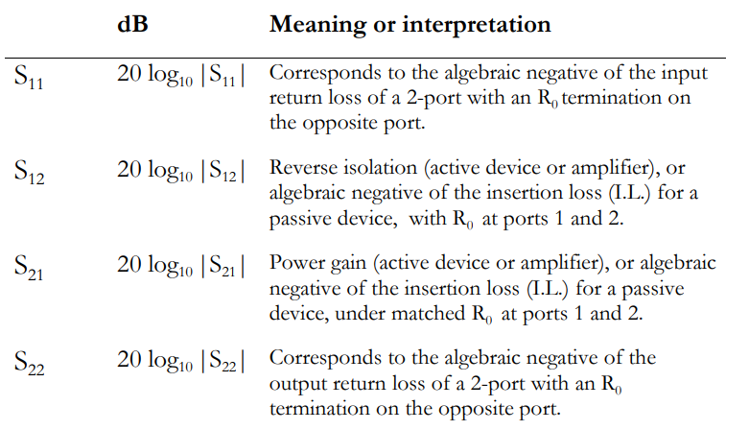
S-Parameters
S₁₂ :
Reverse Gain
Insertion loss
Transmission Phase
S₁₁ :
Input reflection Coeff.
Return loss
VSWR
DUT
S₂₂ :
Output reflection Coeff.
Return loss
VSWR
S₂₁ :
Forward Gain
Insertion loss
Transmission Phase

Slide 5
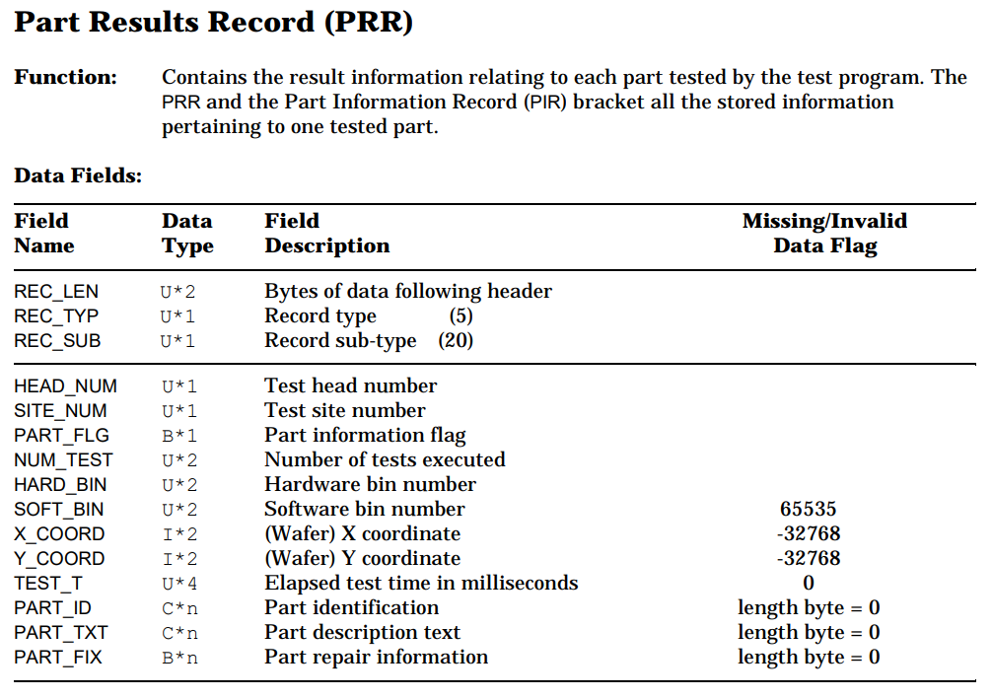

STDF PRR
i = 0
i = 9、10
i = 11、12
i = 17
id_length = space[17];
fread(part_id, sizeof(char), id_length, fp);

Slide 6

STDF PRR
Open file
FILE* fp = fopen("main_Lot_1_Wafer_1_Oct_13_09h33m41s_STDF" , "rb");
Set structure
struct Data {
short x;
short y;
short id;
};
Variable
declaration
unsigned char find[2] = { 0x05, 0x14 };
char space_size = 18;
char space[space_size];
int max_data_num = 100;
struct Data data[max_data_num];
Read the Hex digit
fread(start, sizeof(char) , 2 , fp);
While loop
Find 0x05 0x14
if (start[0] == find[0] && start[1] == find[1]) {
x = space[9] | space[10] << 8;
y = space[11] | space[12] << 8;
id_length = space[17];
fread(part_id, sizeof(char), id_length, fp);
data[num].x = x;
data[num].y = y;
sscanf(part_id, "%hi", &data[num].id);
:
:
:
}
if loop
X_COOR
Y_COOR
PART_ID
Close file
Create array and Output

Slide 7
STDF PRR
x = space[9] | space[10] << 8;
y = space[11] | space[12] << 8;
Ex : {..., 0xfb, 0xff, 0xfc, 0xff, ...}
i= 9 10 11 12
0xfb = 0000 0000 1111 1011
0xff = 0000 0000 1111 1111
0xfc = 0000 0000 1111 1100
0xff = 0000 0000 1111 1111
0000 0000 1111 1011
1111 1111 0000 0000
1111 1111 1111 1011
signed integer
0000 0000 1111 1100
1111 1111 0000 0000
1111 1111 1111 1100
2's complement
%d
signed char x = 0b1111 1111 1111 1011
x = -5
%d
signed char y = 0b1111 1111 1111 1100
y = -4

Slide 8
Thank You For Your Listening

