Slide 1

Day 8: 28/May/2015
Work Assignment

Slide 2

Design Review:
Table Structure of the system
Discuss on the design;
share the part of the system development, and assign students’ part.

Slide 3
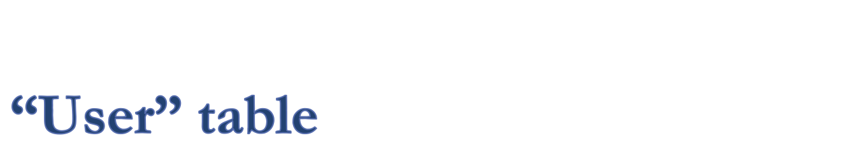
User table is used for the login authentication.
Fields:
email address: string
password: string
handle name: string
Other parameters:
should be added by Designer’s decision.
Explain later.

Slide 4
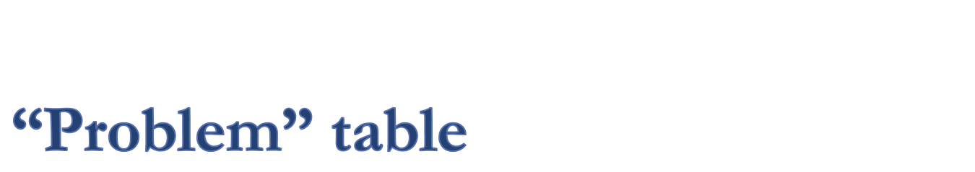
One to one relationship between “event” table.
Fields:
event_id: integer, link to event table
user_id: integer, owner of this “problem”
title: string, should be shown in the list.
content: text, explanation
Other parameters:
should be added by Designer’s decision.
Explain later.

Slide 5
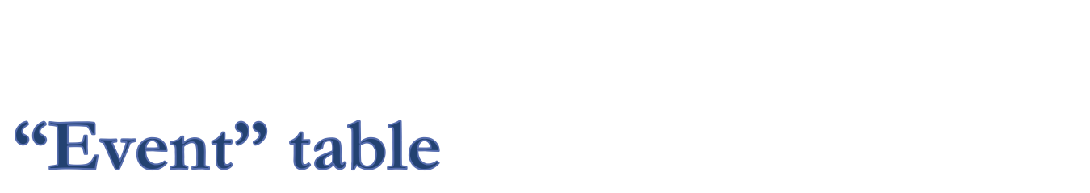
Core of the system:
Register all the facts, incidents, and the things somebody thinks “it is a fact.”
Fields:
title: string, should be shown in the list
contents: text, explanation
user_id, owner of the “event”
Other parameters:
should be added by Designer’s decision.
Explain later.

Slide 6

This is a relational link between events.
Fields:
from_id: event, which causes another.
to_id: event, which is caused by another.
effectivity_voter_id: Array of user_ids.
Can it be another relational link?
Discussion:
How to handle logicality and emotionality links of “voter’s id” and the “level?”

Slide 7
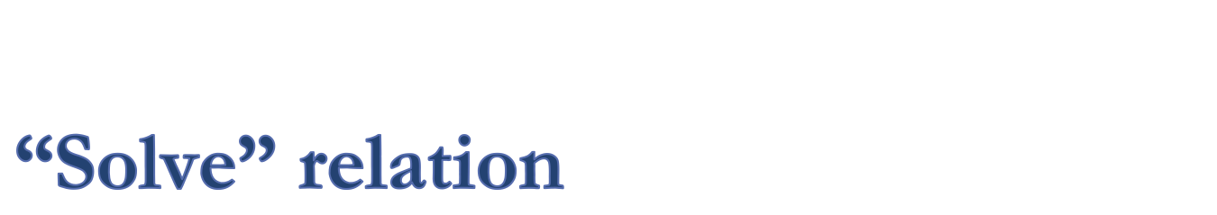
This is a relational link between events.
Field:
from_id: integer, which solve another.
to_id: integer, which is solved by another.
effectivity_voter_id: Array of user_ids.
Can it be another relational link?
Discussion:
How to handle logicality and emotionality links of “voter’s id” and the “level?”

Slide 8
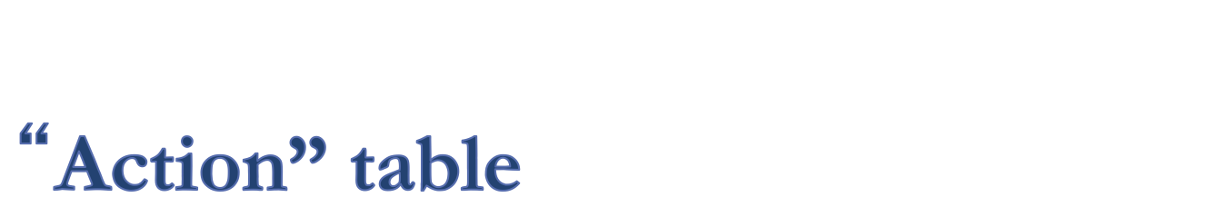
Action is a table, which has link to an event.
Even if one “action” can be effective to several events, the same “actions” should be registered independently to avoid the confusion of the discussion of effectivity.
Or, shall we register only one “action” if they are the same?
How to make the discussion simple?

Slide 9
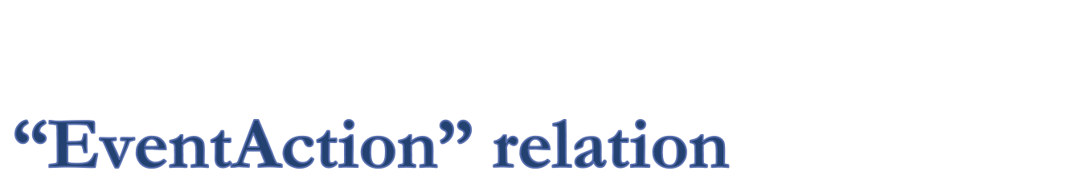
This logic is closely related to the “Action” table policy.
Fields:
ProsCount: integer, voted count.
ConsCount: integer, voted count.
How to register the voters ids and comments.

Slide 10

There is no plan for now.
Where to add comments?
Generally, all comments should be accompanied by voter’s ids.

Slide 11

The goal of the system is to provide the effective solutions, from the extracted facts, by collecting the visitors ideas.
To realize the system’s goal, give your suggestions on the above design.
Improve the design if necessary, before the work is assigned to each students.

Slide 12

When somebody registers “events,” and many people register the “link” to that events from “problem.”
But, if the person who registers the “event” remove the entry, many “problem” loses the link target.
What shall we do?
How to design to avoid these incidents.

Slide 13

How to avoid the similar records are registered independently?
What kind of logics would be necessary?

