Slide 1
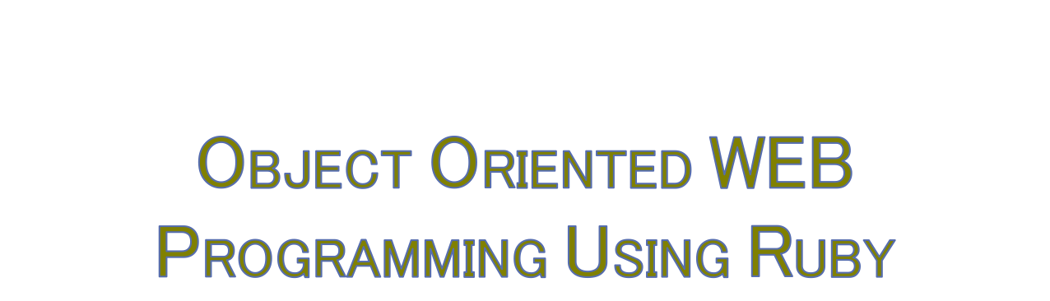
Day 6: 19/May/2016
Merge the design

Slide 2

Everyone “push” the design document to the repository.
Add the presentation document to the project tree, ‘doc’ directory.
Then, ‘push’ the document to each forked repository.
‘New pull request’: will ask the project owner to ‘pull’ the forked document.
Currently, no contention should happen.

Slide 3

We all pull the changes in the original hatuka-k master’s, to share the design documents of our team members.

Slide 4

Everyone, generate the blank model, skeleton, and blank views in each project.
Do it one by one, to avoid the unnecessary conflict in our project.
Note: View designer will generate controller.
Hatuka-k will ‘pull’ those changes.

Slide 5

While the assigned person “generate” the models or the controllers, we will check the “fields,” “actions,” and such.
Give “Note” to the project.
We share “ToDo” documents in our project.

Slide 6

http://www.atmarkit.co.jp/ait/articles/1409/30/news037_2.html
http://tech.grooves.com/entry/2015/04/28/173025
http://qiita.com/jnchito/items/607f956263c38a5fec24

Slide 7

If we have come to think that we need to install new gem, what we should do?
Before adding the gems to Gemfile, write the “Discussion” file in “docs.”
What should we have?
“ToDo.txt”, “Proposal.txt,” and “Discussion.txt”?

Slide 8

Everyone should write 2 “spec” in each assigned parts of the program, except for the members who will design the logics.
Make sure that those “tests” will fail.
Then, write the program code to “pass” the tests, and now comments out back to “fail” the tests.

