Slide 1
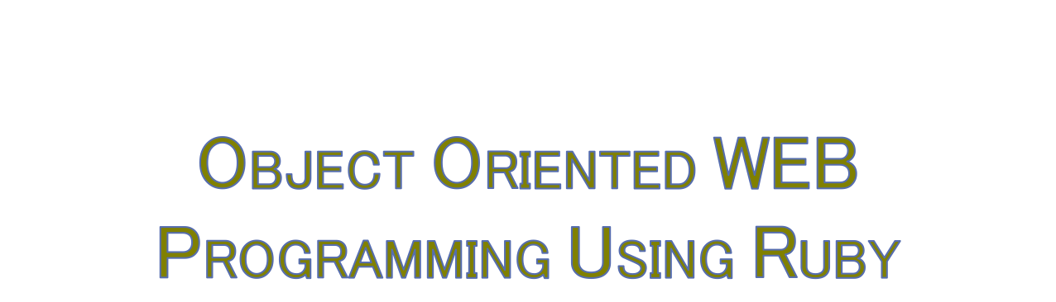
Day 12: 30/June/2016
Towards the end, finish writing program,
then, prepare the Test

Slide 2

https://en.wikipedia.org/wiki/Software_walkthrough
Okay? Now we are all expected to speak in English!

Slide 3

Lastly, two more presentation required;
1) Programing walk-through final review,
2) Test specs reports;
test description and the results.

Slide 4

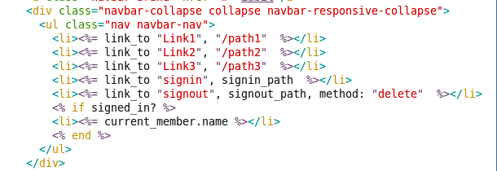
Explanation required:
By doing what? To obtain what?
Then, toss the links to other project members;
which link works what? What is the plan?

Slide 5

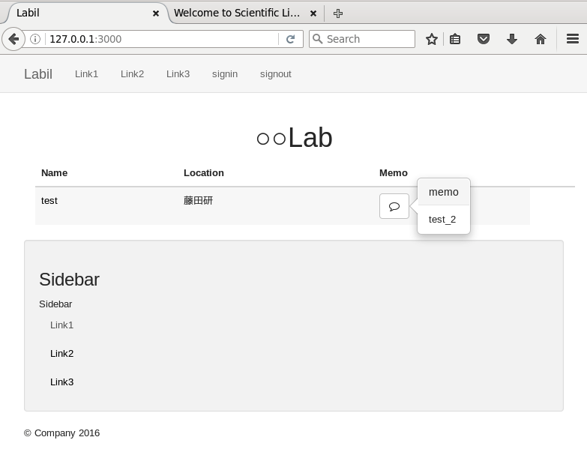

Slide 6

Do we need to unify the “mouse-over” or other design policy?
If so or, if desirable, explain the policy.

Slide 7

Can dummy member be ready?
Who?

Slide 8

Should update ToDo.md, and Done.md
On the command prompt, type
firefox doc/Done.md

Slide 9
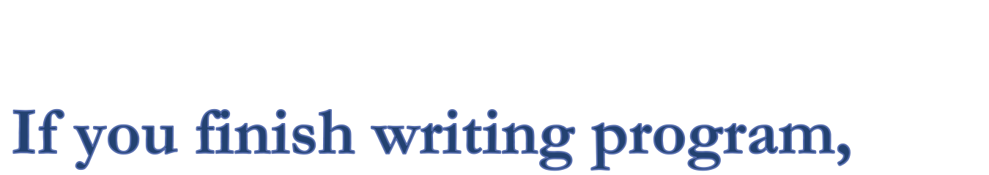
Then, generate and update test documents, and prepare for the presentation on your “test scripts,” and the “test results.”
Who can go forward to these presentation, should do it to complete this class,
and if you cannot, then the minimus presentation should be on “done’s”, and “todo’s.”

