Slide 1
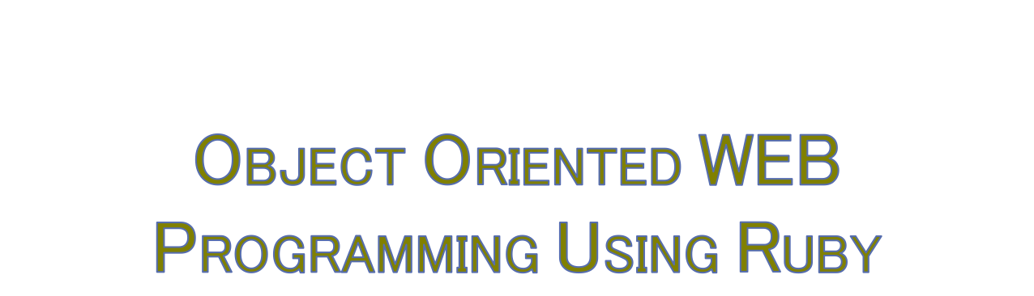
Day 8: 02/June/2016
Test Script writing and
Test running

Slide 2

is to “describe” the specs of classes,
“context” is to describe the scenario,
and before/after/it ‘should be that’ do, and
“expect.”
Learn
http://rspec.info/

Slide 3

http://www.oiax.jp/rails/rspec_capybara_primer/basic_structure.html
Feature / scenario / background => alias
http://qiita.com/jnchito/items/607f956263c38a5fec24
expect(page).to have_....
have_content/have_css/have_link
have_button/have_select/have_selector

Slide 4

http://qiita.com/jnchito/items/2e79a1abe7cd8214caa5

Slide 5

http://ruby-rails.hatenadiary.com/entry/20150102/1420174315
Define the test data with “Factory Girl”, then use those test data with “Capybara”
http://www.oiax.jp/rails/rspec_capybara_primer/let_and_factory_girl.html

Slide 6

http://www.atmarkit.co.jp/ait/articles/1409/30/news037_2.html
http://tech.grooves.com/entry/2015/04/28/173025
http://qiita.com/jnchito/items/607f956263c38a5fec24

Slide 7

If we have come to think that we need to install new gem, what we should do?
Before adding the gems to Gemfile, write the “Discussion” file in “docs.”
What should we have?
“ToDo.txt”, “Proposal.txt,” and “Discussion.txt”?

Slide 8

Everyone should write 2 “spec” in each assigned parts of the program, except for the members who will design the logics.
Make sure that those “tests” will fail.
Then, write the program code to “pass” the tests, and now comments out back to “fail” the tests.

Slide 9

Share the test specs in everyone’s forks.

