Slide 1

Day 11: 23/June/2016
Run and Test, and then Run

Slide 2

Everyone:
First, “git pull upstream master,” to update your own source code.
then, “bundle install,” to re-organaize gems,
“rake db:migrate,” to prepare database,
“rake db:seed,” to read initial data,
then, “rails s,” to run the server,
however…

Slide 3

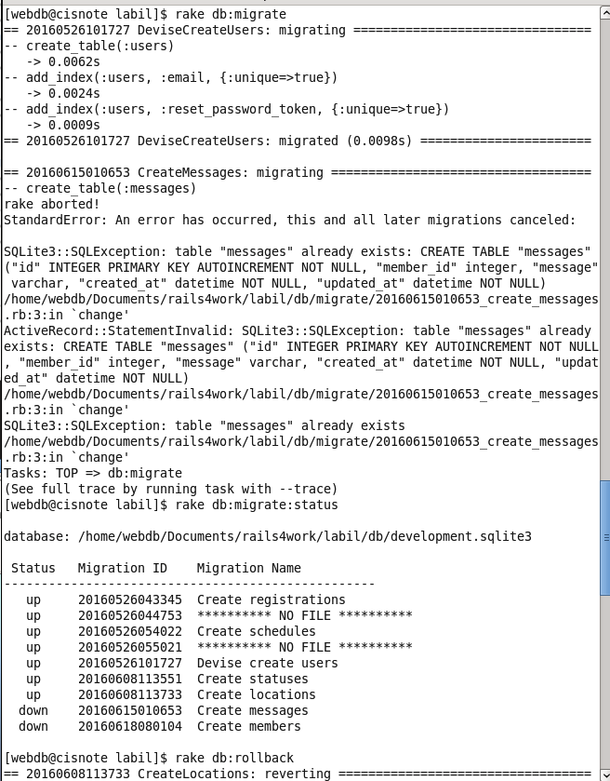
Encountering the errors, in the right;
Messages already exists…
And, some migration files changed…

Slide 4

First, remove “development.sqlite3,”
rm development.sqlite3
(or, if you feel afraid of removing DB file, then rename the file, as;
mv development.sqlite3 development.sqlite3.org)
Then migrate again.
You can start everything about the DB from the beginning.
(Because, we do not have any data yet.)

Slide 5

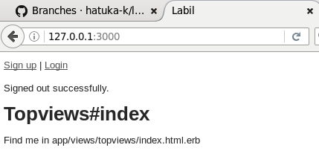
http://127.0.0.1:3000/
Done by last lecture day,
Login request/members registration view.
Check and Discussion
Screen link OK?

Slide 6

Screen transition ok? Or need to modify?
http://127.0.0.1:3000/ →
app/views/topviews/index.html.erb
Links: Sign up | Login
Activity of users:
Visitors may want to see where a friend is.
Lab members may want to sign up or login.

Slide 7

Explain what you have done, to co-op with devise, “login authentication,”
Discussion: Screen links from the Top View
Temporarily installation:
Links for other members to trace,
What links do other members need?
Permanently installation:
How the screen looks like → Own design.

Slide 8

(For bugs: you may need index action to call select1 method)
Registration links
How it should link from TopView?
Currently, what tables are available for other members?
After Yubeshi’s update, what tables are available for other members?

Slide 9

Demonstration:
How to register messages with current installation.
Are there any sample data available for other members to check?
How messages should be displayed in the screen?
Who are the right person to install the “message viewer?”

Slide 10

After the “Devise” plan changed, what is the plan related to “Member” table?

Slide 11

Demonstration or the plan explanation.
How to install the location detection?

Slide 12

Regarding ToDo:
Relations about Schedule table,
Test Data about schedule table,
Discussion:
What elements do we need in schedule tables.

Slide 13

Progress about schedule registration,
http://127.0.0.1:3000/schedules
change to scaffolding?
Or write controller/view one by one?
(It is useful to learn the structure)
Prepare any sample schedule data?
Does anyone need sample schedules?

Slide 14

If so, I am so much sorry.
It is your turn!

Slide 15

Everyone, merge Done and ToDo.md file, by next week.
Possibly, if conditions are satisfied, finish own part, and start writing the test scripts.

