Slide 1
Vanna AI – Summary 4th April ’25

Slide 2
CEO Buddy – Collection & Business – A Talk to Data Platform
In-house developed Gen AI - Talk to Data Platform
MahindRa Group
IP
Talk to Data Platform
Data Security
Optimal Cost
Building AI Ecosystem
Highly Customizable
In-house developed
No dependancy on external vendors
Expertise and Knowledge remains with in the group
An accelerator - to deploy any business use case related to structure data
Feedback or learning from failed queries are getting incorporated
Prediction models or any other workflow can be integrated
Completely aligned with our data compliance policy
Data doesn’t go out of MMFSL servers
LLM is hosted in central India – on MMFSL Azure cloud
LLM and related cost can be controlled in future without any dependency on external party
No license or additional cost
In-house skill development and learning for various teams
Cloud, AI, Data, Applications/API

Slide 3

CEO Buddy – Collection – Plan & Phase
Phase - 1: Collection KPIs
GS3
GS2
NPA
CD%
CE%
AUM
Collections KPI
T-1 Data till ABM Level along with Last 13 months of Month end data
Collections KPI Historical Trend
Day wise Data but limited till Vertical & Circle Level only. MTD vs LMTD & Month end numbers
Data migration and pipeline
AI Engine Setup
Application/UI Dev & Deployment
CISO, PAC, & Cost Approval
Phase – 2 : Collection KPIs - 2
AFC,
BD Recovery,
Disposal Loss,
Bucket X,
Bucket 1 to 4 & above,
Roll Forward (FF) - Roll Backward
Normalization & Stabilization
Collections KPI
Data Cuts to be made available at Vertical, Circle, State, Manufacturer, CH, DM & ABM Level
Narrative Insights
Forecasting capabilities
Scaling to more users
Accuracy Improvement using Failed queries
WIP
Phase – 3 : Business KPI
Business Count,
Business Amount,
IRR%,
Tenure,
Non Starter, ……..
Business KPI
Data Cuts to be made available at Vertical, Circle, State, Manufacturer, CH, DM & ABM Level along with Targets
TBD
Business KPIs
Accuracy Improvement using Failed queries

Slide 4
Testing & Accuracy
Accuracy on 120 Queries
86%
14%
Working Queries- Sample
Not Working Queries- Sample
give me the AUM vertical wise
tell me today's GS3, GS2 count and amount
okay now give me the CE, CD% for the last 12 months
now, show me the MoM trend for NBD amount
now tell me the NPA count for BAU vertical in Maharashtra
give me the GS2 amount, count and percentage
now show me the state wise distribution of aum
show me LMTD vs MTD CD%
give the YoY distribution of NBD count for the last 5 years
show state wise distribution of NPA amount
…
Which vertical had the highest growth in npa count in last 10 months?
give me the verticals that had highest increase in CE% in last 3 months
why is gs3% going up mom
What is Dedupe Amount as on date and how is % of AUM ?
What are the last month same date , last month closing and current month till date GS2 count and value?

Slide 5
CEO Buddy – Cost Calculation – Phase 1
Monthly Cost Estimation – For 30 Users – 40 Queries/Day/user
Estimated no of users | 30
Estimated no of queries per day | 40
Estimated no of queries per month | 36000
Estimated no of text queries | 28800
Estimated no of graph queries | 7200
Cost per text query | 0.7
Cost per graph query | 4
Total text query cost | 20,160
Total graph query cost | 28,800
Total AI Engine cost | 48,960
Infrastructure cost | 12,240
Total cost | 61,200

Slide 6
AI Engine and Architecture

Slide 7

















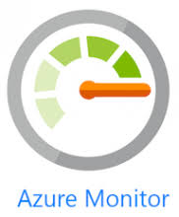

CEO Buddy - Technical Architecture
Data Sources
Web(Intranet)
Collection
(Collection, AUM
& NPA Historical
Daily Data)
On- prem
Sify
AI WORKFLOW
Collection
(Collection, AUM
& NPA Historical
Month Data)
On- prem
Sify
React UI Application
Collection
(AFC (Additional Finance Charges) Data)
Azure SHIR Data factory
On- prem
Sify
Interface Service
LLM Service
Prompts Repo
Collection
(Bad Debt
Recovery Data)
On- prem
Sify
Collection
(Disposal
Loss Data)
ADLS Gen 2
Azure PostgreSQL
On- prem
Sify
Horizontal
Capabilities

Slide 8
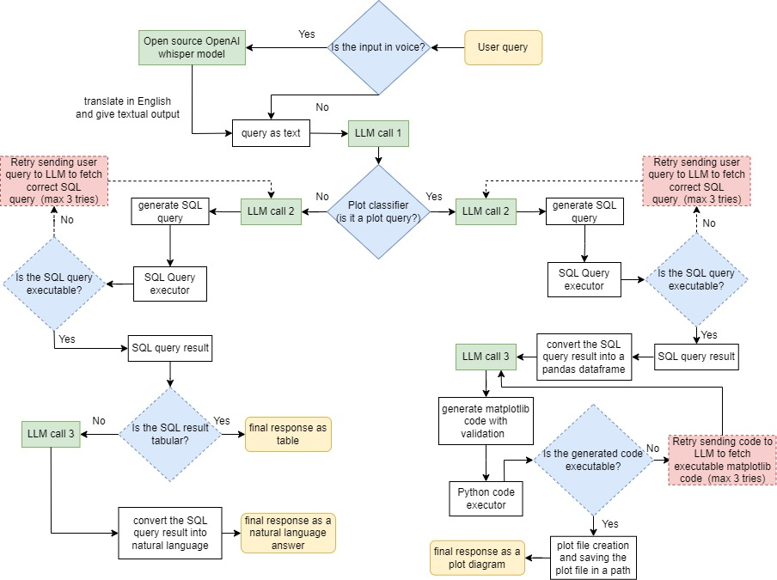
Low Level Architecture

Slide 9
CEO Buddy – Screens

Slide 10
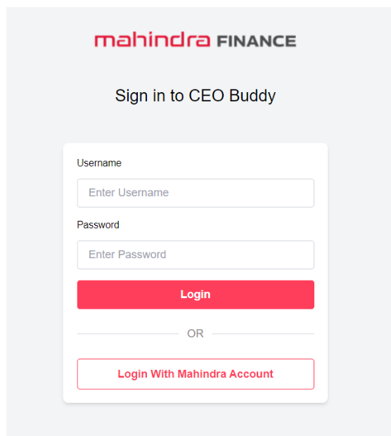
CEO Buddy – SSO login Page
CEO BUDDY URL: https://mmfsl-iht-dealer-buddy2.thankfuldesert-989ed112.centralindia.azurecontainerapps.io

Slide 11
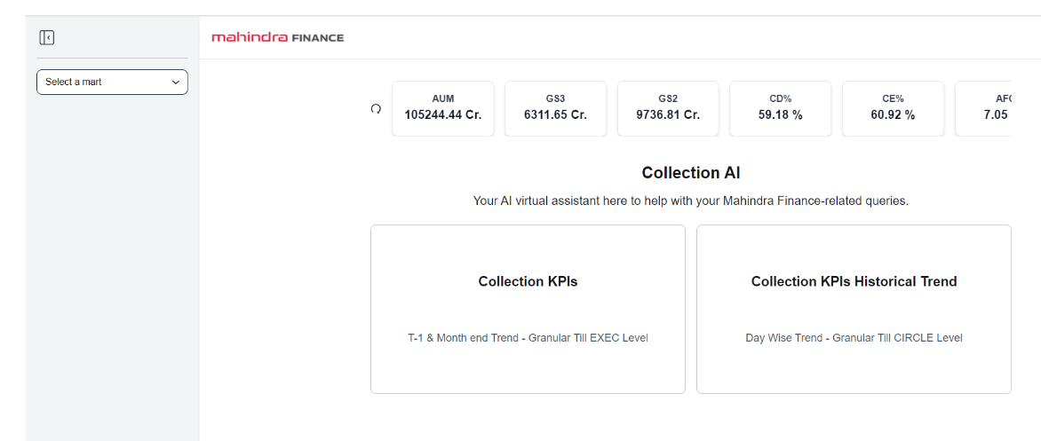
CEO Buddy
CEO Buddy : Collections AI Landing Page after Sign in.
Display of Key KPIs shown on the Screen as on latest date.
User has to select any one tab depending on the Trends & Granularity required

Slide 12
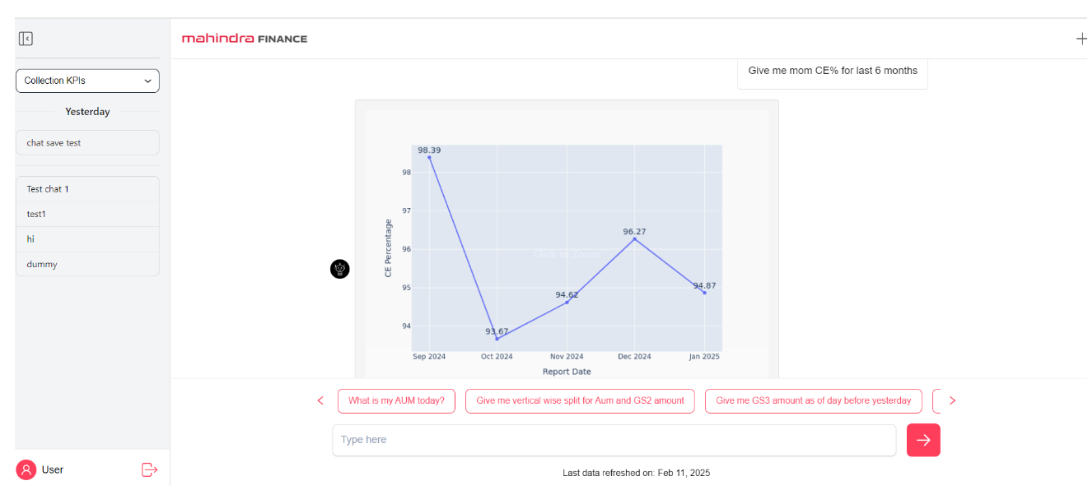
CEO Buddy – Screens with Prompts
Top 5 Questions has been preloaded to get the results quickly. Below shows the MOM CE% Trend chart

Slide 13
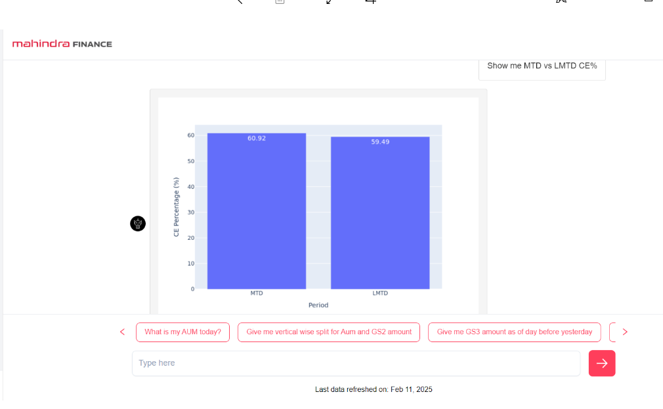
CEO Buddy – Screens with Prompts
Show me MTD vs LMTD CE%

Slide 14
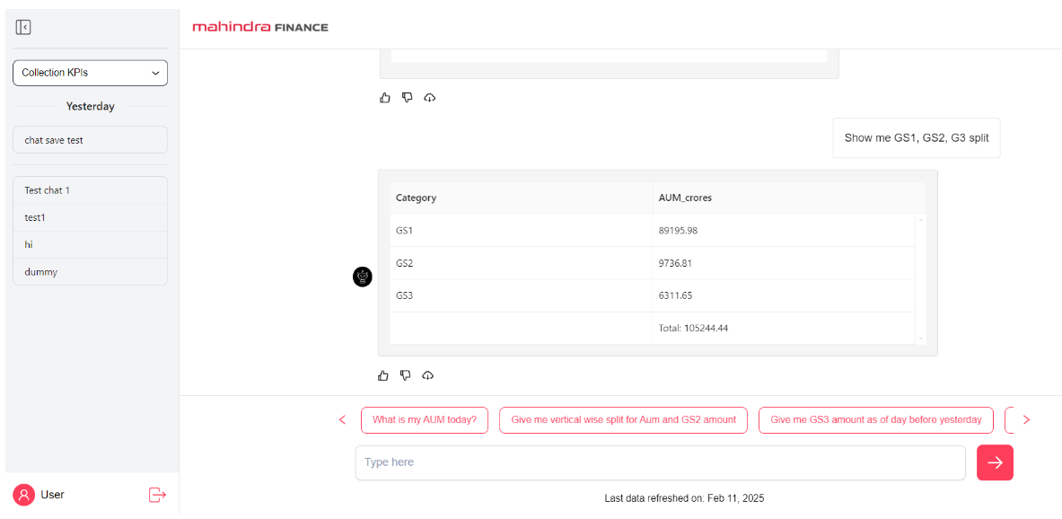
CEO Buddy – Screens with Prompts
GS1, GS2 & GS3 % Split on AUM

Slide 15
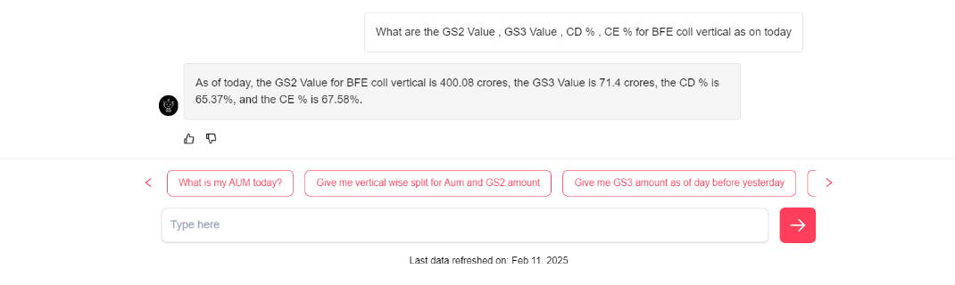
CEO Buddy – Screens with Prompts
BFE Collection Vertical: GS3, GS2, CD% & CE%

Slide 16
Thank you

