Slide 1
Firewall
Prashant Kumar
B.Voc(IOT) 3rd Year

Slide 2
Content
Introduction to Firewall
Why Firewall
How Firewall Works
Types of Firewall
Advantages of Firewall
Disadvantages of Firewall

Slide 3
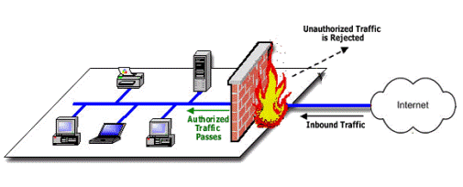
Introduction to Firewall
Firewall is a way which can be use basically in Computer System to protect unauthorized person or intruders.
It helps to secure a network.

Slide 4
Why Firewalls
Use a Firewall to Prevent Unauthorized Remote Access
Firewalls Can Secure Old PCs… Short Term
Firewalls Make Online Gaming Safer
Block Unsuitable or Immoral Content With a Firewall
Firewalls Can Be Hardware or Software

Slide 5
How Firewall Works
Firewall match the network traffic against the rule set defined in its table. Once the rule is matched, associate action is applied to the network traffic.
Rules can be defined on the firewall based on the necessity and security policies of the organization.

Slide 6
Types Of Firewalls
Host- based Firewalls : - Host-based firewall is installed on each network node
Network-based Firewalls : - Network firewall function on network level.

Slide 7
Advantages of Firewall
High security than packet filters
Only need to Scrutinize a few allowable applications
Easy to log and audit all incoming traffic

Slide 8
Disadvantages of Firewall
Additional processing overhead on each connection (Gateway as splice point).
It offers no user authentication.

Slide 9
Thank
You

