Slide 1
P for POWER
Statistical Inference Linda Angulo Lopez

Slide 2
R4.0 Environment
library(knitr) # creating slides
library(ggplot2) # making plots
library(reshape2) # handling data frames

Slide 3
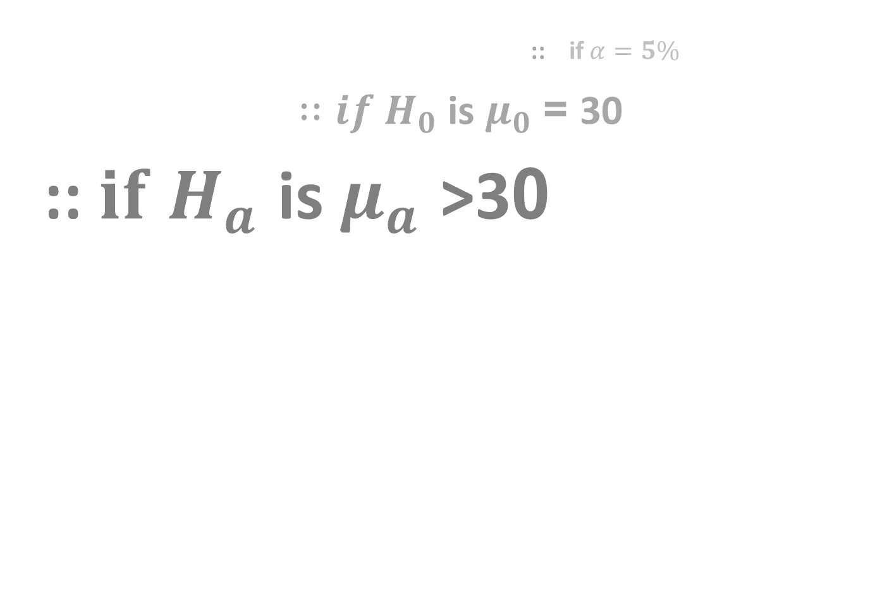
CASE: Respiratory Distress Index and Sleep Disturbances
:: if $α=5\%$
${∷if H}_{0}$ is $μ_{0}$ = 30
::${ if H}_{a}$ is $μ_{a}$ >30

Slide 4
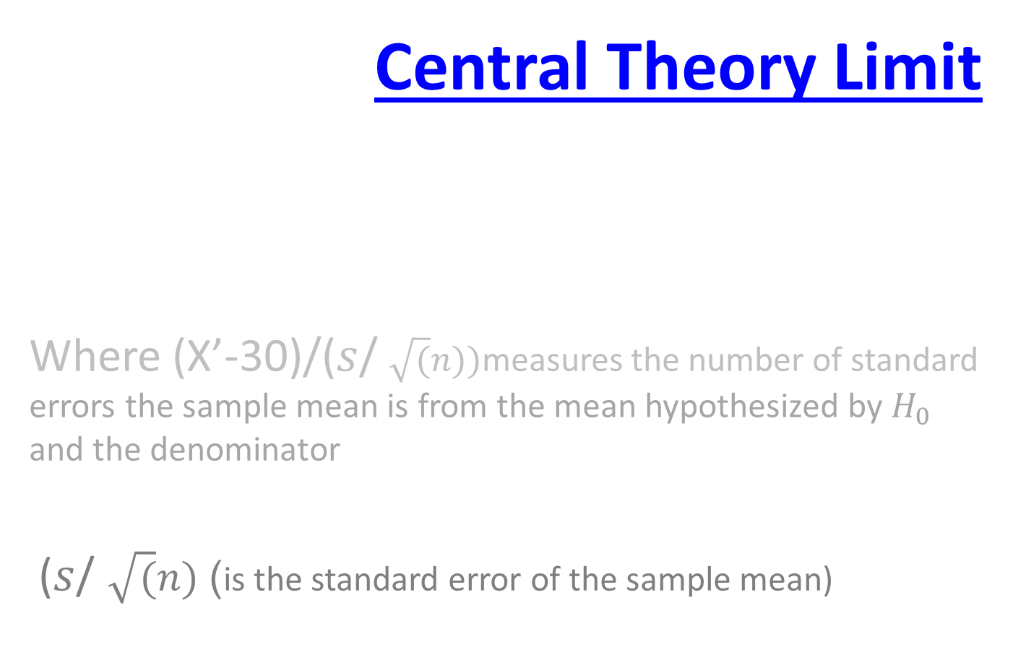
Central Theory Limit
Where (X’-30)/($s$/$\sqrt{(}n))$measures the number of standard errors the sample mean is from the mean hypothesized by $H_{0}$ and the denominator
($s$/$\sqrt{(}n)$) is the standard error of the sample mean)

Slide 5

PS: if $H_{a}$ specified that $μ_{a}$ < $μ_{0}$
:: flip the following reasoning
:: look at the right tail

Slide 6
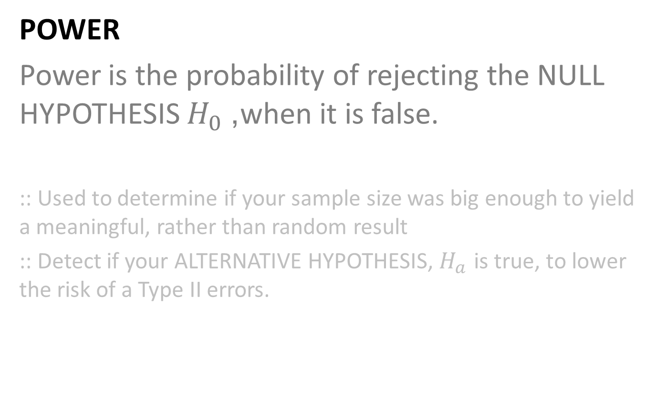
POWER
Power is the probability of rejecting the NULL HYPOTHESIS $H_{0}$, when it is false.
:: Used to determine if your sample size was big enough to yield a meaningful, rather than random result
:: Detect if your ALTERNATIVE HYPOTHESIS, $H_{a}$ is true, to lower the risk of a Type II errors.

Slide 7
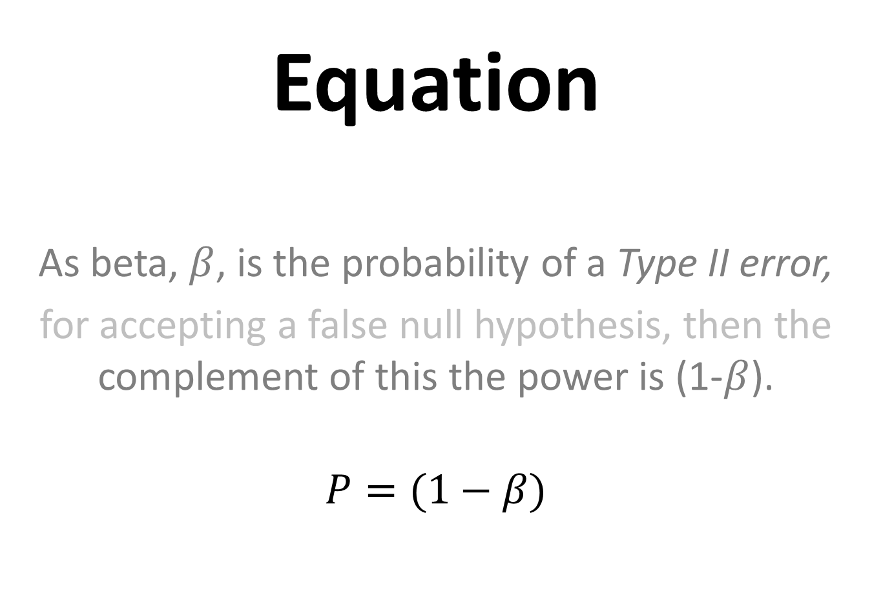
Equation
As beta, $β$, is the probability of a Type II error,
for accepting a false null hypothesis, then the complement of this the power is (1-$β$).
$$P=(1−β)$$

Slide 8
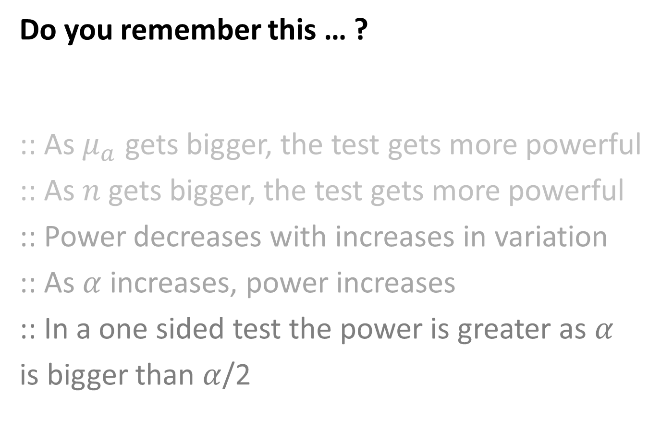
Do you remember this … ?
:: As $μ_{a}$ gets bigger, the test gets more powerful
:: As $n$ gets bigger, the test gets more powerful
:: Power decreases with increases in variation
:: As $α$ increases, power increases
:: In a one sided test the power is greater as $α$
is bigger than $α$/2

Slide 9
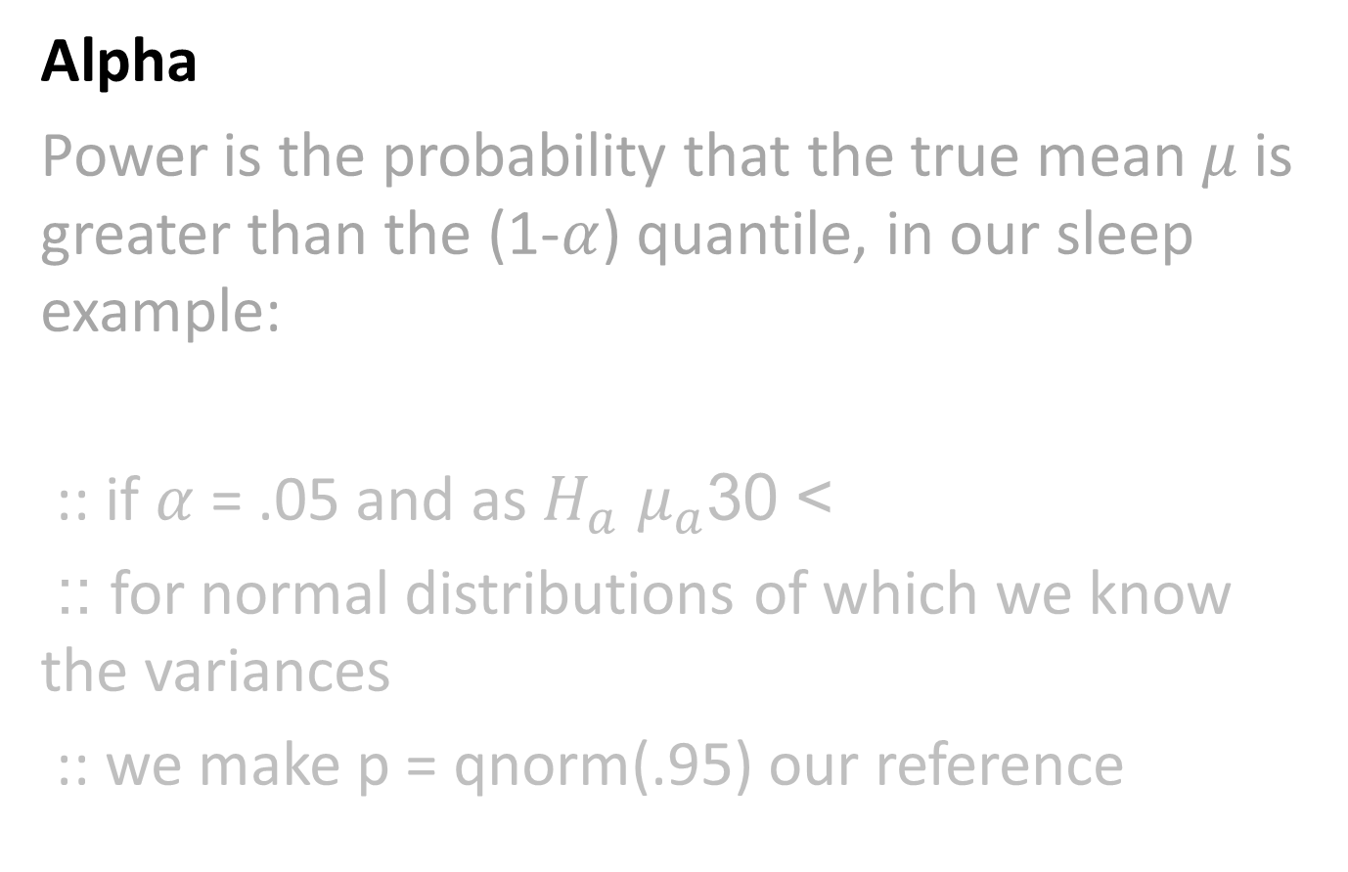
Alpha
Power is the probability that the true mean $μ$ is greater than the (1-$α$) quantile, in our sleep example:
:: if $α$ = .05 and as $H_{a}$ $μ_{a}$ > 30
:: for normal distributions of which we know the variances
:: we make p = qnorm(.95) our reference

Slide 10
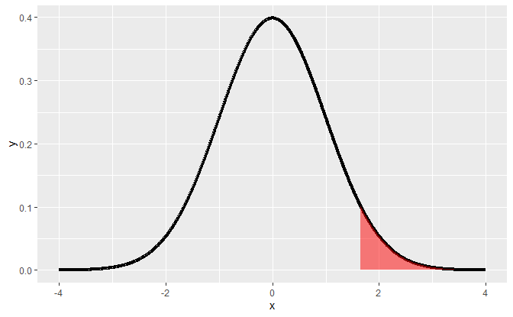
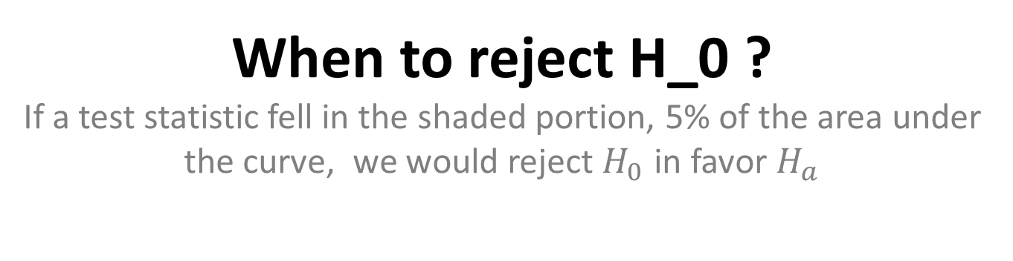
When to reject H_0 ? If a test statistic fell in the shaded portion, 5% of the area under the curve, we would reject $H_{0}$ in favor $H_{a}$

Slide 11
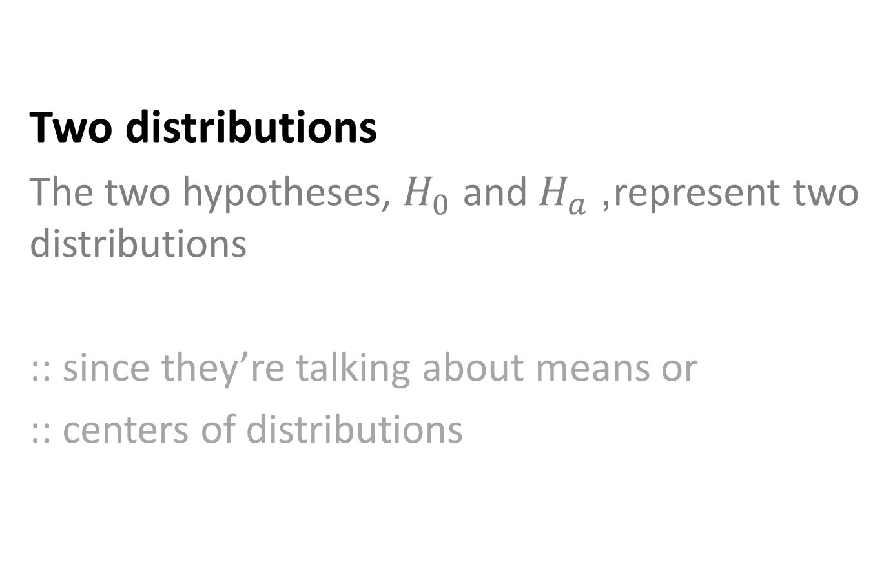
Two distributions
The two hypotheses, $H_{0}$ and $H_{a}$, represent two distributions
:: since they’re talking about means or
:: centers of distributions

Slide 12
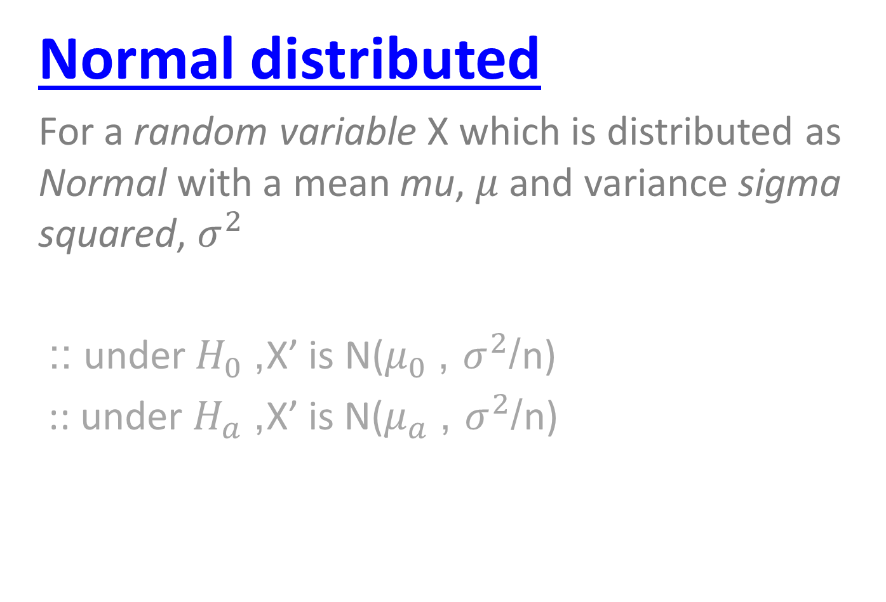
Normal distributed
For a random variable X which is distributed as Normal with a mean mu, $μ$ and variance sigma squared, $σ^{2}$
:: under $H_{0}$, X’ is N($μ_{0}$ , $σ^{2}$/n)
:: under $H_{a}$, X’ is N($μ_{a}$ , $σ^{2}$/n)

Slide 13
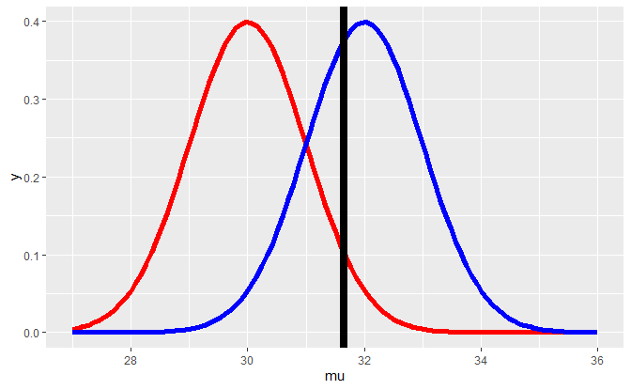
95th percentile of $H_{0}$, black vertical on the red plot

Slide 14

Mean proposed by $H_{a}$, peak of blue plot

Slide 15
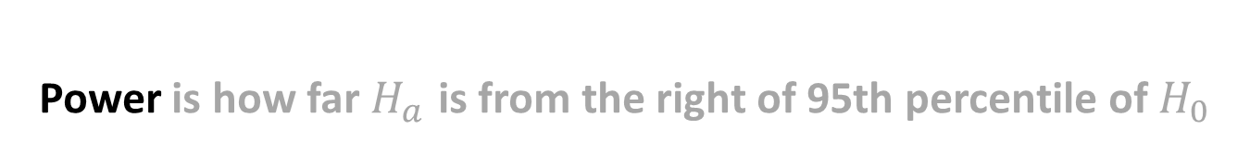
Power is how far $H_{a}$ is from the right of 95th percentile of $H_{0}$

Slide 16
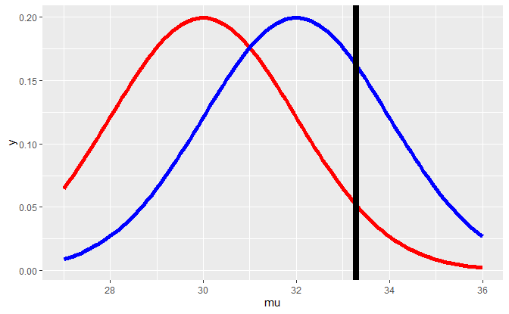
Power depends on the null distribution’s variance

Slide 17
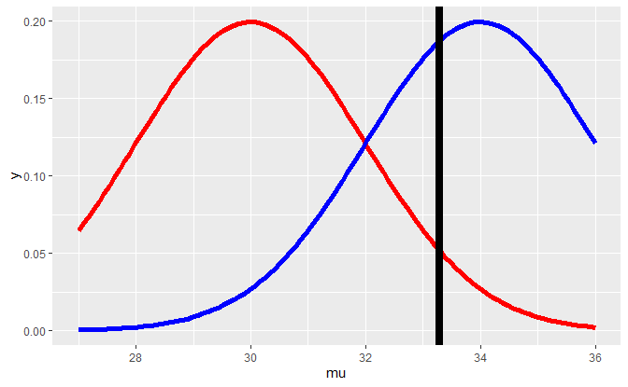
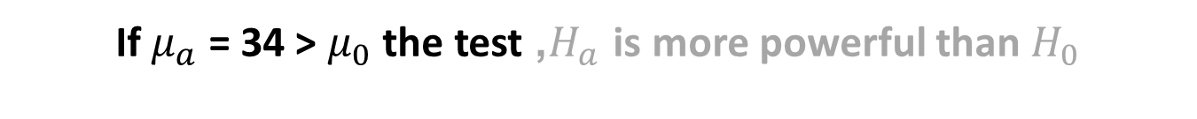
If $μ_{a}$ = 34 > $μ_{0}$ the test, $H_{a}$ is more powerful than $H_{0}$

Slide 18
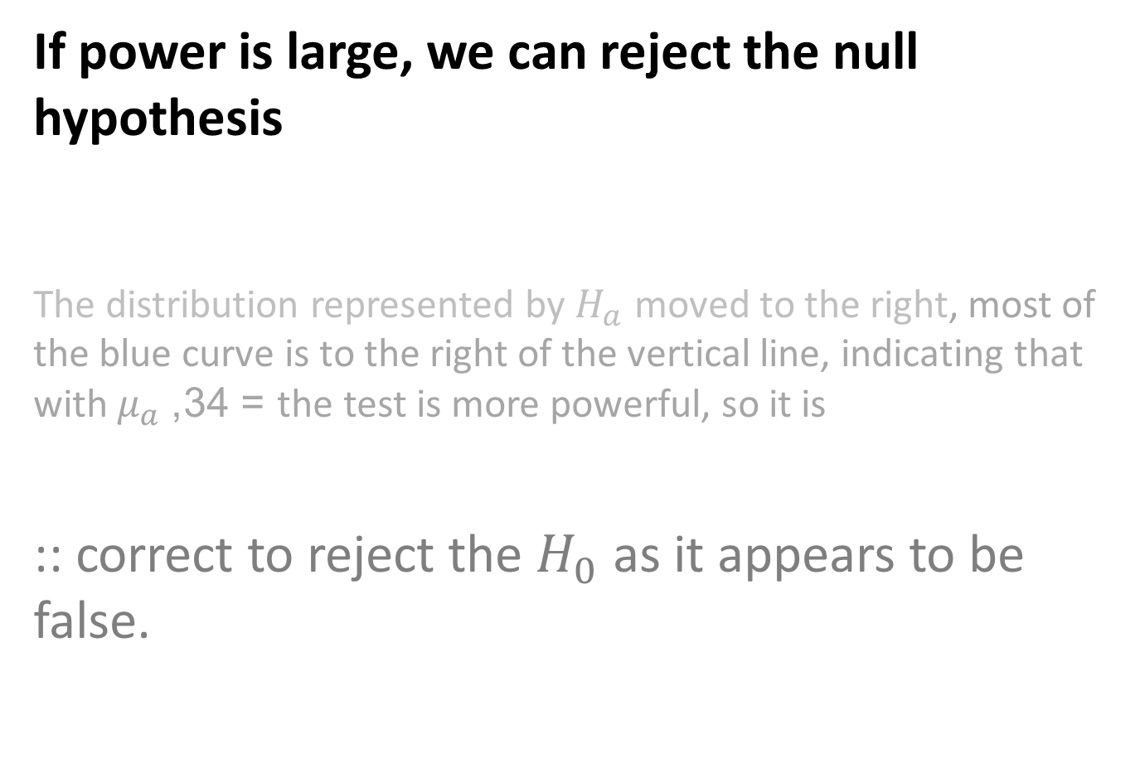
If power is large, we can reject the null hypothesis
The distribution represented by $H_{a}$ moved to the right, most of the blue curve is to the right of the vertical line, indicating that with $μ_{a}$ = 34, the test is more powerful, so it is
:: correct to reject the $H_{0}$ as it appears to be false.

Slide 19
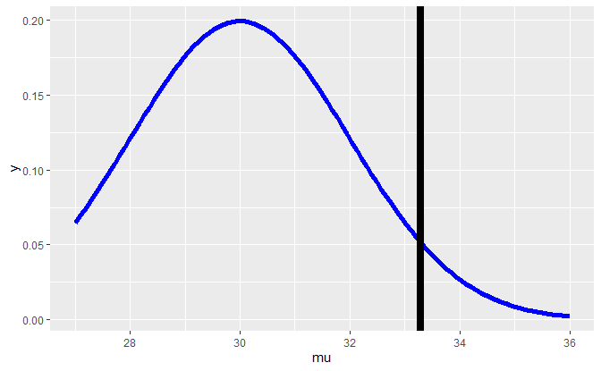

If $μ_{a}$ = 30 = $μ_{0}$ the power is at $α$

Slide 20
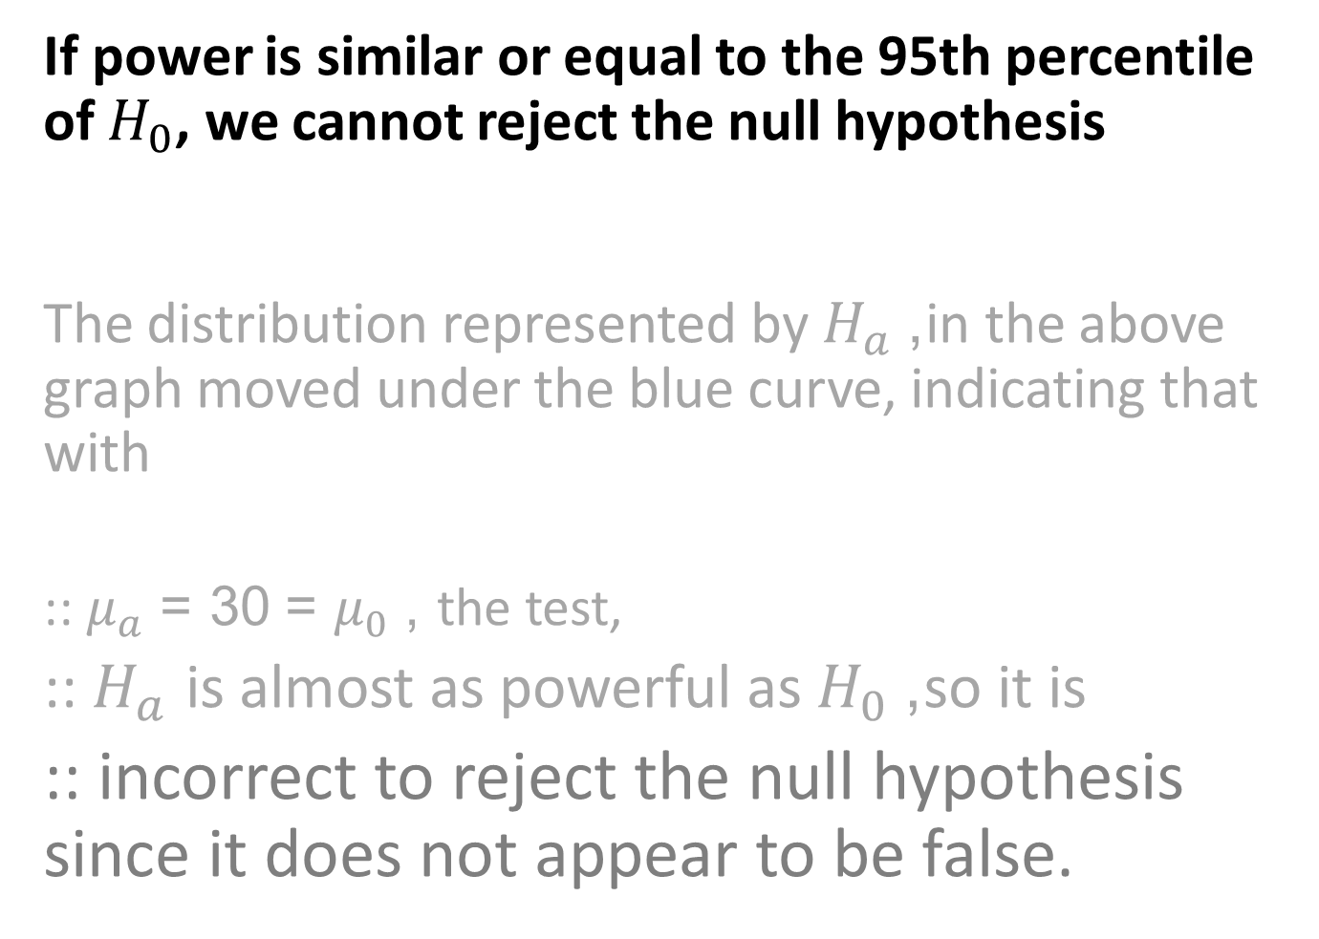
If power is similar or equal to the 95th percentile of $H_{0}$, we cannot reject the null hypothesis
The distribution represented by $H_{a}$, in the above graph moved under the blue curve, indicating that with
:: $μ_{a}$ = 30 = $μ_{0}$ , the test,
:: $H_{a}$ is almost as powerful as $H_{0}$, so it is
:: incorrect to reject the null hypothesis since it does not appear to be false.

Slide 21
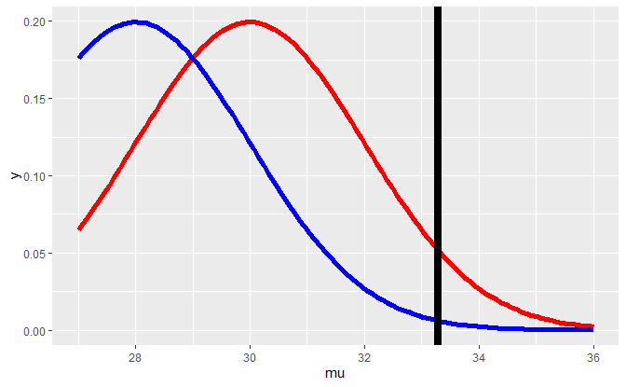
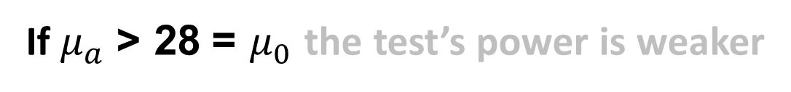
If $μ_{a}$ = 28 < $μ_{0}$ the test’s power is weaker

Slide 22
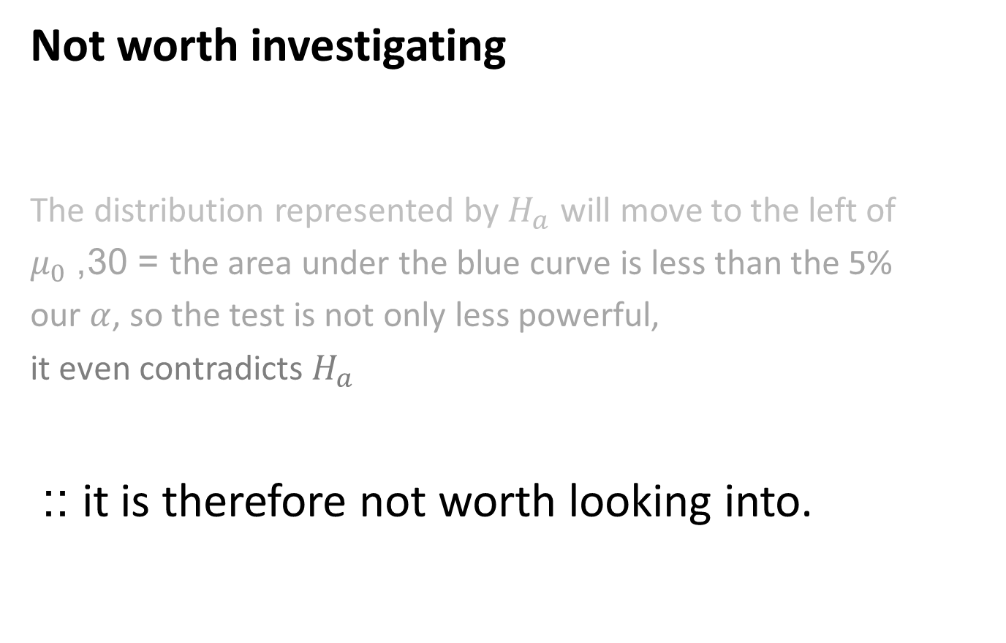
Not worth investigating
The distribution represented by $H_{a}$ will move to the left of
$μ_{0}$ = 30, the area under the blue curve is less than the 5%
our $α$, so the test is not only less powerful,
it even contradicts $H_{a}$
:: it is therefore not worth looking into.

Slide 23
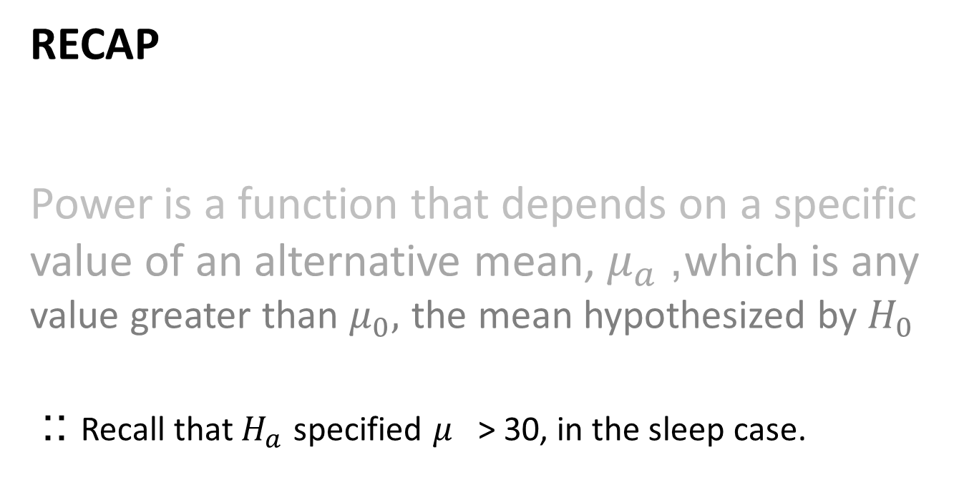
RECAP
Power is a function that depends on a specific value of an alternative mean, $μ_{a}$, which is any value greater than $μ_{0},$ the mean hypothesized by $H_{0}$
:: Recall that $H_{a}$ specified $μ_{}$> 30, in the sleep case.

Slide 24
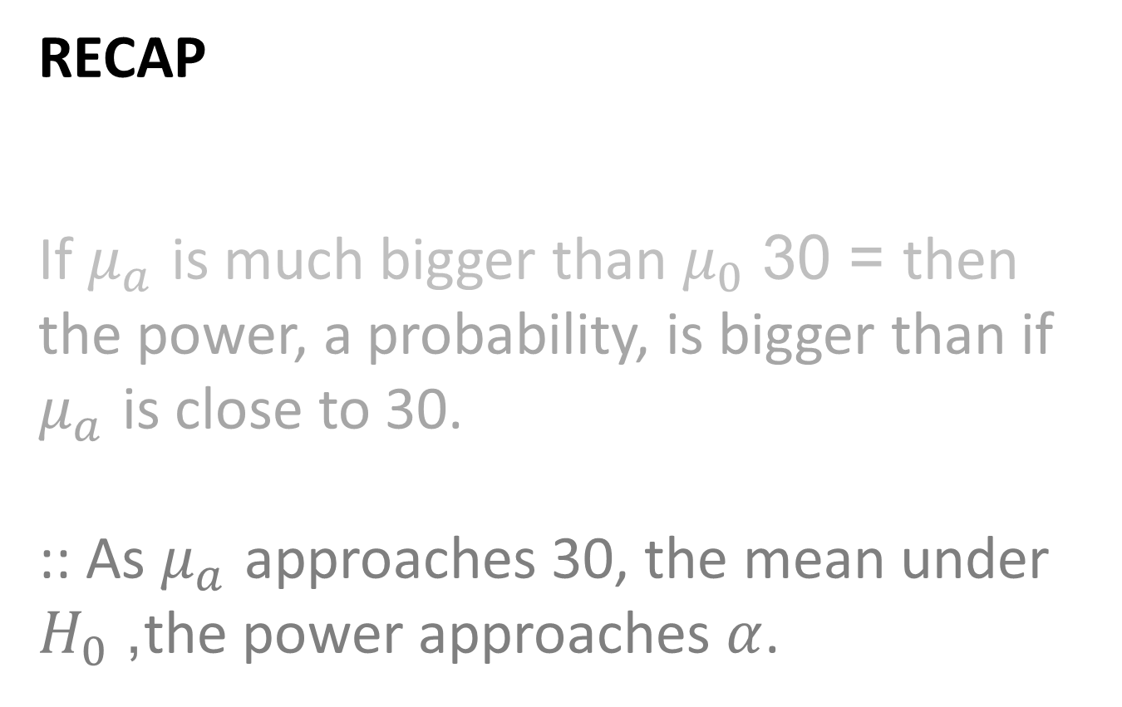
RECAP
If $μ_{a}$ is much bigger than $μ_{0}$ = 30 then the power, a probability, is bigger than if $μ_{a}$ is close to 30.
:: As $μ_{a}$ approaches 30, the mean under $H_{0}$, the power approaches $α$.

Slide 25
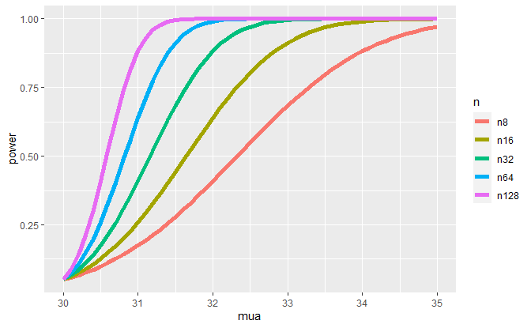
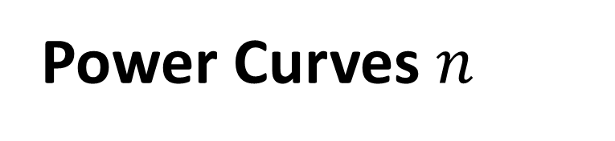
Power Curves $n$

Slide 26
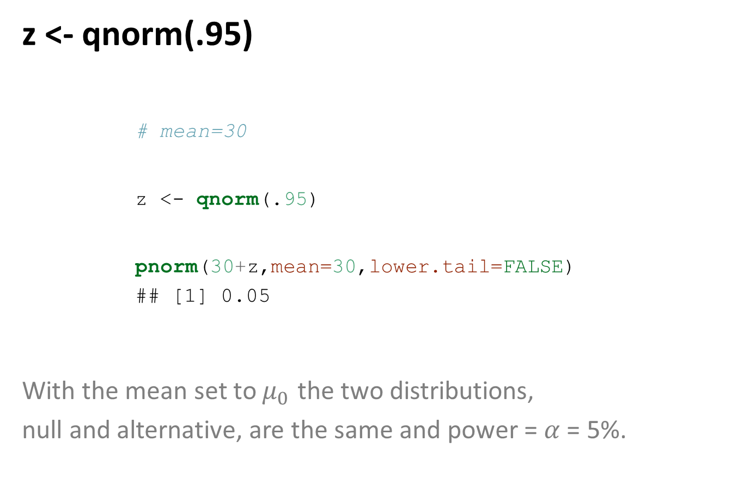
z <- qnorm(.95)
# mean=30 z <- qnorm(.95) pnorm(30+z,mean=30,lower.tail=FALSE)
## [1] 0.05
With the mean set to $μ_{0}$ the two distributions,
null and alternative, are the same and power = $α$ = 5%.

Slide 27
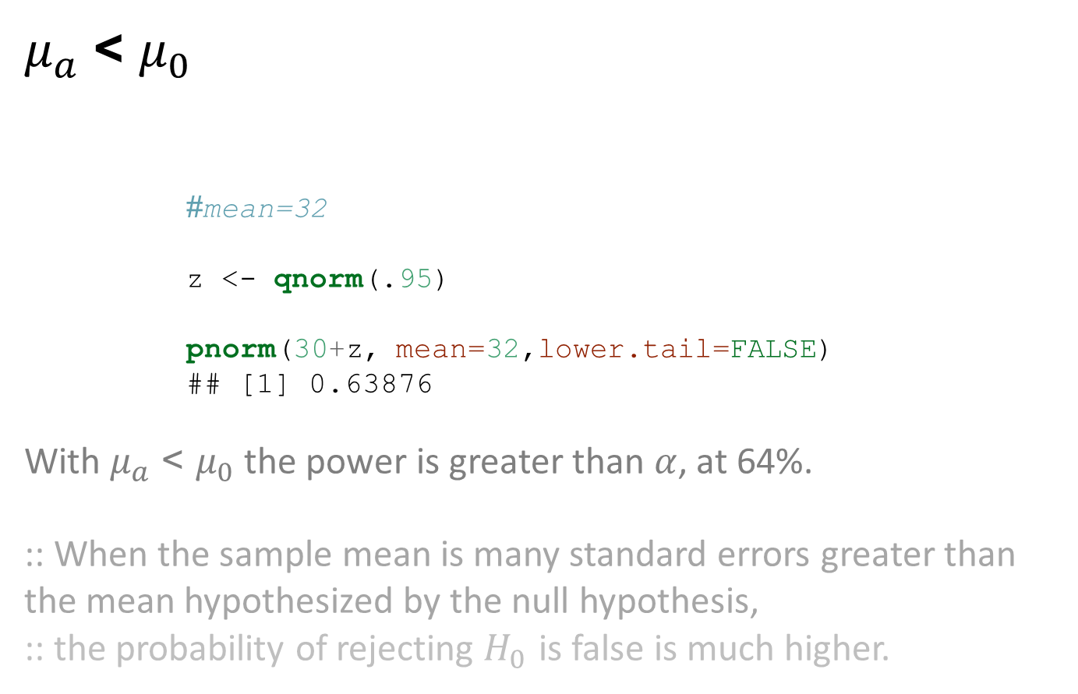
$μ_{a}$ > $μ_{0}$
#mean=32 z <- qnorm(.95) pnorm(30+z, mean=32,lower.tail=FALSE)
## [1] 0.63876
With $μ_{a}$ > $μ_{0}$ the power is greater than $α$, at 64%.
:: When the sample mean is many standard errors greater than
the mean hypothesized by the null hypothesis,
:: the probability of rejecting $H_{0}$ is false is much higher.

Slide 28
Standard deviation, sd
# sd=1 z <- qnorm(.95) pnorm(30+z, mean=32, sd= 1, lower.tail=FALSE)
## [1] 0.63876
# sd=2 z <- qnorm(.95) pnorm(30+z, mean=32, sd= 2, lower.tail=FALSE)
## [1] 0.5704709
:: Power decreases with increases in variation

Slide 29
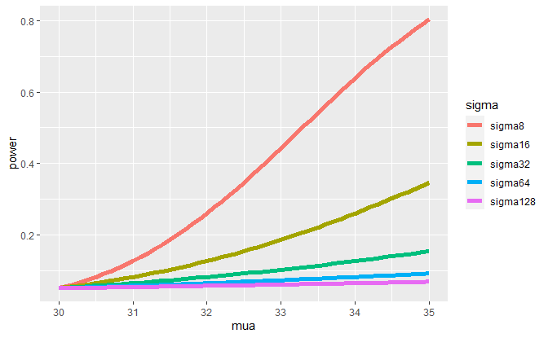
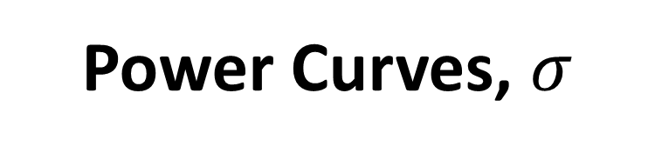
Power Curves, $σ$

Slide 30
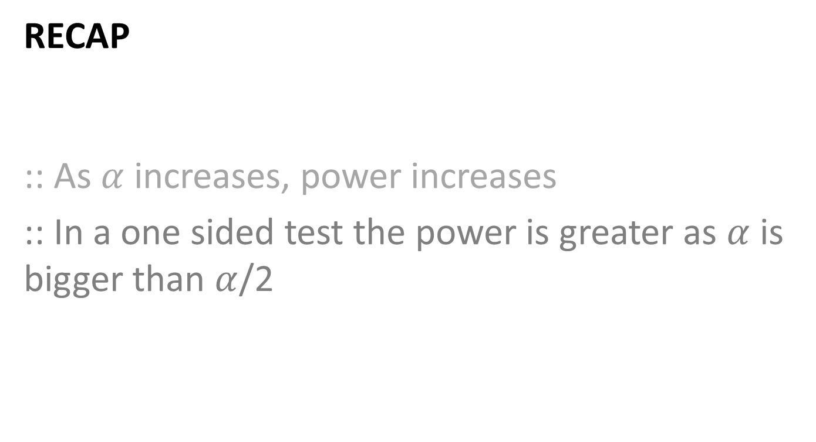
RECAP
:: As $α$ increases, power increases
:: In a one sided test the power is greater as $α$ is bigger than $α$/2

Slide 31
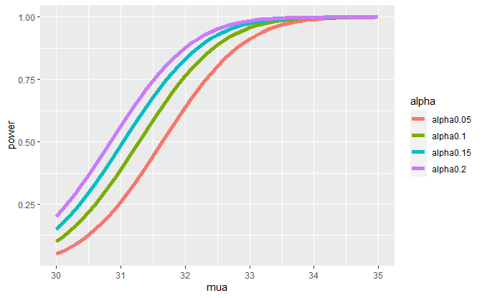
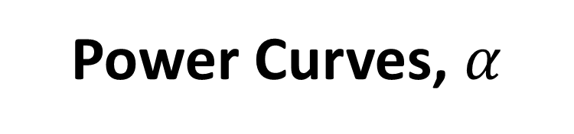
Power Curves, $α$

Slide 32
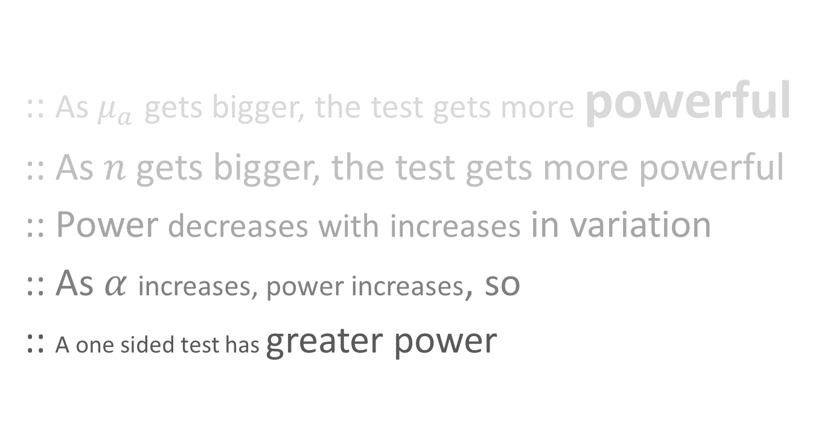
POWERful RECAP
:: As $μ_{a}$ gets bigger, the test gets more powerful
:: As $n$ gets bigger, the test gets more powerful
:: Power decreases with increases in variation
:: As $α$ increases, power increases, so
:: A one sided test has greater power

Slide 33
@lindangulopez Statistical Inference
myCOURSERA notes:
plots from swirl

