Slide 1
P for POWER
Statistical Inference Linda Angulo Lopez

Slide 2
R4.0 Environment
library(knitr) creating slides
library(ggplot2) making plots
library(reshape2) # for data frames

Slide 3
POWER
Power is the probability of rejecting the NULL HYPOTHESIS when it is false.
:: Power is used to determine if your sample size was big enough to yield a meaningful, rather than random, result
:: Detect if your ALTERNATIVE hypothesis is true, to lower the risk of a Type II errors.

Slide 4
Equation
As beta is the probability of a Type II error, for accepting a false null hypothesis, and the complement of this is (1-$β$), the power is:
$$P=(1−β)$$

Slide 5
Sleep Example
:: H_0 mu = 30
:: H_a mu > 30
where (X’-30)/(s/$\sqrt{(}n)$) measures the number of standard errors the sample mean is from the mean hypothesized by H_0 and the denominator, (s/$\sqrt{(}n)$) is the standard error of the sample mean.

Slide 6
Alpha
Power is the probability that the true mean mu is greater than the (1-$α$) quantile
:: if $α$ = .05 and as H_a mu > 30
:: for normal distributions of which we know the variances:
P = qnorm(.95)

Slide 7
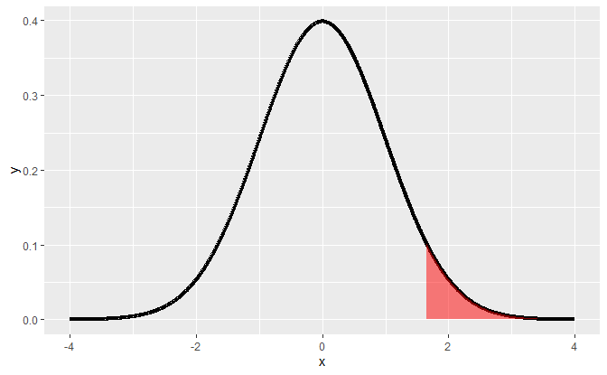
When to reject H_0 ?

Slide 8
If a test statistic fell in the shaded portion, 5% of the area under the curve, we would reject H_0 and favor H_a.

Slide 9
Two distributions
The two hypotheses, H_0 and H_a, represent two distributions
:: since they’re talking about means or
:: centers of distributions.

Slide 10
Normal distributed
For a random variable X which is distributed as Normal with a mean mu (μ) and variance sigma squared (σ2)
:: under H_0, X’ N($μ_{0}$ , $σ^{2}$/n)
:: under H_a, X’ N($μ_{a}$ , $σ^{2}$/n)

Slide 11
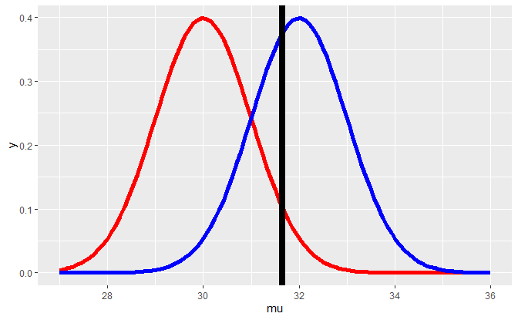
95th percentile of H_0, in red

Slide 12
Mean proposed by H_a, in blue

Slide 13
POWER is how far H_a is right of 95th percentile of H_0

Slide 14
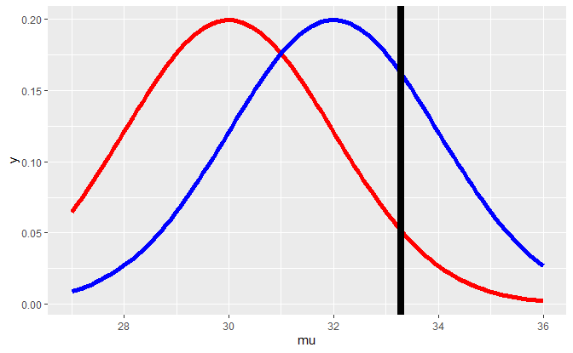
Power depends on the null distribution

Slide 15
If $μ_{a}$ = 34, the test is more powerful
The distribution represented by H_a will moved to the right, almost all (100%) of the blue curve is to the right of the vertical line, indicating that with $μ_{a}$ = 34, the test is more powerful, i.e., there’s a higher probability that it’s
:: correct to reject the null hypothesis since it appears false.

Slide 16
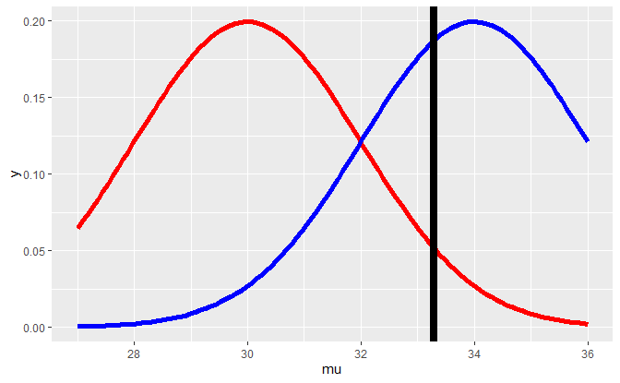

Slide 17
If $μ_{a}$ = 30, the power = $α$
The distribution represented by H_a will move under the blue curve, indicating that with $μ_{a}$ = 30 = $μ_{0}$ 4, the test is as powerful as the H_0.
:: in correct to reject the null hypothesis since it appears not false.

Slide 18
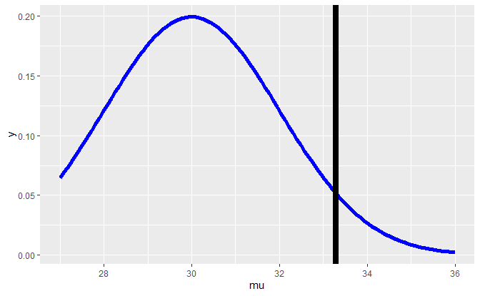

Slide 19
If $μ_{a}$ = 28, the power is weaker
The distribution represented by H_a will move to the left of $μ_{0}$ = 30, the area under the blue curve is less than the 5% so the test is less powerful and contradicts H_a.
:: it’s not worth looking at

Slide 20
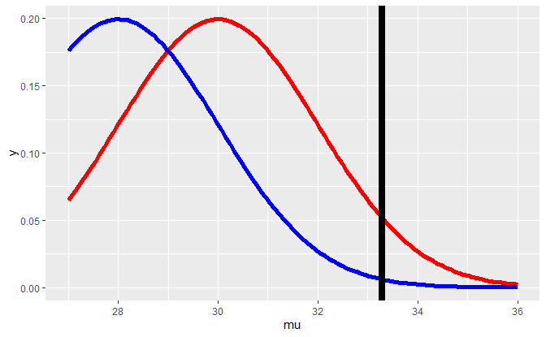

Slide 21
RECAP
Power is a function that depends on a specific value of an alternative mean, mu_a, which is any value greater than mu_0, the mean hypothesized by H_0.
:: Recall that H_a specified mu > 30.

Slide 22
RECAP
If mu_a is much bigger than mu_0=30 then the power (probability) is bigger than if mu_a is close to 30.
:: As mu_a approaches 30, the mean under H_0, the power approaches alpha.

Slide 23
RECAP
:: As $μ_{a}$ gets bigger, it gets more powerful
:: As $n$ gets bigger, it gets more powerful

Slide 24
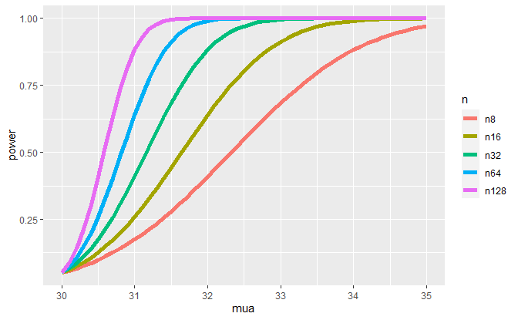
Power Curves $n$

Slide 25
z <- qnorm(.95)
z <- qnorm(.95) pnorm(30+z,mean=30,lower.tail=FALSE)
## [1] 0.05
With the mean set to mu_0 the two distributions, null and alternative, are the same and power=alpha.

Slide 26
$μ_{a}$ > $μ_{0}$
z <- qnorm(.95) pnorm(30+z, mean=32,lower.tail=FALSE)
## [1] 0.63876
With $μ_{a}$ > $μ_{0}$mu_a the power is at 64% as opposed to 5%.
:: When the sample mean is many standard errors greater than the mean hypothesized by the null hypothesis,
:: the probability of rejecting H_0 when it is false is much higher.

Slide 27
Standard deviation, sd
when $sd$ = 1
z <- qnorm(.95) pnorm(30+z, mean=32, sd= 1, lower.tail=FALSE)
## [1] 0.63876
when $sd$ = 2
z <- qnorm(.95) pnorm(30+z, mean=32, sd= 2, lower.tail=FALSE)
## [1] 0.5704709
:: Power decreases with increases in variation

Slide 28
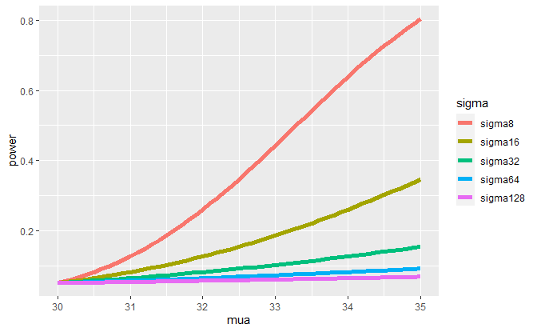
Power Curves $σ$

Slide 29
RECAP
:: As $α$ increases, power increases
:: In a one sided test the power is greater as $α$ is bigger than $α$/2

Slide 30
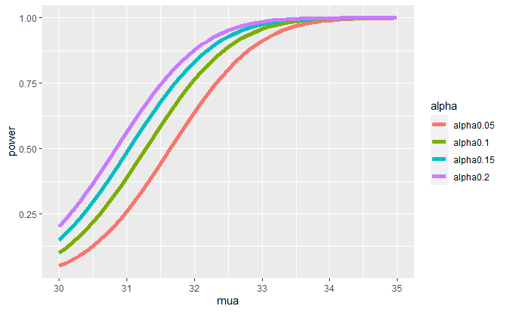
Power Curves $α$

Slide 31
if H_a specified that $μ$ < $μ_{0}$
:: flip the above reasoning
:: look at the right tail

Slide 32
RECAP
Suppose H_a says that mu > mu_0. :: power = 1 - beta
= Prob ( X’ > mu_0 + z_(1-alpha) * sigma/sqrt(n))
assuming that X’~ N(mu_a,sigma^2/n).
:: given the context of the problem, …

Slide 33
for H_a says that mu > mu_0 we know
:: the population mean equals $μ_{0}$
:: the level size of the test is $α$

Slide 34
$β$, $σ$, $n$, and $μ_{a}$
In the statement 1 - beta
= Prob( X’ > mu_0 + z_(1-alpha) * sigma/sqrt(n))
:: Given $μ_{a}$ > $μ_{0}$, $μ_{0}$ and $α$ are specified, :: and X’ depends on the data.
:: The other four quantities, ($β$, $σ$, $n$, and $μ_{a}$) are all unknown.

Slide 35
Solve for $P$ (power) or $n$ (sample size)
:: only $\sqrt{(}n)$ * $\frac{μ_{a}−μ_{0}}{σ}$ is needed
:: this is the effect size

Slide 36
Example: t distributions
:: t quantile instead of the z
Power is still a probability, namely :: $\frac{P(X′−μ_{0})}{(S/\sqrt{(}n)}$ > t_(1-$α$, $n$-1) for H_a that mu > mu_a
:: the proposed distribution is not centered at mu_0, :: have to use the non-central t distribution.

Slide 37
R functipon power.t.test()
:: omit one of the arguments and power.t.test() solves for it
power.t.test(n = 16,delta = 2 / 4, sd=1, type = "one.sample", alt = "one.sided")$power
## [1] 0.6040329
power.t.test(n = 16, delta = 2 , sd=4, type = "one.sample", alt ="one.sided")$power
## [1] 0.6040329
power.t.test(n = 16, delta = 100 , sd=200, type = "one.sample", alt ="one.sided")$power
## [1] 0.6040329

Slide 38
Constant POWER
:: keeping the effect size (the ratio delta/sd) constant preserved the power
:: get a constant effect size with
with the same values for n (16) & alpha (.05), but different delta and standard deviation values

Slide 39
Solve for $n$
:: specify a power we want and solve for the sample size $n$.
power.t.test(power = .8, delta = 2 / 4, sd=1, type = "one.sample", alt = "one.sided")$n
## [1] 26.13751
power.t.test(power = .8, delta = 2, sd=4, type = "one.sample", alt = "one.sided")$n
## [1] 26.13751
power.t.test(power = .8, delta = 100, sd=200, type = "one.sample", alt = "one.sided")$n
## [1] 26.13751

Slide 40
Solve for $δ$ change $n$
:: use power.t.test to find delta for a power=.8 and n=26 and sd=1
power.t.test(power = .8, n=26, sd=1, type = "one.sample", alt = "one.sided")$delta
## [1] 0.5013986
:: use power.t.test to find delta for a power=.8 and n=27 and sd=1
power.t.test(power = .8, n=27, sd=1, type = "one.sample", alt = "one.sided")$delta
## [1] 0.4914855

Slide 41
Solve for $δ$ change $sd$
:: use power.t.test to find delta for a power=.8 and n=26 and sd=2
power.t.test(power = .8, n=26, sd=2, type = "one.sample", alt = "one.sided")$delta
## [1] 1.002797
Plots from swirl repo

