Slide 1
Laboratory Work 6
Detecting Anomalies in
Time-Series Data Using Power BI
IS107 | Power BI Desktop
Tourism Dataset Analysis

Slide 2
Overview
Dataset
LW6-tourism-details.csv — 920 rows of monthly tourism data (2012–2022)
Fields
Period (Date), Accommodation Type (Text), Travel (Text), Tourists (Number)
Tool
Power BI Desktop — Line Chart + Analytics Pane Anomaly Detection
Objective
Detect and explain anomalies in tourist volume over time

Slide 3
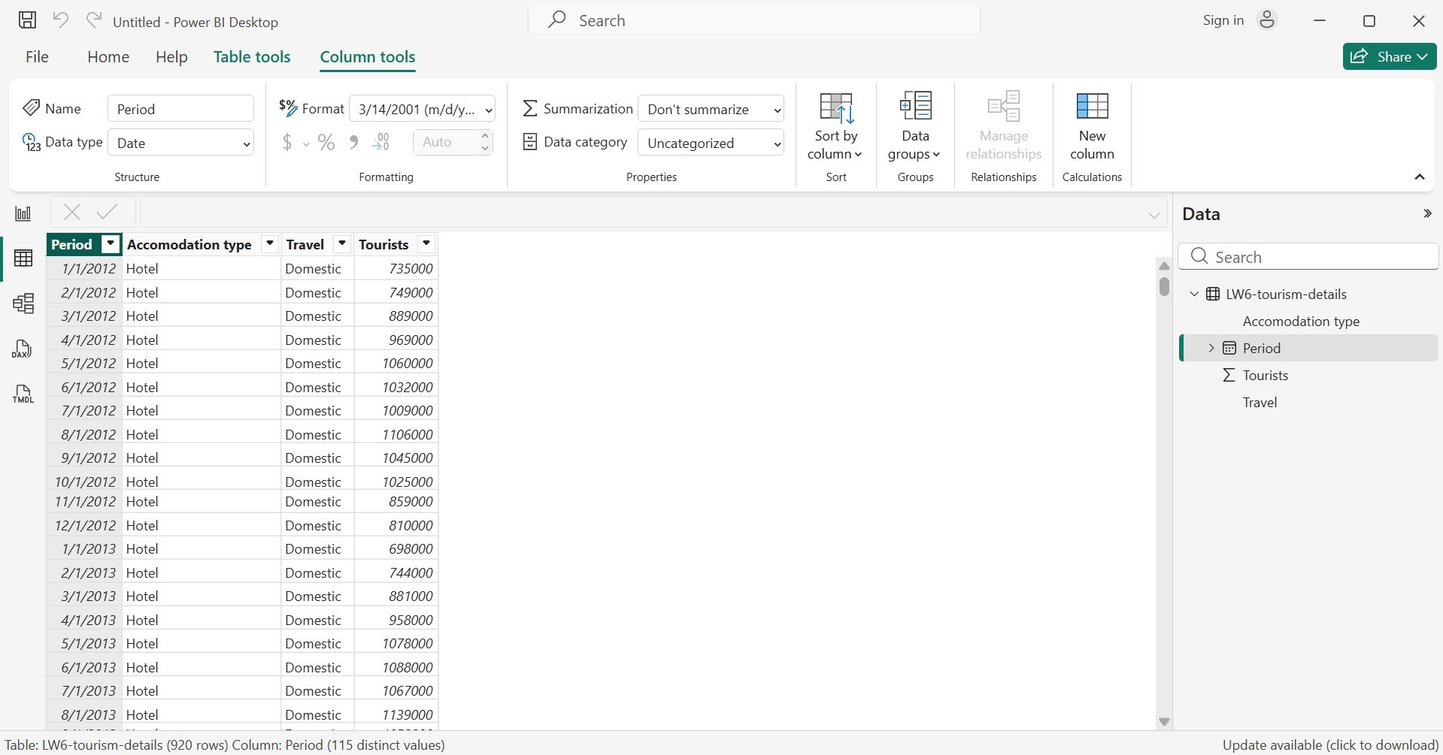
Part 1 — Data Preparation
Imported LW6-tourism-details.csv into Power BI. The Period column was set to Date type.

Slide 4
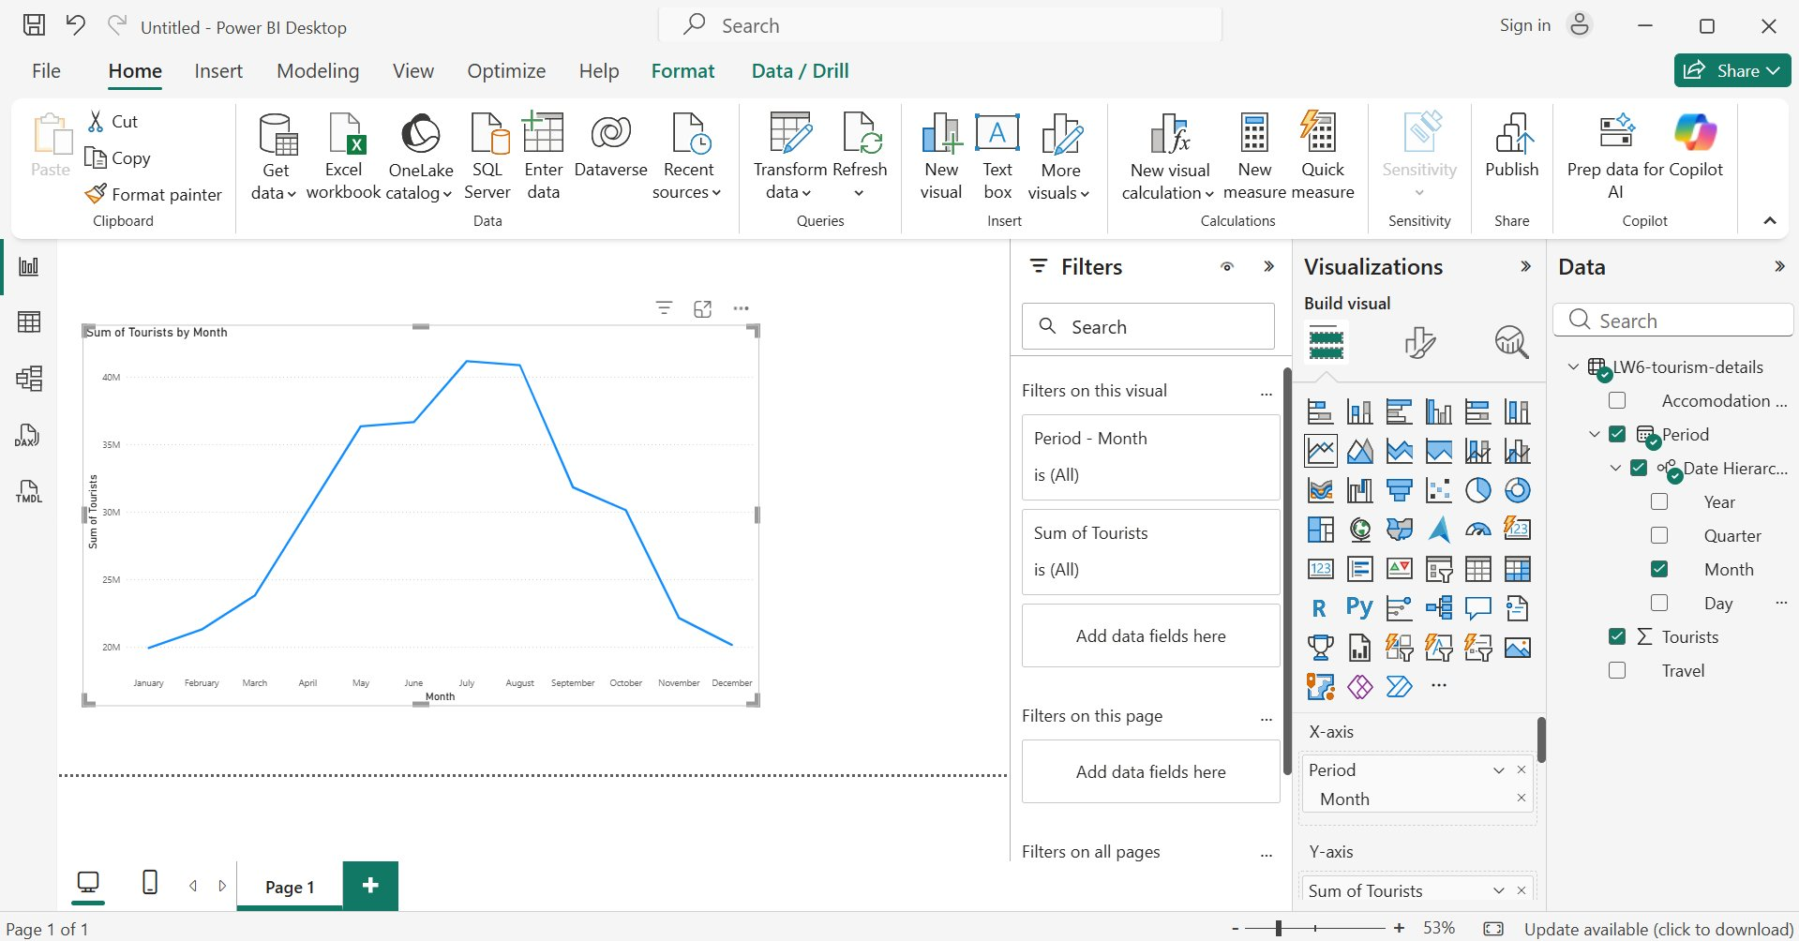
Part 2 — Line Chart: Sum of Tourists by Month
A line chart was created with Period on the X-axis and Tourists on the Y-axis (monthly view).

Slide 5
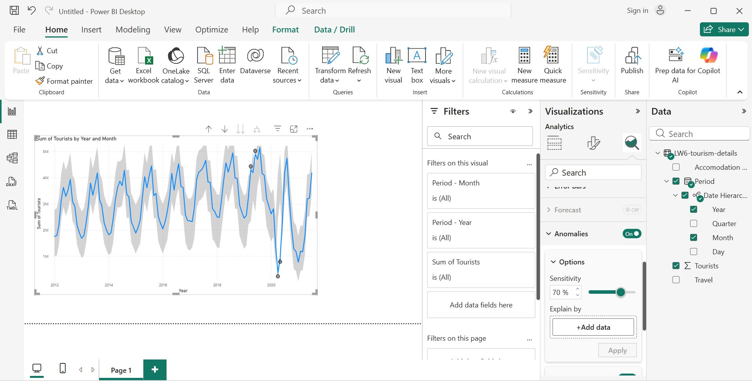
Part 3 — Anomaly Detection Enabled (70% Sensitivity)
Anomalies toggle turned ON in the Analytics pane. Sensitivity set to 70%. Shaded bands show expected range.

Slide 6
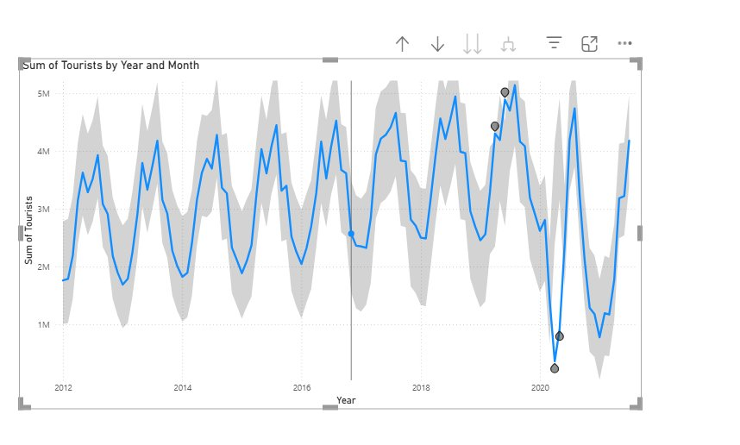
Anomaly Points Highlighted (2019–2021)
Anomaly markers appear around 2019 (unexpectedly high) and 2020–2021 (sharp drops — COVID-19 impact).

Slide 7
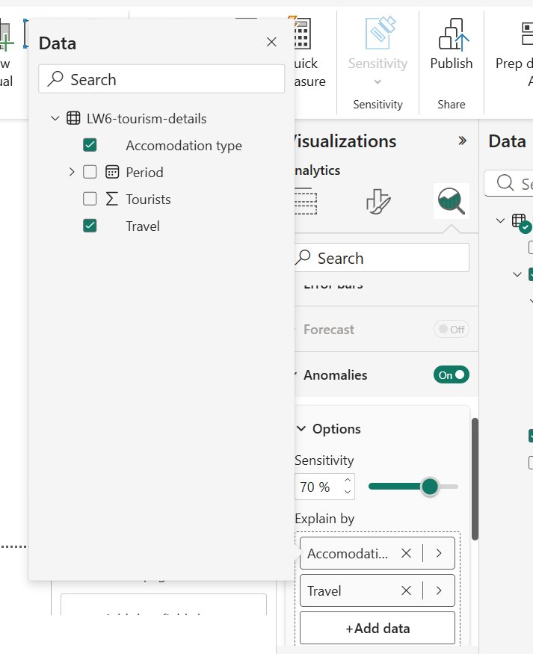
Part 4 — Explain By: Accommodation Type & Travel
'Accommodation type' and 'Travel' were dragged into the Explain By section to provide possible explanations.

Slide 8
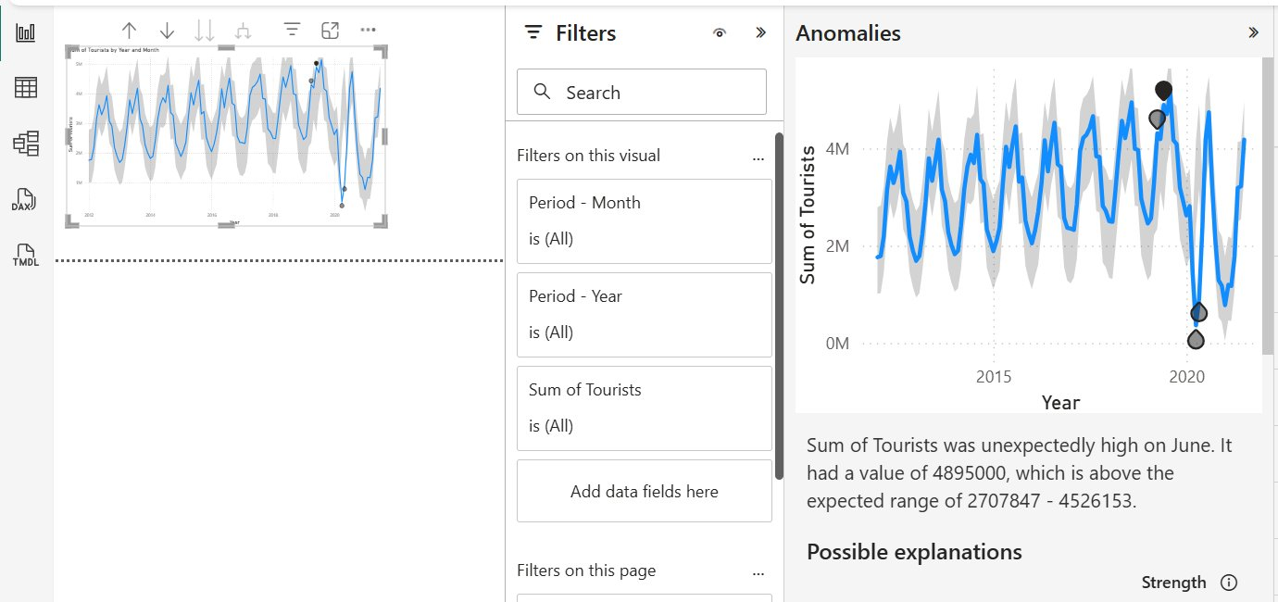
Anomaly: Unexpectedly HIGH — June (4,895,000 Tourists)
Value of 4,895,000 exceeded the expected range of 2,707,847 – 4,526,153. Triggered the anomaly flag.

Slide 9
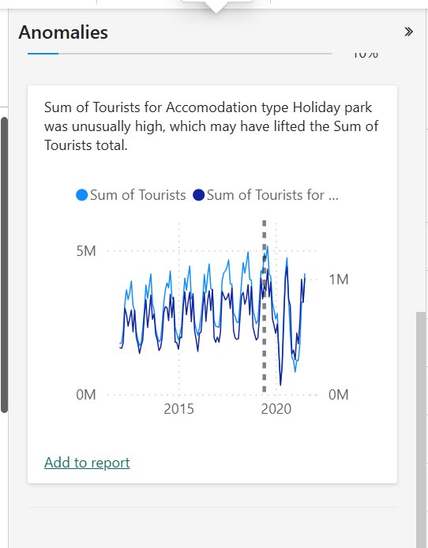
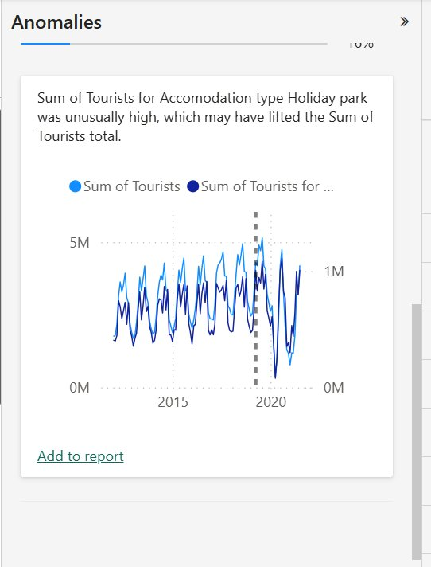
Explanation: Holiday Park — Unusually High
Power BI suggested that the 'Holiday Park' accommodation type was unusually high and may have lifted the total.

Slide 10
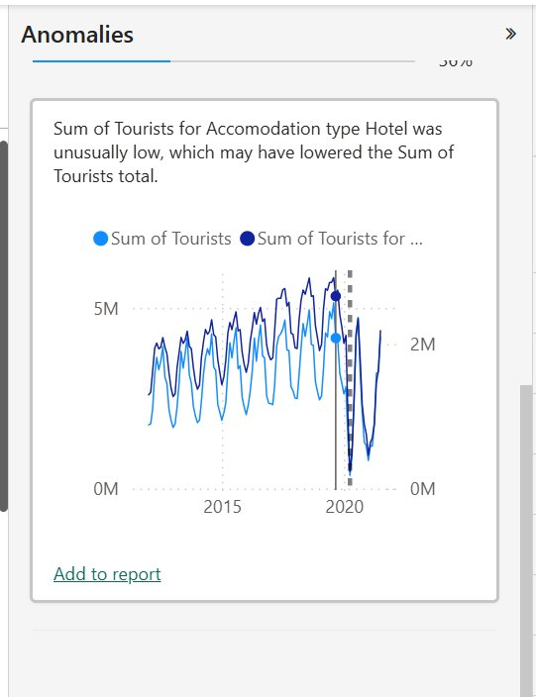
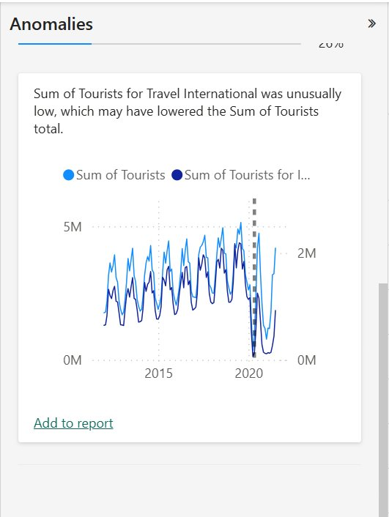
Explanations: Hotel (Low) & International Travel (Low)
Both 'Hotel' accommodation and 'International' travel were identified as unusually low contributors.

Slide 11
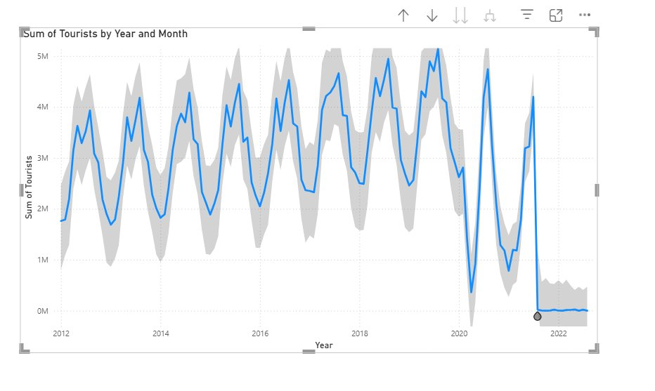
Part 6 — After Adding the New Anomaly Dataset
New 20-row dataset (2021–2022) appended. Report refreshed — new anomaly marker detected in early 2022.

Slide 12
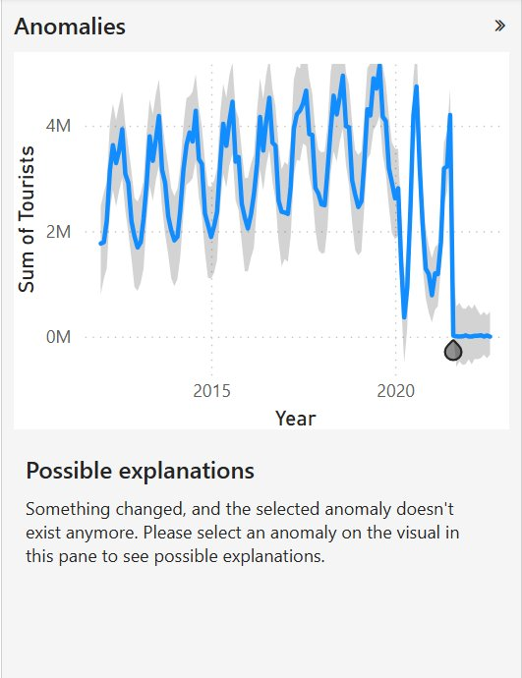
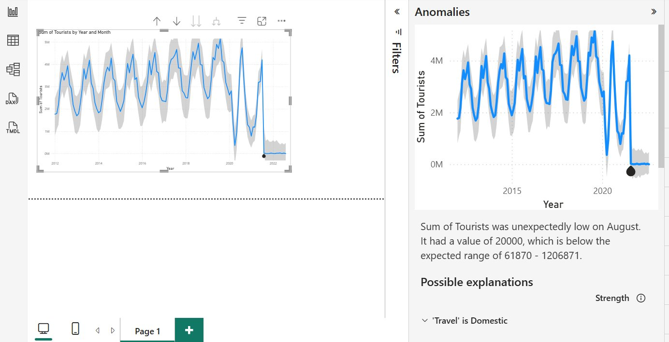
New Anomaly — August 2022: Unexpectedly LOW (20,000)
Value of 20,000 tourists fell far below the expected range of 61,870 – 1,206,871. Domestic travel was the main explanation.

Slide 13
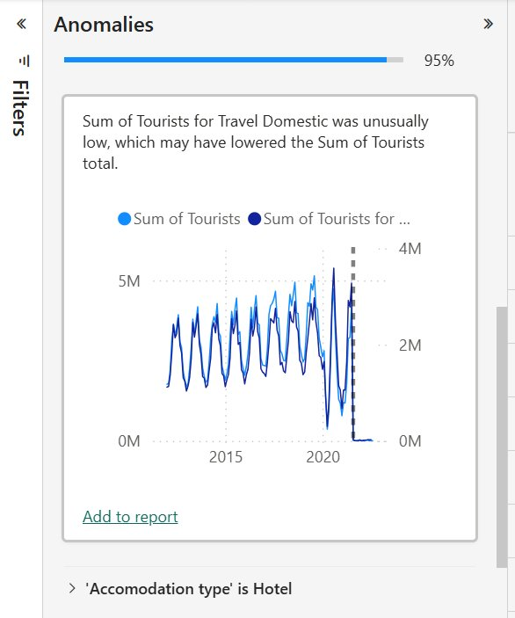
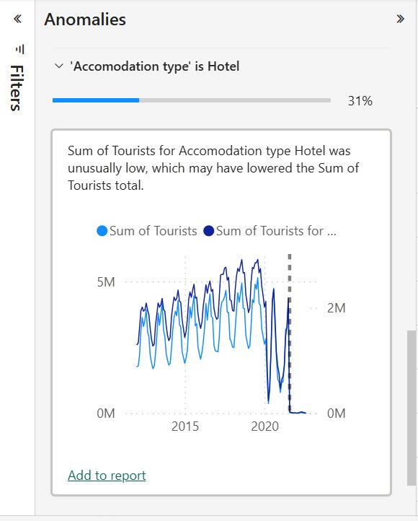
Explanations: Domestic Travel (95%) & Hotel (31%)
'Travel is Domestic' had the strongest explanation strength (95%), followed by 'Accommodation type is Hotel' (31%).

Slide 14
Part 5 — Guide Questions & Analysis
1. What trend and seasonality patterns are observed?
Tourist numbers show consistent seasonal peaks mid-year (June–August) and dips in winter months. An overall upward trend from 2012 to 2019 is visible.
2. Which anomalies are obvious vs. subtle?
The 2020 crash (COVID-19) is highly obvious — a dramatic drop far outside the expected band. The June 2019 peak is subtle — it only slightly exceeds the upper bound.
3. What factors contributed to anomalies?
The high anomaly in 2019 was linked to unusually high Holiday Park bookings. The 2020–2022 lows were driven by COVID-19 — especially drops in International travel and Hotel stays.
4. Are the AI explanations logically valid?
Yes. The suggestions align with real-world context. COVID-19 restrictions directly impacted hotel stays and international travel, confirming the AI's explanations are credible.

Slide 15
Summary
The tourism dataset exhibited consistent seasonal trends with peaks in mid-year months.
Anomaly detection at 70% sensitivity successfully flagged both high and low outliers.
The June 2019 anomaly was driven by an unusually high number of Holiday Park visitors.
The 2020–2022 anomalies clearly reflect the impact of COVID-19 — sharp drops in Hotel stays and International travel.
After appending the new 20-row dataset, a new low anomaly in August 2022 was detected with 'Domestic' travel as the primary explanation (95% strength).
The AI-generated explanations were logically valid and consistent with known global events.

