Slide 1
IS107 Laboratory Work 5
Applying DAX Fundamentals
in Power BI
From Measures to Contextual Analysis
Submitted by: [Your Name] | Power BI Desktop
LW5 | 2026

Slide 2
Data Model Overview
Customers
Orders
Cookie Types
Customer ID
Order ID / Customer ID
Cookie Type
Name
Product, Units Sold
Units Sold
Address / State
Date, Revenue, Cost
Revenue Per Cookie
Phone, Zip
Profit, Day of week
Cost Per Cookie
Notes
Has Chocolate
📌 Cookie Types → Orders (1:*) · Customers → Orders (1:*)

Slide 3
I. Foundational Concepts — Q1 & Q2
Q1 — Excel Formula vs. DAX
Q2 — The Why of DAX
For me, Excel formulas are static — they compute one cell at a time and don't travel across related tables. DAX is a formula language built for relational data models. My thought is that DAX understands table relationships, automatically aggregates across millions of rows, and re-evaluates the moment a filter or slicer changes — something a plain Excel SUM formula simply cannot do. While Excel calculates a cell value, DAX calculates a context-aware result.
Raw numbers alone can't answer questions like "What is my profit margin per cookie type for orders above 500 units?" In my view, the gap DAX fills is dynamic aggregation with context. The data in our Orders table is flat — it has Revenue and Cost per row, but no formula tells Power BI how to sum, filter, or relate them to Cookie Types or Customers. DAX bridges that gap by letting us define reusable logic (Measures) that respond to every visual and filter on the canvas.

Slide 4
II. Calculated Columns vs. Measures — Q3 & Q4
Calculated Column
Measure
Storage
Stored in the model — increases .pbix file size
Computed on the fly — no extra storage
Evaluation
Row-by-row at refresh time
Evaluated per visual / filter context
Best for
Row-level flags (e.g. Has Chocolate)
Aggregations (Sum, Count, %)
Example
Day of week, Has Chocolate column
Total Profit, Count of orders, Profit Margin %
Q4 — How Filter Context Affects a Measure
My thoughts: In my dashboard, when no filter is active, "Count of orders" shows 700 (total). The moment I click a customer row — say ACME Bites — the filter context narrows the evaluation space and the measure instantly returns 206. DAX's CALCULATE function is at the heart of this: it re-evaluates the measure expression inside a modified filter context, making every card, chart, and table automatically reactive to slicers and cross-highlights.

Slide 5
III. Function Application & Syntax — Q5 & Q6
Q5 — The RELATED Function
Q6 — Deconstructing the Formula
For me, RELATED is the bridge between tables. When I was building the Has Chocolate calculated column inside Orders, I needed to look up whether the product belonged to a chocolate category in Cookie Types. RELATED follows the established relationship to fetch a value from the related table — but it only works when a one-to-many relationship has been defined in the Model View. Without that relationship, DAX has no path to traverse and RELATED returns an error. In our model, Cookie Types (1) → Orders (*) via Product enables this lookup.
Total Sales = SUM(Sales[Sales Amount])
Measure Name:
Total Sales — descriptive, unique identifier for the KPI
Function:
SUM( ) — DAX aggregation function; iterates every row in scope
Table:
Sales — explicitly scopes the column lookup to avoid ambiguity
Column:
[Sales Amount] — the specific field being aggregated
Best Practice:
Always prefix with the table name (Table[Column]) so DAX can resolve columns unambiguously across multiple tables — especially critical in our 3-table model.

Slide 6
Visual Results — Key Outputs
Total Units Sold by Customer
Count of Orders by Customer
Profit Margin % by Cookie
ABC Groceries: 221,023
ABC Groceries: 132
Choc Chip: 60.00%
ACME Bites: 329,677
ACME Bites: 206
Fortune Cookie: 50.00%
Park & Shop: 179,448
Park & Shop: 114
Oatmeal Raisin: 56.00%
Tres Delicious: 128,769
Tres Delicious: 92
Snickerdoodle: 62.50%
Wholesome: 266,890
Wholesome Foods: 156
Sugar: 58.33%
TOTAL: 1,125,806
TOTAL: 700
TOTAL: 57.93%
Total Profit (Card)
Choc Chip Orders > 500 units
Distinct Customers / Profit
Total Profit 2:
Count: 185
Each customer: 1
2,717,064.38
unique buyer (5 total)
DAX CALCULATE used
Total Profit: 2,717,070.50
Revenue – Cost = Profit
with FILTER condition
Revenue – Cost
Across all customers
Units Sold > 500
confirmed equal
& all cookie types
on Chocolate Chip rows
across all rows

Slide 7
IV. Analysis & Troubleshooting — Q7 & Q8
Q7 — Negative Total Profit: Broken Formula or Business Insight?
My thoughts: A negative Total Profit figure does NOT mean the DAX formula is broken. For me, it means the formula is working exactly as designed — it's telling me that for that specific category, costs exceeded revenue. The data is the problem, not the logic. To verify: (1) Cross-check the Revenue and Cost columns in the raw Orders table for that category. (2) Confirm the Profit calculated column formula is correct: Profit = Revenue – Cost. (3) Check if there are data-entry errors (e.g. reversed Revenue/Cost values). In our actual results, all profits were positive (Total Profit 2 = 2,717,064.38), which confirms the formula is healthy and the business is profitable across all segments.
Q8 — Profit Margin %: Calculated Column vs. Measure — Which is More Efficient?
A single Measure is far more efficient. For me, creating a Calculated Column for Profit Margin % would compute and store a value for every one of the 700 rows in our Orders table — bloating file size and recalculating at every model refresh. My thought is that a Measure defined as:
Profit Margin % = DIVIDE(SUM(Orders[Profit]), SUM(Orders[Revenue]))
...computes nothing until a visual requests it, and then it computes only the aggregated result scoped to the current filter context. This is both memory-efficient and dynamically correct — if I slice by Cookie Type, the measure automatically re-evaluates for just that subset, while a calculated column would require rebuilding entirely.

Slide 8
Key Takeaways
◆
DAX operates on relational models with context-awareness — not just static cell math.
◆
Calculated Columns store row-level data and grow the file; Measures are on-demand and storage-lean.
◆
Filter Context is what makes a Measure dynamic — the same formula yields different results per visual.
◆
RELATED() requires established model relationships to bridge tables in column formulas.
◆
Profit Margin % is best built as a Measure for efficiency and dynamic filtering.
◆
Unexpected results (negatives) indicate business data issues — not broken DAX logic.
IS107 LW5 · DAX in Power BI · 2026

Slide 9
Appendix
Visual Outputs & Screenshots
A: Power BI Dashboard Visuals | B: Data Tables | C: Model Relationship Diagram
IS107 LW5 · DAX in Power BI · 2026

Slide 10
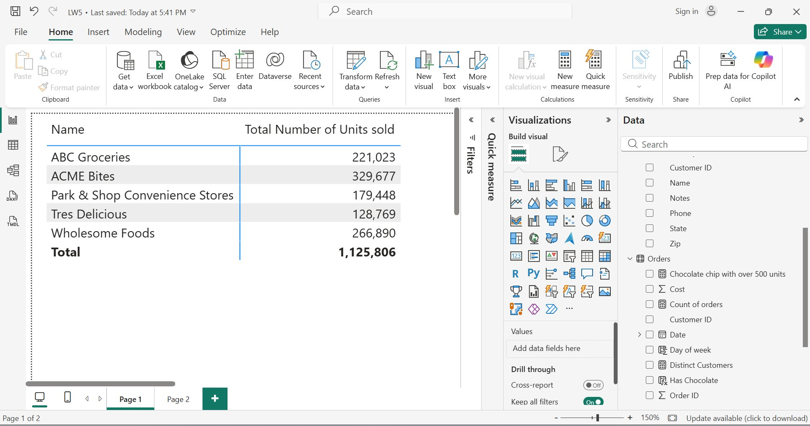
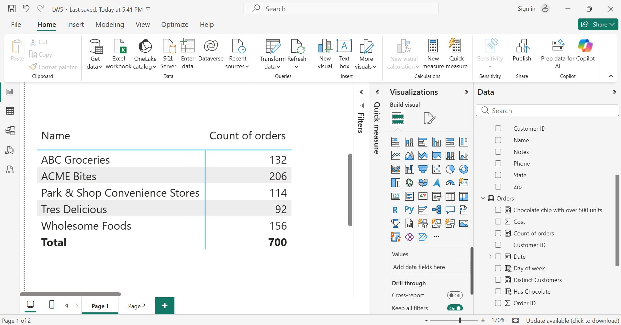
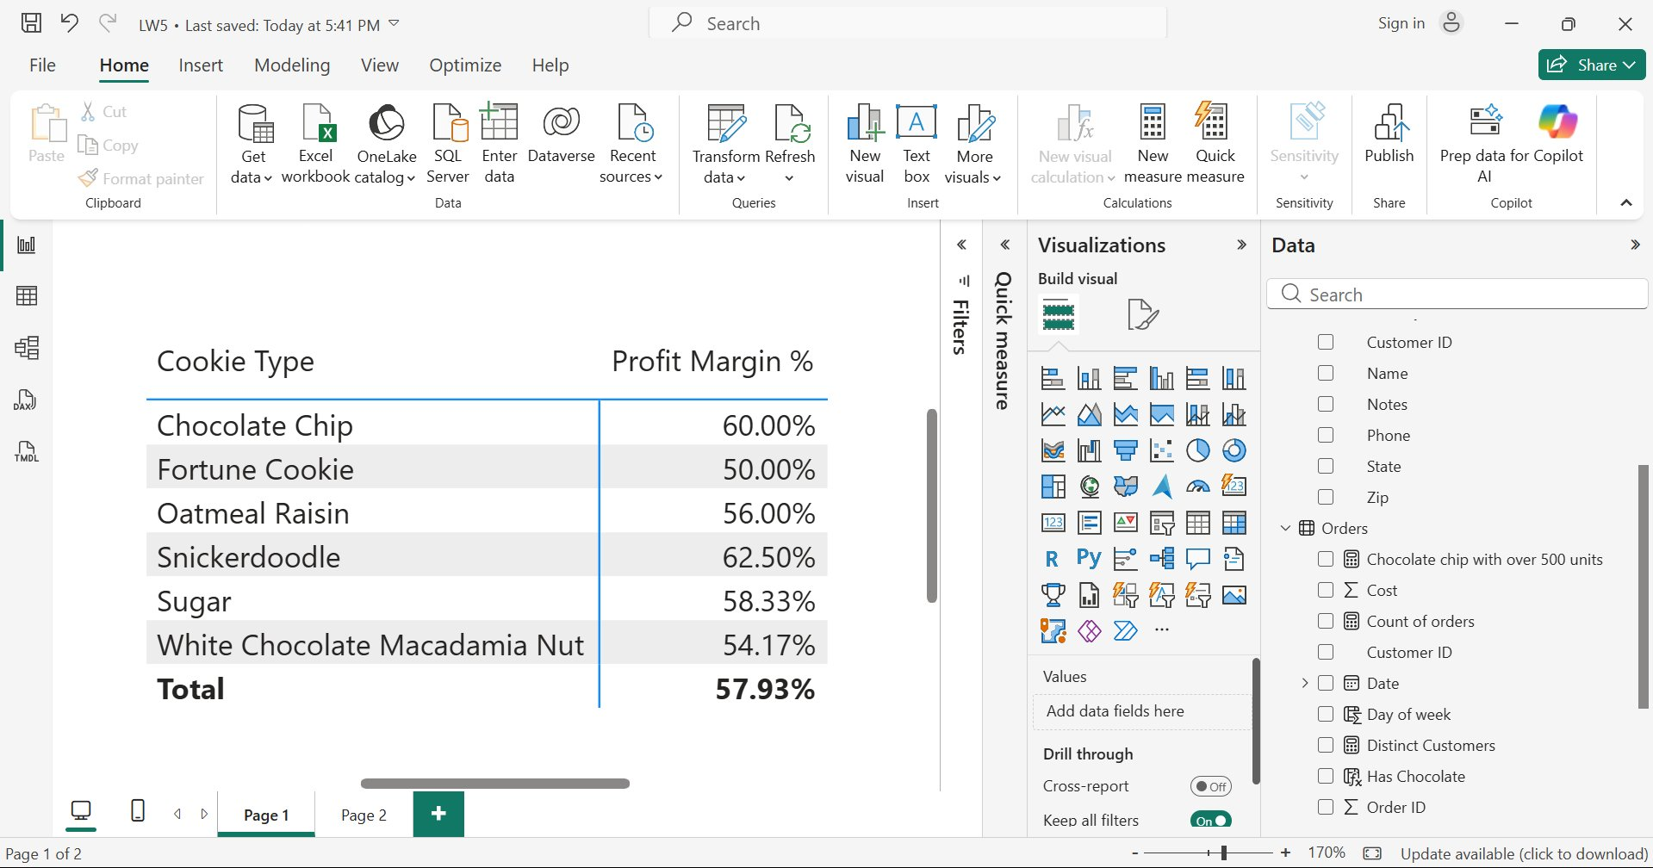
Appendix A — Dashboard Visuals (1/2)
Total Number of Units Sold by Customer
Count of Orders by Customer
Profit Margin % by Cookie Type

Slide 11
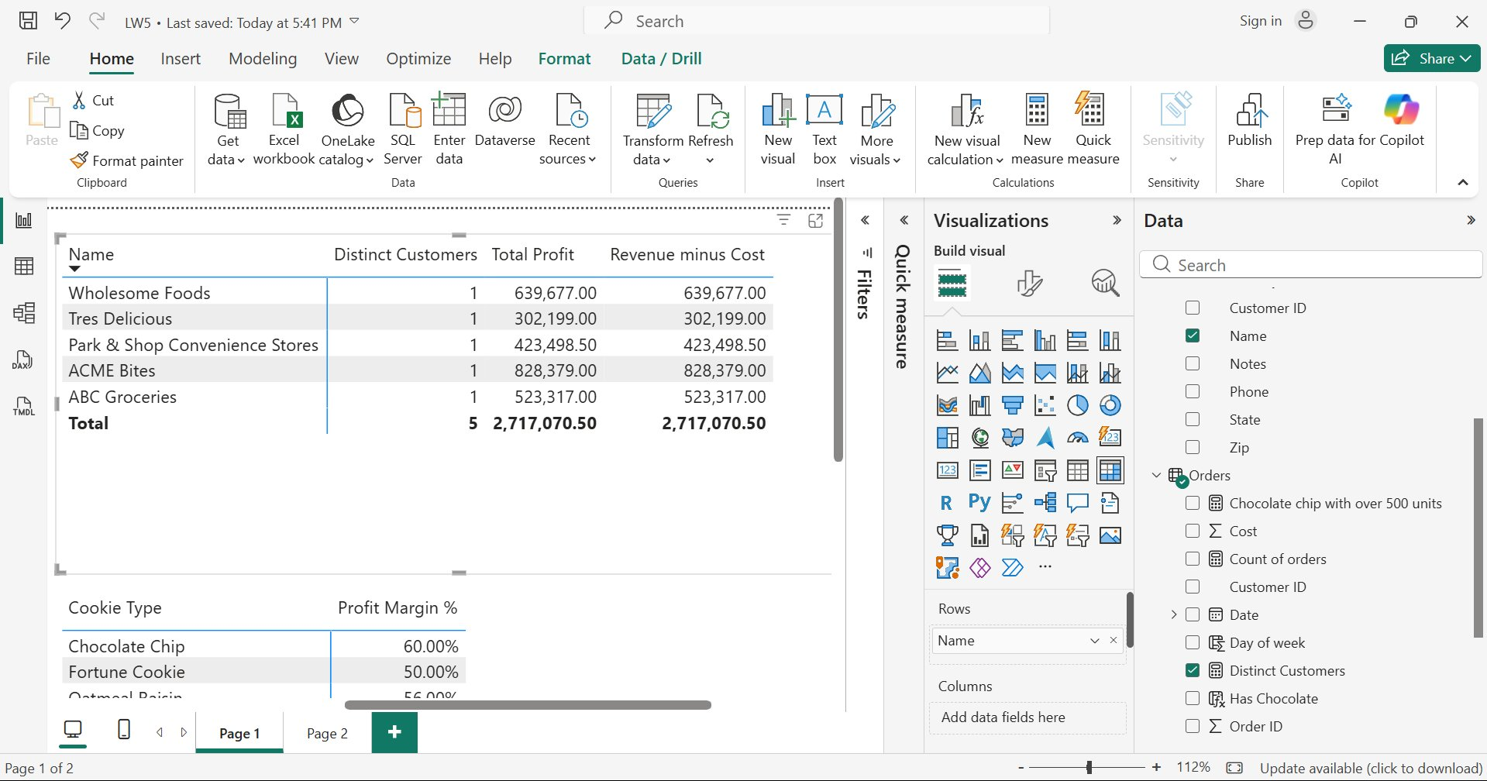
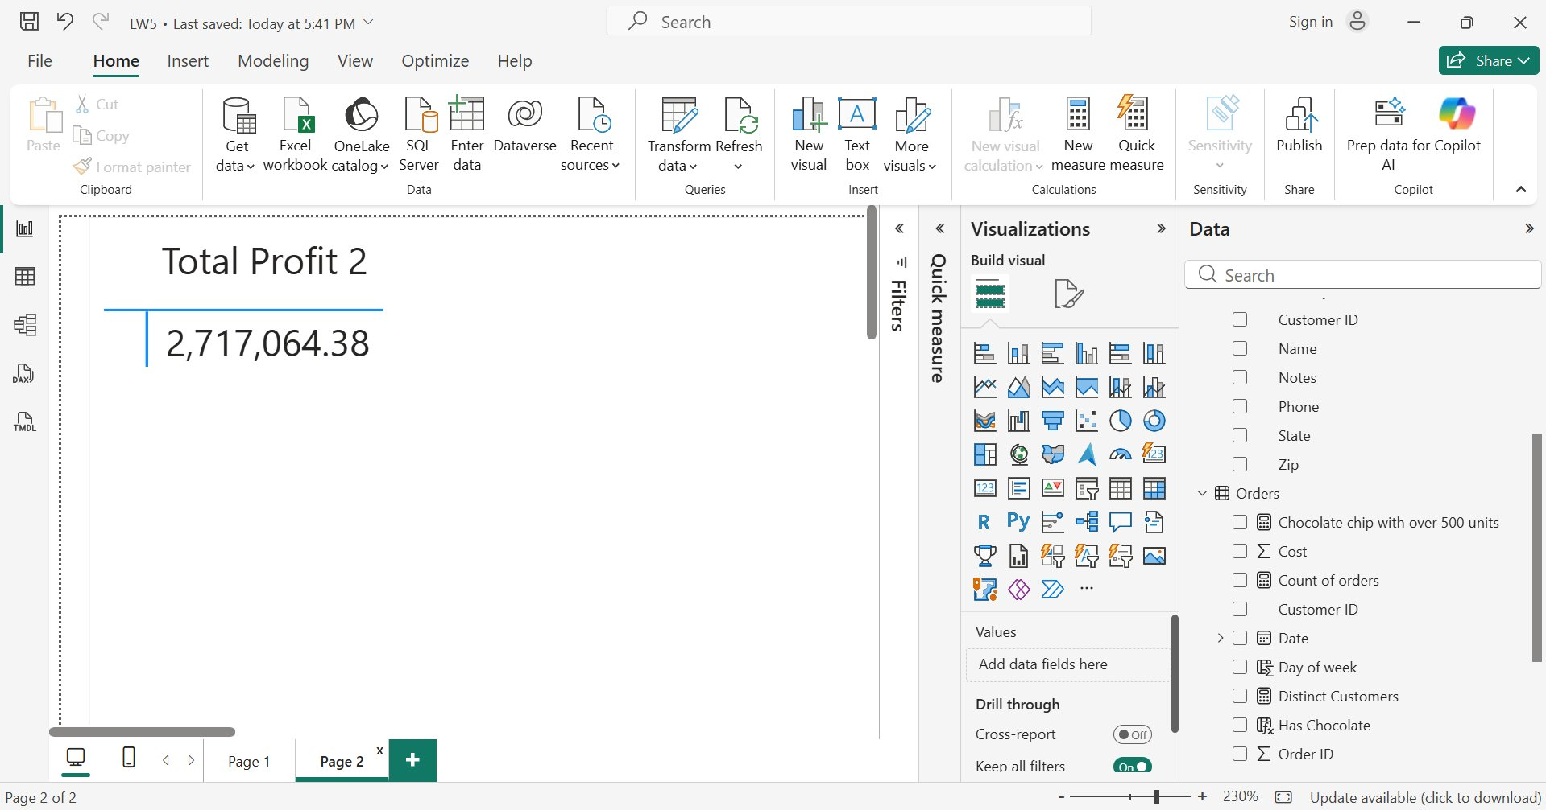
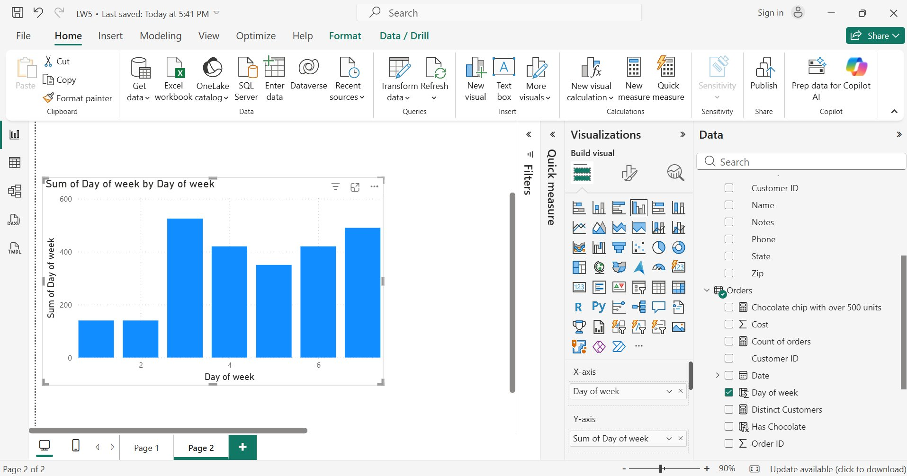
Appendix A — Dashboard Visuals (2/2)
Distinct Customers, Total Profit & Revenue minus Cost
Total Profit 2 (Card Visual)
Sum of Day of Week by Day of Week (Bar Chart)

Slide 12
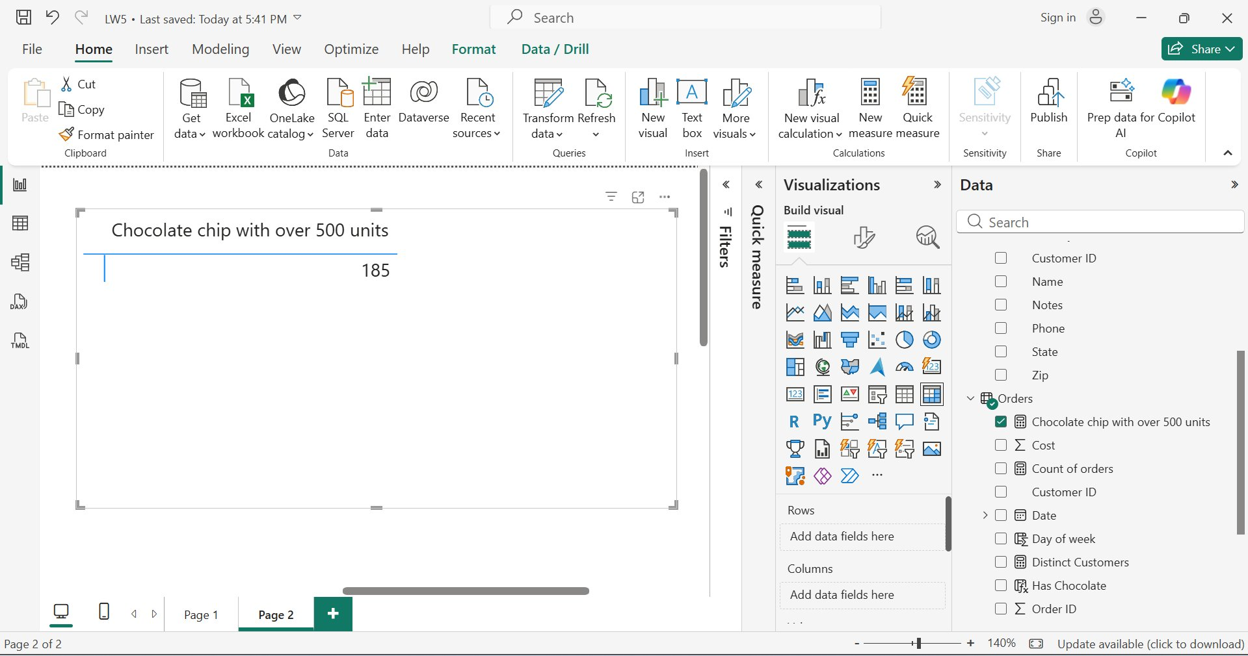
Appendix A — Dashboard Visuals (3/3)
Chocolate Chip Orders with over 500 Units

Slide 13
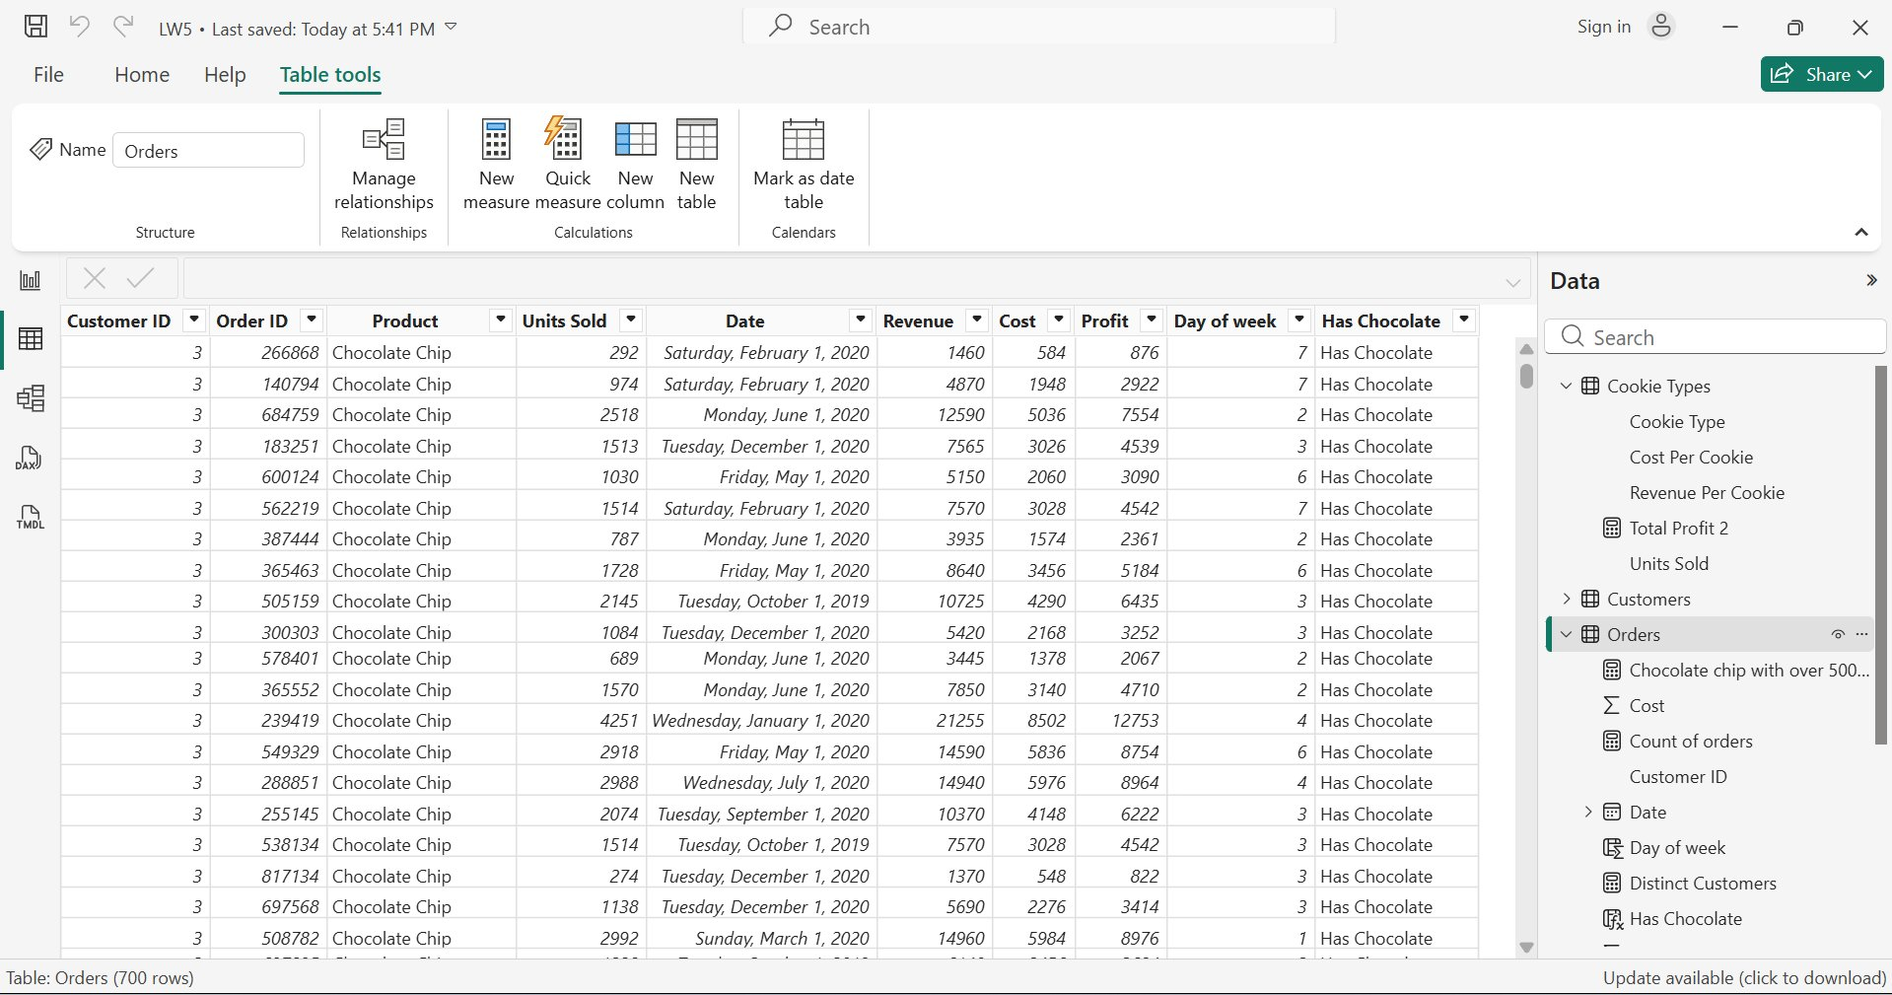
Appendix B — Data Tables
Orders Table — Raw Data View (700 rows)

Slide 14
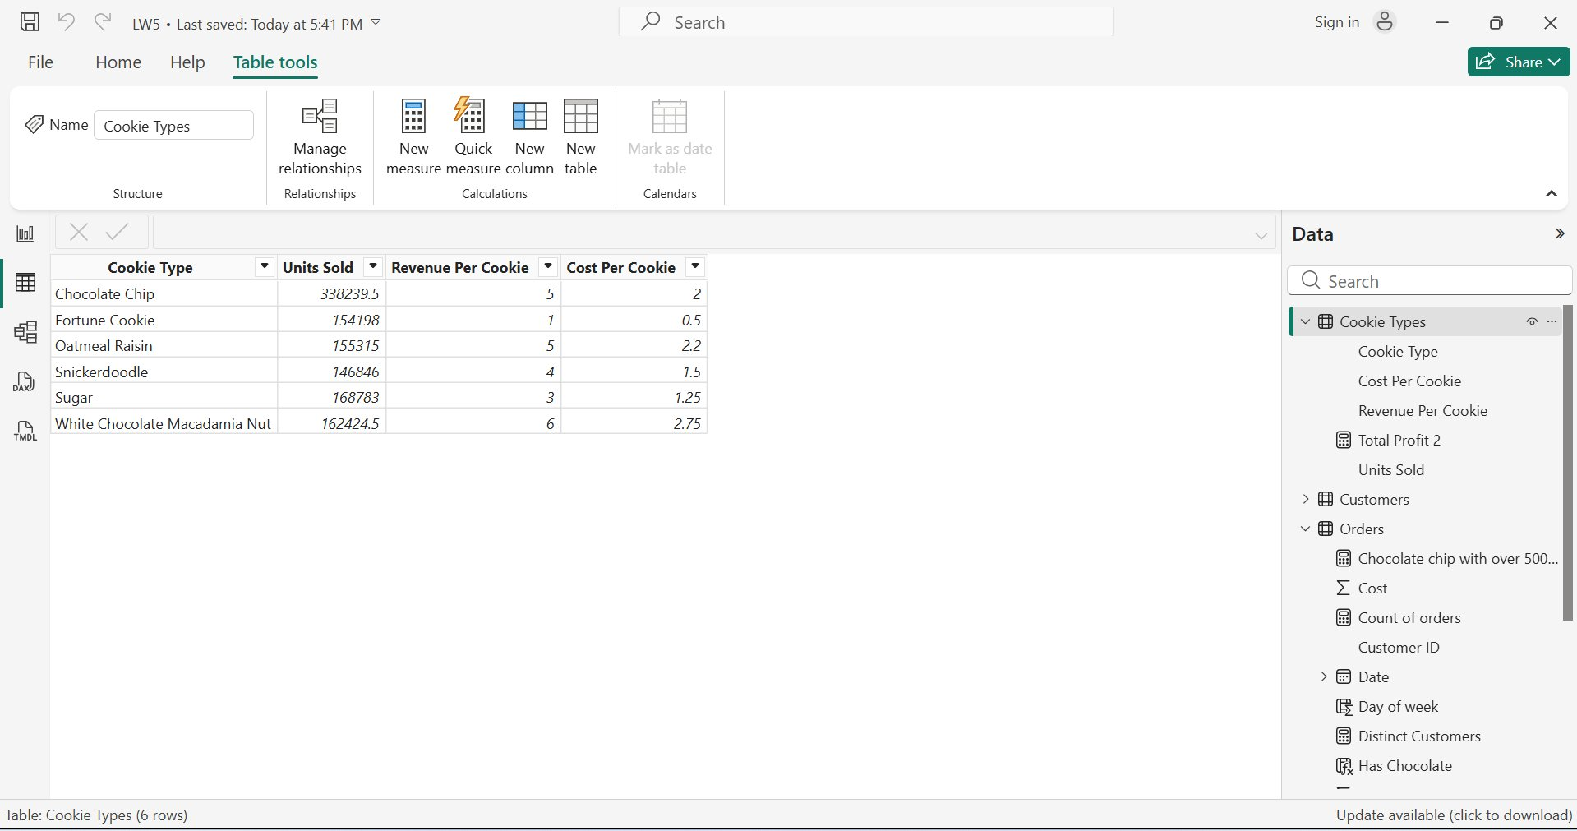
Appendix B — Data Tables
Cookie Types Table — Data View (6 rows)

Slide 15
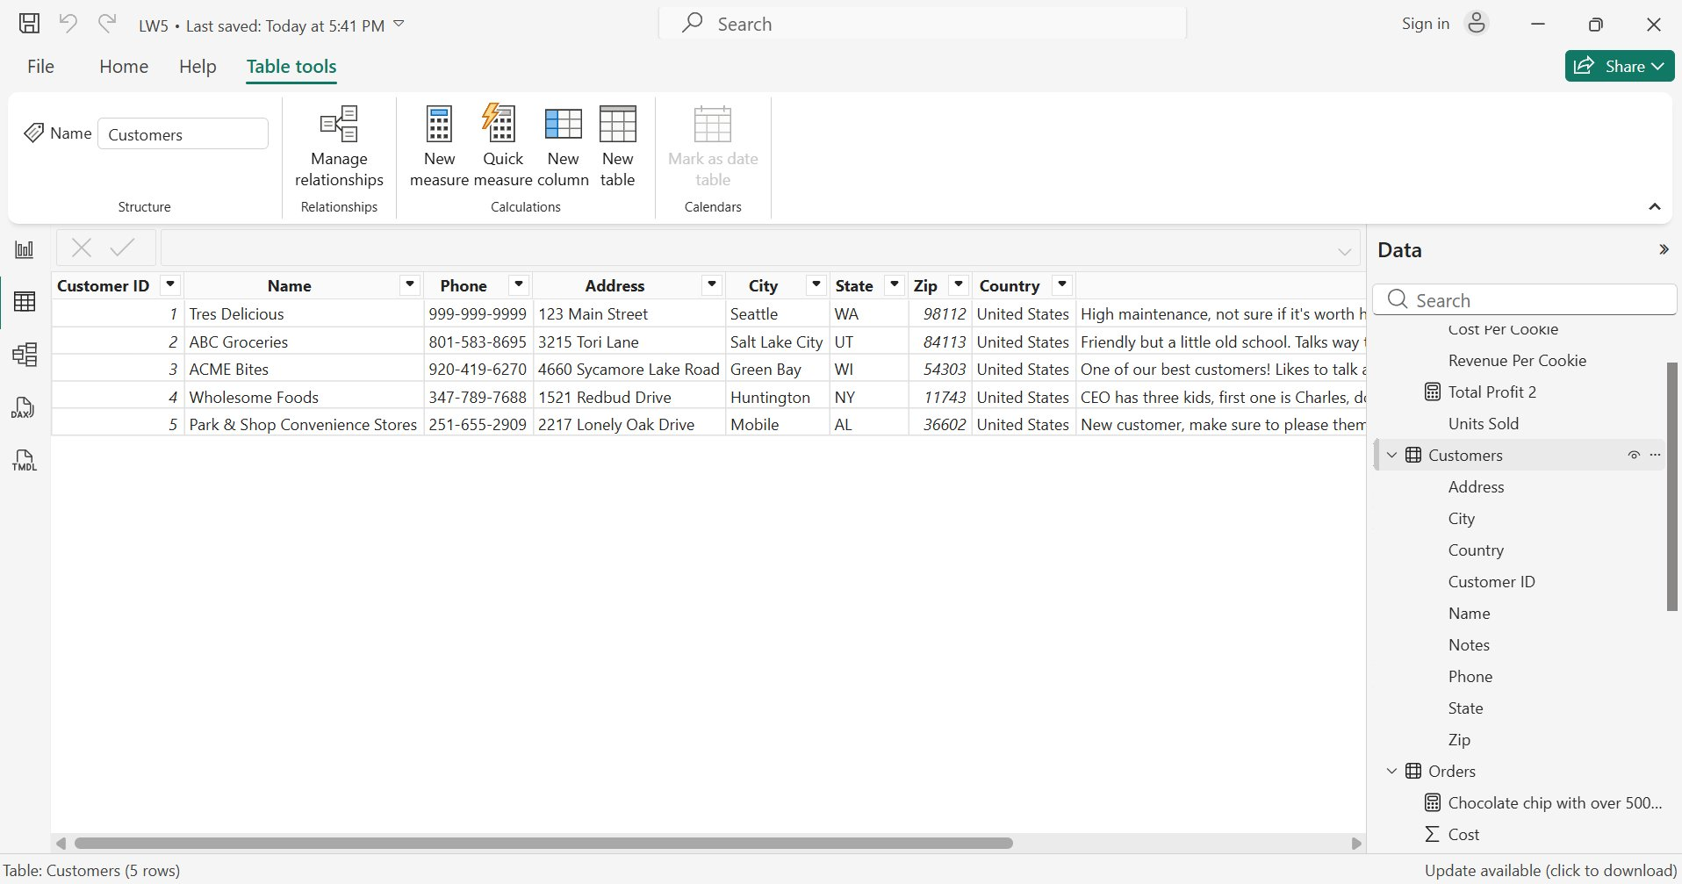
Appendix B — Data Tables
Customers Table — Data View (5 rows)

Slide 16
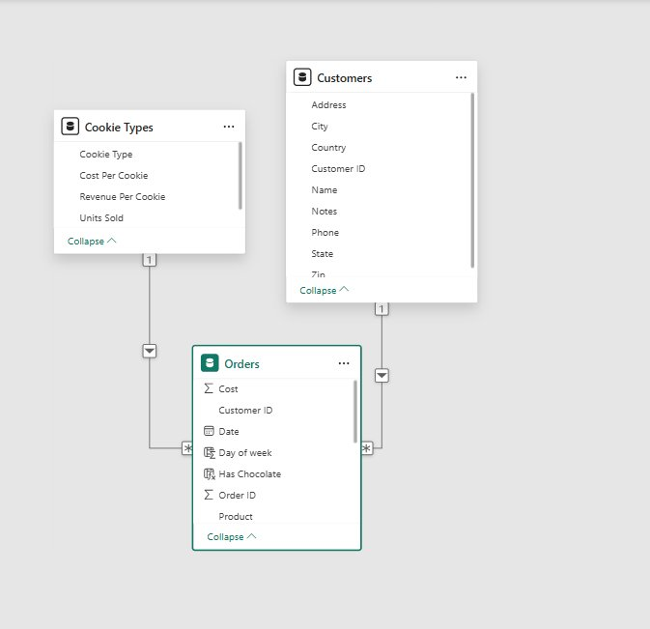
Appendix C — Model Relationship Diagram
Model View — Table Relationships Diagram
The model establishes two 1-to-many relationships: Cookie Types → Orders (via Product) and Customers → Orders (via Customer ID). These relationships enable RELATED() lookups and cross-table DAX measures.

