Slide 1
IS 107 – Business Intelligence
Laboratory Work 4
Forecasting Time-Series Data in Power BI
Dianah Myra Salazar
Instructor: Joseph A. Vistal
Course: IS 107 – Business Intelligence
Forecasting
Time-Series
Power BI
Analytics

Slide 2
Laboratory Work 4 | Overview
Lab 4 Overview
Lab 4 Overview
Part 1: Tourism Data
Part 2: Imperfect Data
Analysis & Report
Download tourism-data.csv
Import into Power BI
Create Line Chart (Yearly)
Add Trend Line
Add Forecast (12 pts, 95% CI, Seasonality 12)
Analyze forecast for 2020
Use tourism-data-modified.csv
Dataset includes COVID disruption (2020–2021)
50 new data points added
Experiment with forecast settings
Analyze confidence intervals
Compare Ignore Last settings
Describe dataset & source
Visualize forecast with screenshots
Discuss trend & seasonality
Interpret confidence intervals
Discuss disruption handling
Conclusions & limitations
Dianah Myra Salazar • IS 107 – Business Intelligence • Laboratory Work 4

Slide 3
P A R T 1
Tourism Data Forecast
Dataset: tourism-data.csv • Objective: Apply Forecasting in Power BI

Slide 4
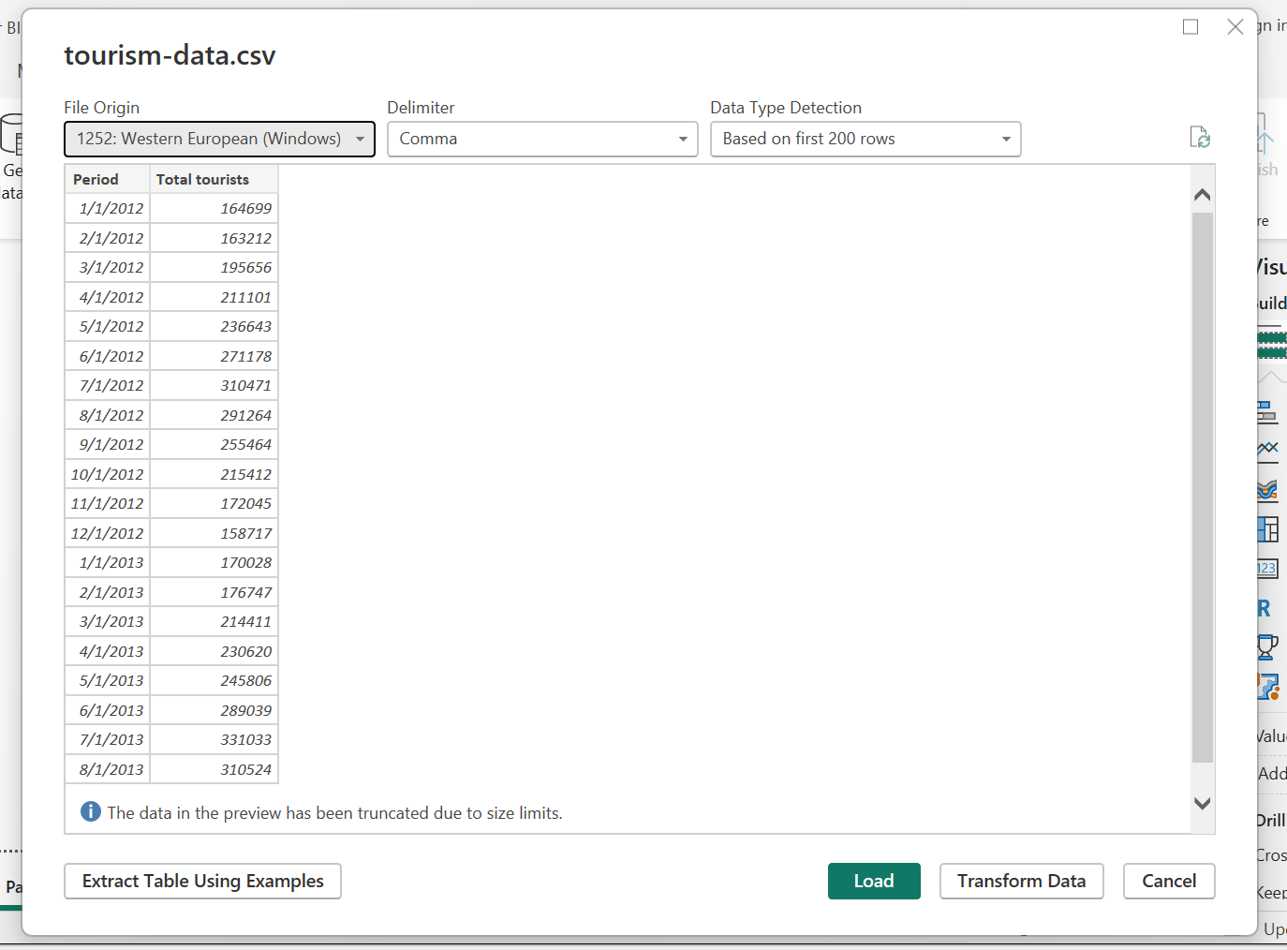
Part 1 – Import & Line Chart | Lab 4
Steps 1 & 2
Step 1–2: Import Data & Create Line Chart
Step 1 – Download Dataset
Go to the GitHub link and save tourism-data.csv to your computer.
Step 2 – Import into Power BI
Home → Get Data → Text/CSV → Load tourism-data.csv
Step 3 – Create Line Chart
• Drag Period → X-axis
• Drag Total tourists → Y-axis
• Set hierarchy to Year + Month
Dianah Myra Salazar • IS 107 – Business Intelligence • Laboratory Work 4

Slide 5
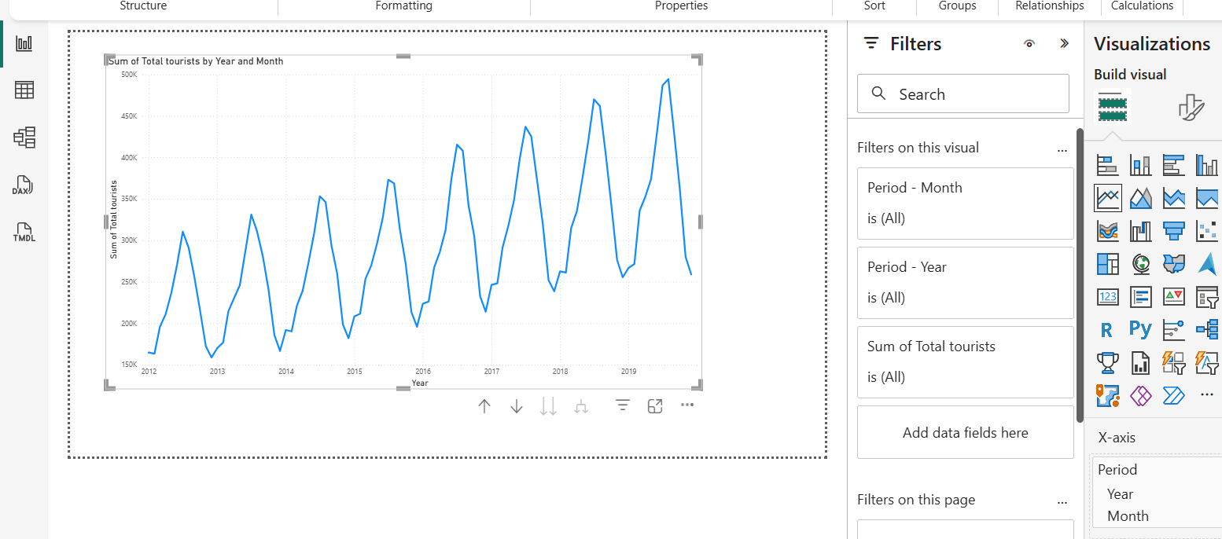
Part 1 – Import & Line Chart | Lab 4
Steps 1 & 2
Step 1–3: Import Data & Create Line Chart
Step 1 – Download Dataset
Go to the GitHub link and save tourism-data.csv to your computer.
Step 2 – Import into Power BI
Home → Get Data → Text/CSV → Load tourism-data.csv
Step 3 – Create Line Chart
• Drag Period → X-axis
• Drag Total tourists → Y-axis
• Set hierarchy to Year + Month
BY YEAR+MONTH
Dianah Myra Salazar • IS 107 – Business Intelligence • Laboratory Work 4

Slide 6
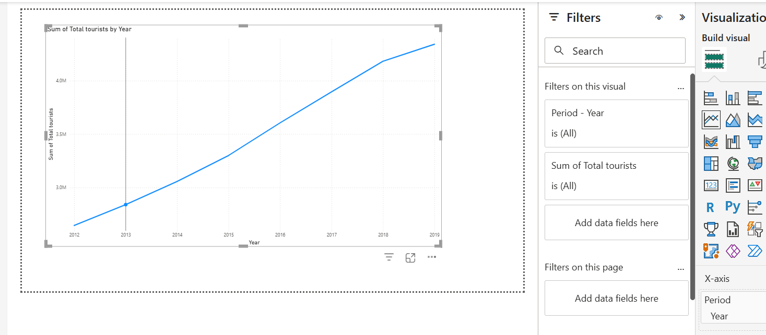
Part 1 – Import & Line Chart | Lab 4
Steps 1 & 2
Step 1–3: Import Data & Create Line Chart
Step 1 – Download Dataset
Go to the GitHub link and save tourism-data.csv to your computer.
Step 2 – Import into Power BI
Home → Get Data → Text/CSV → Load tourism-data.csv
Step 3 – Create Line Chart
• Drag Period → X-axis
• Drag Total tourists → Y-axis
• Set hierarchy to Year + Month
BY YEAR ONLY
Dianah Myra Salazar • IS 107 – Business Intelligence • Laboratory Work 4

Slide 7
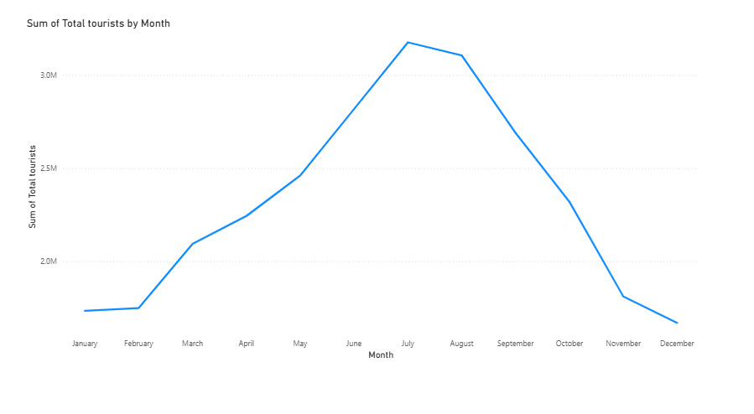
Part 1 – Import & Line Chart | Lab 4
Steps 1 & 2
Step 1–3: Import Data & Create Line Chart
Step 1 – Download Dataset
Go to the GitHub link and save tourism-data.csv to your computer.
Step 2 – Import into Power BI
Home → Get Data → Text/CSV → Load tourism-data.csv
Step 3 – Create Line Chart
• Drag Period → X-axis
• Drag Total tourists → Y-axis
• Set hierarchy to Year + Month
BY MONTH ONLY
Dianah Myra Salazar • IS 107 – Business Intelligence • Laboratory Work 4

Slide 8
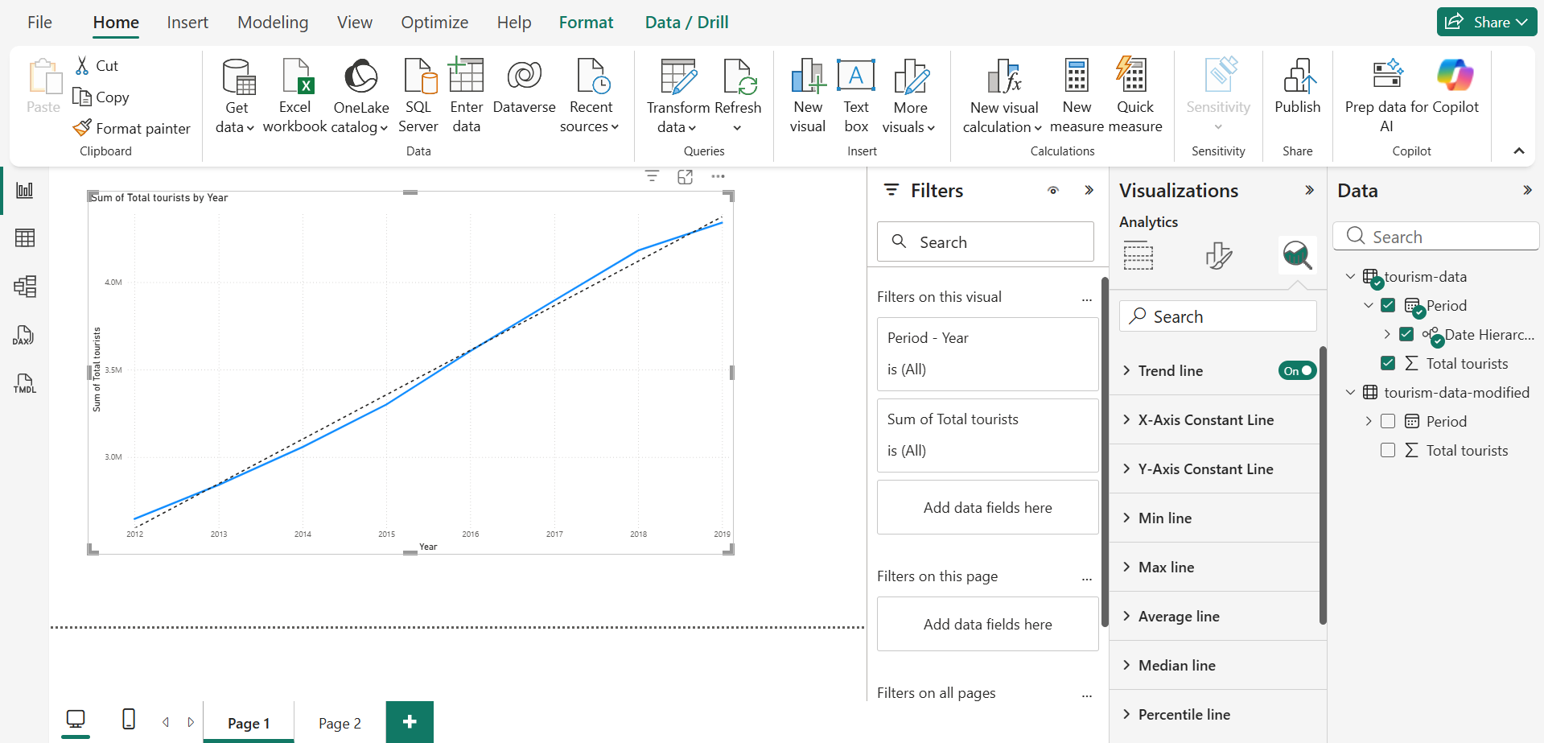
Part 1 – Trend Line | Lab 4
Step 4
Step 4: Add a Trend Line
How to Add Trend Line
1. Click the line chart to select it
2. Click the Analytics icon (🔍) in Visualizations pane
3. Expand 'Trend line'
4. Click + Add
What You Should See
A dashed diagonal line appears across the chart, confirming the strong upward trend in total tourism from 2012 to 2019.
BY YEAR ONLY
Dianah Myra Salazar • IS 107 – Business Intelligence • Laboratory Work 4

Slide 9
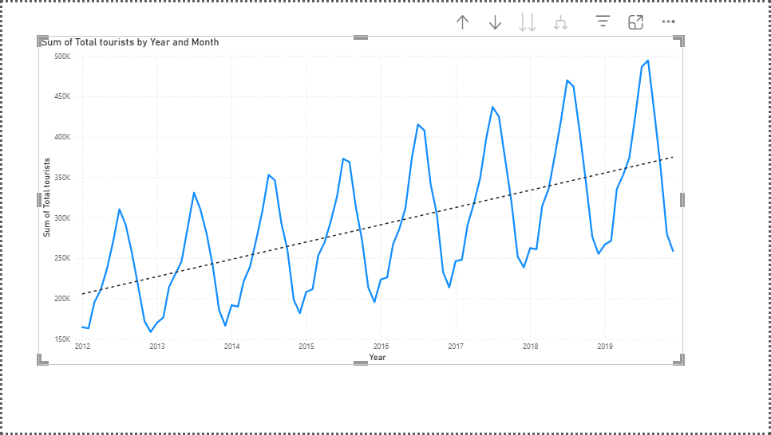
Part 1 – Trend Line | Lab 4
Step 4
Step 4: Add a Trend Line
How to Add Trend Line
1. Click the line chart to select it
2. Click the Analytics icon (🔍) in Visualizations pane
3. Expand 'Trend line'
4. Click + Add
What You Should See
A dashed diagonal line appears across the chart, confirming the strong upward trend in total tourism from 2012 to 2019.
BY MONTH + YEAR
Dianah Myra Salazar • IS 107 – Business Intelligence • Laboratory Work 4

Slide 10
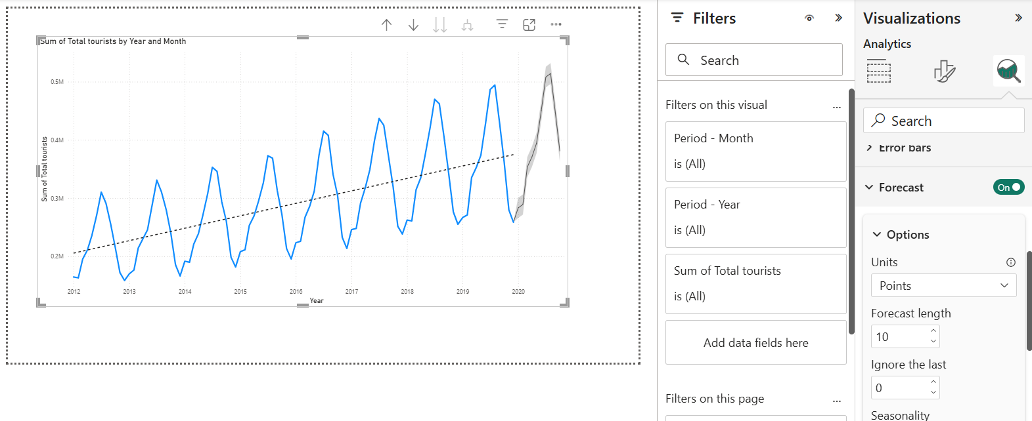
Part 1 – Forecast Configuration | Lab 4
Steps 5 & 6
Step 5: Add Forecasting
Forecast Configuration Settings
Forecast length
12 points
Ignore last
0 points
Confidence interval
95%
Seasonality
12 points
Then Click Apply
The forecast extends beyond 2019 as a gray shaded area representing the 95% confidence interval.
Dianah Myra Salazar • IS 107 – Business Intelligence • Laboratory Work 4

Slide 11
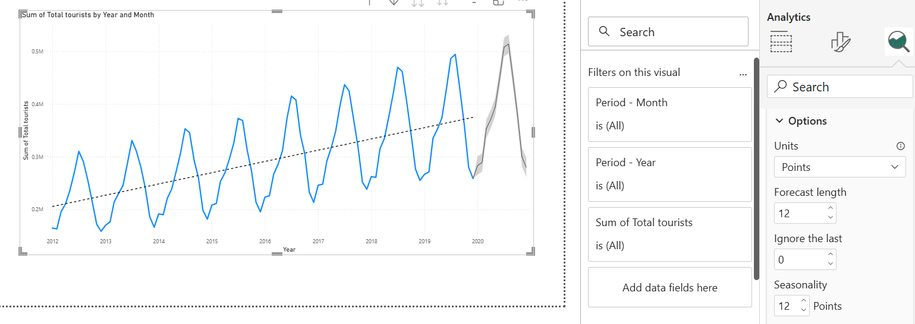
Part 1 – Forecast Configuration | Lab 4
Steps 5 & 6
Step 6: Configure the Forecast
Forecast Configuration Settings
Forecast length
12 points
Ignore last
0 points
Confidence interval
95%
Seasonality
12 points
Then Click Apply
The forecast extends beyond 2019 as a gray shaded area representing the 95% confidence interval.
Dianah Myra Salazar • IS 107 – Business Intelligence • Laboratory Work 4

Slide 12
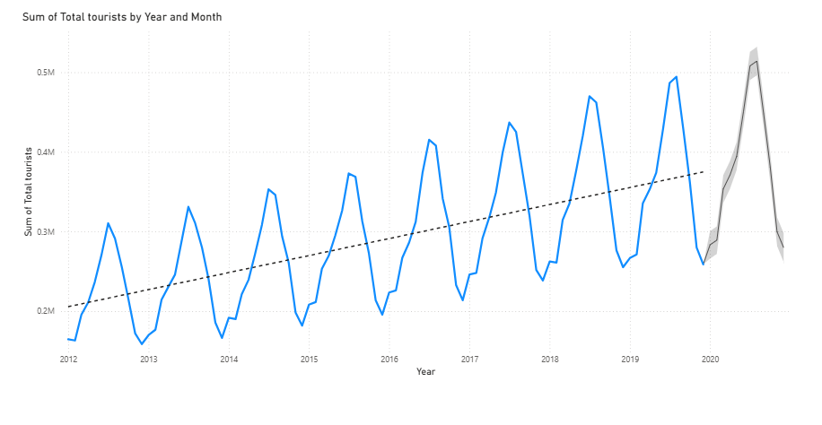
Part 1 – Forecast Analysis | Lab 4
Step 7
Step 7: Analyze the Forecast
Trend
Clear upward trend from ~2.8M (2012) to 4.6M (2019). The model captures consistent year-over-year tourism growth.
Seasonality
Strong peaks in July–August, troughs in Jan–Feb each year. Seasonality = 12 correctly identifies the annual cycle.
Confidence Interval
The narrow gray shaded area at 95% CI indicates high model confidence — consistent patterns in training data produce reliable forecasts.
Dianah Myra Salazar • IS 107 – Business Intelligence • Laboratory Work 4

Slide 13
P A R T 2
Forecasting with Imperfect Data
Dataset: tourism-data-modified.csv • 50 new points with COVID-19 disruption

Slide 14
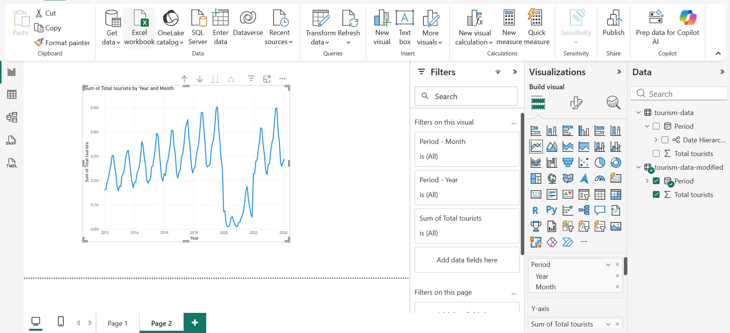
Part 2 – Dataset Description | Lab 4
Step 8–10
Part 2 – Imperfect Data Overview
Dataset: tourism-data-modified.csv
• Jan 2012 – Feb 2024 (146 rows)
• 50 new data points beyond original
• COVID disruption simulated in 2020–2021
• Recovery trend through 2022–2024
Phases Observed
2012–2019: Stable growth + seasonal waves
2020: Near-collapse (lockdowns)
2021: Partial recovery
2022–2024: Strong recovery to pre-pandemic levels
Dianah Myra Salazar • IS 107 – Business Intelligence • Laboratory Work 4

Slide 15
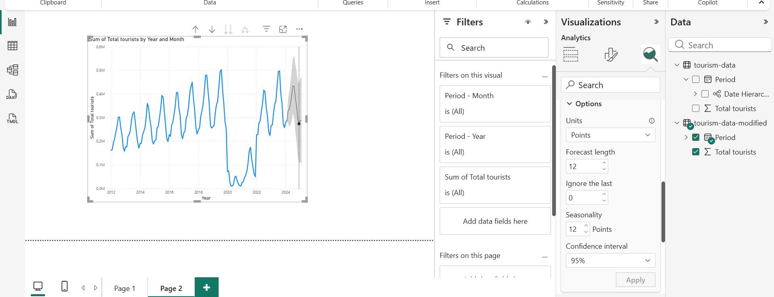
Part 2 – Experiment 1 | Lab 4
Step 11
Experiment 1: Baseline Forecast (Ignore last = 0, CI = 95%)
Settings
Forecast length
12
Ignore last
0
Seasonality
12
Confidence interval
95%
Observation
Forecast continues recovery trend. Confidence interval is moderately wide due to COVID disruption in training data. Projects continued seasonal growth.
Dianah Myra Salazar • IS 107 – Business Intelligence • Laboratory Work 4

Slide 16
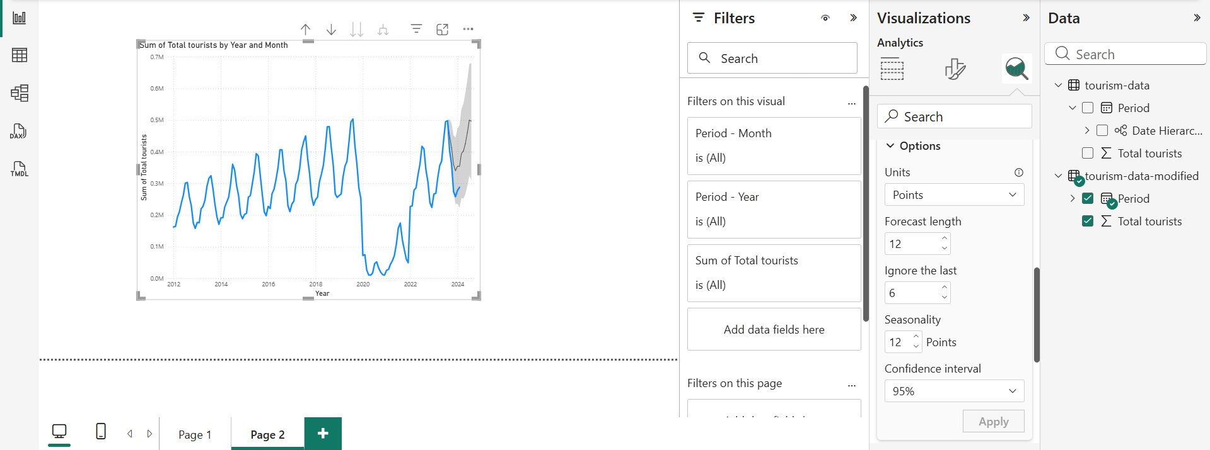
Part 2 – Experiment 2 | Lab 4
Step 11
Experiment 2: Ignore Last 6 Points (CI = 95%)
Settings
Forecast length
12
Ignore last
6 ← changed
Seasonality
12
Confidence interval
95%
Observation
Excluding the last 6 months shifts the forecast start earlier. The confidence interval widens slightly — less recent data = more uncertainty in predictions.
Dianah Myra Salazar • IS 107 – Business Intelligence • Laboratory Work 4

Slide 17
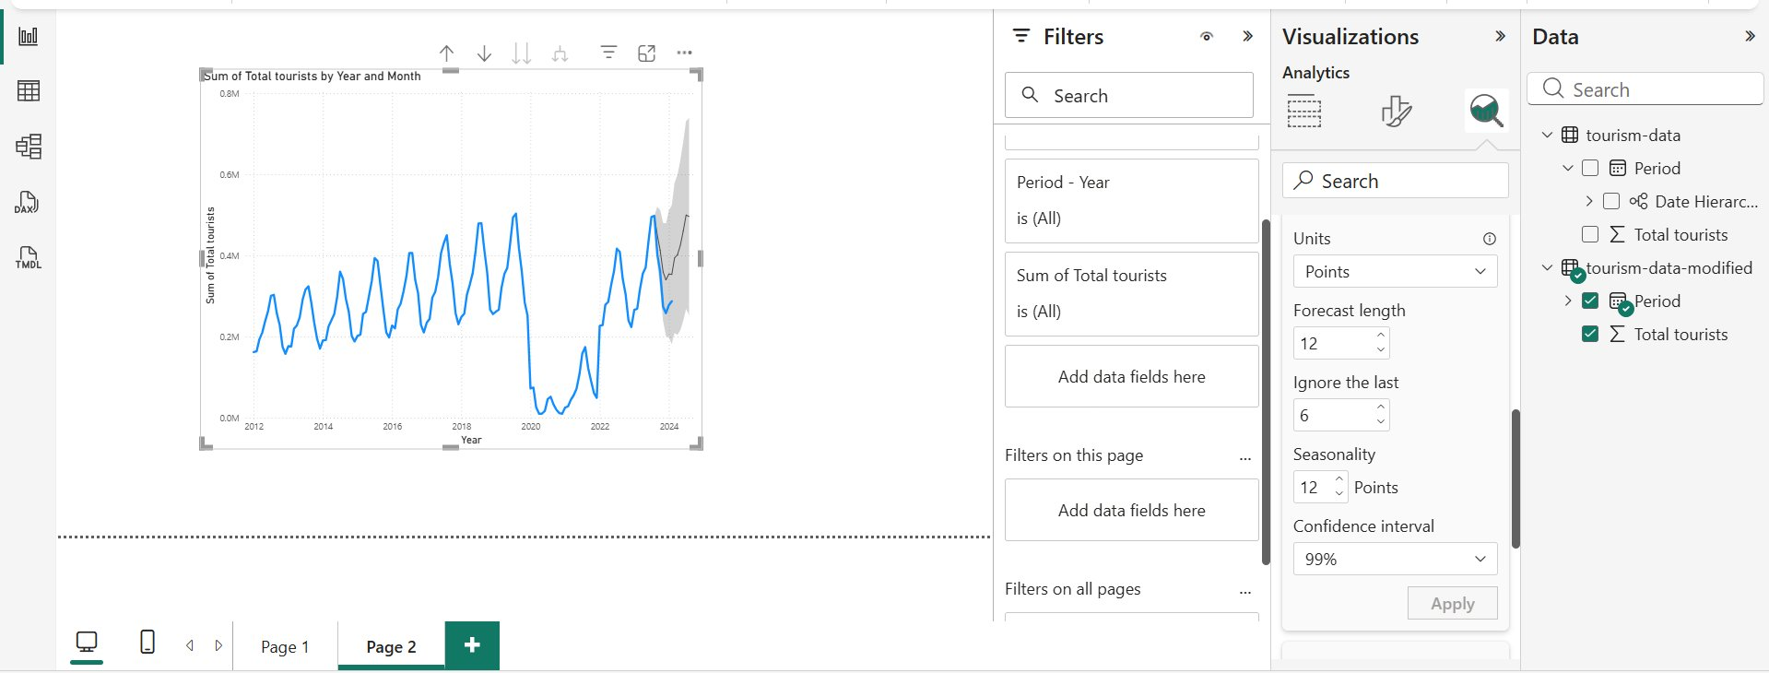
Part 2 – Experiment 3 | Lab 4
Step 11
Experiment 3: Higher Confidence Interval (CI = 99%)
Settings
Forecast length
12
Ignore last
6
Seasonality
12
Confidence interval
99% ← changed
Observation
The gray shaded area is noticeably wider at 99% CI. To be 99% sure, the model must encompass a much broader range — reflecting high uncertainty from the COVID disruption.
Dianah Myra Salazar • IS 107 – Business Intelligence • Laboratory Work 4

Slide 18
Part 2 – Disruption Analysis | Lab 4
Step 12
How the Forecast Handled the COVID Disruption
Did NOT Predict the Disruption
Wider Confidence Intervals
Power BI cannot foresee sudden external shocks like COVID-19 from historical time-series data alone. The sudden drop was entirely unpredictable.
All 3 experiments showed wider CI compared to Part 1 — the model accounts for the higher uncertainty introduced by the disruption in training data.
Incorporated Recovery Trend
Seasonal Pattern Disrupted
Post-disruption recovery data (2022–2024) positively influenced the forecast, projecting continued growth following the recovery trajectory.
COVID years broke the regular annual seasonal cycle, reducing the model's confidence in seasonal pattern estimation.
Dianah Myra Salazar • IS 107 – Business Intelligence • Laboratory Work 4

Slide 19
Part 1 & 2 – Guide Questions | Lab 4
Analysis
Guide Questions & Answers
What does a narrow confidence interval suggest?
How does Ignore Last affect the forecast?
A narrow CI indicates the model has high confidence — the historical data has a consistent and predictable pattern, so the forecast range is tight.
Setting Ignore Last = 6 excludes the 6 most recent data points from training. The forecast shifts earlier and the CI widens slightly, showing more uncertainty from less recent data.
How does changing CI from 95% to 99% affect the visual?
How useful is Power BI forecasting for this data?
The shaded gray area becomes noticeably wider. At 99%, the model needs a broader range to guarantee the true value falls within the interval — implying more uncertainty.
Highly useful for clean data (Part 1). For imperfect data (Part 2), the wide CI after disruptions limits practical reliability — more advanced modeling may be needed.
Dianah Myra Salazar • IS 107 – Business Intelligence • Laboratory Work 4

Slide 20
Conclusion
✔ Strengths
Easy to use with no coding required. Effective for clean, seasonal data. Configurable settings allow fine-tuning. Confidence intervals communicate reliability visually.
✘ Limitations
Cannot predict external shocks. Wide CI after disruptions reduces reliability. Based on exponential smoothing only — no ARIMA or ML models available.
★ Key Takeaway
Power BI forecasting is ideal for stable time-series. For datasets with major anomalies like COVID-19 disruptions, the forecast should be interpreted with caution and supplemented by domain expertise.
Dianah Myra Salazar • IS 107 – Business Intelligence • Instructor: Joseph A. Vistal

