Slide 2
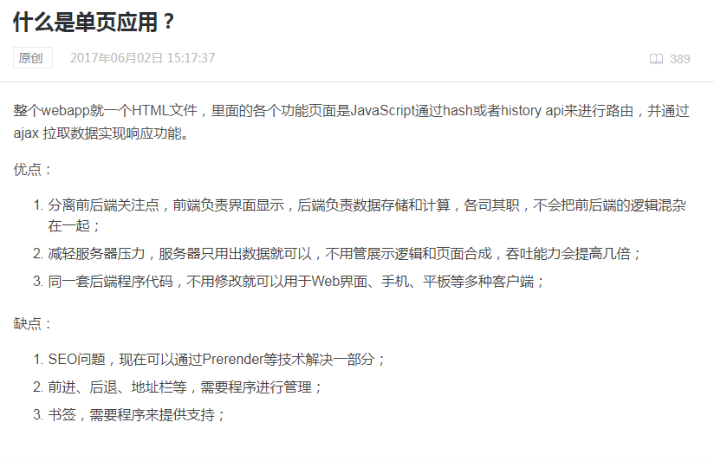
VUE

Slide 3
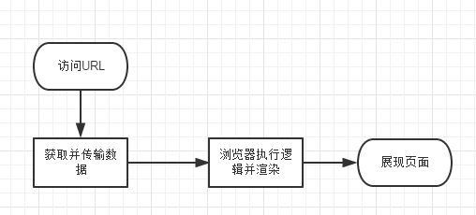
http://36.7.138.114:124/pc/2018/birthday2.0
http://36.7.138.114:124/app/wap/#/
json-server
html-server
html
SEO 首屏加载

Slide 4
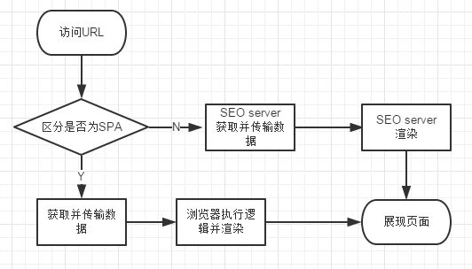

Slide 5
Single Page Application
SPA
Search Engine Optimization
SEO
Server Side Rendering
SSR
VUE ?

Slide 6
NUXT
package.json
asyncData
pages

