Slide 1

Sixth Sensor Technology
Every Life Counts.
India's first Collision Avoidance System for automobiles.
www. sixthsensor.in

Slide 2

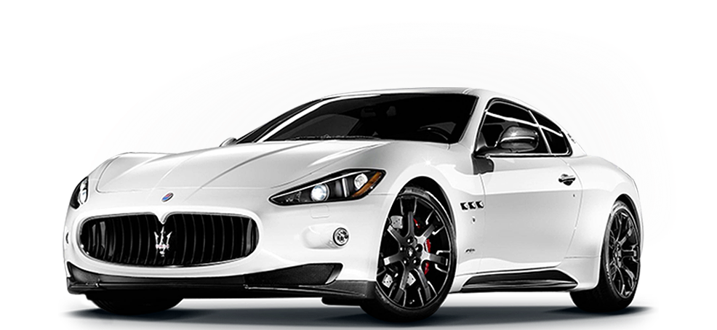


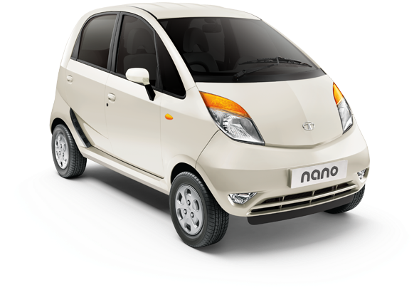


USD 100,000
0-100 IN 3.2 SECS
USD 1,500
0-80 IN 10.2 SECS
VALUE OF LIFE INSIDE BOTH VEHICLES
Notes:
If the value of life is same then why only the luxury high end expensive cars have safety systems built in ? Isnt the life in the 90% low end vehicles not important enough to get them the safety system ? With this mindset we started sixth sensor technology – collision avoidance system for aftermarket vehicles.
Now what is the aftermaket system mean ? It is installed in vehicle after the customer has bought it.

Slide 3
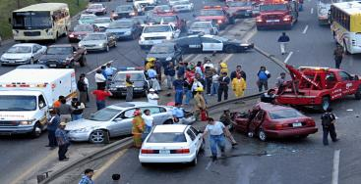
Driver today…
1.3m
people die globally in
road accidents every year
75%+
of the road accidents
are due to driver error
Notes:
Due to absence of safety systems in such vehicles, 13lacs ppl die every year and you would be surprised that most of these accident could have been avoided as 75% of accidents is due to driver error.

Slide 4






…Driverless tomorrow
Level – 0
DRIVER
Level – 1
FEET OFF
Level – 2
HAND OFF
Level – 3
EYES OFF
Level – 4
MIND OFF
Level – 5
PASSENGER
No Assistance
Assisted
Partially Automated
Highly Automated
Fully Automated
Autonomous
Human
Transfer of Responsibility
Machine

Slide 5
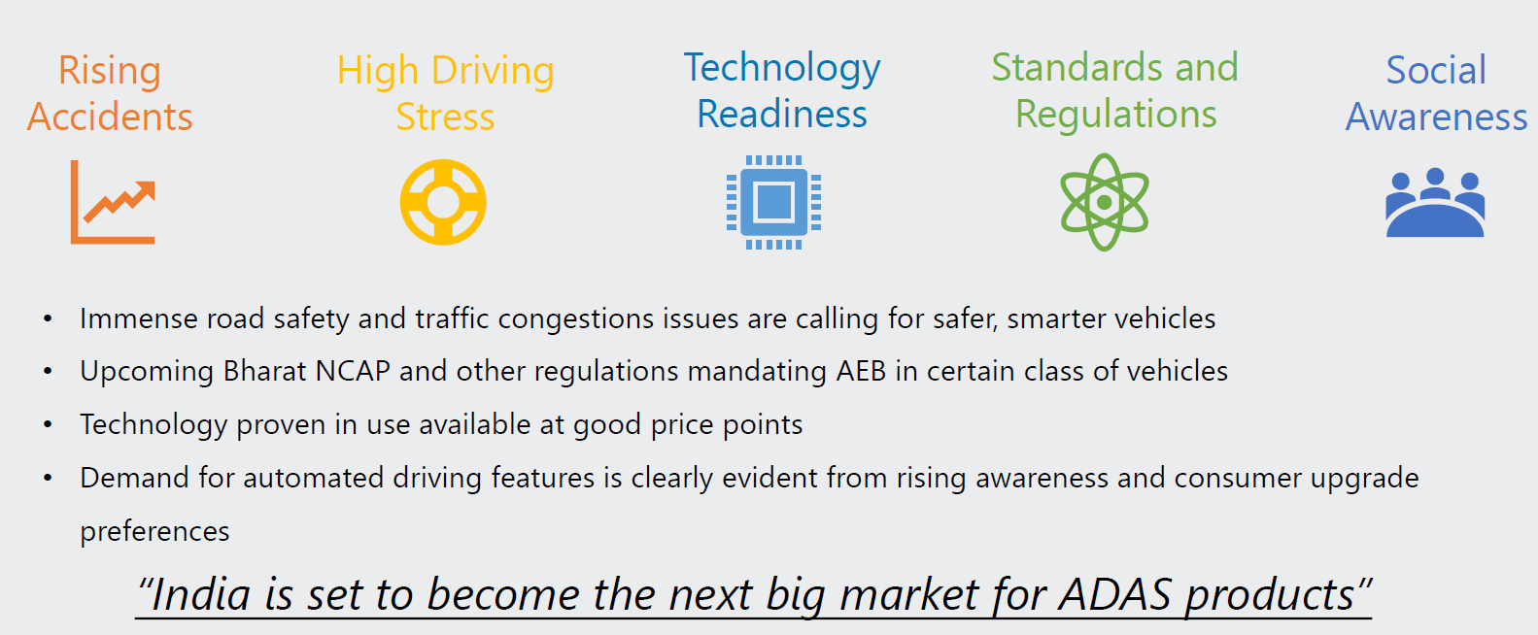
WHY
ADAS ?
ADAS along with the electric vehicle shall be the next big revolution / megatrend in the automobile Industry in India as well as in the world.
2019

Slide 6










Advanced Driver Assistance System – Time has come
Forward Collision
Alert
Adaptive Cruise
Control
Lane keep
Assist
Pedestrian
Detection
Traffic Sign
Recognition
Lane Departure
Warning System
Collision Mitigating
Braking
Blind Spot
Monitoring
Adaptive
Headlighting
Driver Status
Monitoring
~25% CAGR in global ADAS industry size
2018
USD14bn
2025
USD67bn
Notes:
What is ADAS ? It is advanced driver assistance systems, and they are basically active safety systems rather than passive and its market as of now is 14BN and goes to 67BN by 2025.

Slide 7
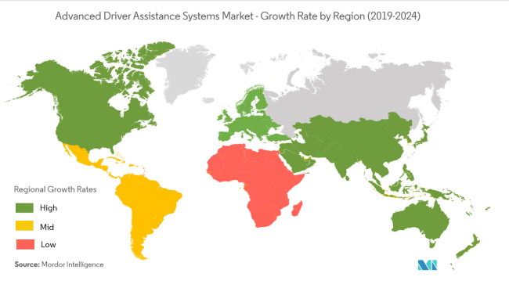
India – One of the fastest growing markets
INDIA
16 accidents per hour
5m Cars & CVs sold annually
15% CAGR
Low Penetration
Growing Awareness
Government Push
Notes:
India is number one in the world for road accidents.

Slide 8
Sixth Sensor – 1st Indian Aftermarket player in ADAS
Only
1st
6
Indian company in RF/ LIDAR based Collision Avoidance System
Aftermarket player in India in Collision Avoidance System
Products in the portfolio
500+
1
Winner
lives saved since inception
Patent Filed
of Best Innovation in Urban Mobility by NASSCOM in 2019

Slide 9

Sixth Sensor – Vision
To be a leading player in Advanced Driver Assistance System space with a wide range of assistance, monitoring and predictive solutions built through continuous Research & Development.

Slide 10
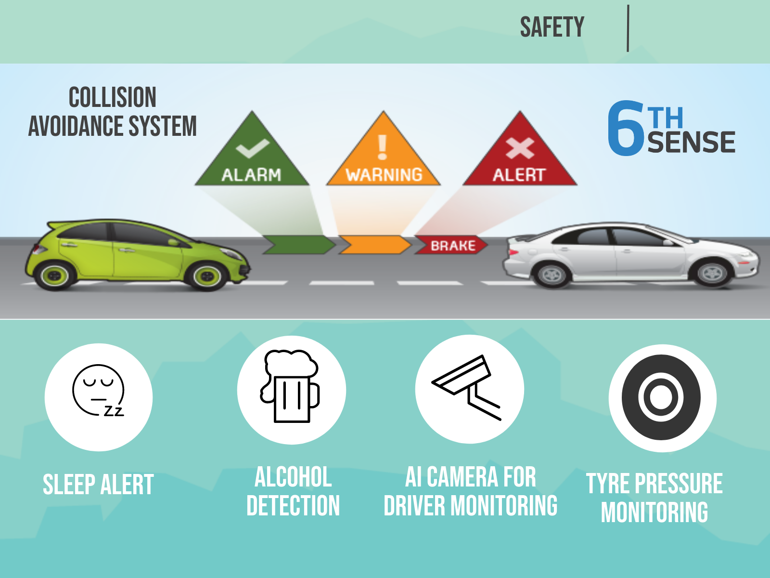

Slide 11

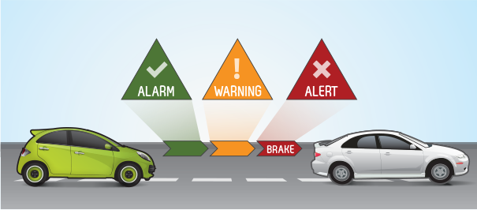
COLLISION AVOIDANCE
SYSTEM
Automatic braking will be applied if the vehicle is too close to the obstacle in front.
The algorithm is based on distance to the object, relative velocity and time to collision.
2020

Slide 12
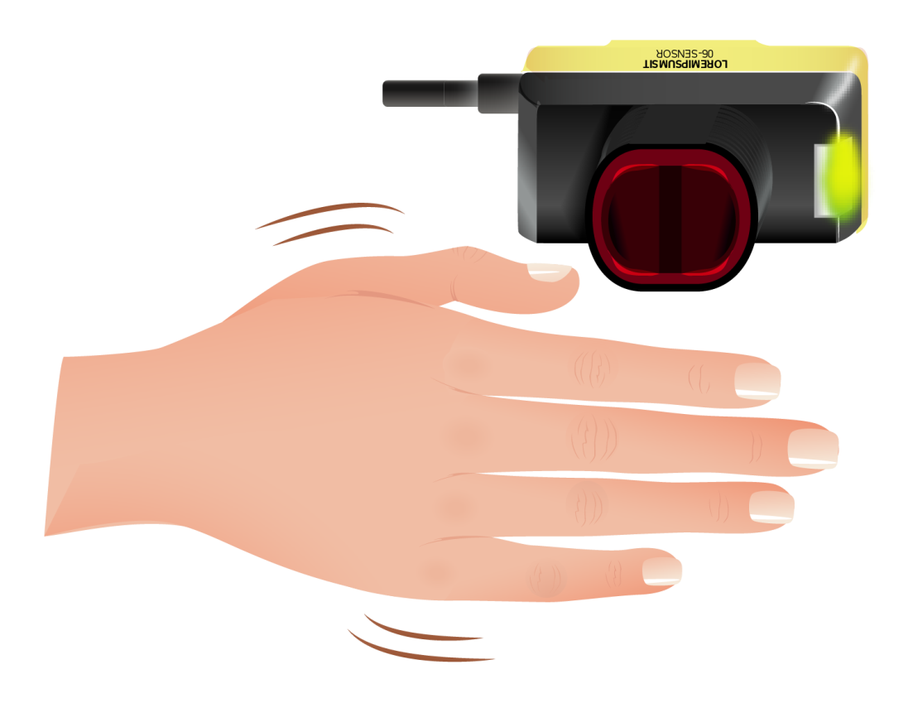


SLEEP ALERT
Optional
Wave Hand in front of sensor once every minute
Between 10 pm to 6 am.
Else accelerator off and brake ON
2020

Slide 13






DRIVER
EVALUATION
Driving score is determined based on the below factors.
Changes in driving pattern over a period of time and better score can decide his incentives, thereby changing the driving habits and making them safe
Automatic
Braking
Accelerator off
Due to sleep
Tailgating
Alarms
Over Speed limit
& Speed Governor
Rapid Acceleration
& Sudden Braking
Rash Turning &
Bumpy rides
Excessive
Honking
Vehicle Idling
2020
Notes:
instaLLATION

Slide 14
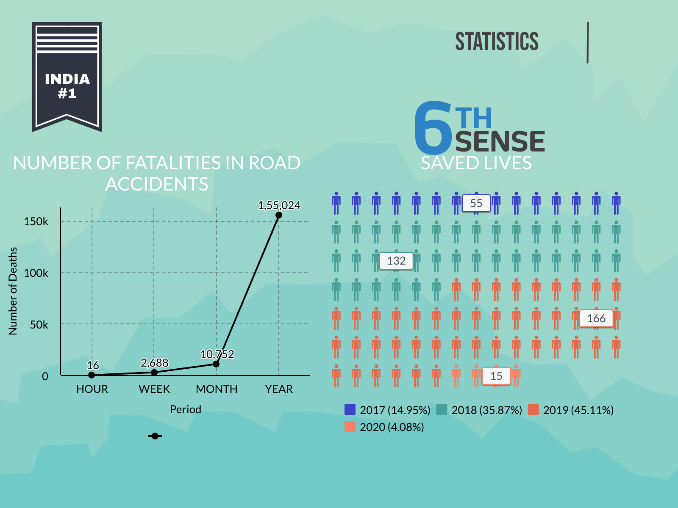

Slide 15
ALCOHOL
DETECTION
Alcohol detection is done in the blood using non-invasive
methods which is more accurate then using the breath analyzer
Test to be taken before start of every trip and also during
periodic intervals while on the trip to ensure NO cheating.
Fingerprint is also scanned which also ensure that the intended
driver is only taking the test
Vehicle immobility option provided for detection of alcohol
and management is alerted
Under development
2020

Slide 16
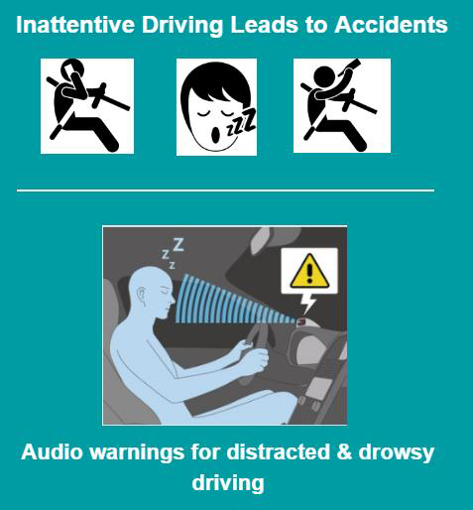
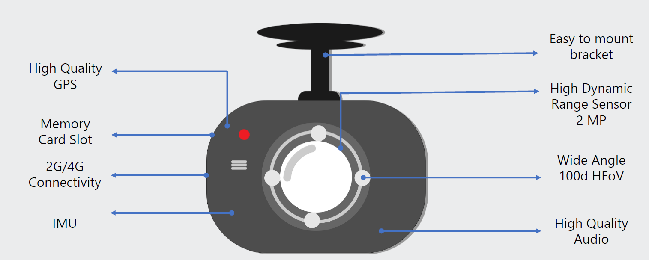
DRIVER
MONITORING
The Camera along with the Driver monitoring will also have the on road monitoring of the obstacles in the same packaging with the optional camera.
2019

Slide 17
TIRE PRESSURE
MONITORING
Real-time tire pressure monitoring is available for the driver
as well as the management
Any pressure above or below the thresholds will trigger a warning
Vehicle immobility option is available if the pressure if beyond
the thresholds
Increases life of the tires which is indirectly increase in profits
2020

Slide 18


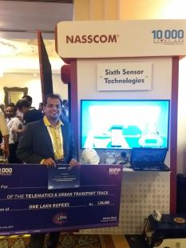









Proven track record
Strong customer base across private logistics companies, STUs and OEMs
Winner of NASSCOM Urban Mobility Innovation 2019 Award

Slide 19
The way forward
Technology Roadmap
Sales Roadmap

Slide 20
Technology roadmap
Objective
Widen Target Addressable Market
New Product Development
To cover every ‘error’
Technology cost reduction
Drive affordability
1
2
4
3
Ease of Installation
B2C market
Interoperability
Wider partner network

Slide 21

Market prioritization – Aftermarket in Phase I
SUBSCRIPTION
7-8X the size of new vehicle market
Based on kms running – very affordable
SAAS
WHERE EVERY LIFE COUNTS + OTHER IMPACT
MAINLY AFTERMARKET
State Transport Units and City buses – Political impact
Corporate Employee Fleet – Brand Impact
Schools – Brand impact
Large Logistics companies – Downtime impact
Oil & Gas Fleet, chemical – Environment impact
INDUSTRY
COLLABORATE WITH :
Tier 1-2 OE suppliers
Telematics providers
ADAS Integrators
TECHNOLOGY PARTNERS

Slide 22
Influencers – Long term growth drivers
Government
Mandate implementation of ADAS in new vehicles
HACCP compliance
Part of the compliance requirement for MINING and HAZMAT vehicles
Insurance
Reduced insurance premium on use of safety solutions

Slide 23




Unique Selling Point USP
LOGIC
The entire algorithm has been developed based on Indian road conditions.
PRICE
Lowest price compared to international and local competitors
AFTERMARKET
Only company to provide Collision Avoidance System as aftermarket solution
UNIVERSAL
From passenger segment to mining trucks, we cover all

Slide 24
COMPETITORS
 |  | Competitors |  | Advantage over them
 |  | Mobileye |  | Radar Sensor over Camera sensor.
 |  |  |  | Much less cost than them.
 |  |  |  | No automatic braking
 |  | Hi Tech |  | Radar Sensor over Camera sensor.

Slide 25
PATENTS
 | PATENT APPLICATION PUBLICATION (21) Application No.2/MUM/2015 A
 | Date of filing of Application :01/01/2015 Publication Date : 08/07/2016
 | Title of the invention : A SYSTEM AND METHOD FOR COLLISION AVOIDANCE FOR A HOST VEHICLE
 | Name of Applicant :
 | 1)Sixth Sensor Technology Pvt. Ltd.
 | Address of Applicant :A/118, Ghatkopar Industrial Estate,
 | LBS Marg, Ghatkopar (West), Mumbai 400086, Maharashtra,
 | India Maharashtra India
 | Name of Inventor :
 | 1)Rajesh Dagli
 | 2)Paritosh Dagli
 | Abstract :
 | The present invention provides a system and a method for avoiding collision of a vehicle. The system for avoiding collision of a
 | vehicle, the system comprising at least one proximity sensor for detecting objects in the proximity of the vehicle; a braking
 | mechanism for actuating a braking pedal of the vehicle; an alarm unit for indicating objects in a predetermined proximity of the
 | vehicle; and a control unit connected to the proximity sensor, the braking mechanism, and the alarm unit, the control unit determines
 | proximity of the objects from the vehicle in real time and generates one or more alarms based on proximity of objects from the vehicle
 | to avoid collision.

Slide 26
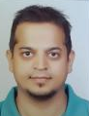
Promoter background
PARITOSH DAGLI
Founder & CEO
“My near fatal car accident about a decade ago helped me realize a dire need for developing safety solutions and collision avoidance system.
On further research, realized that cost has been a major roadblock to ADAS and the need of the hour was to develop an efficient and affordable collision avoidance and driver monitoring system.
That is where the journey began”
- Paritosh Dagli
Paritosh leads the strategy and R&D for Sixth Sensor
Prior to starting Sixth Sensor, Paritosh worked as Quality Engineer at Apple Inc and Barracuda Inc
Paritosh has done his Masters in Computer Engineering from Santa Clara, US
Paritosh has strong understanding of embedded technology,

Slide 27
Other Director and Advisor
Rajesh Dagli
DIRECTOR
SIXTH SENSOR / SPRANGLE ALLOY
IIT pass out in 1972, Rajesh has over 40 years of entrepreneurship experience
Started his entrepreneurial journey in 1974 by setting up a metallurgical laboratory – Jewel Metallochem Laboratory.
In 2000, Rajesh moved to manufacturing sector by setting up alloy manufacturing facility for gold and silver jewellery under Sprangle Alloy Pvt Ltd.
Technology background and 40+ years of entrepreneurial experience have played a crucial role in Sixth Sensor
Bhushan Gajaria
FOUNDER OF BEEHIVE
CAPITAL ADVISORS
Bhushan comes with 15+ years of experience in startup investment, startup handholding, capital market and FMCG.
Before starting Beehive in 2012 he was Senior VP at IDFC Securities, Auto and Auto Ancillary practice. He was voted amongst the best auto analysts by The Wall Street Journal in 2011.
Bhushan has been associated with many startups in technology space and incubators as mentor and advisor.
Bhushan is assisting Sixth Sensor on business strategy, Finance and Capital Raising

Slide 28
PAST 3 YEARS REVENUE AND ORDER BOOK
NO. OF CUSTOMERS |  |  | REVENUE
65 |  |  | 2018-19 | 2019-20 | 2020-21
 |  |  | 65 Lacs | 63 Lacs | 6.3 Lacs
CUSTOMER NAMES |  |  | VRL LOGISTICS LTD. | VRL LOGISTICS LTD. | Singh & Associates
 |  |  | Cache Technologies | Lithium Urban Technologies | Amazon Development Centre
 |  |  | Shivagi Rao Travels | Dell International Services | Jones Lang Lasalle Property consultants
 |  |  | Citrix RAD India P.Ltd. | Travels world | Bosch Ltd.
 |  |  | Travels world | Singh & Associates | Mjunction Services Ltd
 |  |  | Brakes India P.Ltd. | Carzonrent India P.Ltd. | Automative Research Association of India
 |  |  | J & S Global | Ecos Mobility & Hospitality
 |  |  | Times Logistics | Janani Torus & Resort
 |  |  | Varuna Integrated Logistics | Trivision Mobility P.Ltd.
 |  |  | Tirumala Cabs | M K Travels
 |  |  | Jakhar Travels | ANP Travels
 |  |  | Laxmi Travels | KAS Travels
 |  |  | Konduskar | Shivaji Rao Travels
 |  |  | Prasanna Purple Mobility | Brakes India P.Ltd.
 |  |  | Uttar Prades Road Transport | Best Roadways Ltd.
 |  |  |  | VE Commercial Vechiles Ltd.
 |  |  |  | Uttarpradesh Road Transport

Slide 29
Aggressive scale up ahead
DISTRIBUTION REACH : CHANNEL PARTNERS
VOLUME: REVENUE SALES

Slide 30
Financial projections
INR in Million | FY21E | FY22E | FY23E | FY24E | FY25E
Direct | 9.4 | 38.7 | 115.2 | 286.3 | 646.5
Channel | 1.8 | 21.7 | 105.2 | 238.4 | 535.3
OEM | - | - | 19.4 | 167.1 | 450.9
Total Revenues | 11.2 | 60.4 | 239.8 | 691.8 | 1,632.7
Direct Cost | 7.8 | 41.2 | 166.1 | 471.3 | 1,053.7
Marketing Cost | 1.1 | 7.9 | 33.4 | 94.0 | 216.0
Employee Cost | 4.4 | 15.7 | 28.3 | 42.0 | 59.1
Other Corporate Overheads | 4.4 | 11.2 | 14.8 | 25.4 | 44.9
Total Cost | 17.7 | 76.0 | 242.6 | 632.8 | 1,373.7
EBITDA | (6.4) | (15.6) | (2.9) | 59.1 | 259.0
PBT | (14.1) | (24.8) | (13.2) | 44.6 | 240.6
Revenue of 163 Cr in 5 years with EBITDA of 26 Cr

Slide 31




KEY QUESTION
HOW WOULD YOU INCRESE SALES FROM JUST 65 LACS TO 163 CR IN 5 YEARS ?
SUBSCRIPTION
Providing SAAS model to B2B customers would definitely see increase in sales based on kms reading.
PLUG AND PLAY
Have minimum components but very effective and quick solution for all vehicles.
OEM
Get OE approved ADAS solution , that will skyrocket the sales, even if it is not factory fitted.
MARKETING , CHANNEL PARTNERS AND B2C
Launching it for B2C would definitely help along with the various channel partners that we will create.

Slide 32
INR 10 cr raise in 2 years
Fund Raise
INR 10 Cr in the next 2 years. Currently we need 3 cr at 25% equity
Fund Use
Marketing – 42%
Continued R&D spend – 14%
Capex and Debts - 11 %
Working capital requirement as revenue grows multifold due to subscription model – 32%

Slide 33
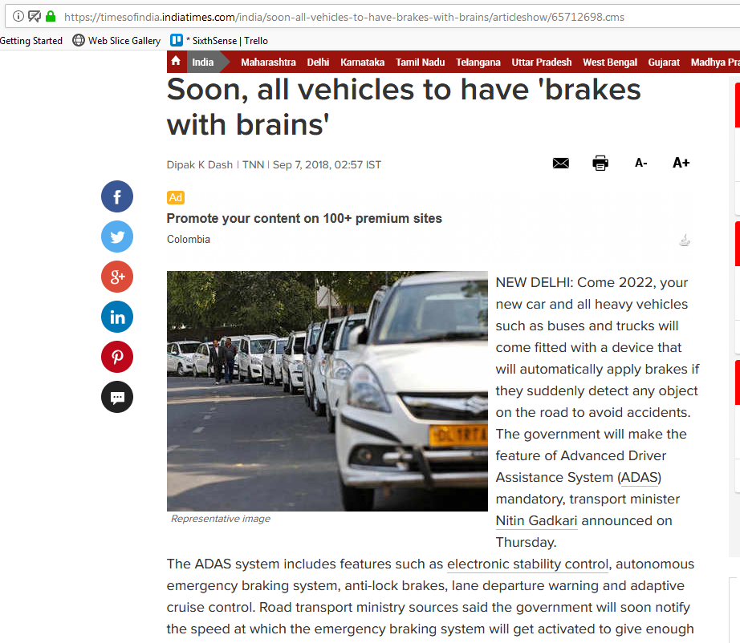
WHY TO COLLABORATE
AEBS AND FCWS are going to be mandatory for N2, N3, M2, M3 vehicles from 2022/23.

Slide 34
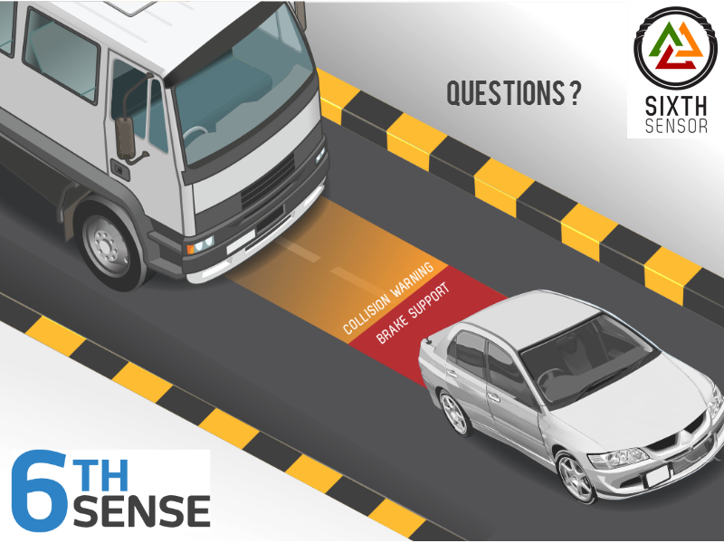

Slide 35
THANK YOU
Sixth Sensor Technology
EVERY LIFE COUNTS !

