Slide 1
ACMA-PwC Start-up Initiative:
Plenary Event 13th April, 2022 @ 1:00 pm, Pride Plaza, Aerocity, Delhi

Slide 2
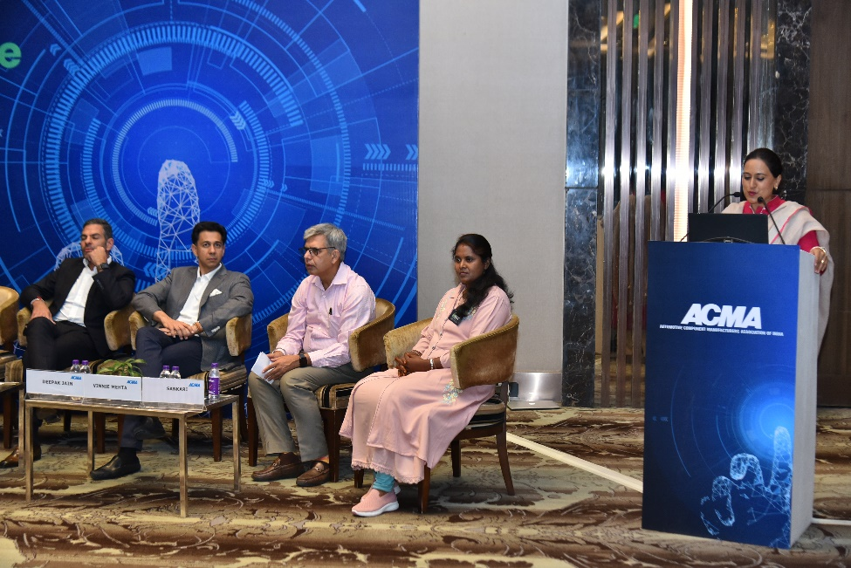
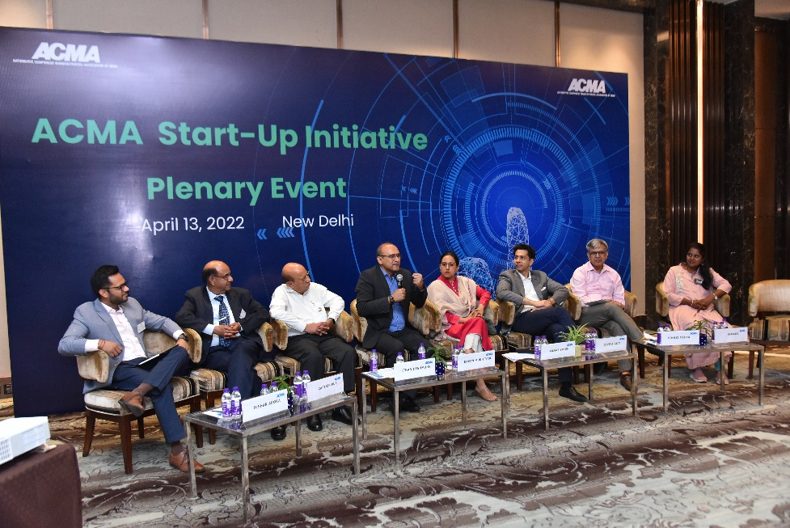
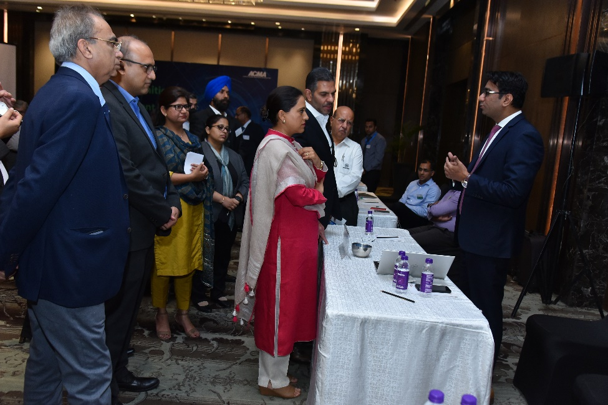
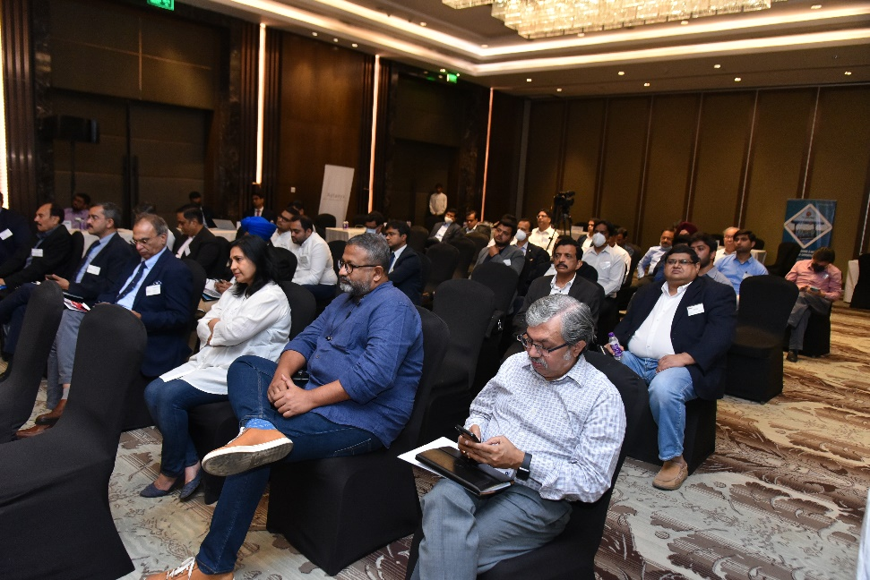
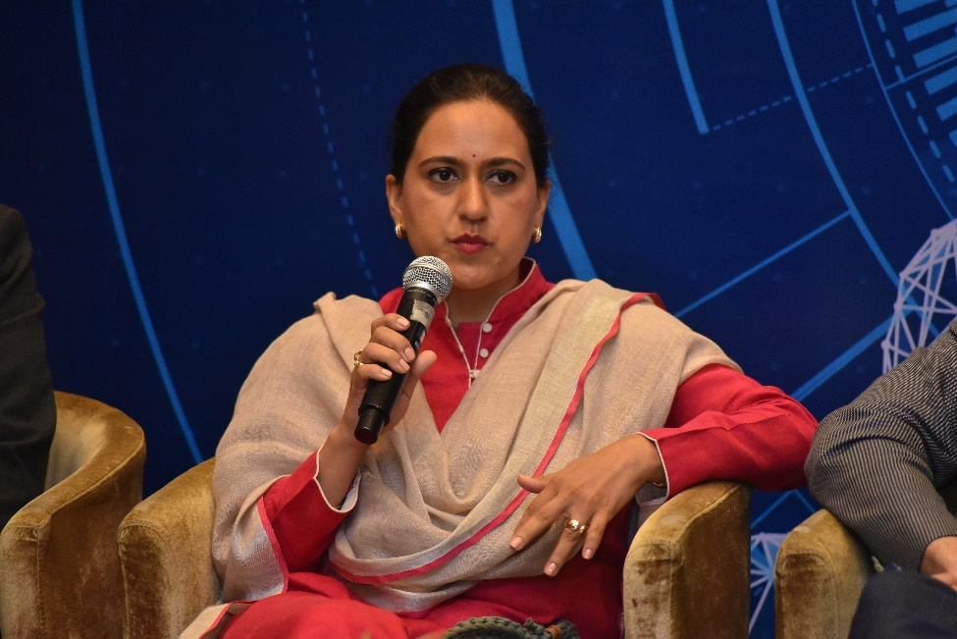
Glimpses

