Slide 1
Data Structures
Chapter 4 Lists

Slide 2
Chain (1/3)
Chain:
  A singly linked list in which the last node has a null link
Operations for chains
  Inverting a chain
    For a list of length ≧1 nodes, the while loop is executed length times and so the computing time is linear or O(length).
...
NULL
lead
invert
×
...
NULL
lead

Slide 3
Chain (2/3)
Invert the list
trail
middle
lead
NULL
...
NULL

Slide 4
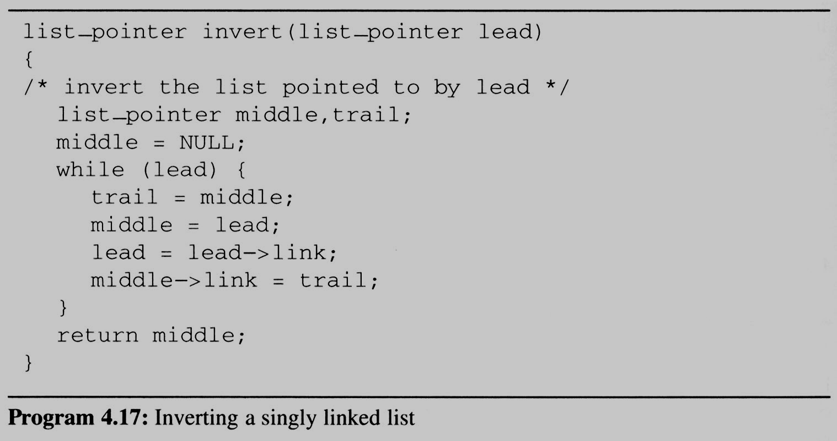
Chain (2/3)
Two extra pointers
trail
middle
middle
trail
lead
lead
NULL
...
NULL

Slide 5
Chain (3/3)
Concatenates two chains
  Concatenates two chains, ptr1 and ptr2.
  Assign the list ptr1 followed by the list ptr2.
temp
NULL
NULL
ptr1
ptr2

Slide 6
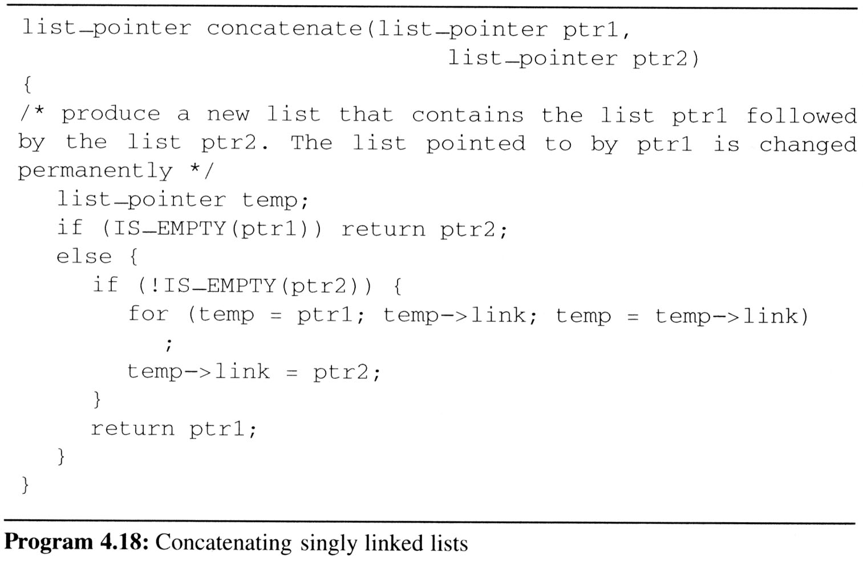
Chain (3/3)
Concatenates two chains
O(length of list ptr1)

Slide 7
Circularly Linked Lists (1/10)
Circular Linked list
  The link field of the last node points to the first node in the list.
Example
  Represent a polynomial ptr = 3x¹⁴+2x⁸+1 as a circularly linked list.
ptr
3 | 14
2 | 8
1 | 0

Slide 8
Circularly Linked Lists (2/10)
自己做垃圾回收，當delete node時，用list紀錄位址，先不還給系統
Maintain an Available List
  We free nodes that are no longer in use so that we may reuse these nodes later
  We can obtain an efficient erase algorithm for circular lists, by maintaining our own list (as a chain) of nodes that have been “freed”.
  Instead of using malloc and free, we now use get_node (program 4.13) and ret_node (program 4.14).
...
avail
NULL
List of freed nodes

Slide 9
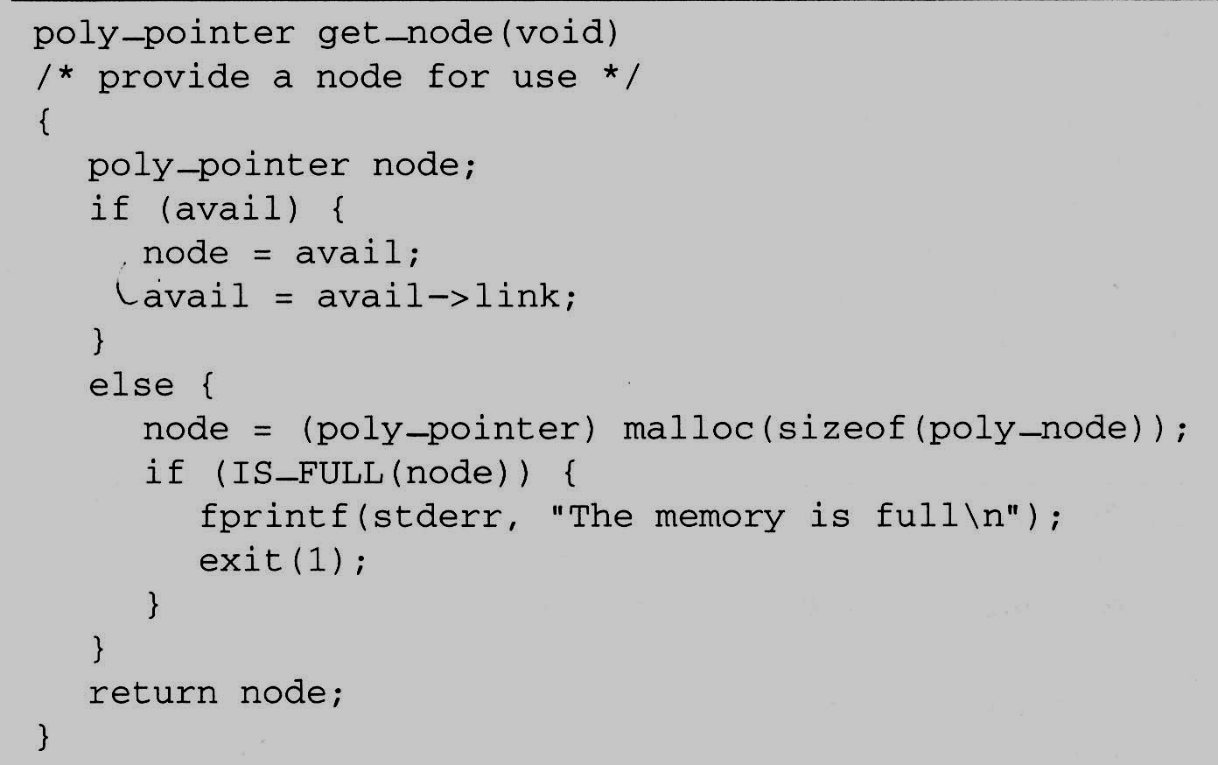
Circularly Linked Lists (3/10)
Maintain an Available List (cont’d)
  When we need a new node, we examine this list.
  If the list is not empty, then we may use one of its nodes.
  Only when the
  list is empty we
  do need to use
  malloc to
  create a new
  node.

Slide 10
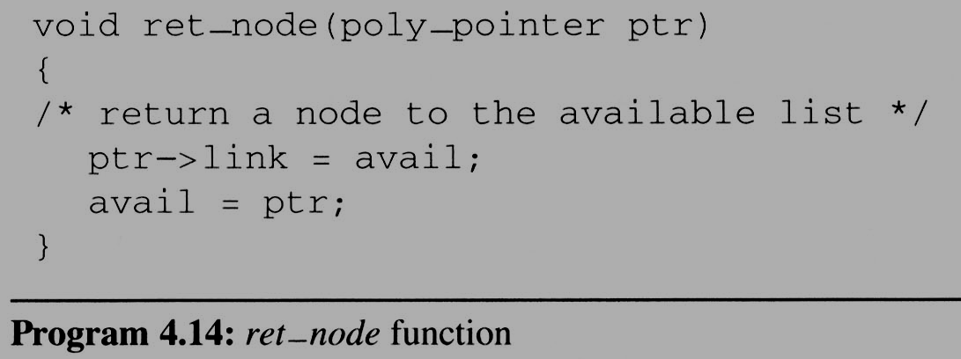
Circularly Linked Lists (4/10)
Maintain an Available List (cont’d)
Insert ptr to the front of this list
  Let avail be a variable of type poly_pointer that points to the first node in our list of freed nodes.
  Henceforth, we call this list the available space list or avail list.
  Initially, we set avail to NULL

Slide 11
Circularly Linked Lists (5/10)
Maintain an Available List
  Erase a circular list in a fixed amount (constant) of time O(1) independent of the number of nodes in the list using cerase
ptr
•
•
• • •
•
temp
avail
•
•
• • •
NULL
注意紅色link所連接而成的 chain

Slide 12
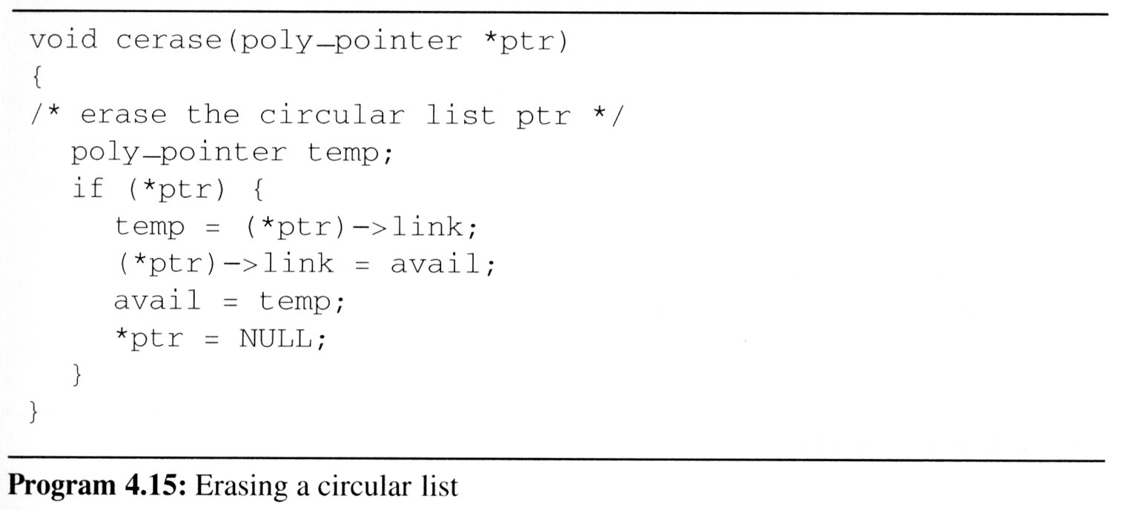
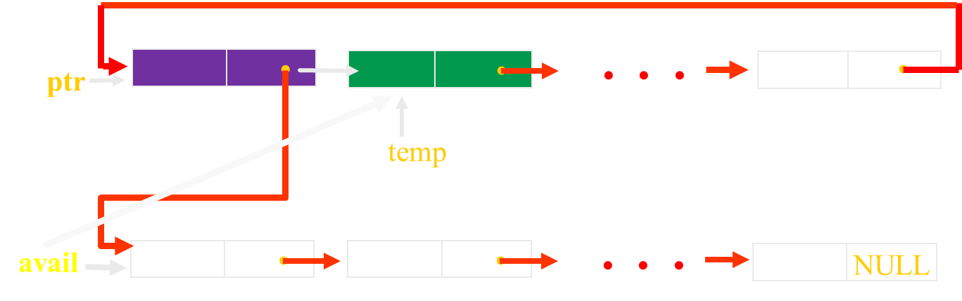
Circularly Linked Lists (5/10)
Maintain an Available List

Slide 13
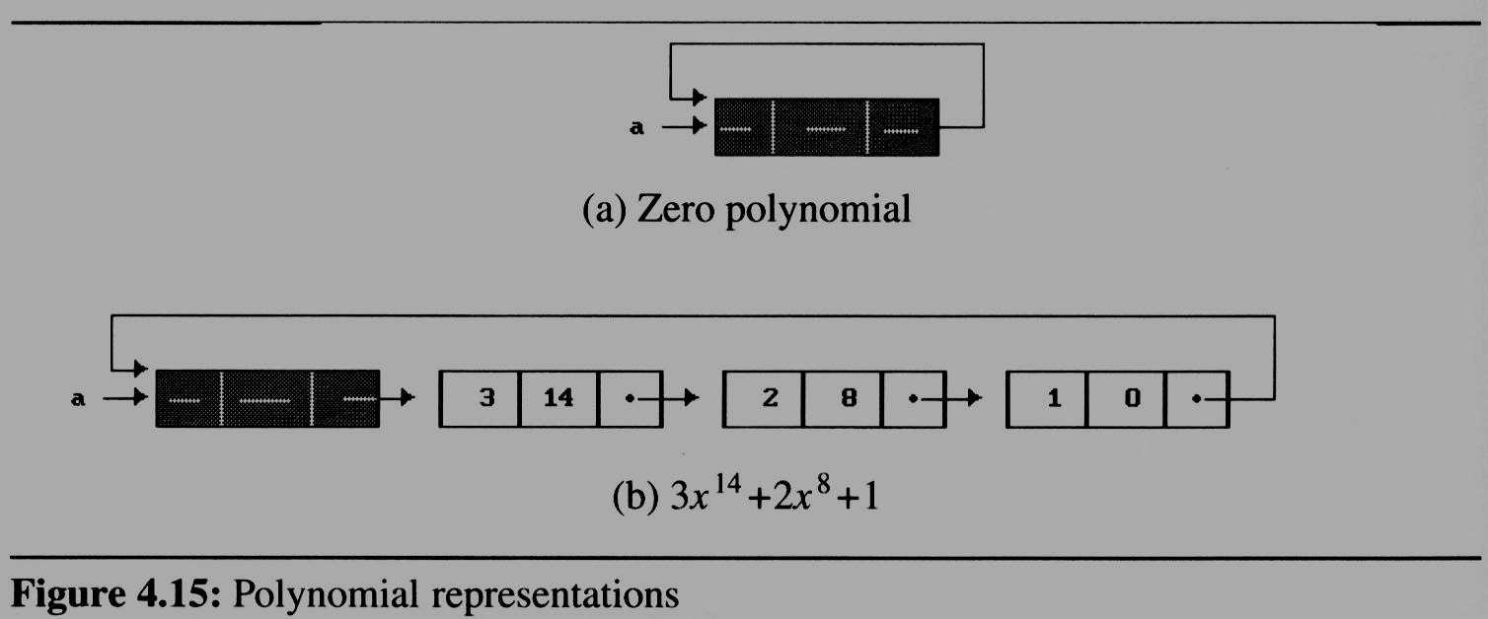
Circularly Linked Lists (6/10)
if多項式只有一項0，用head node表示
We must handle the zero polynomial as a special case. To avoid it, we introduce a head node into each polynomial
  each polynomial, zero or nonzero, contains one additional node.
Why ?
So !

Slide 14
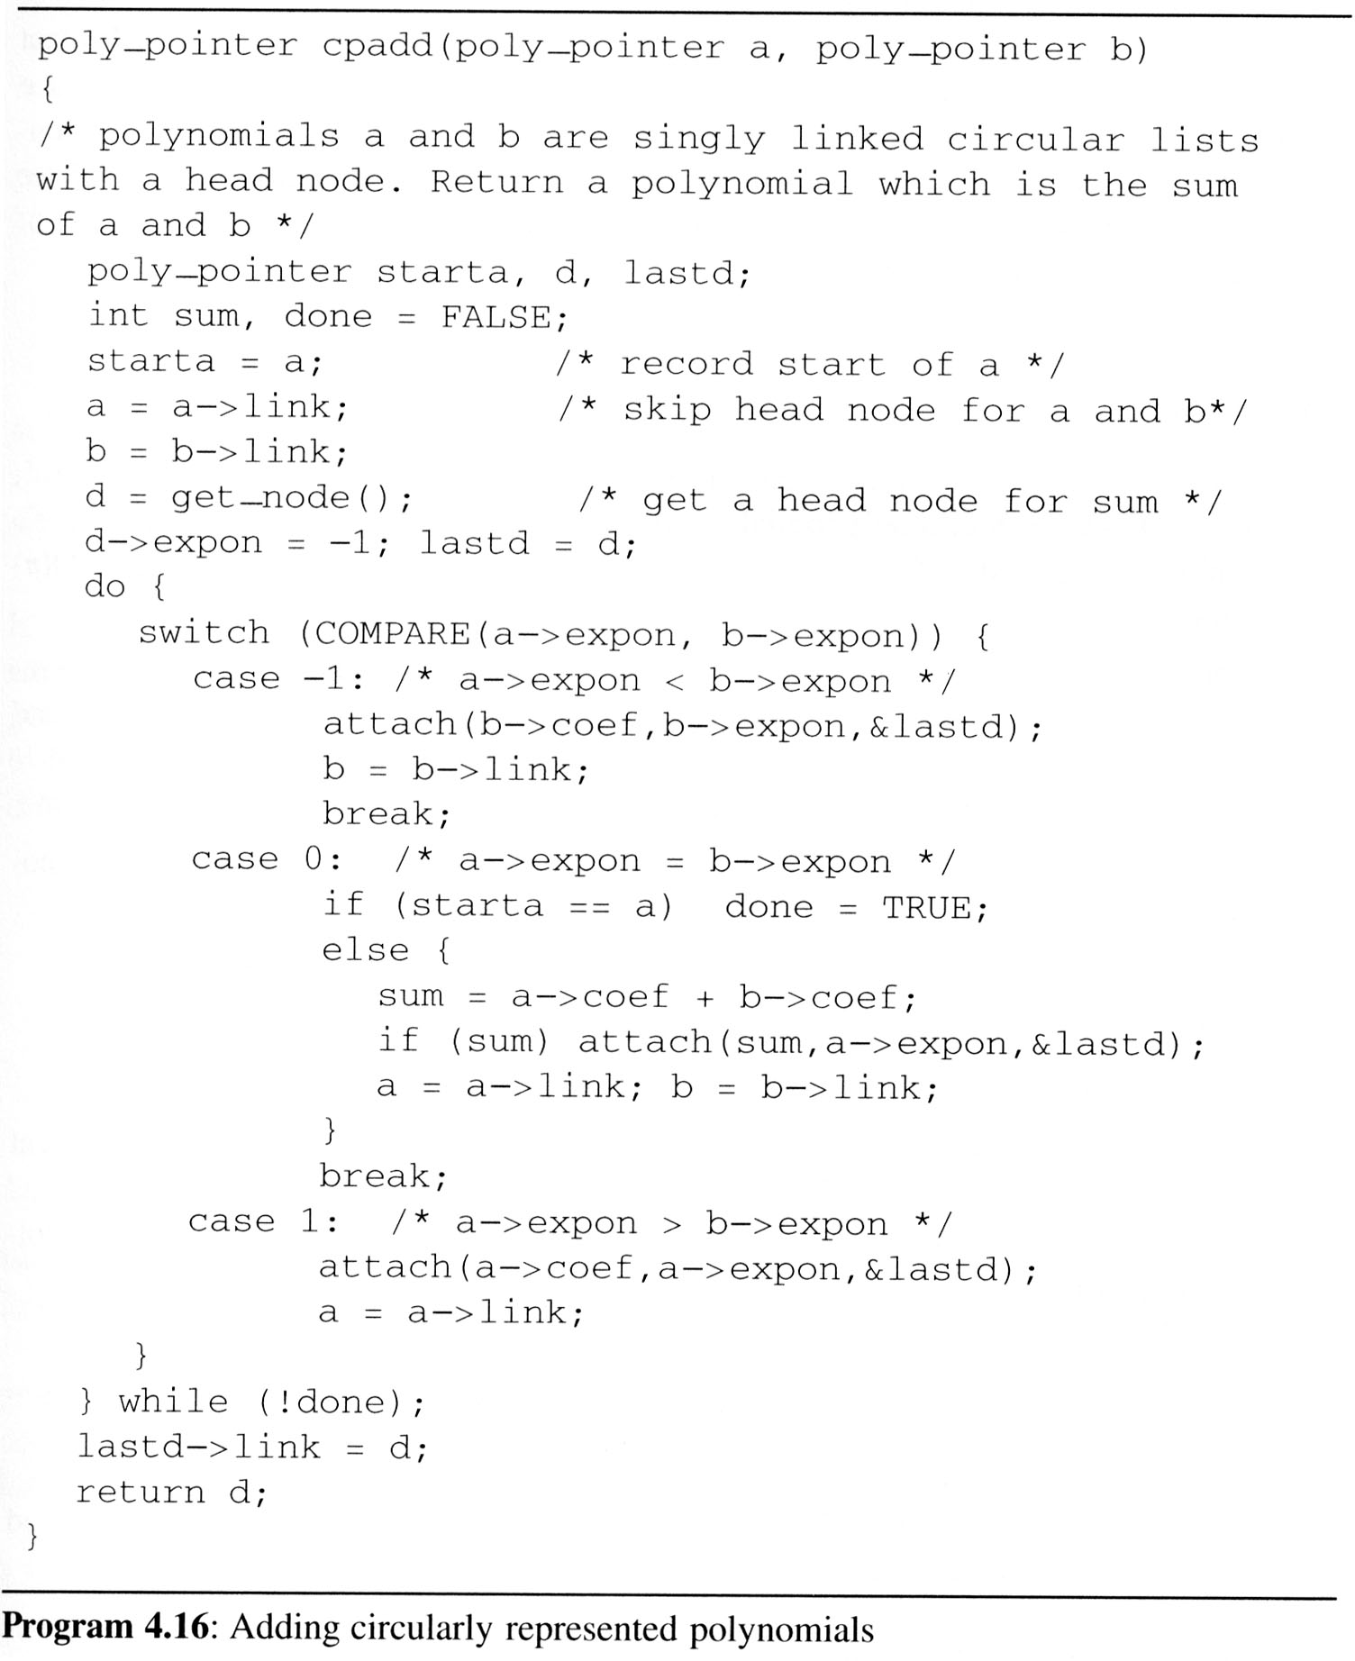
Circularly Linked Lists (7/10)
For fit the
circular list with head node representation
  We may remove the test for (*ptr) from cerase
  Changes the original padd to cpadd
/* head node */
/*a->expon=-1, so b->expont > -1 */
/* link to the first node */

Slide 15
Circularly Linked Lists (8/10)
Operations for circularly linked lists
  What happens when we want to insert a new node at the front of the circular linked list ptr?
  move down the entire length of ptr.
  Possible Solution:
即使是環狀的list，要在ptr前面加入node，還是要繞一圈回來。所以ptr應該要指向list end node ??
ptr
x₁
x₂
x₃
x₁
x₂
x₃
ptr

Slide 16
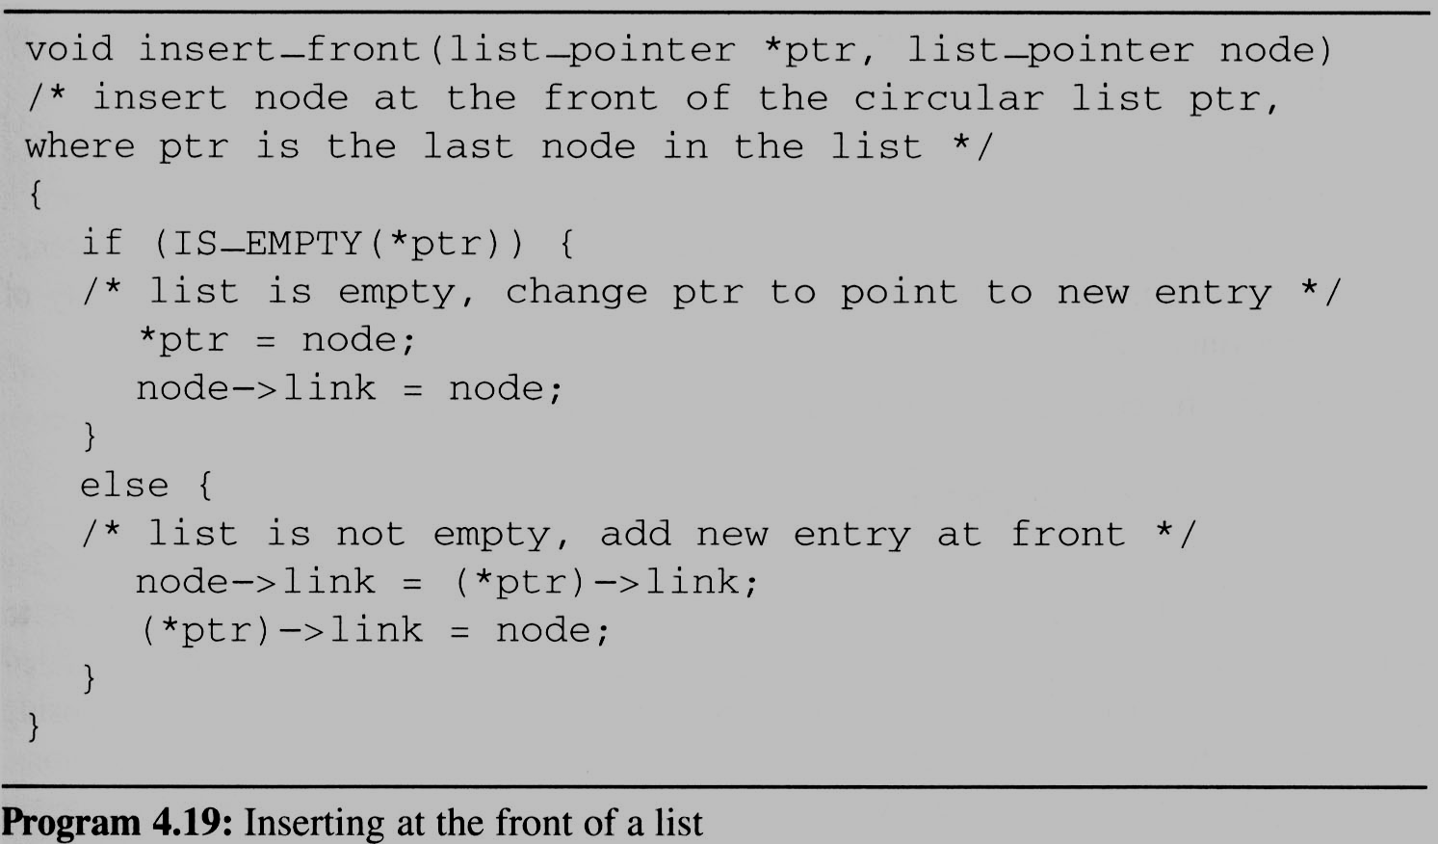
Circularly Linked Lists (9/10)
Insert a new node at the front of a circular list
To insert node at the rear, we only need to add the additional statement *ptr = node to the else clause of insert_front
X
x₁
x₂
x₃
ptr
node

Slide 17
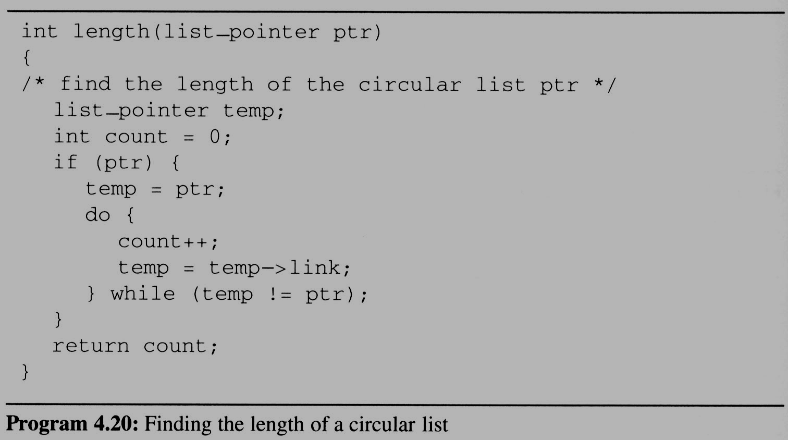
Circularly Linked Lists (10/10)
Finding the length of a circular list

Slide 18
Equivalence Relations (1/6)
Reflexive Relation
  for any polygon x, x ≡ x (e.g., x is electrically equivalent to itself)
Symmetric Relation
  for any two polygons x and y, if x ≡ y, then y ≡ x.
Transitive Relation
  for any three polygons x, y, and z, if x ≡ y and y ≡ z, then x ≡ z.

Slide 19
Equivalence Relations (1/6)
Definition:
  A relation over a set, S, is said to be an equivalence relation over S iff it is symmertric, reflexive, and transitive over S.

Slide 20
Equivalence Relations (2/6)
Example:
  if we have 12 polygons numbered 0 through 11
  0 ≡ 4, 3 ≡ 1, 6 ≡ 10, 8 ≡ 9, 7 ≡ 4, 6 ≡ 8, 3 ≡ 5, 2 ≡ 11, 11 ≡ 0
  we can partition the twelve polygons into the following equivalence classes:
{0, 2, 4, 7, 11};{1, 3, 5};{6, 8, 9,10}
輸入
輸出

Slide 21
Equivalence Relations (2/6)
Two phases to determine equivalence
  First phase: the equivalence pairs (i, j) are read in and stored.
  Second phase:
    we begin at 0 and find all pairs of the form (0, j).
    Continue until the entire equivalence class containing 0 has been found, marked, and printed.
Next find another object not yet output, and repeat the above process.

Slide 22
Equivalence Relation (3/6)
Program to find equivalence classes
#include <stdio.h>
#define MAX_SIZE 24
#define IS_FULL(ptr) (!(ptr))
#define FALSE 0
#define TRUE 1
typedef struct node *node_pointer;
typedef struct node {
int data;
node_pointer link;

Slide 23
Equivalence Relation (3/6)
Program to find equivalence classes
  void main(void){
  short int out[MAX_SIZE];
  node_pointer seq[MAX_SIZE];
  node_pointer x, y, top;
  int i, j, n;
    printf(“Enter the size (<=%d) ”, MAX_SIZE);
    scanf(“%d”, &n);
    for(i=0; i<n; i++){
    /*initialize seq and out */
    out[i] = TRUE; seq[i] = NULL;
  }
  /* Phase 1 */
  /* Phase 2 */
  }

Slide 24
Equivalence Relations (4/6)
Phase 1: read in and store the equivalence pairs <i, j>
[0]
11
4
NULL
[1]
3
用array of list把輸入存起來，
要怎麼知道哪些是同一群?
DFS?!
NULL
[2]
11
NULL
[3]
5
1
NULL
[4]
7
0
NULL
[5]
3
NULL
[6]
8
10
NULL
[7]
4
NULL
[8]
6
9
NULL
[9]
8
NULL
[10]
6
NULL
[11]
0
2
NULL
0 ≡ 4, 3 ≡ 1, 6 ≡ 10, 8 ≡ 9, 7 ≡ 4, 6 ≡ 8, 3 ≡ 5, 2 ≡ 11, 11 ≡ 0

Slide 25
Equivalence Relations (4/6)
Phase 1: read in and store the equivalence pairs <i, j>
[0]
11
4
NULL
[1]
3
NULL
[2]
11
NULL
Seq[ ]
[3]
5
1
NULL
[4]
7
0
NULL
[5]
3
NULL
[6]
8
10
NULL
[7]
4
NULL
[8]
6
9
NULL
[9]
8
NULL
[10]
6
NULL
[11]
0
2
NULL
0 ≡ 4, 3 ≡ 1, 6 ≡ 10, 8 ≡ 9, 7 ≡ 4, 6 ≡ 8, 3 ≡ 5, 2 ≡ 11, 11 ≡ 0

Slide 26
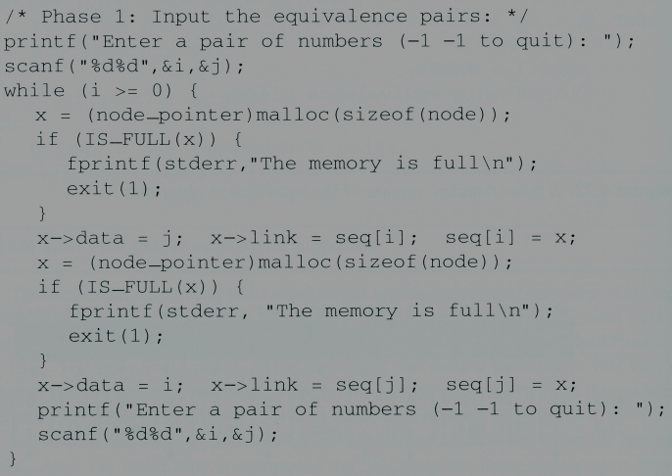
Equivalence Relations (4/6)
Phase 1: read in and store the equivalence pairs <i, j>
[0]
11
4
NULL
[1]
3
NULL
[2]
11
NULL
[3]
5
1
NULL
[4]
7
0
NULL
(1)
(2)
[5]
3
NULL
Insert x to the top of lists seq[i]
[6]
8
10
NULL
[7]
4
NULL
[8]
6
9
NULL
[9]
8
NULL
[10]
6
NULL
Insert x to the top of lists seq[j]
[11]
0
2
NULL
0 ≡ 4, 3 ≡ 1, 6 ≡ 10, 8 ≡ 9, 7 ≡ 4, 6 ≡ 8, 3 ≡ 5, 2 ≡ 11, 11 ≡ 0

Slide 27
Equivalence Relations (5/6)
Phase 2:
  begin at 0 and find all pairs of the form <0, j>, where 0 and j are in the same equivalence class
  by transitivity, all pairs of the form <j, k> imply that k in the same equivalence class as 0
  continue this way until we have found, marked, and printed the entire equivalent class containing 0

Slide 28


Equivalence Relations (6/6)
x
Phase 2
y
i=
1
11
0
j=
11
0
2
4
0
7
top
4
[0]
11
4
NULL
[1]
3
NULL
out:
[0]
[1]
[2]
[3]
[4]
[5]
[6]
[7]
[8]
[9]
[10]
[11]
[2]
11
NULL
[3]
5
1
Stack做垃圾回收，
存完後放stack
NULL
[4]
7
0
NULL
[5]
3
NULL
[6]
8
10
NULL
New class: 0
11
4
7
2
[7]
4
NULL
BFS: 先把跟0相連的都讀完，
mark as visted，把11 4 push stack。
從stack pop出4，去讀4的相鄰串列，
有未讀過的再push stack…
第一個class就搞定了。
Ps: push時marked as visited.
[8]
6
9
NULL
[9]
8
NULL
[10]
6
NULL
[11]
0
2
NULL

Slide 29
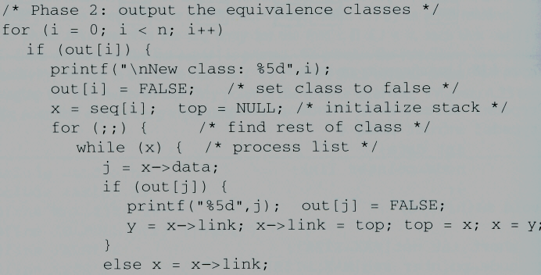
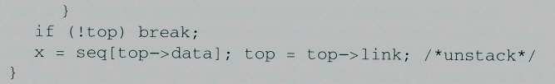
Equivalence Relations (6/6)
x
y
[0]
[1]
[2]
[3]
[4]
[5]
[6]
[7]
[8]
[9]
i=
1
0
j=
11
4
7
0
4
0
2
11
[10]
[11]
Phase 2
top
out:
[0]
11
4
NULL
[1]
3
NULL
[2]
11
NULL
[3]
5
1
NULL
[4]
7
0
NULL
[5]
3
NULL
[6]
8
10
NULL
[7]
4
NULL
[8]
6
9
NULL
[9]
8
NULL
[10]
6
NULL
[11]
0
2
NULL
New class: 0
11
4
7
2

Slide 30
Doubly Linked Lists (1/4)
Singly linked lists pose problems because we can move easily only in the direction of the links
...
NULL
?
ptr

Slide 31
Doubly Linked Lists (1/4)
Doubly linked list has at least three fields
    typedef struct node *node_pointer;
    typedef struct node{
    node_pointer llink;
    element item;
    node_pointer rlink;
    };

Slide 32
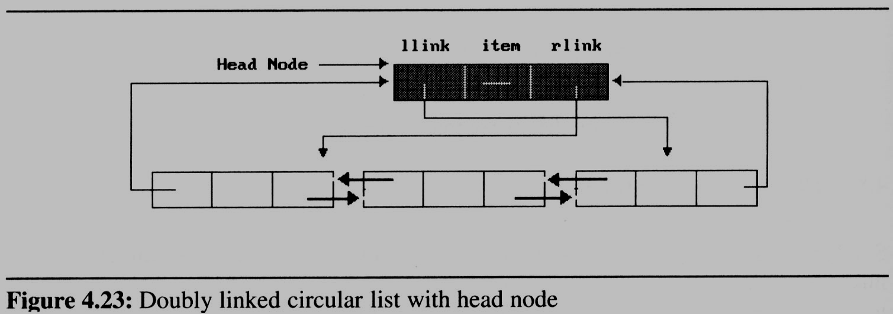
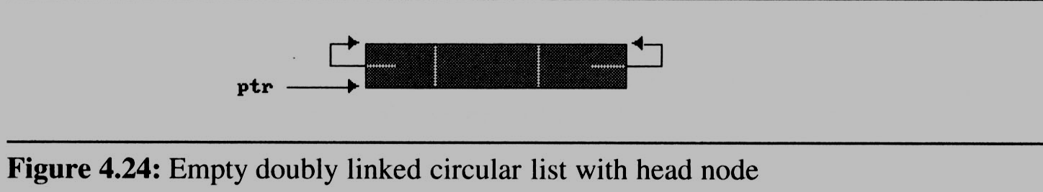
Doubly Linked Lists (2/4)
Sample
  doubly linked circular with head node:
  empty double linked circular list with head node

Slide 33
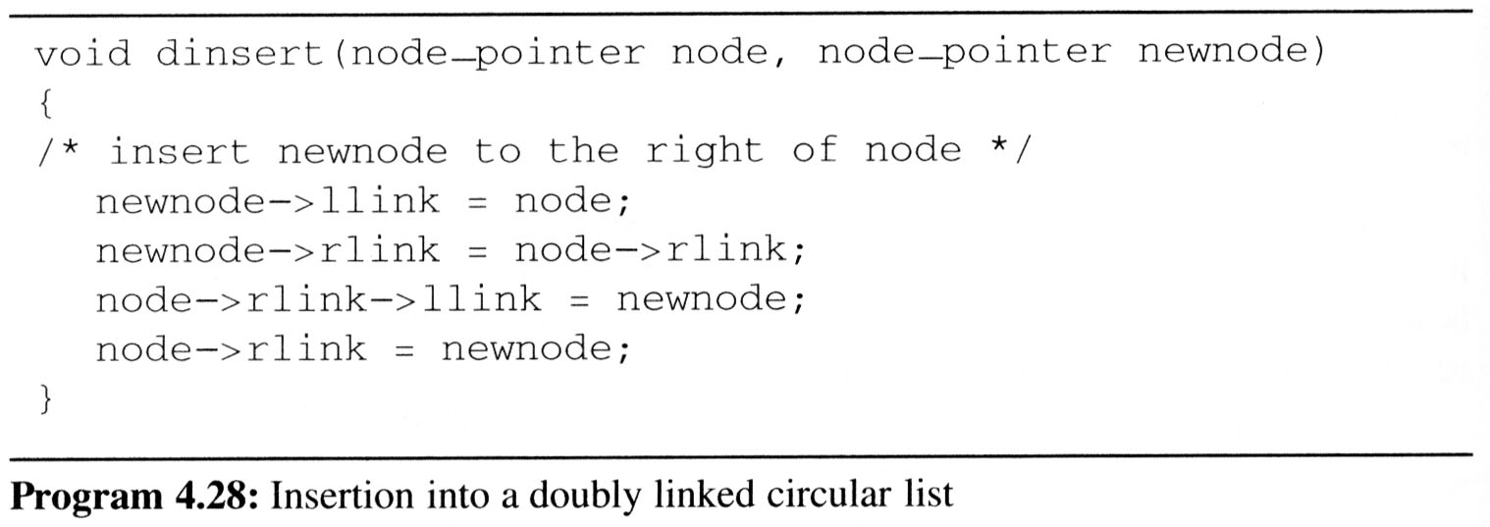


Doubly Linked Lists (3/4)
Insert node
Head node
node
llink item rlink
New node

Slide 34
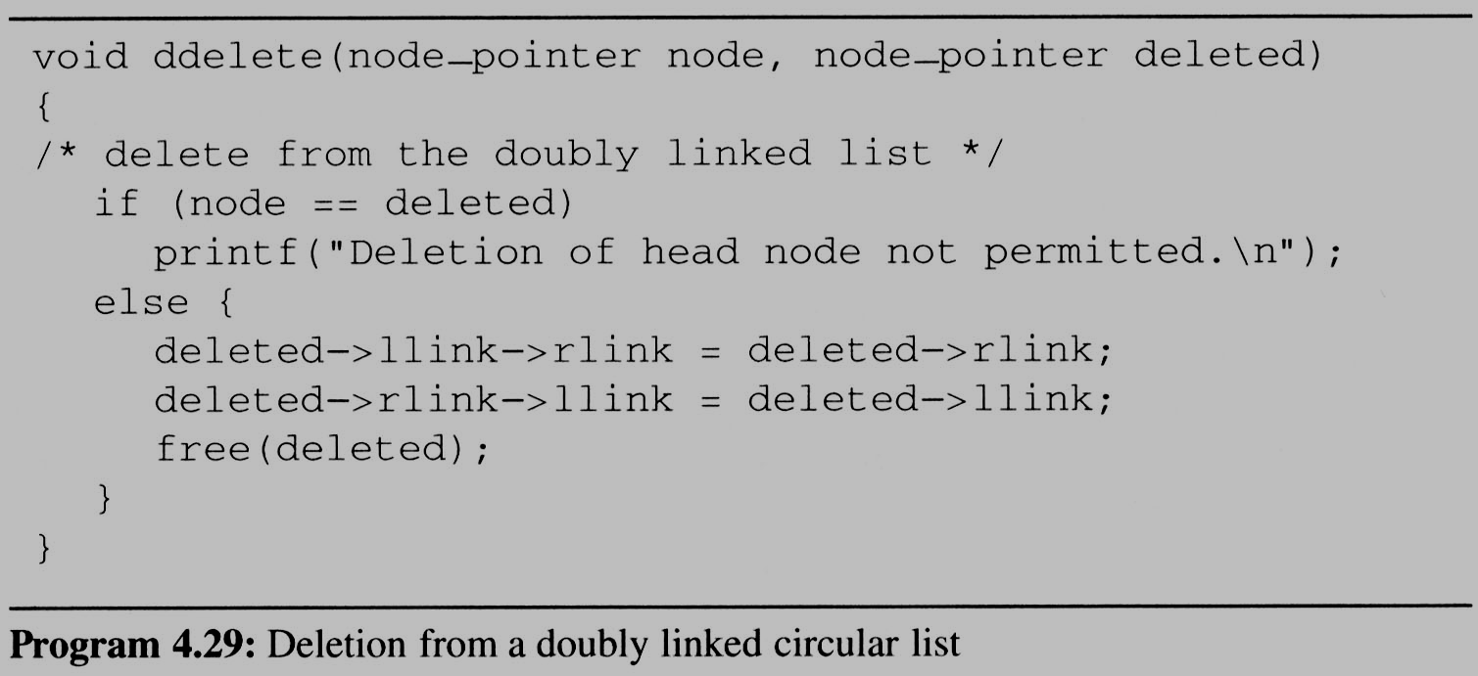
Doubly Linked Lists (4/4)
Delete node
Head node
llink item rlink
deleted node

