Slide 1
Data Structures
Chapter 3 Stacks and Queues

Slide 2
3.3 A Mazing Problem (1/8)
Representation of the maze
  The most obvious choice is a two dimensional array
    0s the open paths and 1s the barriers
entrance
0 1 0 0 0 1 1 0 0 0 1 1 1 1 1
1 0 0 0 1 1 0 1 1 1 0 0 1 1 1
0 1 1 0 0 0 0 1 1 1 1 0 0 1 1
1 1 0 1 1 1 1 0 1 1 0 1 1 0 0
1 1 0 1 0 0 1 0 1 1 1 1 1 1 1
0 0 1 1 0 1 1 1 0 1 0 0 1 0 1
0 1 1 1 1 0 0 1 1 1 1 1 1 1 1
0 0 1 1 0 1 1 0 1 1 1 1 1 0 1
1 1 0 0 0 1 1 0 1 1 0 0 0 0 0
0 0 1 1 1 1 1 0 0 0 1 1 1 1 0
0 1 0 0 1 1 1 1 1 0 1 1 1 1 0
exit

Slide 3
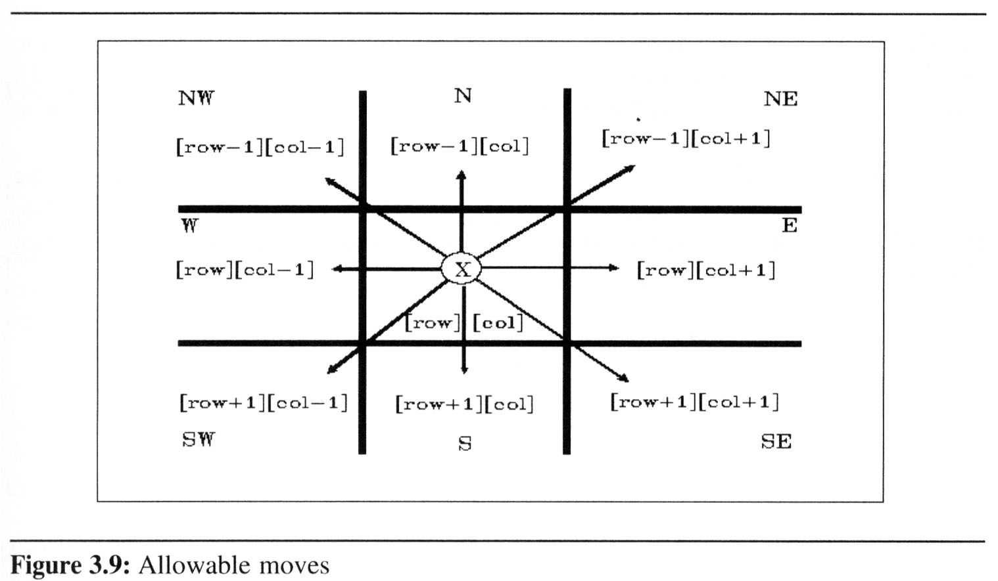
3.3 A Mazing Problem (2/8)
X marks the spot of our current location, maze[row][col]
possible moves from this position
x

Slide 4
3.3 A Mazing Problem (3/8)
  Notice that not every position has eight neighbors.
    To avoid checking for these border conditions we can surround the maze by a border of ones. Thus an m×p maze will require an (m+2) × (p+2) array
entrance
1 1 1 1 1 1 1 1 1 1 1 1 1 1 1 1 1
1 0 1 0 0 0 1 1 0 0 0 1 1 1 1 1 1
1 1 0 0 0 1 1 0 1 1 1 0 0 1 1 1 1
1 0 1 1 0 0 0 0 1 1 1 1 0 0 1 1 1
1 1 1 0 1 1 1 1 0 1 1 0 1 1 0 0 1
1 1 1 0 1 0 0 1 0 1 1 1 1 1 1 1 1
1 0 0 1 1 0 1 1 1 0 1 0 0 1 0 1 1
1 0 1 1 1 1 0 0 1 1 1 1 1 1 1 1 1
1 0 0 1 1 0 1 1 0 1 1 1 1 1 0 1 1
1 1 1 0 0 0 1 1 0 1 1 0 0 0 0 0 1
1 0 0 1 1 1 1 1 0 0 0 1 1 1 1 0 1
1 0 1 0 0 1 1 1 1 1 0 1 1 1 1 0 1
1 1 1 1 1 1 1 1 1 1 1 1 1 1 1 1 1
exit

Slide 5
3.3 A Mazing Problem (4/8)
    The entrance is at position [1][1] and the exit at [m][p]
entrance
1 1 1 1 1 1 1 1 1 1 1 1 1 1 1 1 1
1 0 1 0 0 0 1 1 0 0 0 1 1 1 1 1 1
1 1 0 0 0 1 1 0 1 1 1 0 0 1 1 1 1
1 0 1 1 0 0 0 0 1 1 1 1 0 0 1 1 1
1 1 1 0 1 1 1 1 0 1 1 0 1 1 0 0 1
1 1 1 0 1 0 0 1 0 1 1 1 1 1 1 1 1
1 0 0 1 1 0 1 1 1 0 1 0 0 1 0 1 1
1 0 1 1 1 1 0 0 1 1 1 1 1 1 1 1 1
1 0 0 1 1 0 1 1 0 1 1 1 1 1 0 1 1
1 1 1 0 0 0 1 1 0 1 1 0 0 0 0 0 1
1 0 0 1 1 1 1 1 0 0 0 1 1 1 1 0 1
1 0 1 0 0 1 1 1 1 1 0 1 1 1 1 0 1
1 1 1 1 1 1 1 1 1 1 1 1 1 1 1 1 1
exit

Slide 6
3.3 A Mazing Problem (5/8)
X marks the spot of our current location, maze[row][col]
possible moves from this position
x

Slide 7
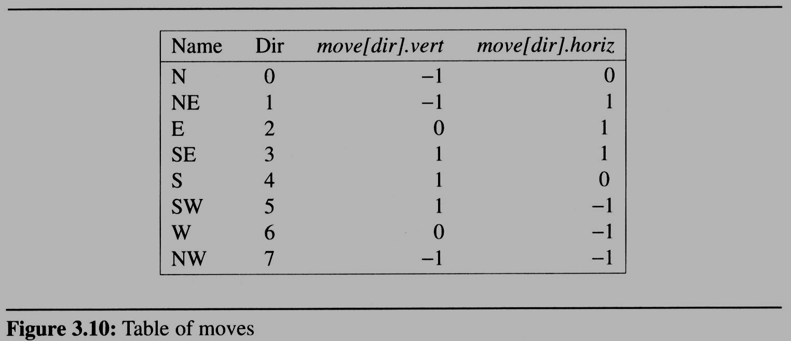
3.3 A Mazing Problem (6/8)
A possible implementation:
  the possible directions to move in an array
    typedef struct {
    short int vert;
    short int horiz;
    } offsets;
    offsets move[8];

Slide 8
3.3 A Mazing Problem (7/8)
  If we are at position, maze[row][col], and we wish to find the position of the next move
    next_row = row + move[dir].vert;
    next_col = col + move[dir].horiz;

Slide 9
3.3 A Mazing Problem (8/8)
Initial attempt at a maze traversal algorithm
  maintain a second two-dimensional array, mark, to record
  the maze positions already checked
  use stack to keep pass history
#define MAX_STACK_SIZE 100 /*maximum stack size*/
typedef struct {
short int row;
short int col;
short int dir;
} element;
element stack[MAX_STACK_SIZE];

Slide 10
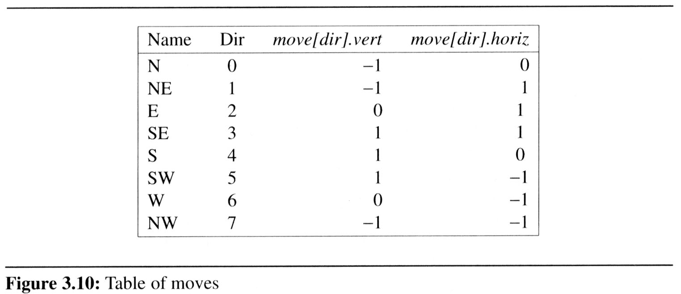
R: row
C: col
D: dir
R 1 C 1 D 1
R4 C14 D 2
R3 C12 D 5
R3 C13 D 3
R3 C13 D 6
Pop out
R2 C12 D 3
R2 C11 D 2
maze[1][1]: entrance
Initially set mark[1][1]=1
R1 C10 D 3
1 1 1 1 1 1 1 1 1 1 1 1 1 1 1 1 1
1 0 1 0 0 0 1 1 0 0 0 1 1 1 1 1 1
1 1 0 0 0 1 1 0 1 1 1 0 0 1 1 1 1
1 0 1 1 0 0 0 0 1 1 1 1 0 0 1 1 1
1 1 1 0 1 1 1 1 0 1 1 0 1 1 0 0 1
1 1 1 0 1 0 0 1 0 1 1 1 1 1 1 1 1
1 0 0 1 1 0 1 1 1 0 1 0 0 1 0 1 1
1 0 1 1 1 1 0 0 1 1 1 1 1 1 1 1 1
1 0 0 1 1 0 1 1 0 1 1 1 1 1 0 1 1
1 1 1 0 0 0 1 1 0 1 1 0 0 0 0 0 1
1 0 0 1 1 1 1 1 0 0 0 1 1 1 1 0 1
1 0 1 0 0 1 1 1 1 1 0 1 1 1 1 0 1
1 1 1 1 1 1 1 1 1 1 1 1 1 1 1 1 1
█ █ █ █ █ █ █ █ █ █ █ █ █ █ █ █ █
█ █ █ █ █ █ █ █ █ █ █ █ █ █ █ █ █
█ █ █ █ █ █ █ █ █ █ █ █ █ █ █ █ █
█ █ █ █ █ █ █ █ █ █ █ █ █ █ █ █ █
█ █ █ █ █ █ █ █ █ █ █ █ █ █ █ █ █
█ █ █ █ █ █ █ █ █ █ █ █ █ █ █ █ █
█ █ █ █ █ █ █ █ █ █ █ █ █ █ █ █ █
█ █ █ █ █ █ █ █ █ █ █ █ █ █ █ █ █
█ █ █ █ █ █ █ █ █ █ █ █ █ █ █ █ █
█ █ █ █ █ █ █ █ █ █ █ █ █ █ █ █ █
█ █ █ █ █ █ █ █ █ █ █ █ █ █ █ █ █
█ █ █ █ █ █ █ █ █ █ █ █ █ █ █ █ █
█ █ █ █ █ █ █ █ █ █ █ █ █ █ █ █ █
R 1 C 9 D 2
❒
❒
❒
❒
❒
❒
❒
R 1 C 8 D 2
❒
❒
❒
❒
❒
R 2 C 7 D 1
❒
❒
❒
❒
❒
❒
❒
R 3 C 6 D 1
R 3 C 5 D 2
R 2 C 4 D 3
R 1 C 5 D 5
R 1 C 4 D 2
R 1 C 3 D 2
R 2 C 2 D 1
R 1 C 1 D 1
maze[15][11]: exit
R 1 C 1 D 3

Slide 11
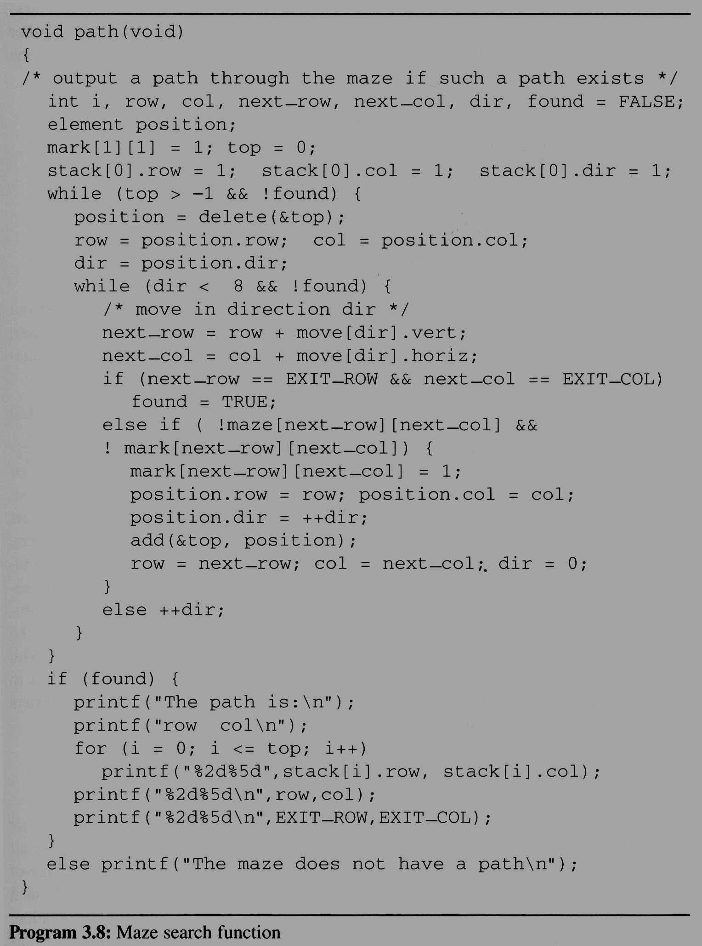
3.3 A Mazing Problem (7/8)
Analysis:
  The worst case of computing time of path is O(mp), where m and p are the number of rows and columns of the maze
  respectively
(1,1)
(m,p)
(m+2)*(p+2)

Slide 12
3.3 A Mazing Problem (8/8)
The size of a stack
  0 0 0 0 0 1
  1 1 1 1 1 0
  1 0 0 0 0 1
  0 1 1 1 1 1
  1 0 0 0 0 1
  1 1 1 1 1 0
  1 0 0 0 0 1
  0 1 1 1 1 1
  1 0 0 0 0 0
m*p

Slide 13
3.4 Evaluation of Expressions (1/14)
3.4.1 Introduction
  The representation and evaluation of expressions is of great interest to computer scientists.
    ((rear+1==front) || ((rear==MAX_QUEUE_SIZE-1) && !front)) x = a/b - c+d*e - a*c
    If we examine expressions (3.1),
    we notice that they contains:
    operators: ==, +, -, ||, &&, !
    operands: rear, front, MAX_QUEUE_SIZE
    parentheses: ( )

Slide 14
3.4 Evaluation of Expressions (2/14)
Understanding the meaning of these or any other expressions and statements
  assume a = 4, b = c = 2, d = e = 3 in the statement (3.2), finding out the value of x = a/b – c + d*e - a*c
    Interpretation 1: ((4/2)-2)+(3*3)-(4*2) = 0+8+9 = 1
    Interpretation 2: (4/(2-2+3))*(3-4)*2 = (4/3)*(-1)*2 = -2.66666…

Slide 15
3.4 Evaluation of Expressions (2/14)
Understanding the meaning of these or any other expressions and statements
  assume a = 4, b = c = 2, d = e = 3 in the statement (3.2), finding out the value of x = a/b – c + d*e - a*c
    Interpretation 1: ((4/2)-2)+(3*3)-(4*2) = 0+8+9 = 1
    Interpretation 2: (4/(2-2+3))*(3-4)*2 = (4/3)*(-1)*2 = -2.66666…
How to generate the machine instructions corresponding to a given expression?
precedence rule + associative rule

Slide 16
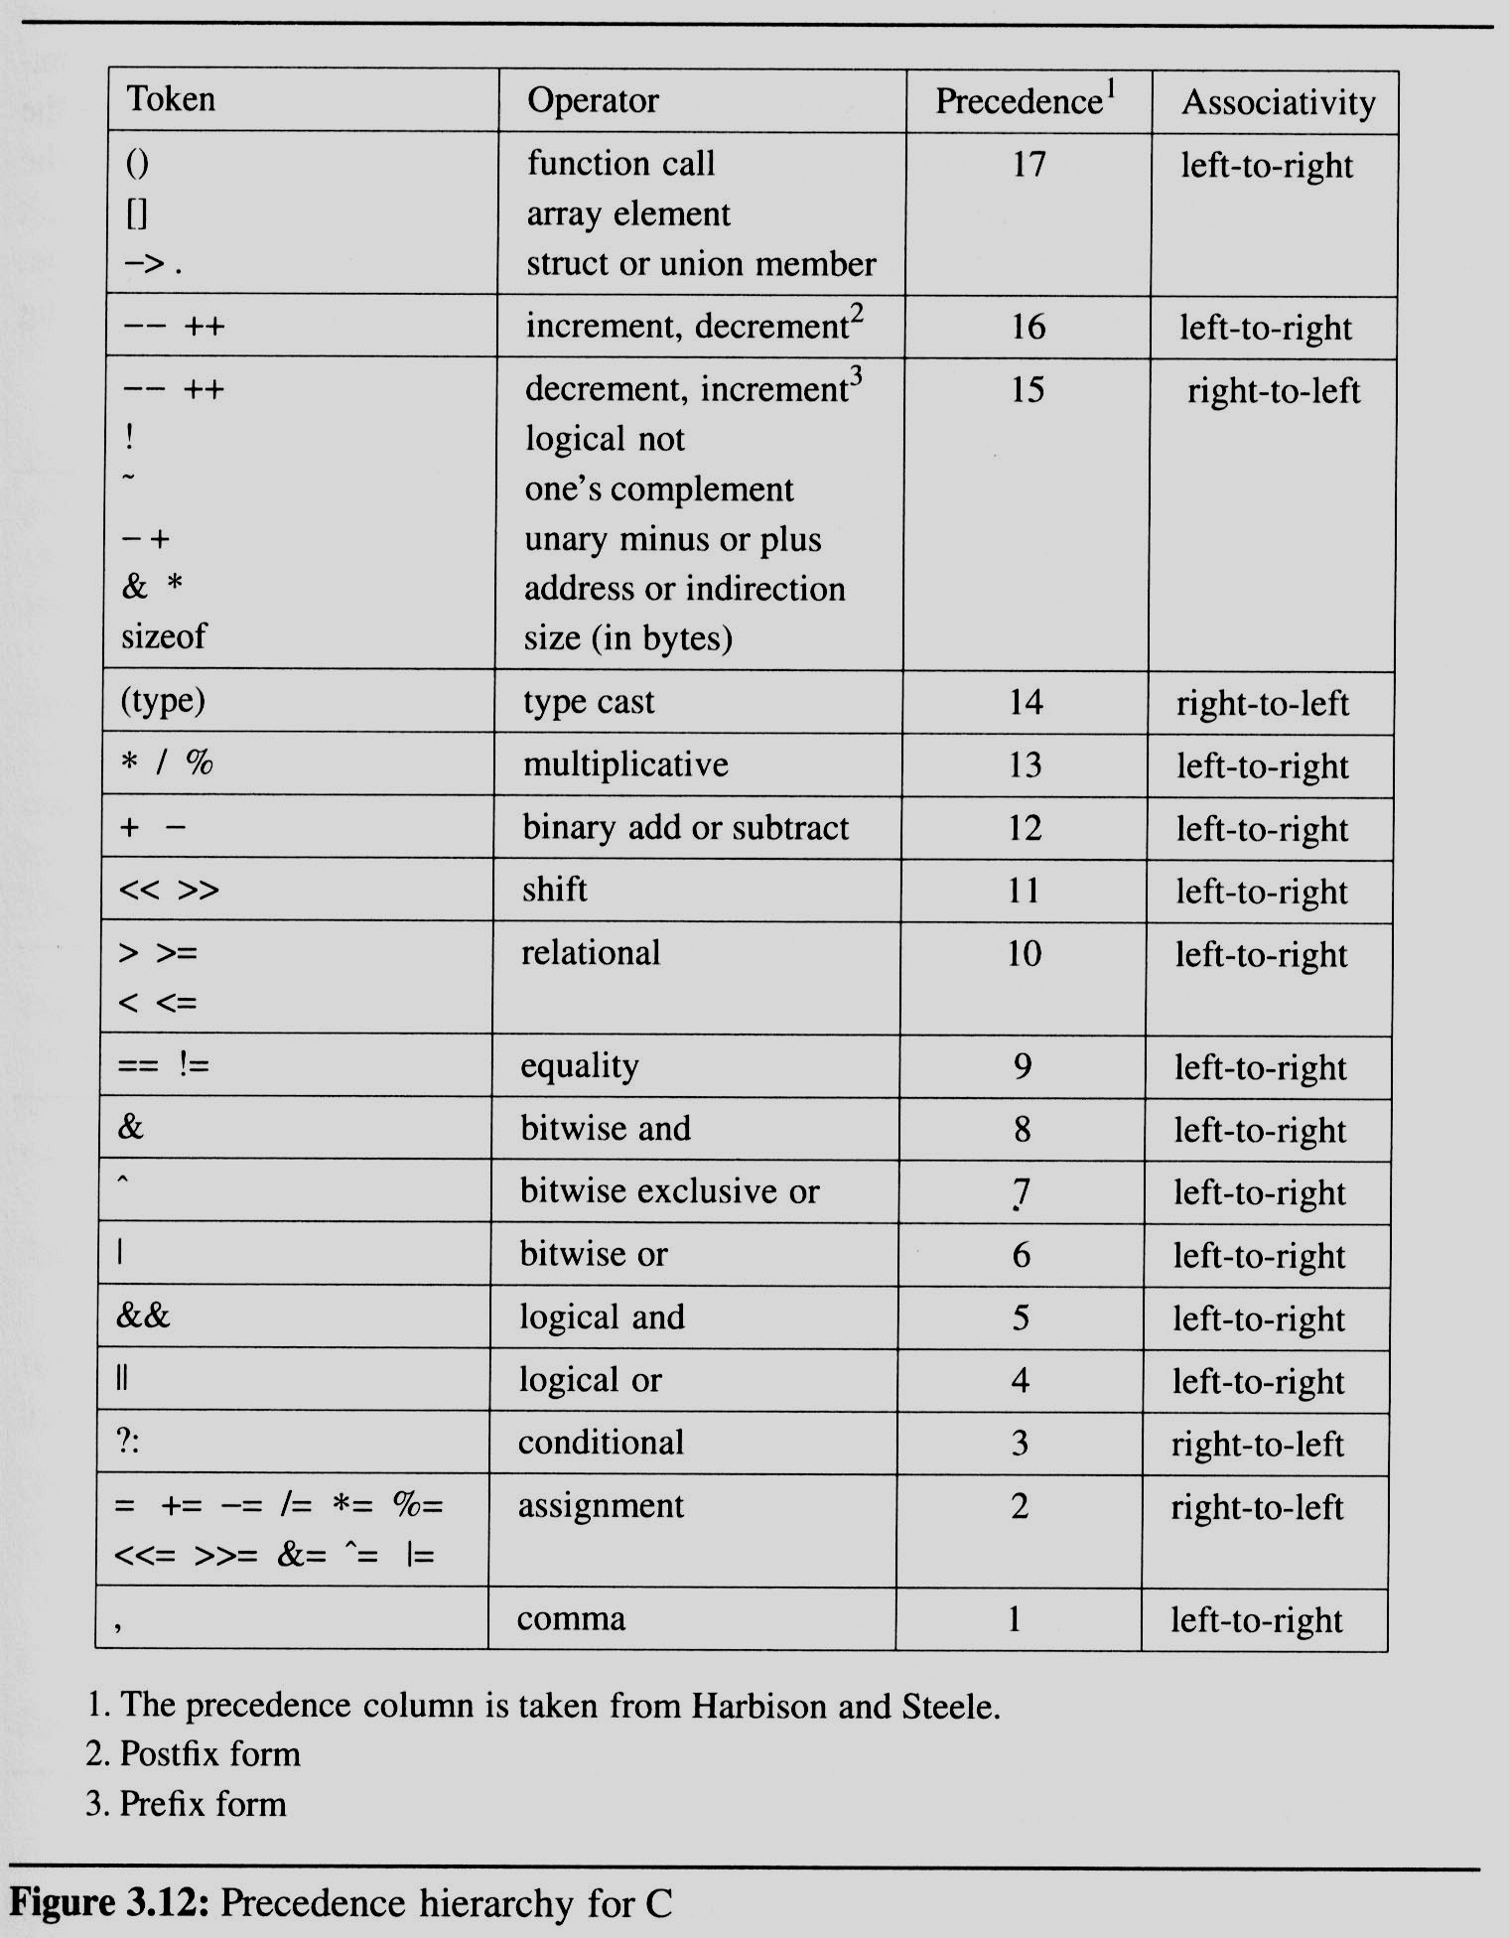
3.4 (3/14)
順位
Precedence hierarchy and associative for C

Slide 17
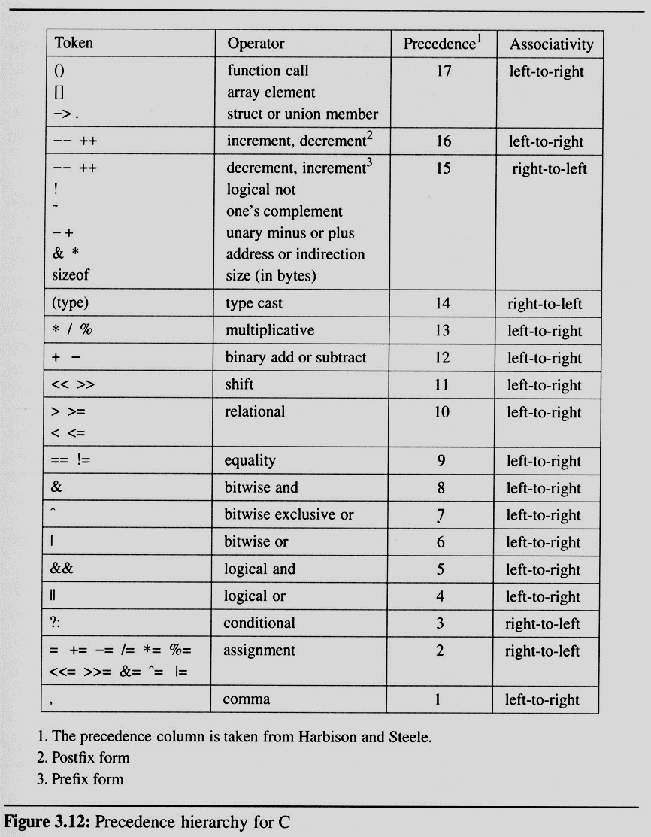
3.4 (3/14)

Slide 18
3.4 Evaluation of Expressions (4/14)
Evaluating postfix expressions
  The standard way of writing expressions is known as infix notation
    binary operator in-between its two operands
  Infix notation is not the one used by compilers to evaluate expressions
  Instead compilers typically use a parenthesis-free notation referred to as postfix

Slide 19
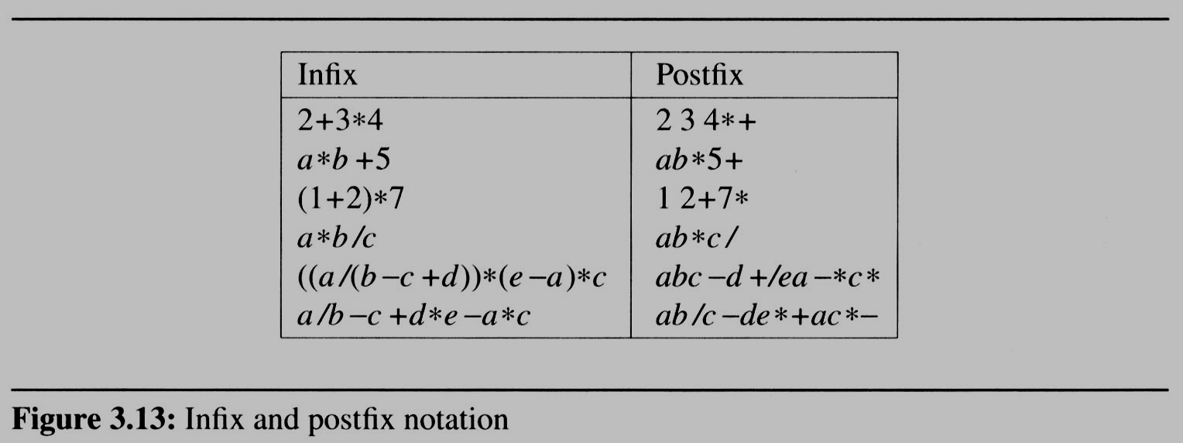
3.4 Evaluation of Expressions (4/14)
Evaluating postfix expressions
運算子at後方
碰到運算子可直接運算
寫程式把
Infix轉postfix

Slide 20
3.4 Evaluation of Expressions (5/14)
Evaluating postfix expressions is much simpler than the evaluation of infix expressions:
  There are no parentheses to consider.
  To evaluate an expression we make a single left-to-right scan of it. 只需要左掃到右
  We can evaluate an expression easily by using
  a “stack”
不需要括號

Slide 21
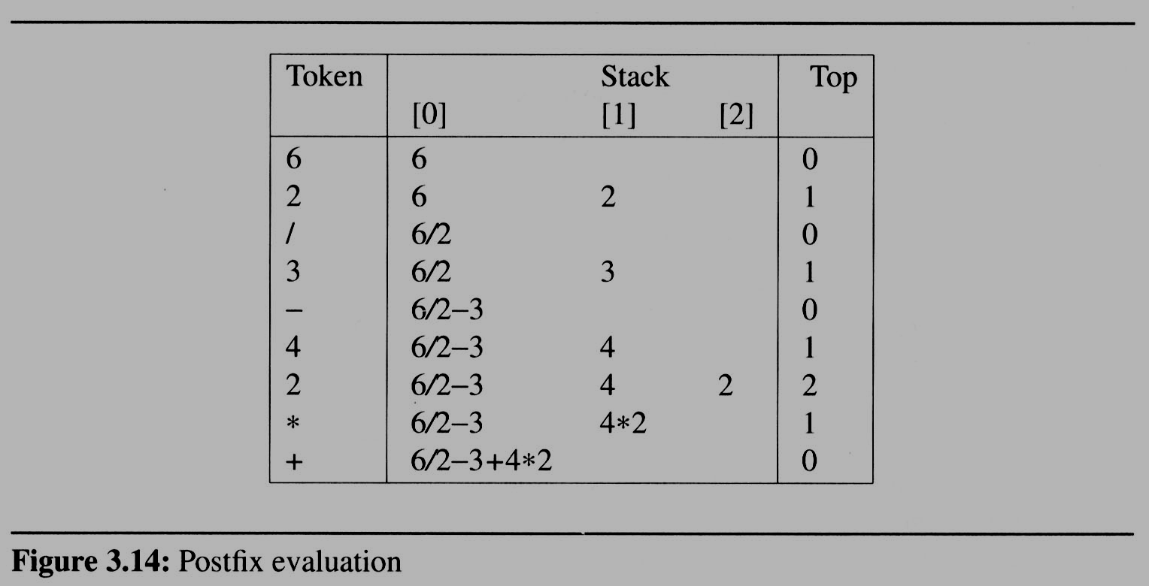
3.4 Evaluation of Expressions (5/14)
6 2/3-4 2*+
Postfix算法

Slide 22
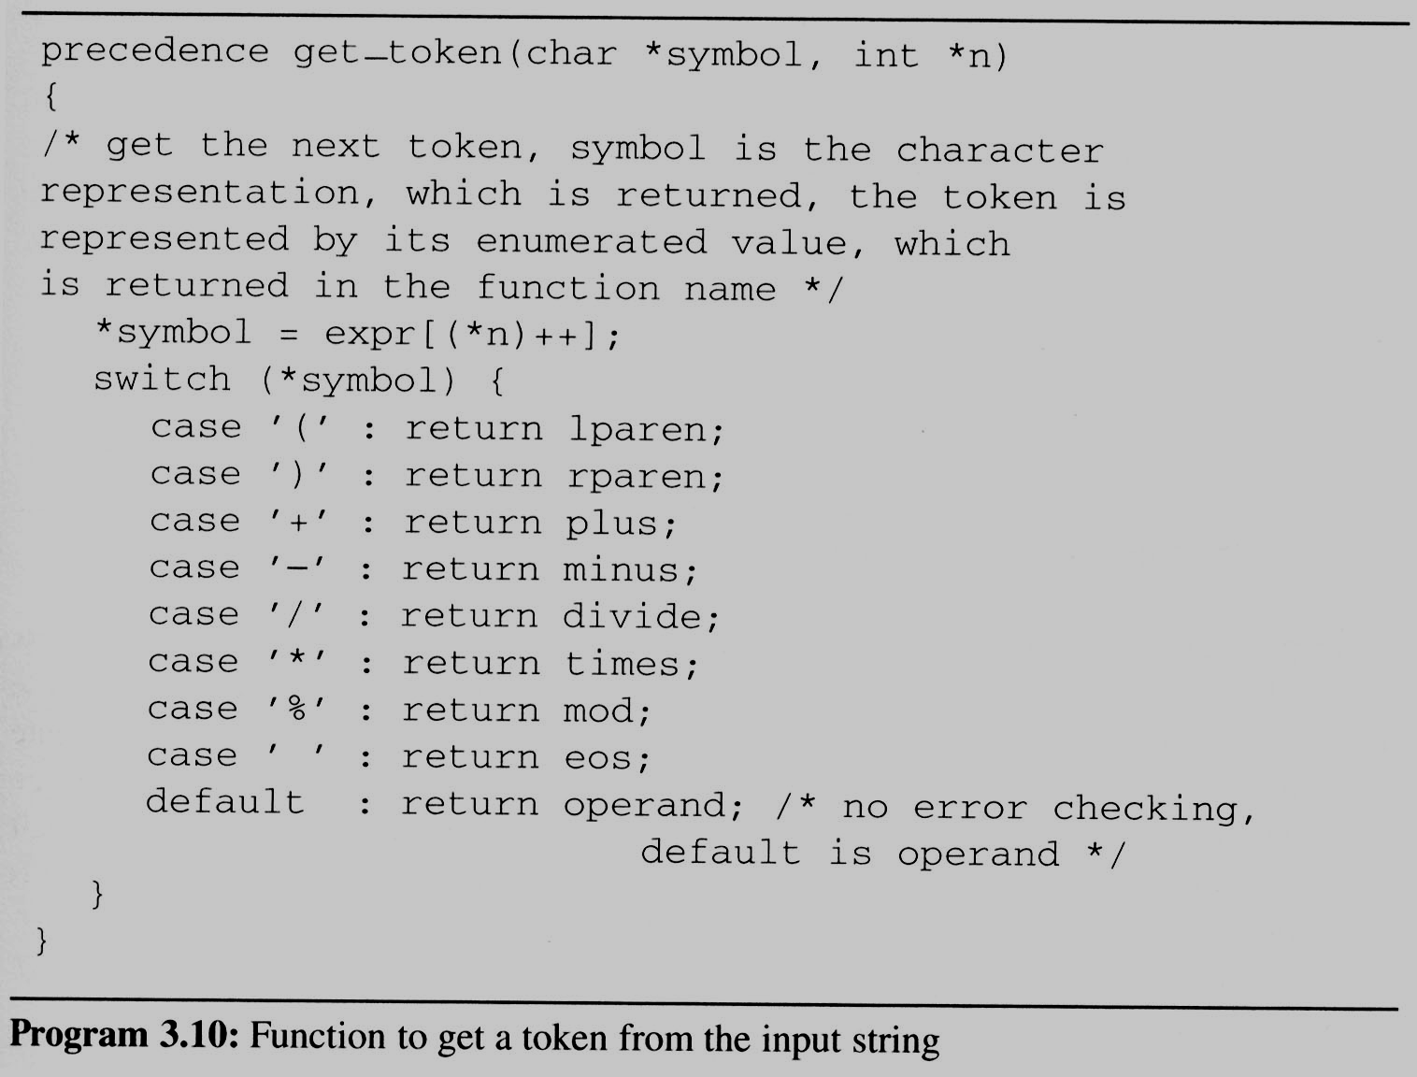
3.4 Evaluation of Expressions (7/14)
Get Token

Slide 23
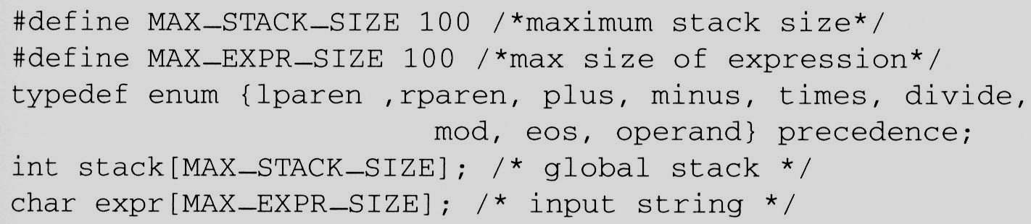
3.4 Evaluation of Expressions (6/14)
Representation
  We now consider the representation of both the stack and the expression

Slide 24
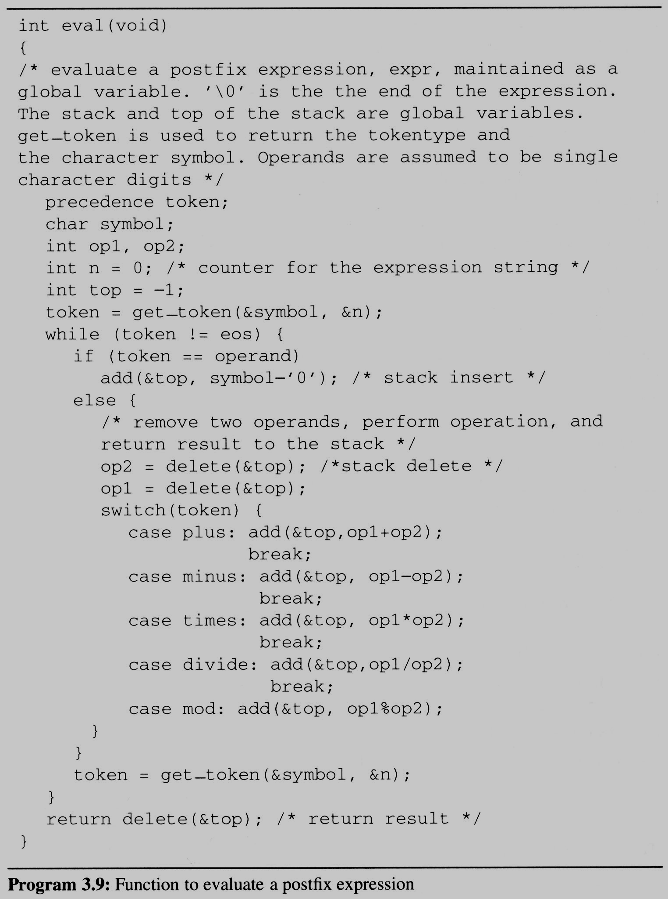
3.4 (8/14)
Evaluation of
Postfix Expression

Slide 25
3.4 Evaluation of Expressions (9/14)
string: 6 2/3-4 2*+
we make a single left-to-right scan of it
add the string with the operator
6 2 / 3 - 4 2 * +
2
2
the answer is
not an operator, put into the stack
not an operator, put into the stack
is an operator, pop two elements of the stack
not an operator, put into the stack
is an operator, pop two elements of the stack
not an operator, put into the stack
not an operator, put into the stack
is an operator, pop two elements of the stack
is an operator, pop two elements of the stack
end of string, pop the stack and get answer
1
2
3
4
4*2
6 / 2 - 3 + 4 * 2
6
6/2
6/2-3
0
6/2-3+4*2
top
STACK
now, top must +1
now, top must -2
now, top must -1

Slide 26
3.4 Evaluation of Expressions (10/14)
We can describe an algorithm for producing a postfix expression from an infix one as follows
  EX: Trans a / b - c + d * e - a * c To postfix
  (1) Fully parenthesize expression
a / b - c + d * e - a * c
 ((((a / b) - c) + (d * e)) - (a * c))
  (2) All operators replace their corresponding right parentheses
((((a / b) - c) + (d * e)) - (a * c))
  (3)Delete all parentheses
a b / c - d e * + a c * -
 The order of operands is the same in infix and postfix
如何把infix轉成postfix?
加括號
把每個括號裡的運算子，放到最後面
去掉括號
two passes
*
*
/
-
-
+

Slide 27
3.4 Evaluation of Expressions (11/14)
Algorithm to convert from infix to postfix
  Assumptions:
    operators: (, ), +, -, *, /, %
    operands: single digit integer or variable of one character
  Scan string from left to right
  Operands are taken out immediately
  Operators are taken out of the stack as long as their in-stack precedence (isp) is higher than or equal to the incoming precedence (icp) of the new operator
  ‘(‘ has low isp, and high icp
    op ( ) + - * / % eos
    Isp 0 19 12 12 13 13 13 0
    Icp 20 19 12 12 13 13 13 0
甚麼時候從stack拿出來
Stack中優先序
In Stack優先序
In Stack時外面的優先序(*)比stack top(+)高 > 把(*)放進去

Slide 28
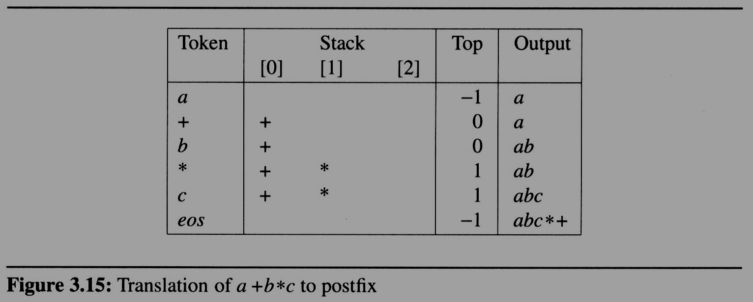

3.4 Evaluation of Expressions (12/14)
  EX: translate a+b*c to postfix
icp
isp
12
12
13
13
13
0

Slide 29
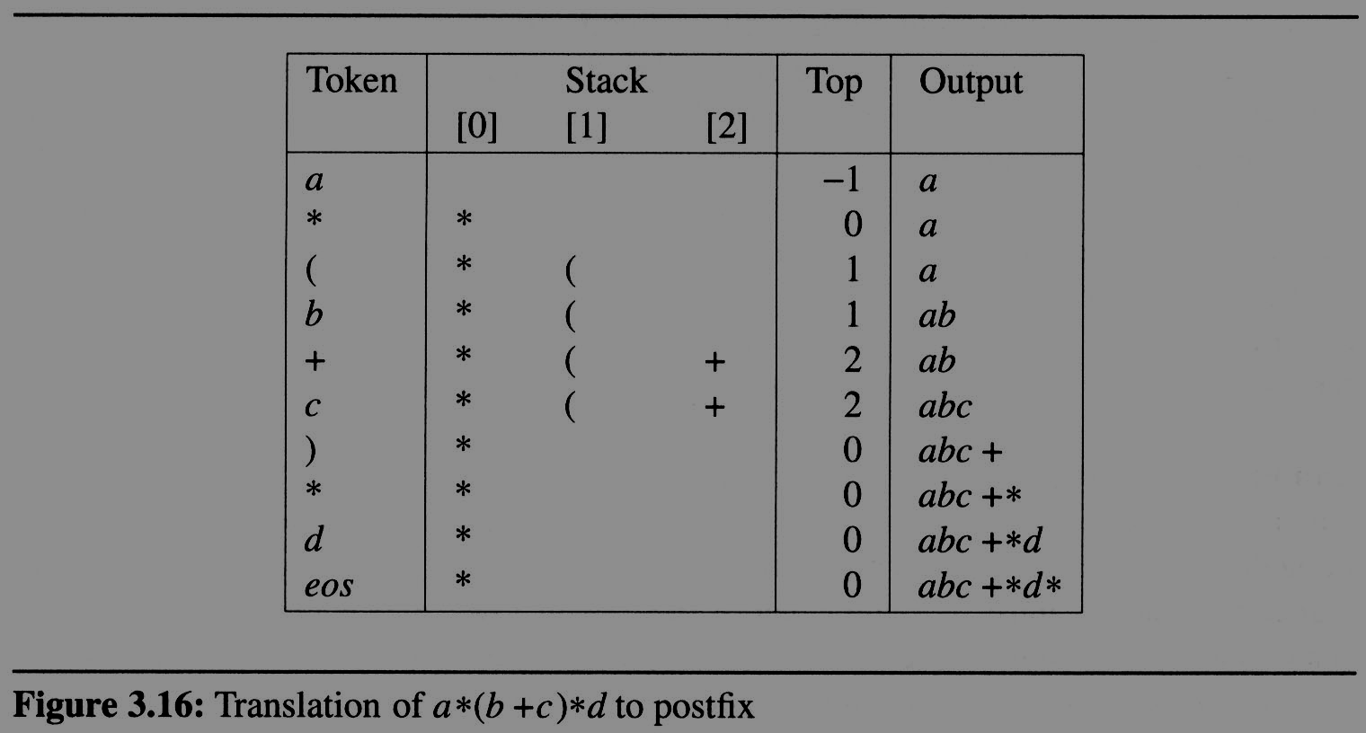
3.4 Evaluation of Expressions (12/14)
The expression a*(b+c)*d, which yields abc+*d* in postfix
icp
isp
13
13
20
0
0
12
12
match )
12
19
13
13
13
13
0
13

Slide 30
3.4 Evaluation of Expressions (13/14)
a * ( b + c ) / d
operand, print out
operator
operator
operand, print out
operator
operand, print out
operator
operator
operand, print out
eos
push into the stack
+
pop the stack and printout
2
the isp of “( “ is 0 and the icp of “* “ is 13
the isp of “/ “ is 13 and the icp of “* “ is 13
the isp of “+“ is 12 and the icp of “( “ is 20
operator “)”, pop and print out until “(”
(
1
*
output
0
/
a
b
c
+
*
d
/
top
stack
now, top must +1
now, top must - 1

Slide 31
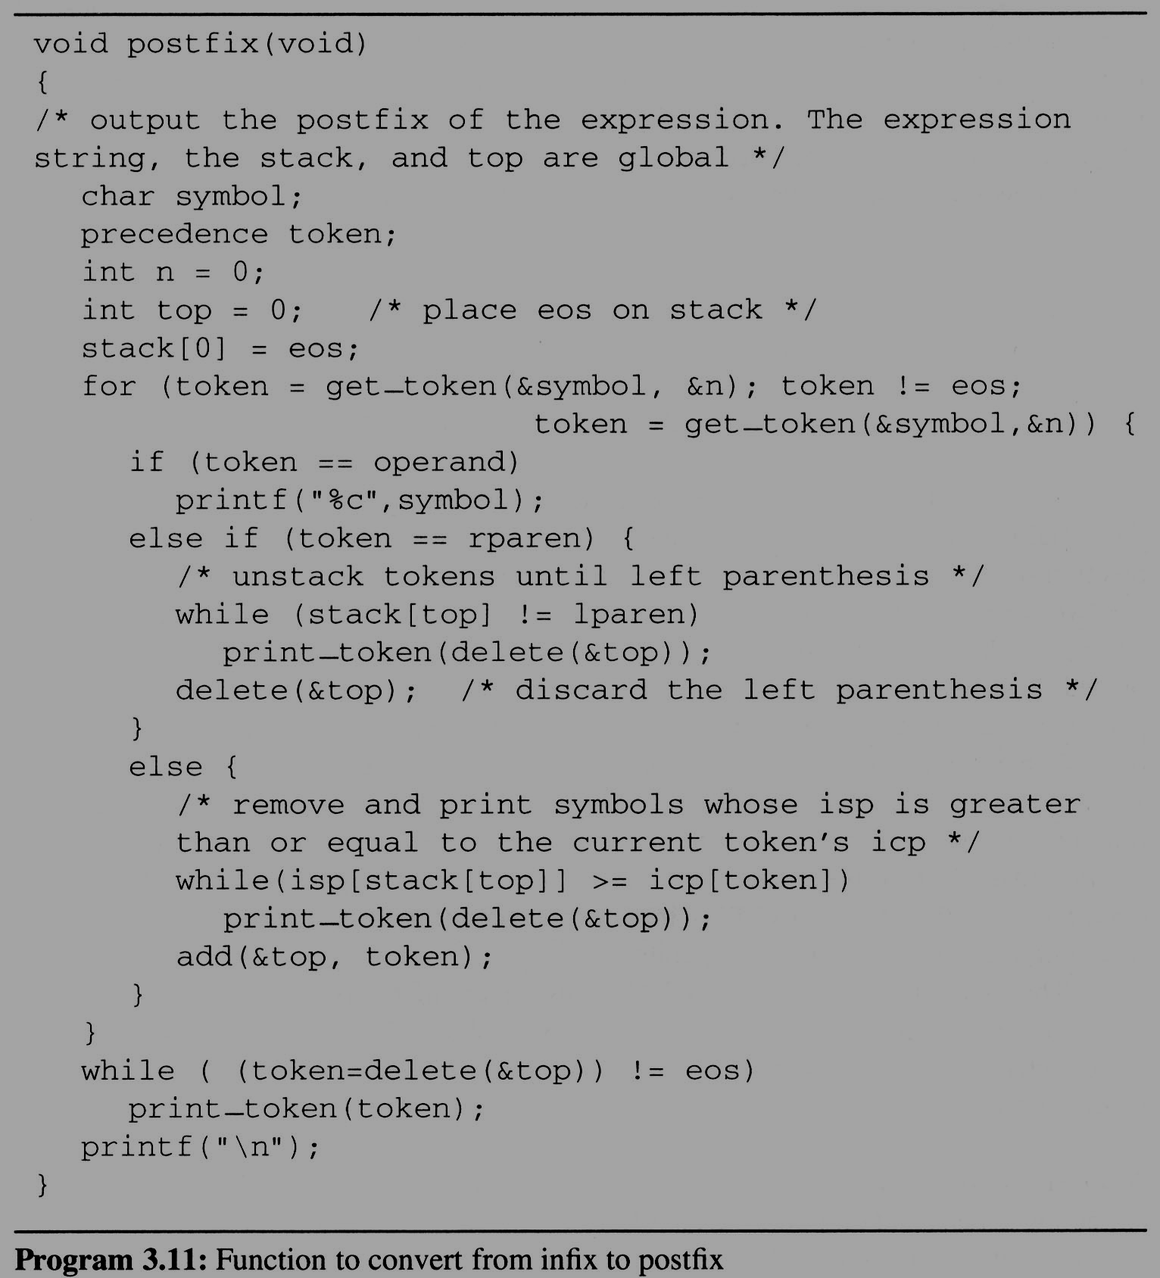
3.4 Evaluation of Expressions (14/14)
Complexity: Θ(n)
  The total time spent here is Θ(n) as the number of tokens that get stacked and unstacked is linear in n
  where n is the number of tokens in the expression

Slide 32
Multiple stacks and queues
multiple stacks
m[0] m[1] …, m[n-2] m[n-1]
bottommost bottommost
stack 1 stack 2

Slide 33
(往右)
Find j, stack_no < j < n
such that top[j] < boundary[j+1]
or, 0 ≤ j < stack_no
(往左)
b[0] t[0] b[1] t[1] b[i] t[i] t[i+1] t[j] b[j+1] b[n]
b[i+1] b[i+2]
b=boundary, t=top
meet
往左或右找一個空間

