Slide 1
CS235102
Data Structures
Chapter 4 Lists

Slide 2
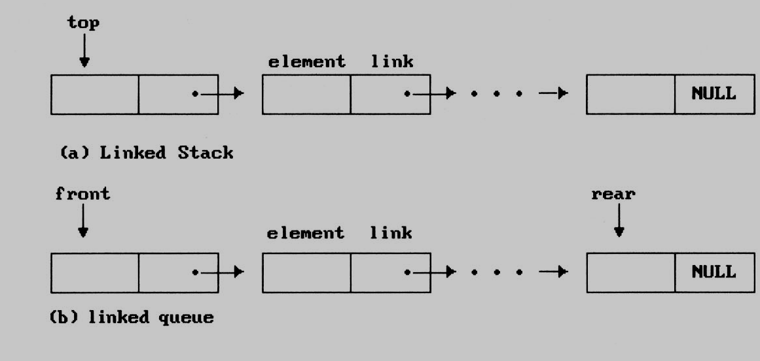
Dynamically Linked Stacks and Queues (1/8)
Notice that direction of links for both stack and the queue facilitate easy insertion and deletion of nodes.

Slide 3
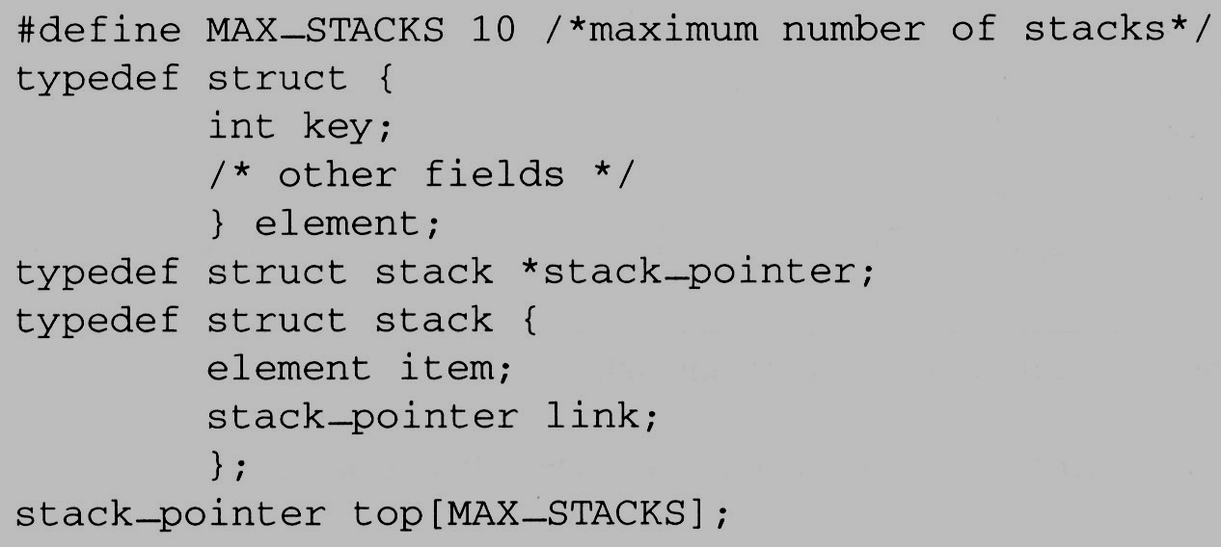
Dynamically Linked Stacks and Queues (2/8)
Represent n stacks
Stack
top
item
link
link
...
NULL

Slide 4
Dynamically Linked Stacks and Queues (3/8)
Push in the linked stack
  void add(stack_pointer *top, element item){
  /* add an element to the top of the stack */
  stack_pointer temp = (stack_pointer) malloc (sizeof (stack));
  if (IS_FULL(temp)) {
  fprintf(stderr, “ The memory is full\n”);
  exit(1);
  }
  temp->item = item;
  temp->link = *top;
  *top= temp;
  }
temp
item
link
top
link
link
...
NULL

Slide 5
Dynamically Linked Stacks and Queues (4/8)
Pop from the linked stack
  element delete(stack_pointer *top) {
  /* delete an element from the stack */ Pop
  stack_pointer temp = *top;
  element item;
  if (IS_EMPTY(temp)) {
  fprintf(stderr, “The stack is empty\n”);
  exit(1);
  }
  item = temp->item;
  *top = temp->link;
  free(temp);
  return item;
  }
temp
top
item
link
link
link
...
NULL

Slide 6
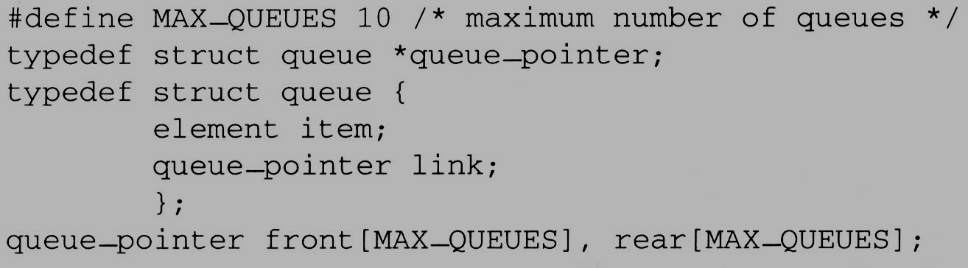
Dynamically Linked Stacks and Queues (5/8)
Represent n queues
Queue
front
item
link
Delete from
link
...
Add to
rear
NULL

Slide 7
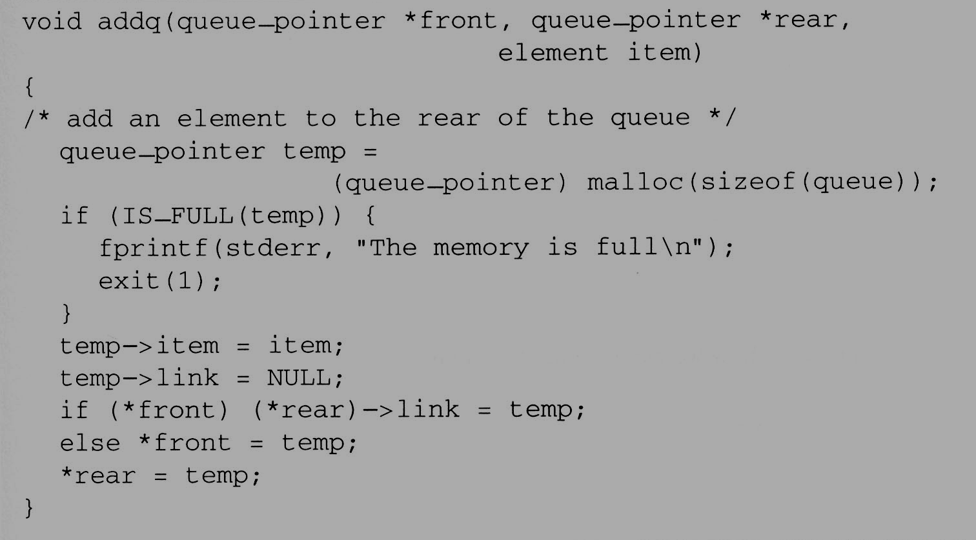
Dynamically Linked Stacks and Queues (6/8)
enqueue in the linked queue
...

Slide 8
Dynamically Linked Stacks and Queues (5/8)
Represent n queues

Slide 9
Dynamically Linked Stacks and Queues (8/8)
The solution presented above to the n-stack, m-queue problem is both computationally and conceptually simple.
  We no longer need to shift stacks or queues to make space.
  Computation can proceed as long as there is memory available.

Slide 10
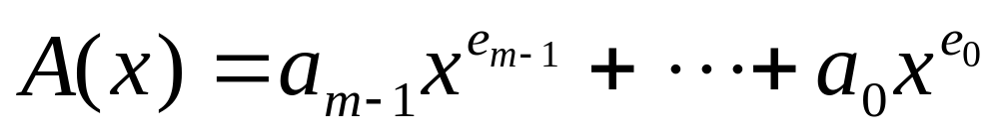
Polynomials (1/9)
Representing Polynomials As Singly Linked Lists
  The manipulation of symbolic polynomials, has a classic example of list processing.
  In general, we want to represent the polynomial:
    Where the a_{i} are nonzero coefficients and the e_{i} are nonnegative integer exponents such that
    e_{m-1} ＞ e_{m-2} ＞ … ＞ e₁ ＞ e₀ ≧ 0 .
  We will represent each term as a node containing coefficient and exponent fields, as well as a pointer to the next term.

Slide 11
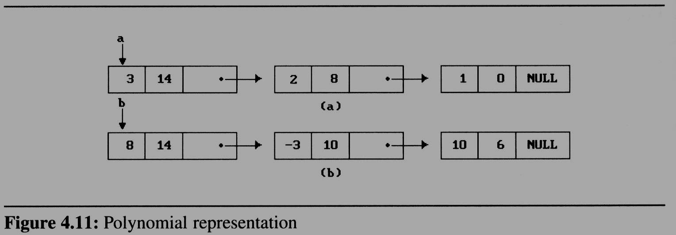


Polynomials (2/9)
coef | expon | link

Slide 12
Polynomials (2/9)
Assuming that the coefficients are integers,
the type declarations are:
  typedef struct poly_node *poly_pointer;
  typedef struct poly_node {
  int coef;
  int expon;
  poly_pointer link;
  };
  poly_pointer a,b,d;
coef | expon | link

Slide 13
Polynomials (3/9)
Adding Polynomials
  To add two polynomials,we examine their terms starting at the nodes pointed to by a and b.
    If the exponents of the two terms are equal
      add the two coefficients
      create a new term for the result.
    If the exponent of the current term in a is less than b
      create a duplicate term of b
      attach this term to the result, called d
      advance the pointer to the next term in b.
    We take a similar action on a if a->expon > b->expon.
  Figure 4.12 generating the first three term of
  d = a+b (next page)

Slide 14
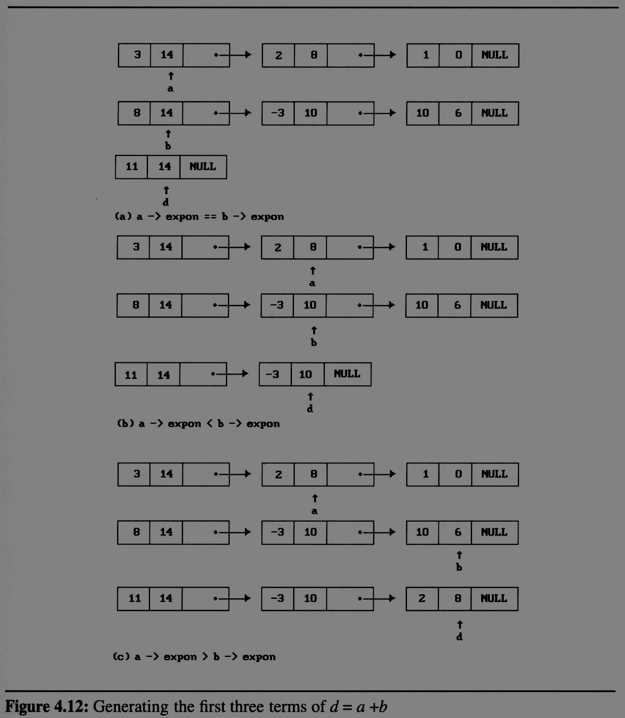
Polynomials (4/9)

Slide 15
Polynomials (4/9)

Slide 16
Polynomials (4/9)

Slide 17
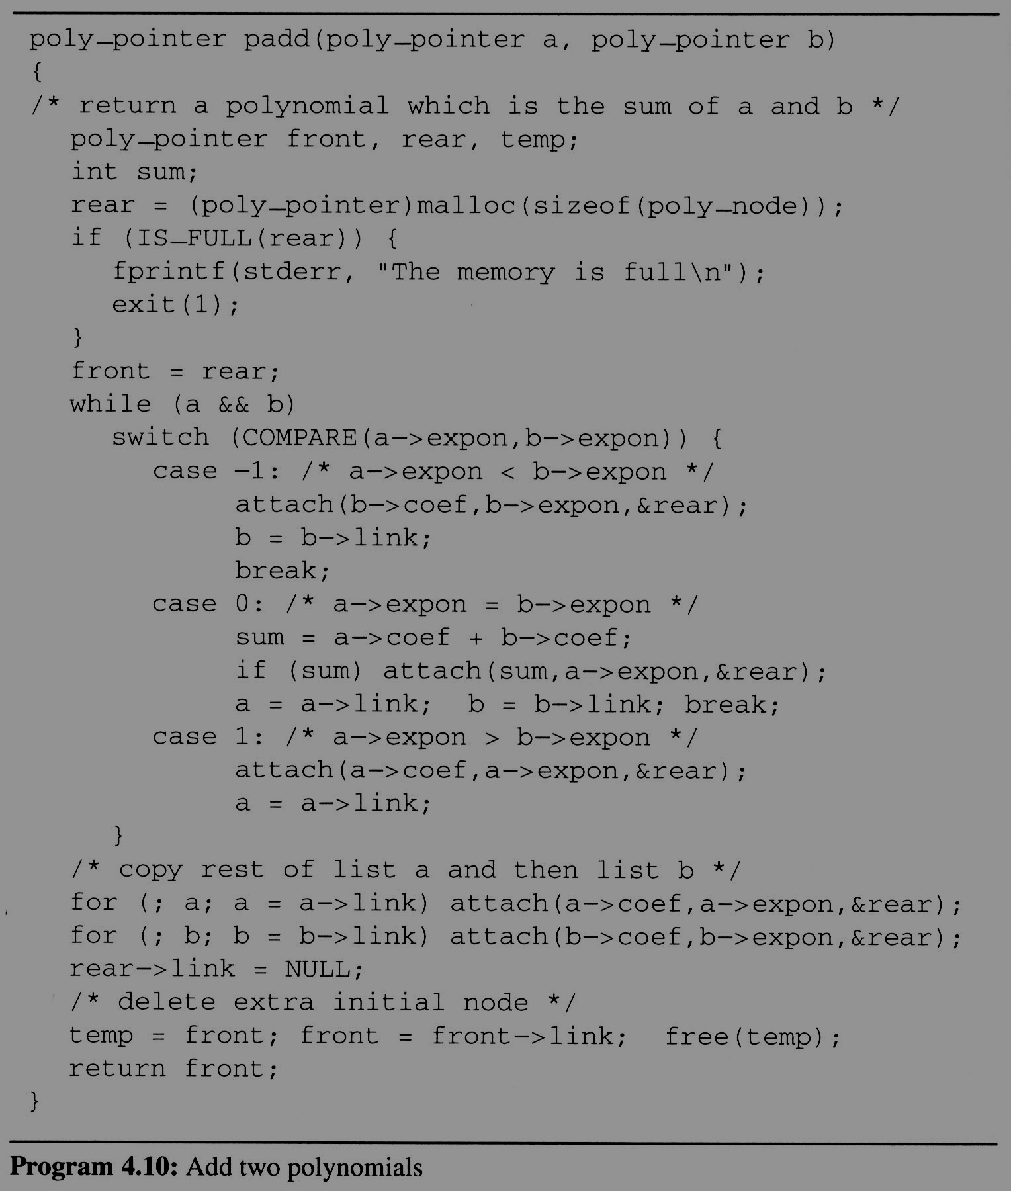
Polynomials
(5/9)
Add two
polynomials

Slide 18
Polynomials (6/9)
Attach a node to the end of a list
void attach(float coefficient, int exponent, poly_pointer *ptr)
{
  /* create a new node with coef = coefficient and expon = exponent, attach it to the node pointed to by ptr. Ptr is updated to point to this new node */
  poly_pointer temp;
  temp = (poly_pointer) malloc(sizeof(poly_node));
  /* create new node */
  if (IS_FULL(temp)) {
  fprintf(stderr, “The memory is full\n”);
  exit(1);
  }
  temp->coef = coefficient; /* copy item to the new node */
  temp->expon = exponent;
  (*ptr)->link = temp; /* attach */
  *ptr = temp; /* move ptr to the end of the list */
  }

Slide 19
Polynomials (7/9)
Analysis of padd
  coefficient additions
  0 ≤ additions ≤ min(m, n)
  where m (n) denotes the number of terms in A (B).
  exponent comparisons
  extreme case:
  e_{m-1} > f_{m-1} > e_{m-2} > f_{m-2} > … > e₁ > f₁ > e₀ > f₀
  m+n-1 comparisons
  creation of new nodes
  extreme case: maximum number of terms in d is m + n new nodes
  summary: O(m+n)

Slide 20
Polynomials (8/9)
A Suite for Polynomials
  e(x) = a(x) * b(x) + d(x)
  poly_pointer a, b, d, e;
  ...
  a = read_poly();
  b = read_poly();
  d = read_poly();
  temp = pmult(a, b);
  e = padd(temp, d);
  print_poly(e);
read_poly()
print_poly()
padd()
psub()
pmult()
temp is used to hold a partial result.
By returning the nodes of temp, we
may use it to hold other polynomials

Slide 21
Polynomials (9/9)
Erase Polynomials
  void erase (poly_pointer *ptr){
  /* erase the polynomial pointed to by ptr */
  poly_pointer temp;
  while (*ptr){
  temp = *ptr;
  *ptr = (*ptr) -> link;
  free(temp);
  }
  }

