Slide 1
Data Structures
Chapter 5 Trees

Slide 2
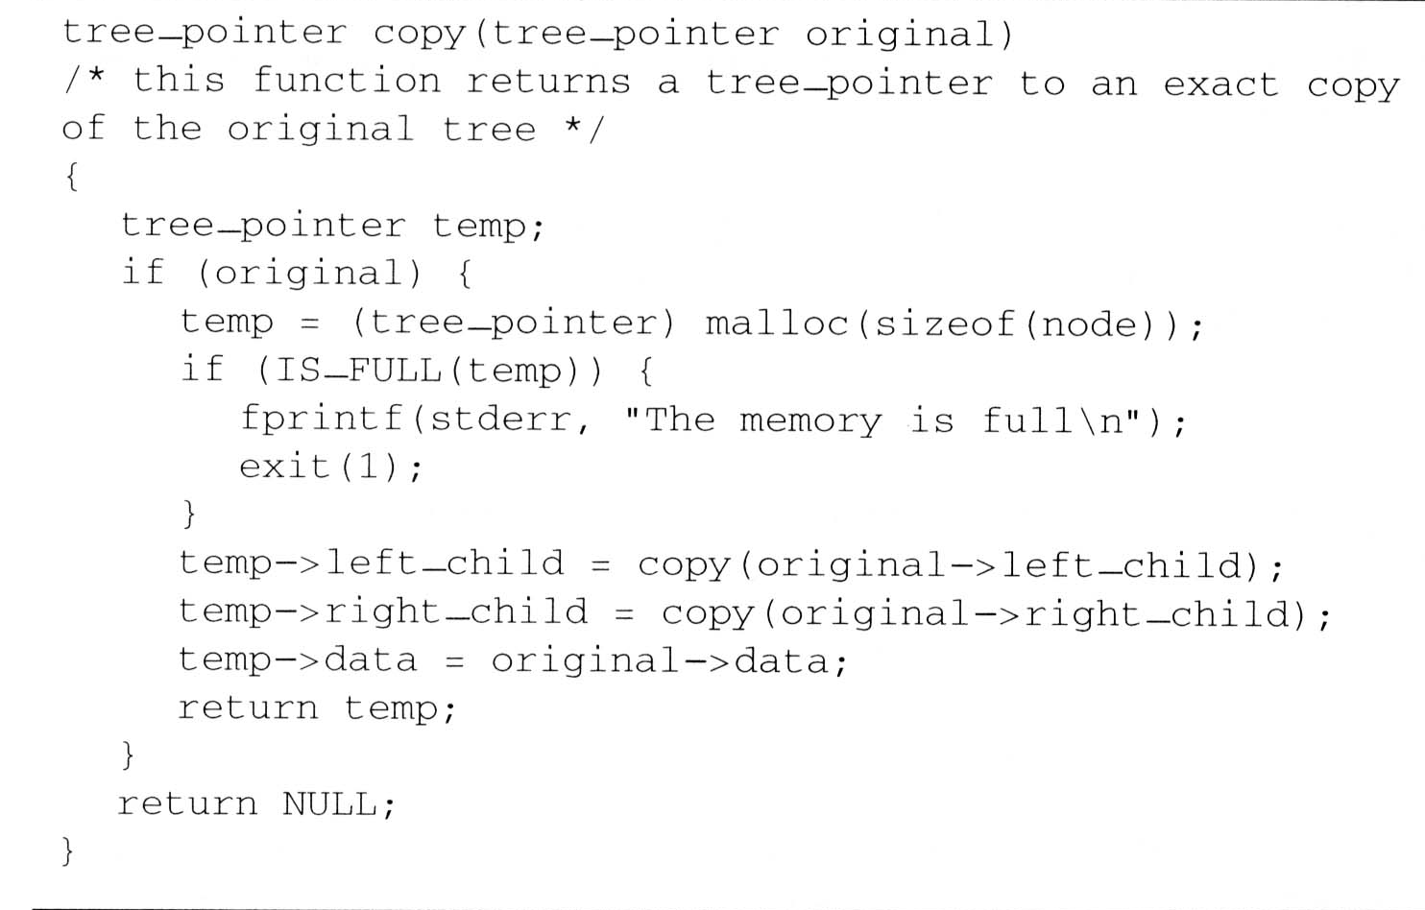
Additional Binary Tree Operations (1/7)
Copying Binary Trees
  we can modify the postorder traversal algorithm only slightly to copy the binary tree
similar as Program 5.3

Slide 3
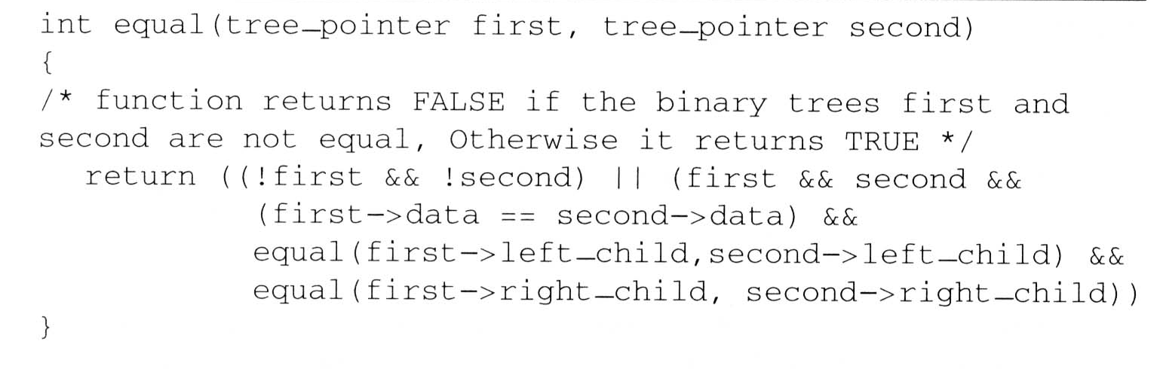
Additional Binary Tree Operations (2/7)
Testing Equality
  Binary trees are equivalent if they have the same topology and the information in corresponding nodes is identical
V
L
R
the same topology and data as Program 5.6

Slide 4
Additional Binary Tree Operations (3/7)
Variables: x₁, x₂, …, x_{n} can hold only of two possible values, true or false
Operators: ∧(and), ∨(or), ¬(not)
Propositional Calculus Expression
  A variable is an expression
  If x and y are expressions, then ¬x, x∧y, x∨y are expressions
  Parentheses can be used to alter the normal order of evaluation (¬ > ∧ > ∨)
  Example: x₁ ∨ (x₂ ∧ ¬x₃)

Slide 5
Additional Binary Tree Operations (4/7)
Satisfiability problem:
  Is there an assignment to make an expression true?
Solution for the Example x₁ ∨ (x₂ ∧ ¬x₃) :
  If x₁ and x₃ are false and x₂ is true
  false ∨ (true ∧ ¬false) = false ∨ true = true
For n value of an expression, there are 2^{n} possible combinations of true and false

Slide 6
Additional Binary Tree Operations (5/7)
(x₁ ∧ ¬x₂) ∨ (¬ x₁ ∧ x₃) ∨ (¬x₃)
postorder traversal
∨
data
∨
¬
value
∧
∧
X₃
X₁
¬
¬
X₃
X₂
X₁

Slide 7
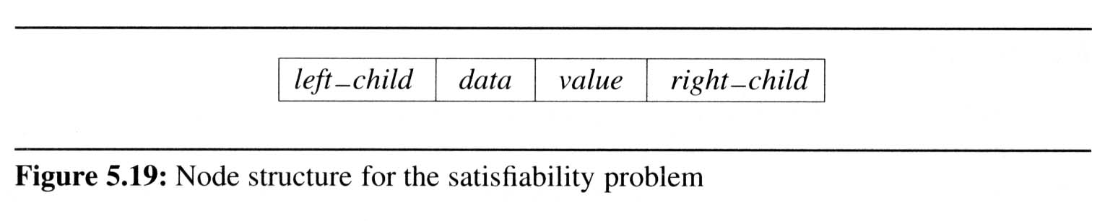
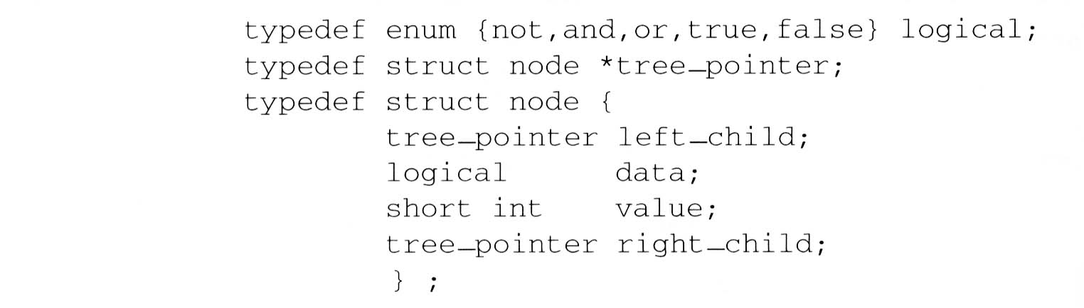
Additional Binary Tree Operations (6/7)
node structure
  For the purpose of our evaluation algorithm, we assume each node has four fields:
  We define this node structure in C as:

Slide 8
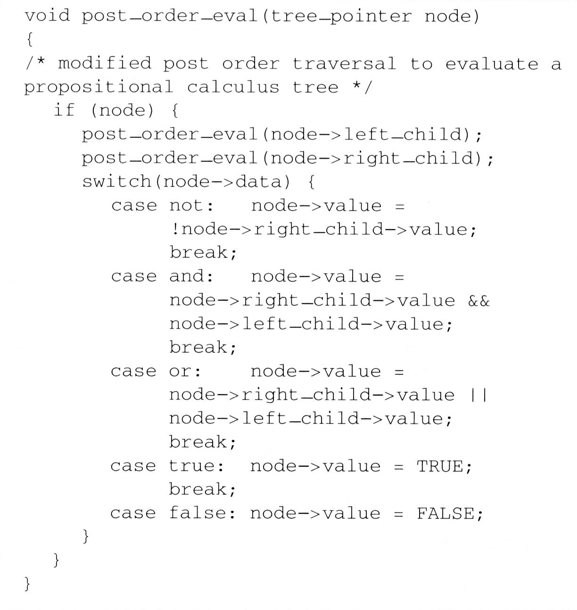
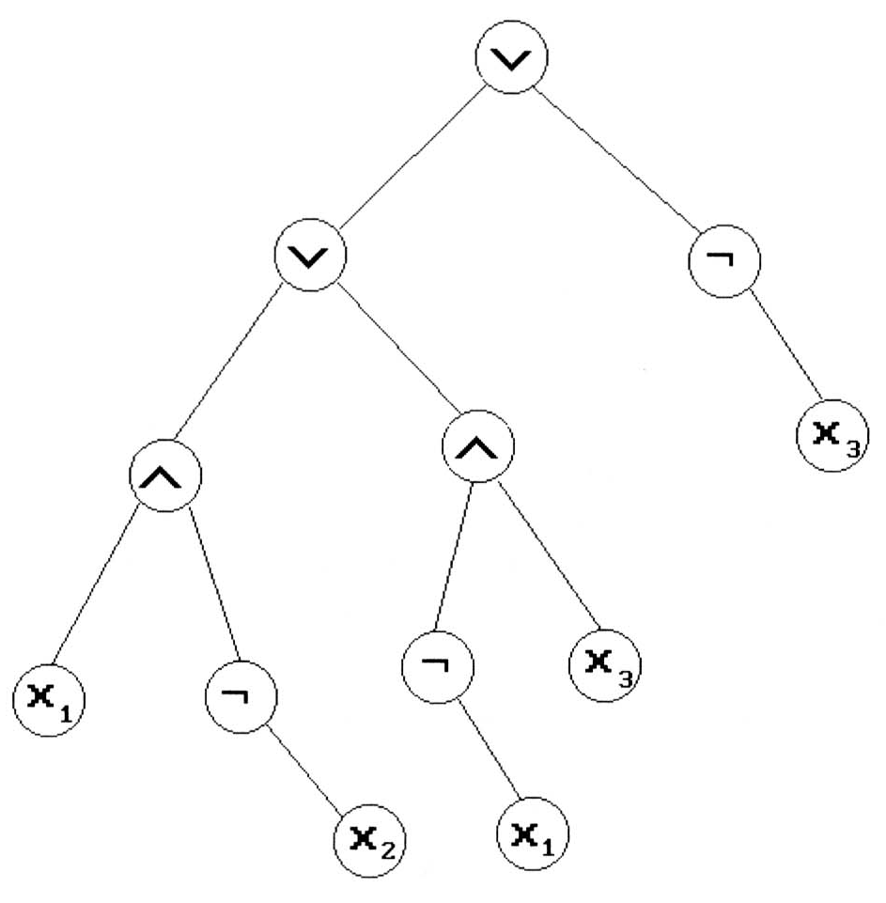
Additional Binary Tree Operations (7/7)
Satisfiability function
  To evaluate the tree is
  easily obtained by
  modifying the original
  recursive postorder
  traversal
L
R
V
node
TRUE
TRUE
FALSE
FALSE
T
TRUE
TRUE
T
F
TRUE
FALSE
FALSE
TRUE
F
T
FALSE
TRUE

Slide 9
Additional Binary Tree Operations (7/7)
Satisfiability function
L
R
V

Slide 10
Threaded Binary Trees (1/10)
Threads
  Too many null pointers in current representation of binary trees
  n: number of nodes
  number of non-null links: n-1
  total links: 2n
  null links: 2n-(n-1) = n+1
  Solution: replace these null pointers with some useful “threads”

Slide 11
Threaded Binary Trees (2/10)
Rules for constructing the threads
  If ptr->left_child is null,
  replace it with a pointer to the node that would be visited before ptr in an inorder traversal
  If ptr->right_child is null,
  replace it with a pointer to the node that would be visited after ptr in an inorder traversal

Slide 12
Threaded Binary Trees (3/10)
A Threaded Binary Tree
root
A
t: true ⇒ thread
f: false ⇒ child
dangling
f
B
f
C
D
t
E
t
F
G
dangling
inorder traversal:
H
I
H D I B E A F C G

Slide 13
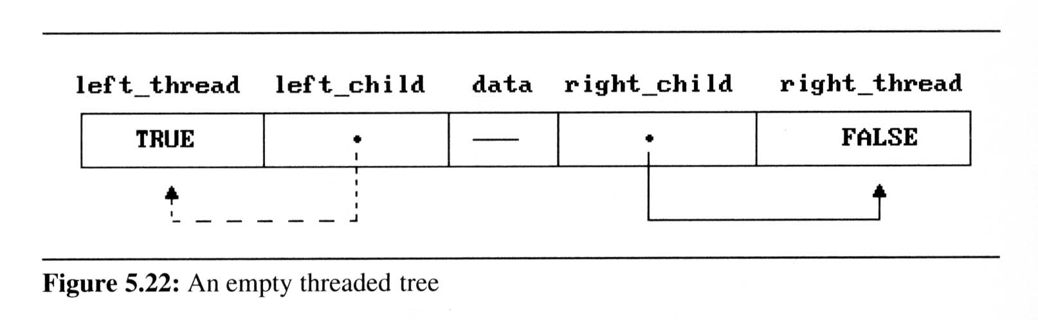
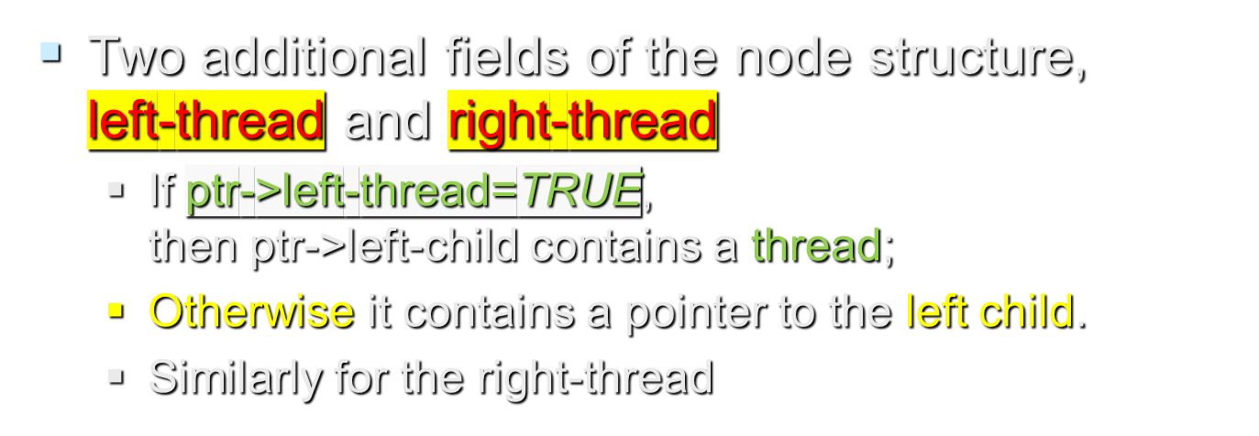
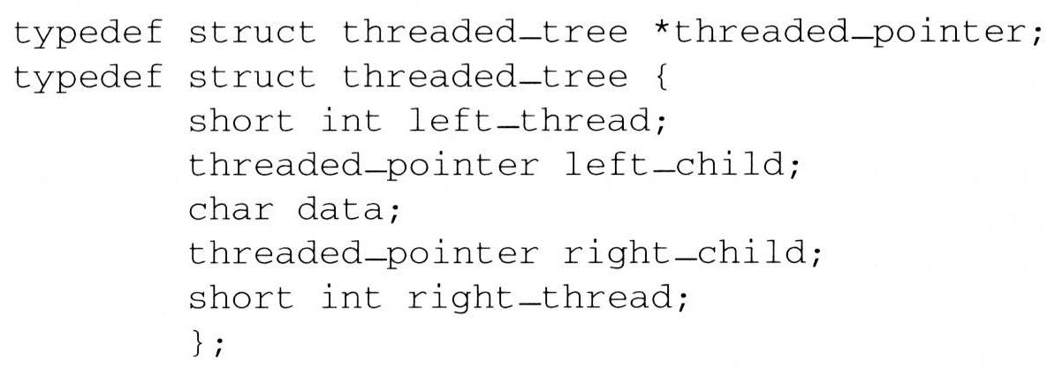
Threaded Binary Trees (4/10)

Slide 14
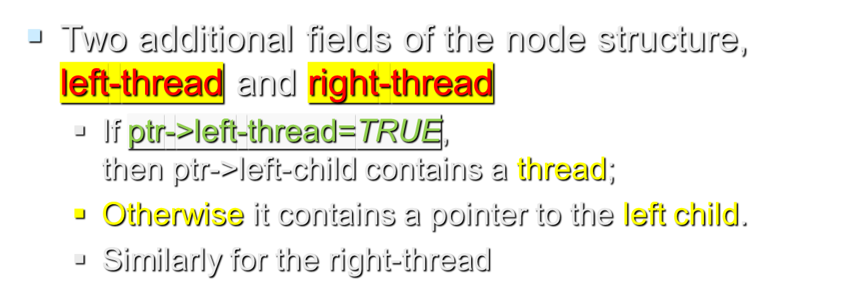
Threaded Binary Trees (4/10)

Slide 15
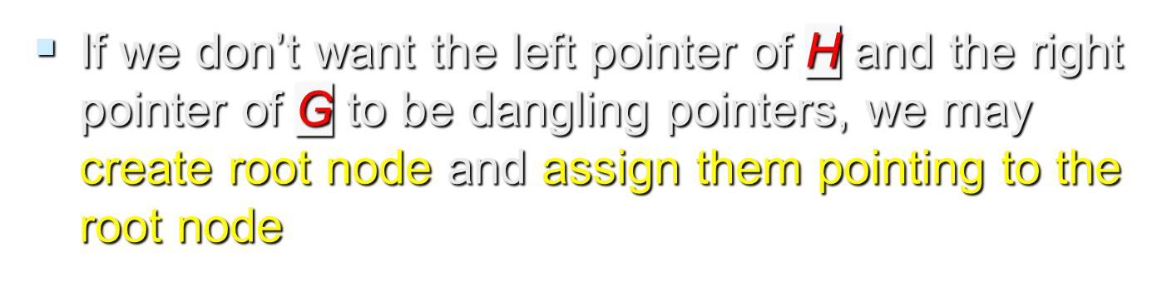
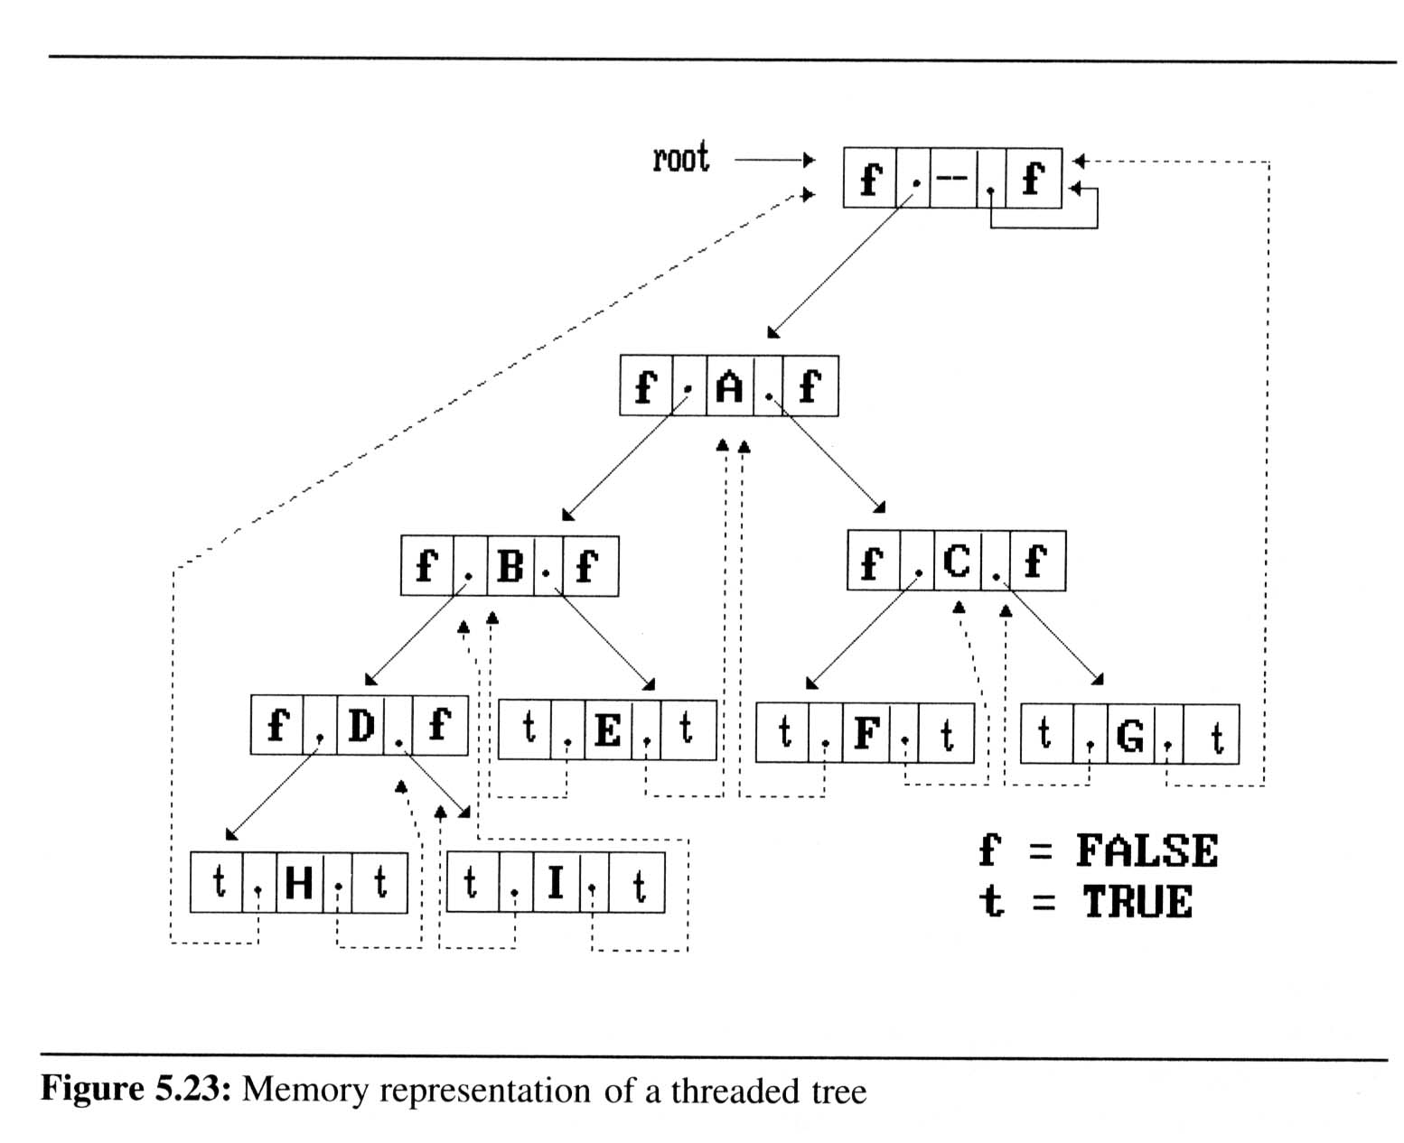

Threaded Binary Trees (5/10)

Slide 16
Threaded Binary Trees (6/10)
Inorder traversal of a threaded binary tree
  By using of threads we can perform an inorder traversal without making use of a stack (simplifying the task)

Slide 17
Threaded Binary Trees (6/10)
Inorder traversal of a threaded binary tree
  If ptr->right_thread = TRUE, the inorder successor of ptr is ptr->right_child by definition of the threads
  Otherwise we obtain the inorder successor of ptr by following a path of left-child links from the right-child of ptr until we reach a node with left_thread = TRUE

Slide 18
Threaded Binary Trees (7/10)
Finding the inorder successor (next node) of a node
  threaded_pointer insucc(threaded_pointer tree){
  threaded_pointer temp;
  temp = tree->right_child;
  if (! tree->right_thread)
  while (!temp->left_thread)
  temp = temp->left_child;
  return temp;
  }
tree
temp

Slide 19
Threaded Binary Trees (8/10)
Inorder traversal of a threaded binary tree
  void tinorder(threaded_pointer tree){
  /* traverse the threaded binary tree inorder */
  threaded_pointer temp = tree;
  for (;;) {
  temp = insucc(temp);
  if (temp==tree)
  break;
  printf(“%3c”,temp->data);
  }
  }
output:
H
D
I
B
E
A
F
C
G
tree
Time Complexity: O(n)

Slide 20
Threaded Binary Trees (9/10)
Insertion of Threaded Binary Tree
  Insert child as the right child of node parent
root
A
parent
B
C
X
child

Slide 21
Threaded Binary Trees (9/10)
Insertion of Threaded Binary Tree
  Insert child as the right child of node parent
A
parent
B
child
X
C
D
E
F

Slide 22
Threaded Binary Trees (10/10)
Right insertion in a threaded binary tree
  void insert_right(thread_pointer parent, threaded_pointer child){
  /* insert child as the right child of parent in a threaded binary tree */
  threaded_pointer temp;
  child->right_child = parent->right_child;
  child->right_thread = parent->right_thread;
  child->left_child = parent;
  child->left_thread = TRUE;
  parent->right_child = child;
  parent->right_thread = FALSE;
  If(!child->right_thread){
  temp = insucc(child);
  temp->left_child = child;
  }
  }
root
A
parent
B
C
X
child
parent
temp
A
B
child
X
C
D
First Case
Second Case
E
F
successor

Slide 23
Heaps (1/6)
  Definition: A max(min) tree is a tree in which the key value in each node is no smaller (larger) than the key values in its children.
  Definition: A max (min) heap is a complete binary tree that is also a max (min) tree

Slide 24
Heaps (1/6)
Basic Operations:
  creation of an empty heap
  insertion of a new element into a heap
  deletion of the largest element from the heap

Slide 25
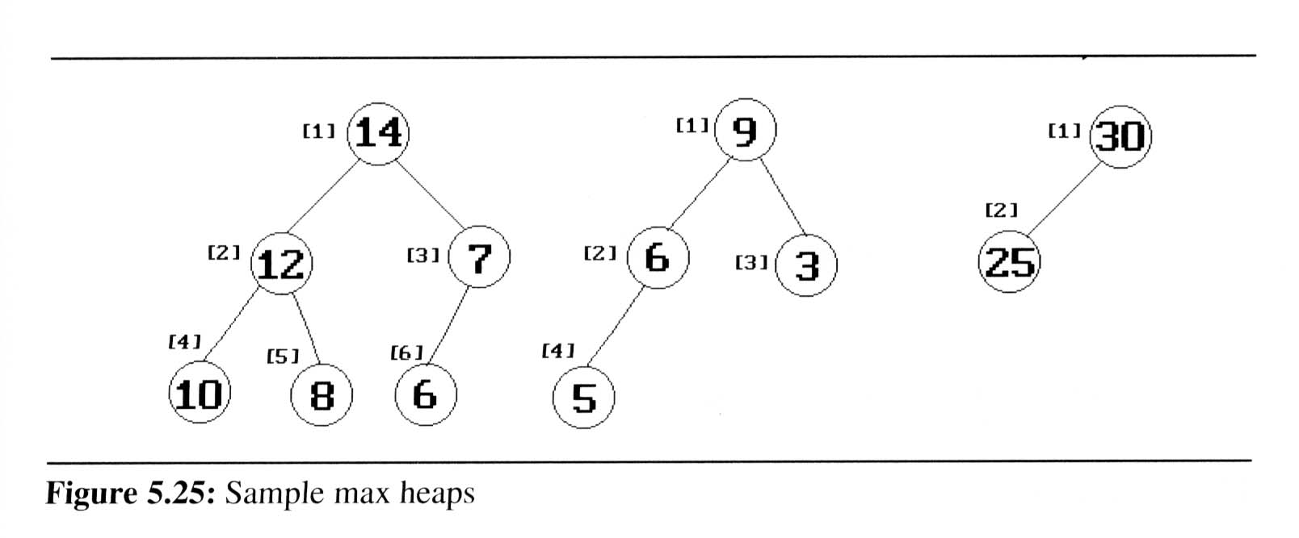
Heaps (2/6)
The examples of max heaps
  The root of max heap contains the largest element

Slide 26
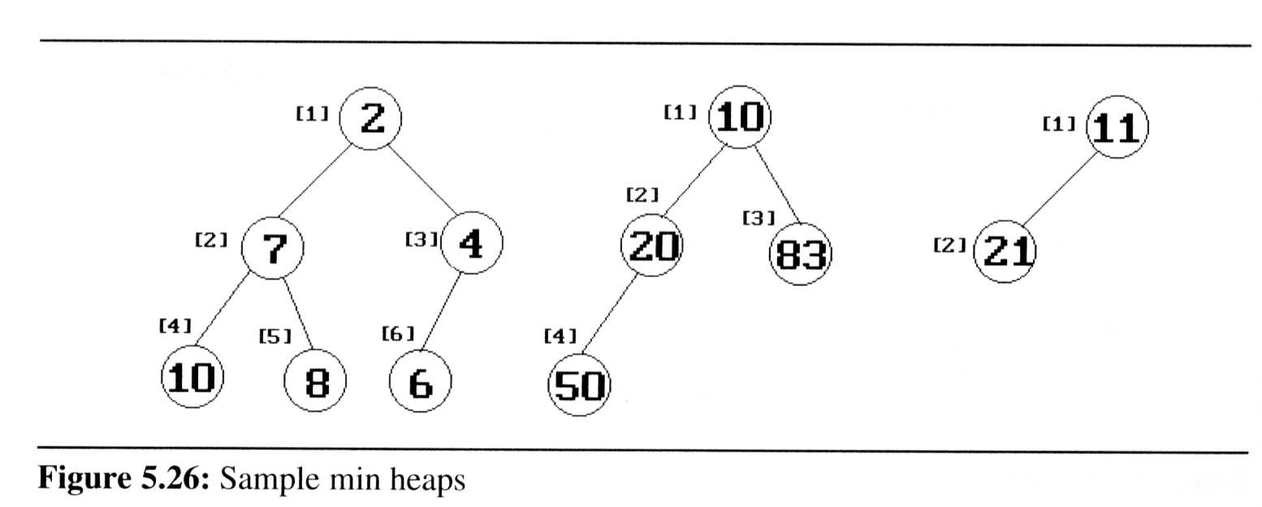
Heaps (2/6)
The examples of min heaps
  The root of min heap contains the smallest element

Slide 27
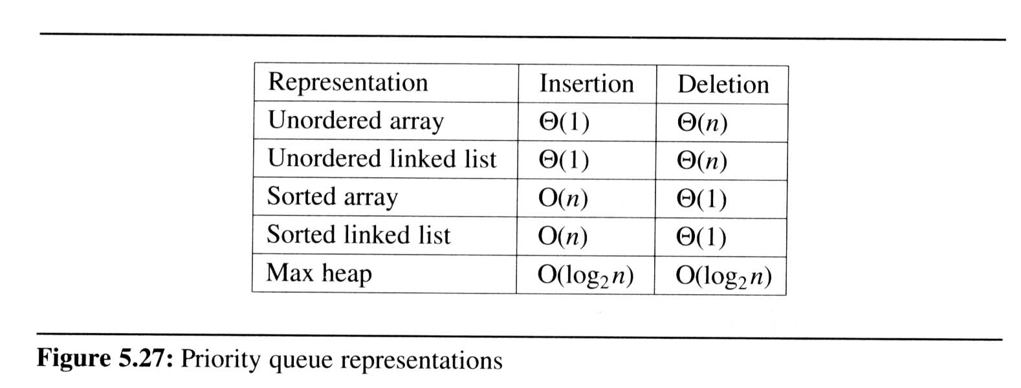
Heaps (4/6)
Priority queues
  delete the element with highest (lowest) priority
  insert the element with arbitrary priority
Heaps is the only way to implement priority queue

Slide 28
Heaps (5/6)
Insertion Into A Max Heap
  Analysis of insert_max_heap
    The complexity of the insertion function is O(log₂ n)
insert
21
[1]
5
20
21
*n=
6
5
[2]
[3]
15
20
2
5
i=
6
3
7
3
1
[4]
[5]
[6]
[7]
14
10
2
5

Slide 29
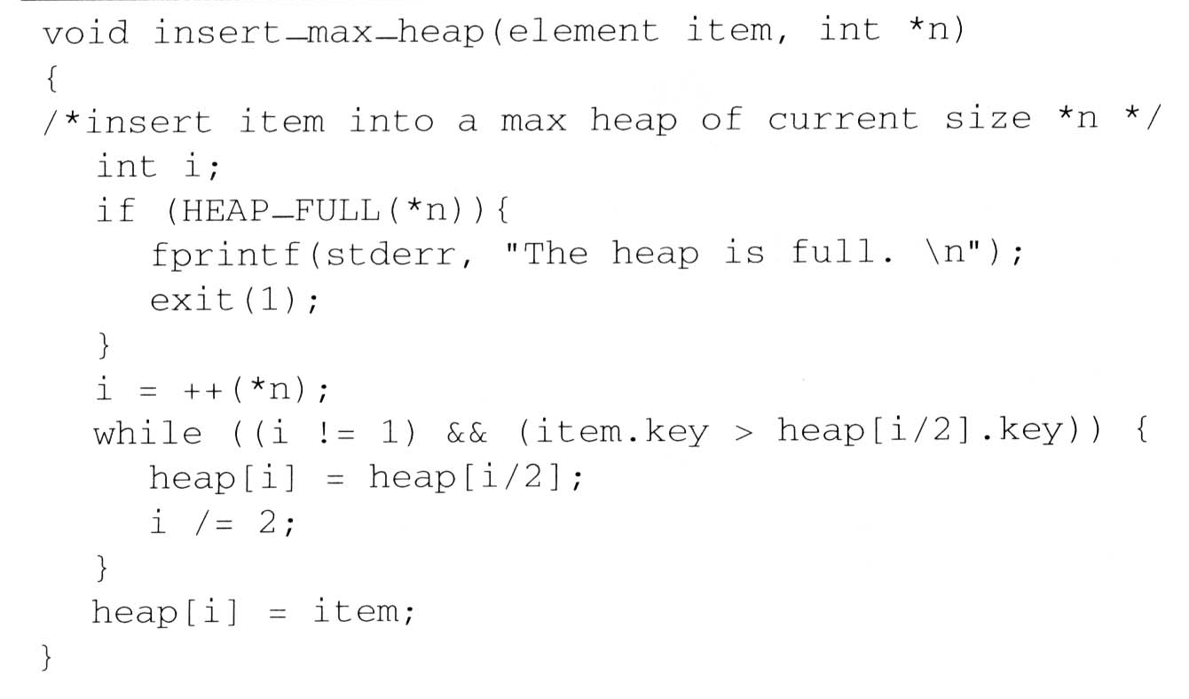
Heaps (5/6)
Insertion Into A Max Heap
insert
21
5
*n=
6
5
i=
6
3
7
3
1
[1]
20
21
[2]
[3]
15
20
2
5
parent sink
item upheap
[4]
[5]
[6]
[7]
14
10
2
5

Slide 30
Heaps (6/6)
Deletion from a max heap
  After deletion, the heap is still a complete binary tree
  Analysis of delete_max_heap
    The complexity of the insertion function is O(log₂ n)
parent =
1
2
4
*n=
5
4
child =
2
4
8
[1]
15
20
[2]
[3]
15
14
2
[4]
[5]
14
10
10

Slide 31
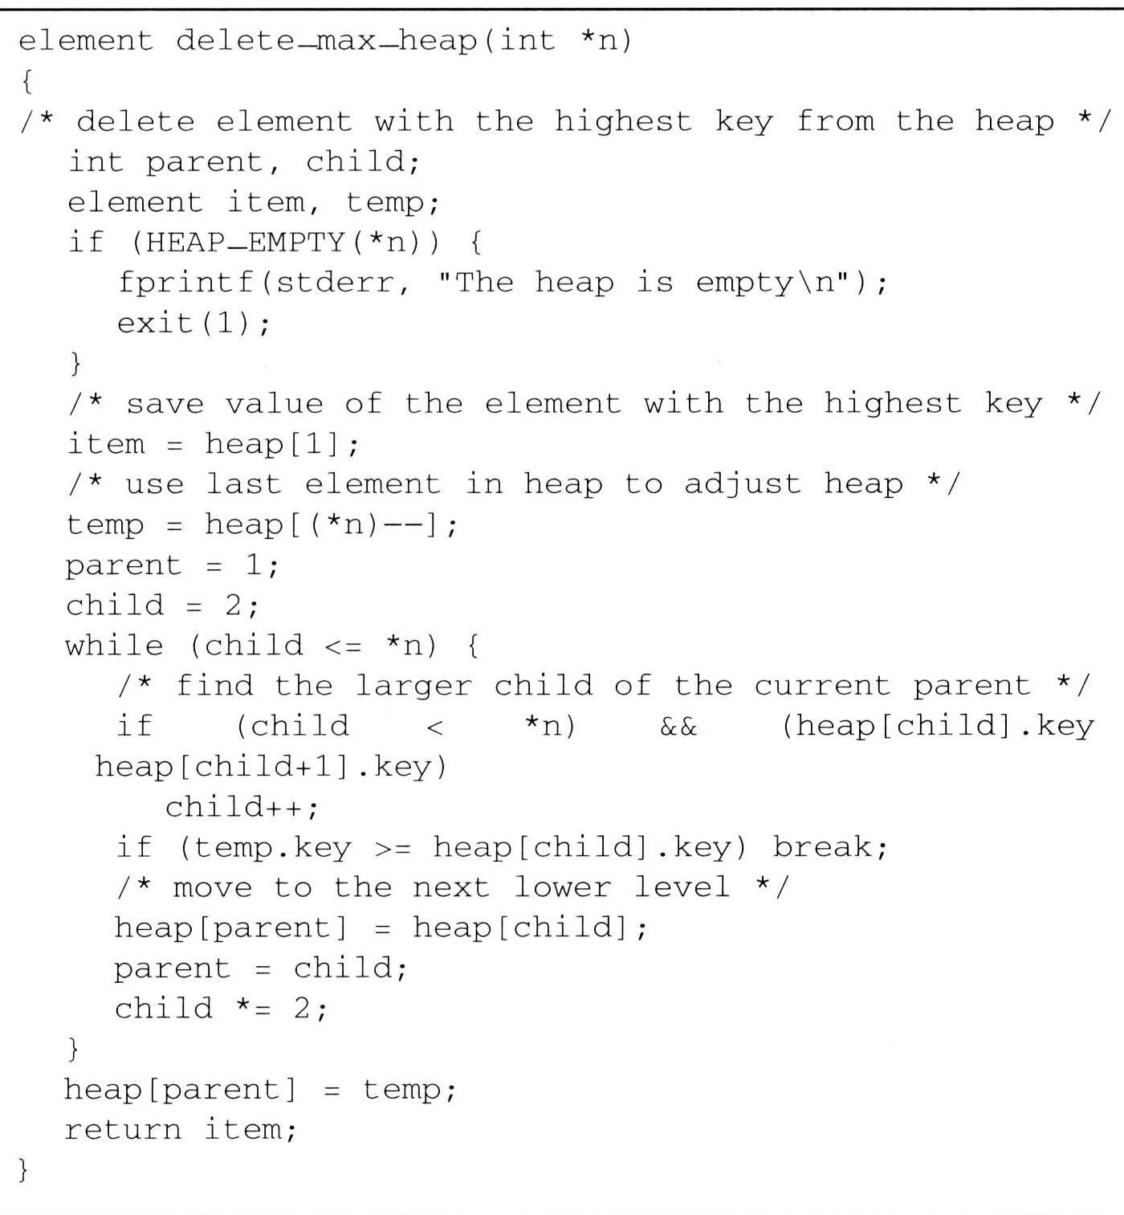
Heaps (6/6)
Deletion from a max heap
parent =
1
2
4
*n=
5
4
child =
2
4
8
[1]
15
20
[2]
[3]
15
<
14
2
[4]
[5]
14
10
10
item.key =
20
temp.key =
10

Slide 32
Binary Search Trees (1/8)
Why do binary search trees need?
  Heap is not suited for applications in which arbitrary elements are to be deleted from the element list
    a min (max) element is deleted O(log₂n)
    deletion of an arbitrary element O(n)
    search for an arbitrary element O(n)

Slide 33
Binary Search Trees (1/8)
Definition of binary search tree:
  Every element has a unique key
  The keys in a nonempty left subtree (right subtree) are smaller (larger) than the key in the root of subtree
  The left and right subtrees are also binary search trees

Slide 34
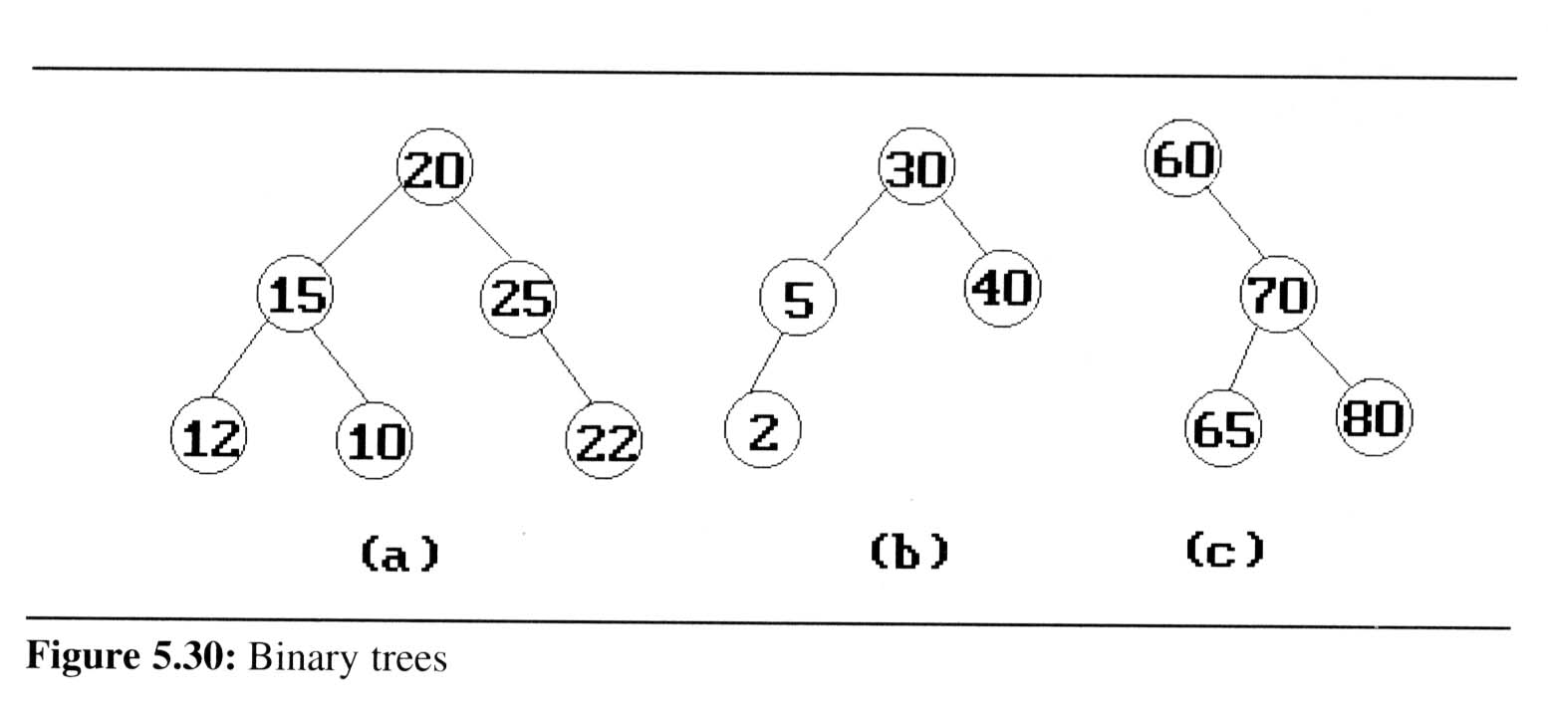
Binary Search Trees (2/8)
Example: (b) and (c) are binary search trees
medium
smaller
larger

Slide 35
Binary Search Trees (3/8)
Search:
Search(25)
Search(76)
44
17
88
32
65
97
28
54
82
29
76
80

Slide 36
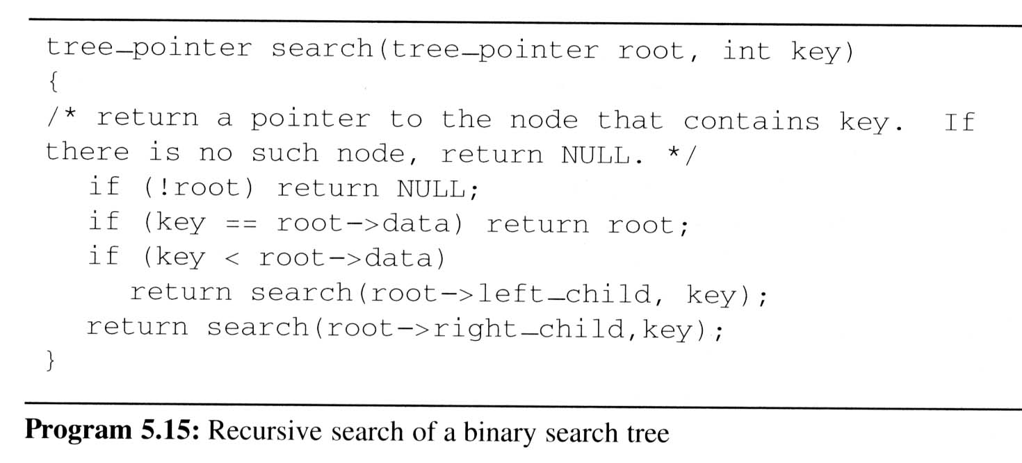
Binary Search Trees (4/8)
Searching a binary search tree

Slide 37
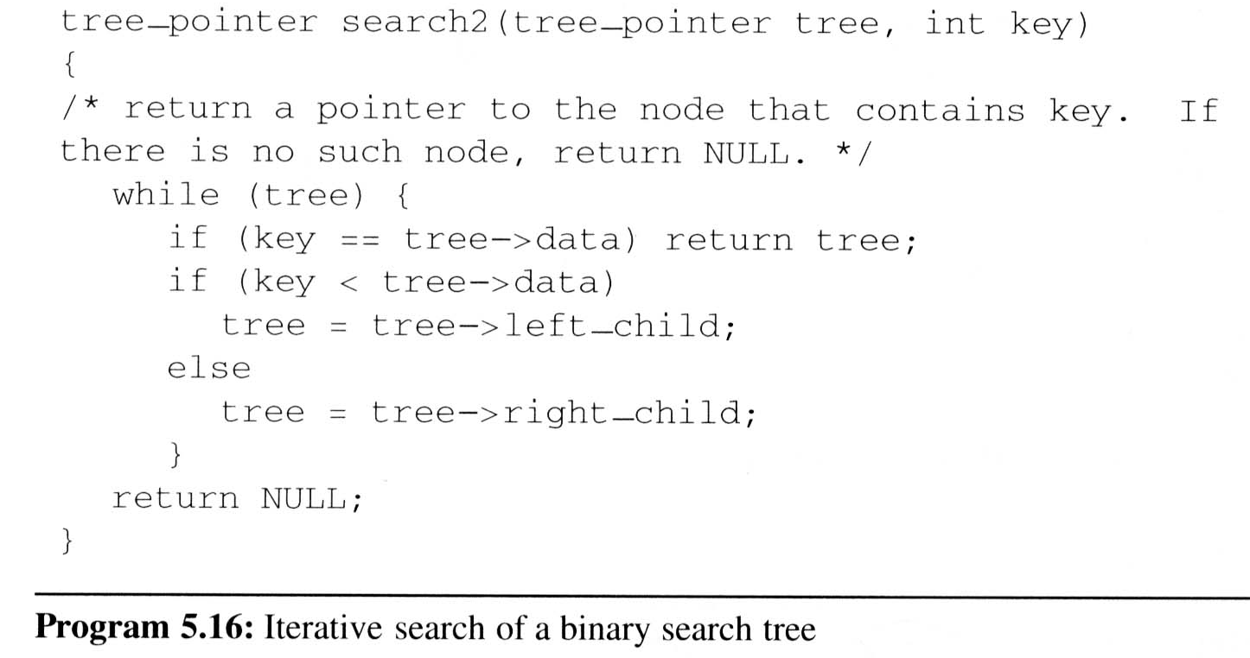
Binary Search Trees (4/8)
Searching a binary search tree
O(h)

Slide 38
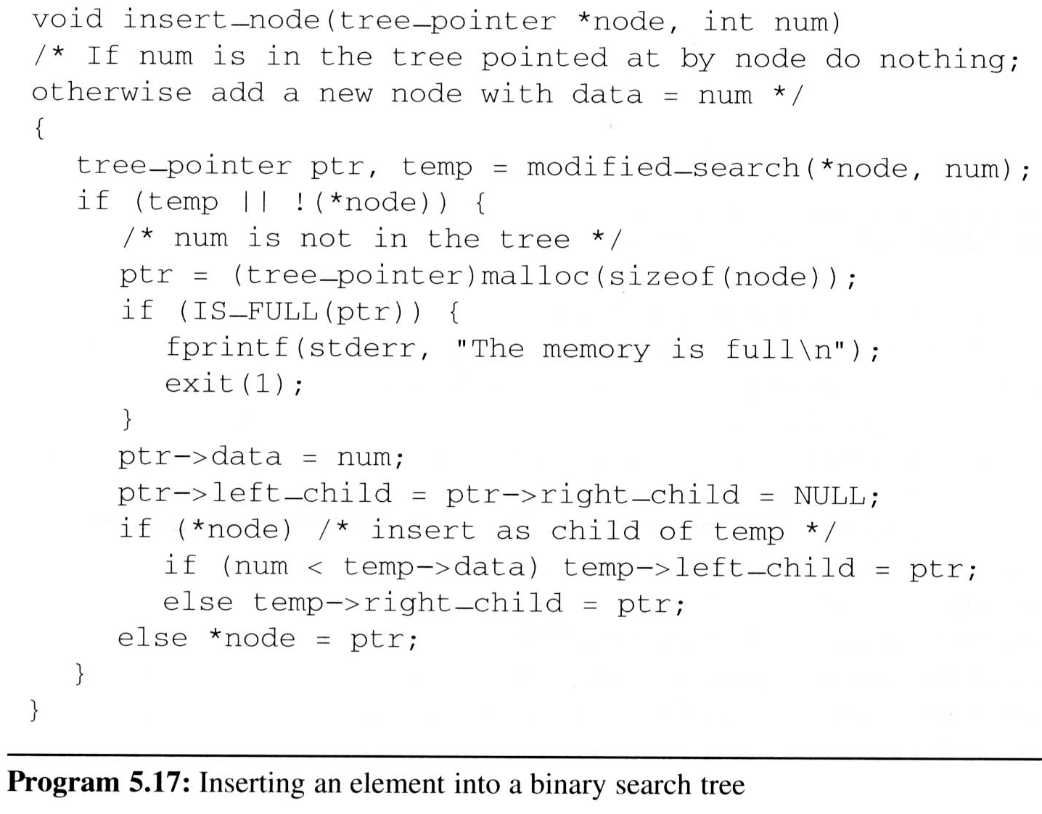
Binary Search Trees (5/8)
Inserting into a binary search tree
An empty tree
參下方備忘稿
Notes:
Modified-search is a slightly modified version of itersearch, i.e., Iterative search of binary search tree，which search the binary tree *node for the key k. If the tree is empty of is present, it returns null. Otherwise, it returns a pointer to the last node of the tree that was encountered during the searchif k

Slide 39
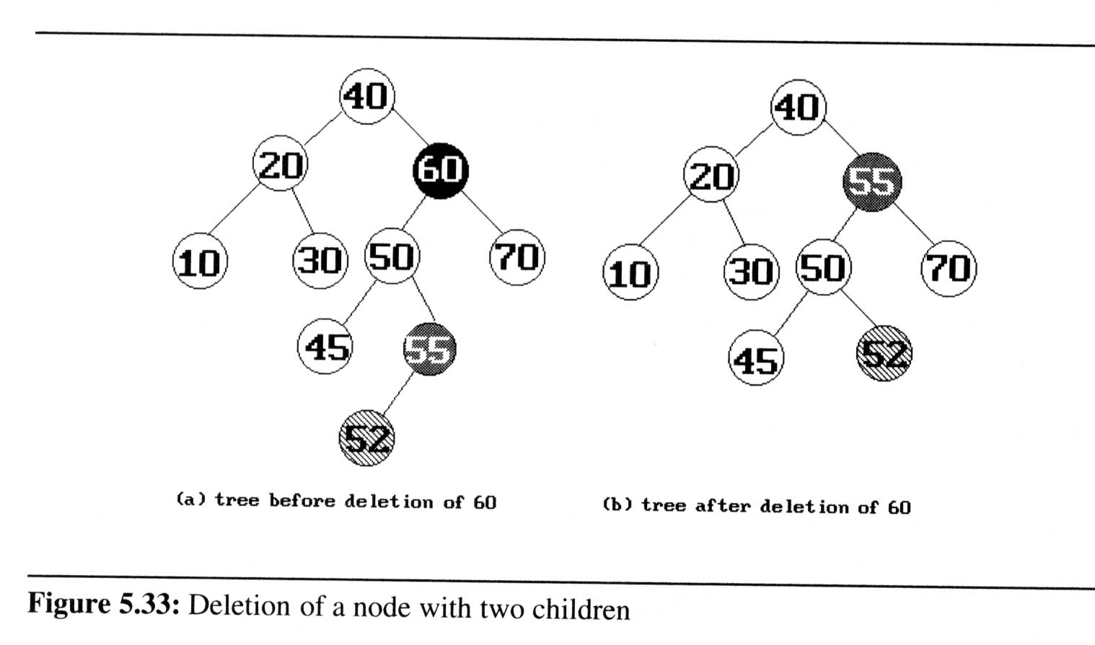
Binary Search Trees (6/8)
Deletion from a binary search tree

Slide 40
Binary Search Trees (6/8)
Deletion from a binary search tree
  Three cases should be considered
  case 1. leaf → delete
  case 2. one child → delete and change the pointer to this child
  case 3. two child → either the smallest element in the right
  subtree or the largest element in the
  left subtree

Slide 41
Binary Search Trees (7/8)
Height of a binary search tree
  The height of a binary search tree with n elements can become as large as n.
  It can be shown that when insertions and deletions are made at random, the height of the binary search tree is O(log₂n) on the average.
  Search trees with a worst-case height of O(log₂n) are called balance search trees

Slide 42
Binary Search Trees (8/8)
Time Complexity
  Searching, insertion, removal
    O(h), where h is the height of the tree
  Worst case - skewed binary tree
    O(n), where n is the # of internal nodes
Prevent worst case
  rebalancing scheme
  AVL, 2-3, and Red-black tree

Slide 43
Selection Trees (1/7)
Problem:
  suppose we have k order sequences, called runs, that are to be merged into a single ordered sequence
Solution: (for determine maximum/minimum)
  straightforward : k-1 comparison
  selection tree : ⎡log₂k⎤+1
There are two kinds of selection trees:
winner trees and loser trees

Slide 44
Selection Trees (2/7)
Definition: (Winner tree)
  a selection tree is the binary tree where each node represents the smaller of its two children
  root node is the smallest node in the tree
  a winner is the record with smaller key
Rules:
  tournament : between sibling nodes
  put X in the parent node ⇒ X win

Slide 45
Input: k ordered sequences
10
9
20
6
8
9
90
17
15
20
20
15
15
11
95
18
16
38
30
25
50
16
99
20
…
…
…
28
…
…
…
…
…
…
…
…
…
…
…
…

Slide 46
Selection Trees (3/7)
Winner Tree
6
6
8
9
6
8
17
10
9
20
6
8
9
90
17
15
20
20
15
15
11
95
18
16
38
30
25
50
16
99
20
…
…
…
28
…
…
…
…
…
…
…
…
…
…
…
…

Slide 47
Selection Trees (5/7)
After one record has been output
6
8
6
9
8
9
6
15
8
17
10
9
20
6
15
8
9
90
17
15
20
20
25
15
11
95
18
16
38
30
28
50
16
99
20
…
…
…
…
…
…
…
…
…
…
…
…
…
…
…
…

Slide 48
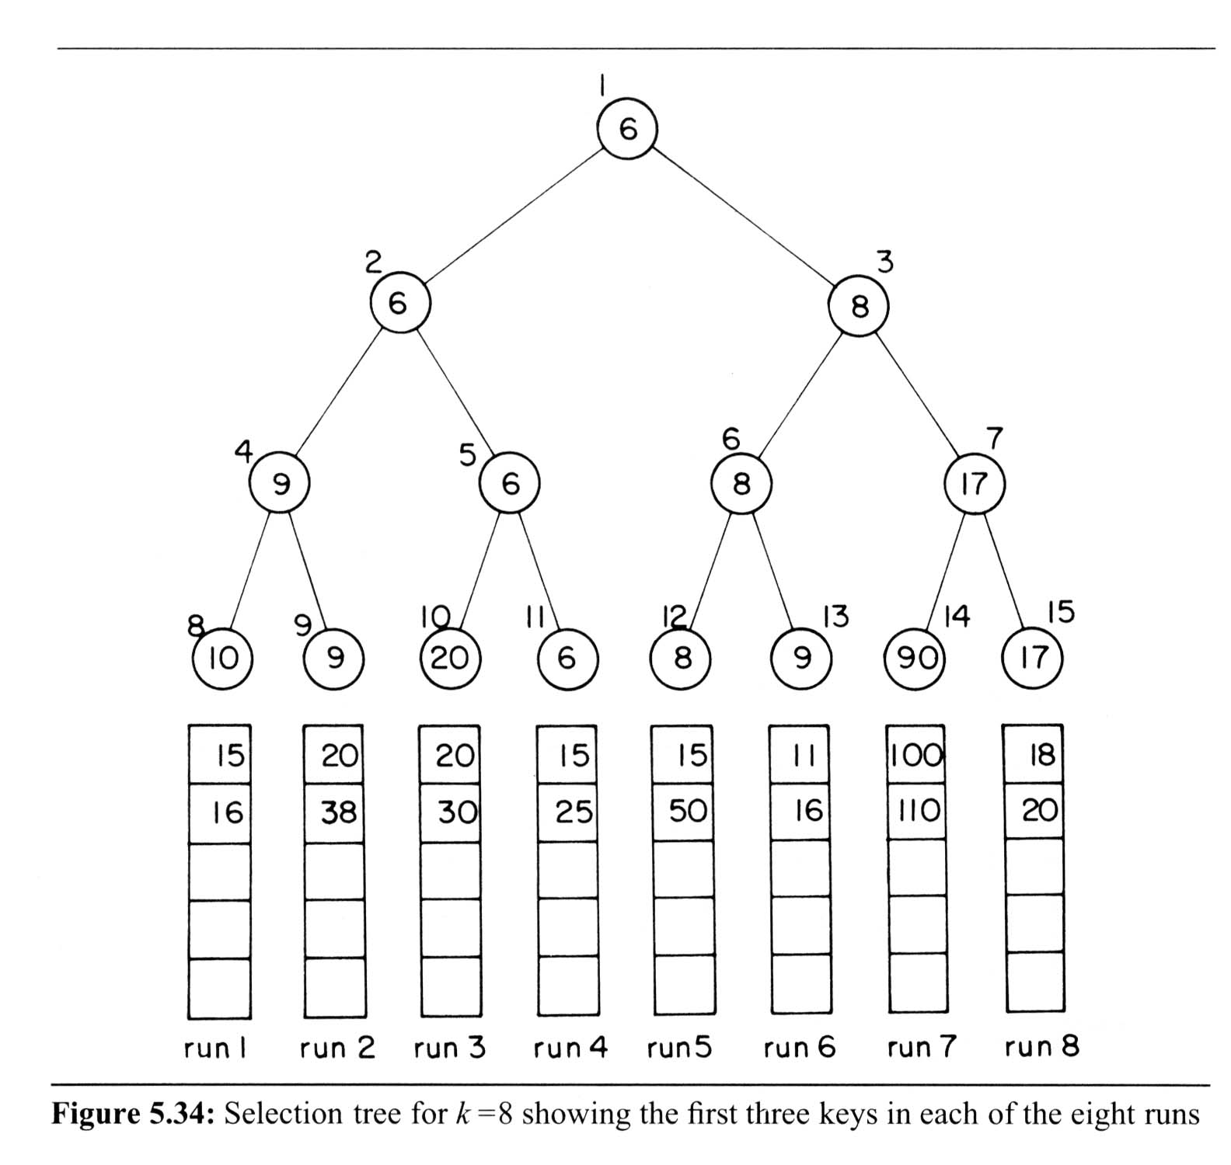
Selection Trees (6/7)
Tree of losers can be conducted by Winner tree
0
6
8
9
17
10
20
9
90

Slide 49
Selection Trees (4/7)
Analysis of merging runs using winner trees
  # of levels: ⎡log₂K ⎤ +1 ⇒ restructure time: O(log₂K)
  merge time: O(nlog₂K)
  setup time: O(K)
  merge time: O(nlog₂K)
Slight modification: tree of loser
  consider the parent node only (vs. sibling nodes)

Slide 50
Selection Trees (7/7)
The loser tree after output 6
0
8
Overall winner
1
9
2
3
15
17
4
5
6
7
10
20
9
90
9
10
11
12
13
14
15
10
9
20
15
8
9
90
17
run
1
2
3
4
5
6
7
8

