Slide 1
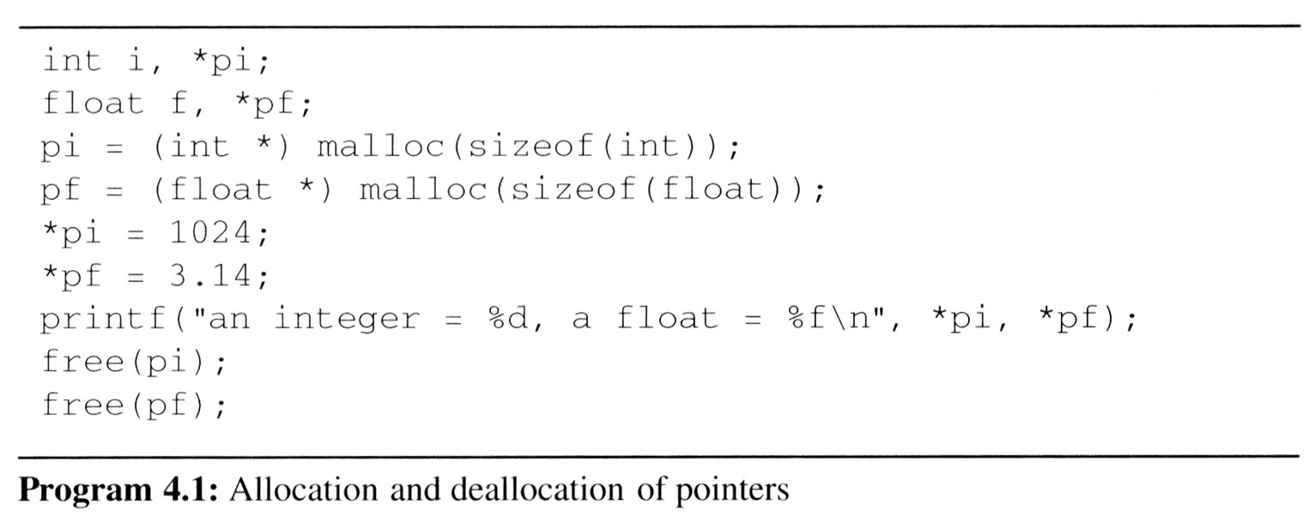
Pointers (5/5)
Using dynamically allocated storage
Request memory
Free memory

