Slide 1
Data Structures
Chapter 3 Stacks and Queues

Slide 2
Chapter 3 Stacks and Queues
The Stack Abstract Data Type
The Queue Abstract Data Type
A Mazing Problem
Evaluation of Expressions

Slide 3
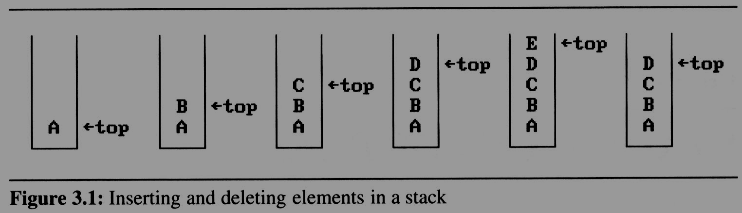
3.1 The stack ADT (1/5)
A stack is an ordered list in which insertions and deletions are made at one end called the top.
If we add the elements A, B, C, D, E to the stack, in that order, then E is the first element we delete from the stack
A stack is also known as a Last-In-First-Out (LIFO) list.
C
Top
B
Top
A
Top

Slide 4
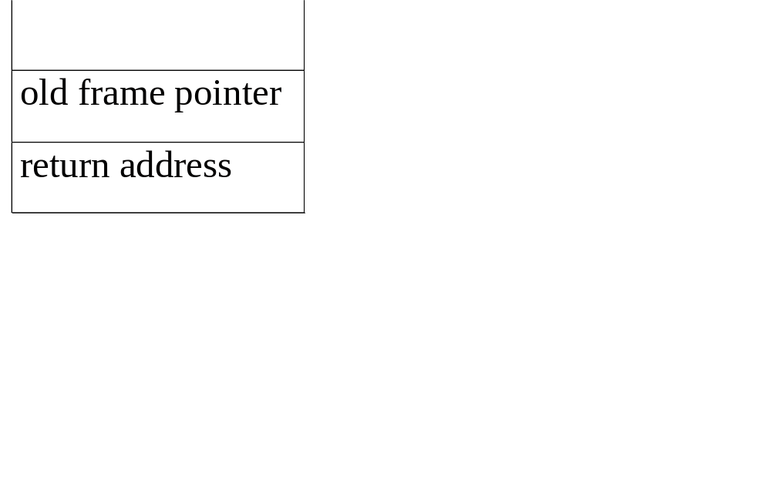
An application of stack: stack frame of function call
(activation record)
System Stack
fp: a pointer to current stack frame
Main {
…..
a1(v1, v2);
q=q+1
…..
}
fp
stack frame of invoking function
從main把執行全給a1()，要先紀錄main執行到哪
If main 執行完要回到哪
CHAPTER 3

Slide 5
An application of stack: stack frame of function call
(activation record)
Main {
…..
a1(v1, v2);
q=q+1
…..
}
fp: a pointer to current stack frame
fp
main
stack frame of invoking function
CHAPTER 3

Slide 6
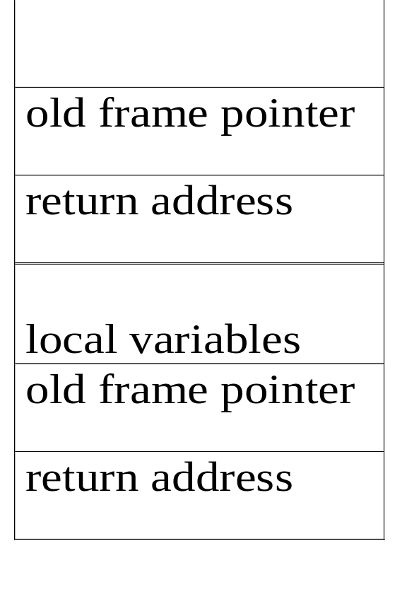
An application of stack: stack frame of function call
(activation record)
fp: a pointer to current stack frame
fp
al
fp
main
stack frame of invoking function
system stack before a1 is invoked
system stack after a1 is invoked
(a) (b)
CHAPTER 3

Slide 7
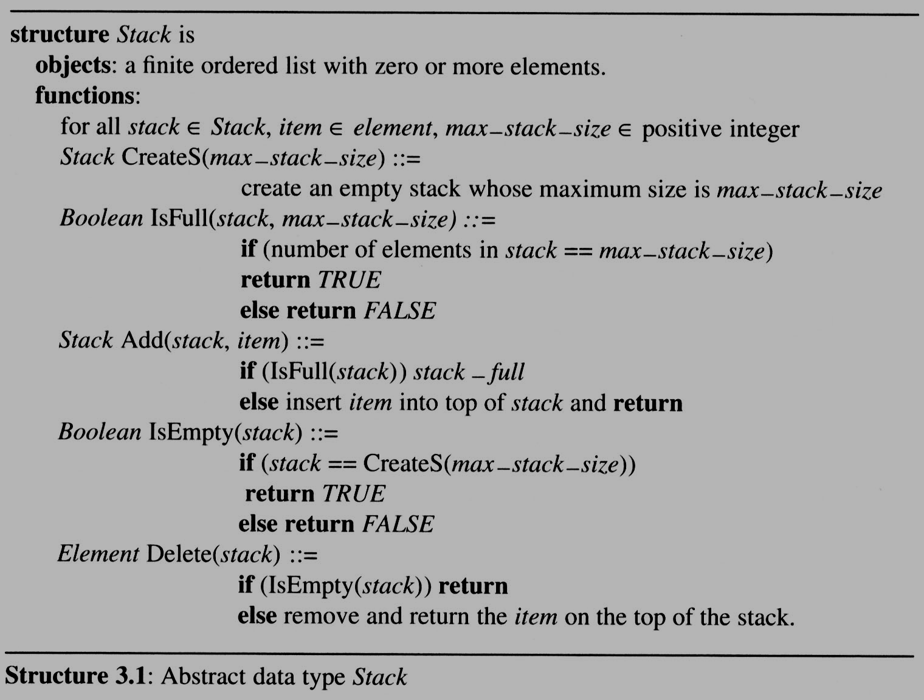
3.1 The stack ADT (3/5)

Slide 8
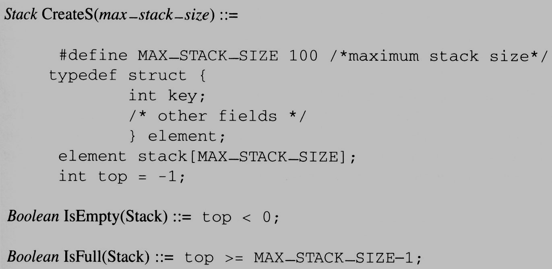
3.1 The stack ADT (4/5)
Implementation: using array

Slide 9
3.1 The stack ADT (5/5)
ADD to A Stack
void push(element item)
{
/* add an item to the global stack */
if (top >= MAX_STACK_SIZE-1) {
stack_full( );
return;
}
stack[++top] = item;
}
stack
item
Top

Slide 10
3.1 The stack ADT (5/5)
element pop()
{
/* return the top element from the stack */
if (top == -1) // -1 0 自己決定
return stack_empty( ); /* returns and error key */
return stack[top--];
}
Delete from a stack
stack
item
Top

Slide 11
3.2 The queue ADT (1/7)
A queue is an ordered list in which all insertion take place one end, called the rear and all deletions take place at the opposite end called the front
First-In-First-Out (FIFO) list
If we insert the elements A, B, C, D, E, in that order, then A is the first element we delete from the queue

Slide 12
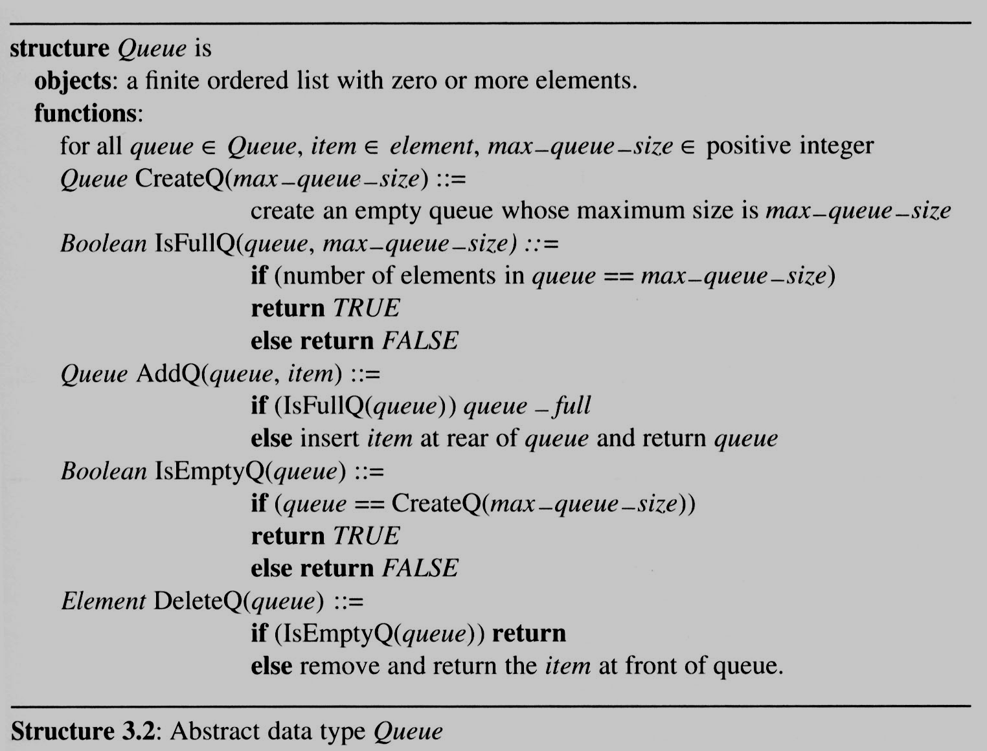
3.2 The queue ADT (2/7)

Slide 13
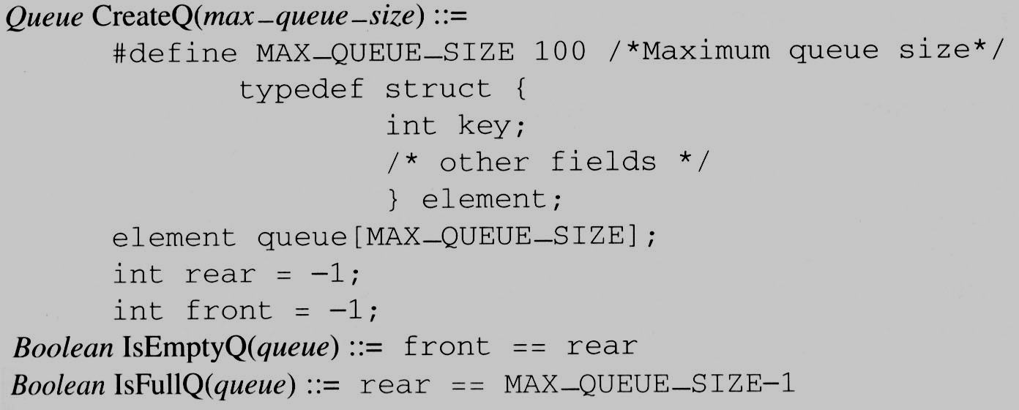
3.2 The queue ADT (3/7)
Implementation 1:
using a one dimensional array and
two variables, front and rear

Slide 14
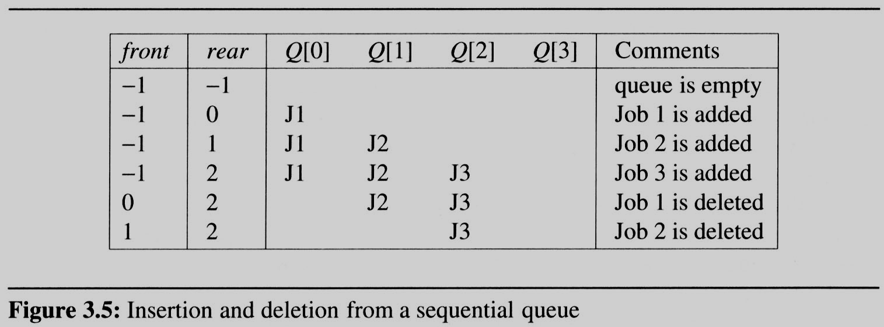
3.2 The queue ADT (5/7)
Example 3.2 [Job scheduling]:
  Figure 3.5 illustrates how an operating system might process jobs if it used a sequential representation for its queue.
Fornt: 第一個有放東西，前一個index。 Rare: 最後一個有放東西的位址(index)。

Slide 15
3.2 The queue ADT (5/7)
Example 3.2 [Job scheduling]:
    As jobs enter and leave the system, the queue gradually shift to right.
    In this case, queue_full should move the entire queue to the left so that the first element is again at queue[0], front is at -1, and rear is correctly positioned.
      Shifting an array is very time-consuming, queue_full has a worst case complexity of O(MAX_QUEUE_SIZE).

Slide 16
3.2 The queue ADT (4/7)
void addq(element item)
{
/* add an item to the queue */
if (rear == MAX_QUEUE_SIZE_1) {
queue_full( );
return;
}
queue [++rear] = item;
}
add前先看是否滿了
element deleteq()
{
/* remove element at the front of the queue */
if ( front == rear)
return queue_empty( ); /* return an error key */
return queue [++ front];
}
檢查是不是空的
problem: there may be available space when IsFullQ is true i.e. movement is required.

Slide 17
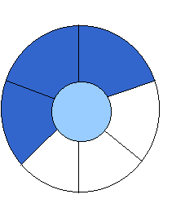
Implementation 2: regard an array as a circular queue
front: one position counterclockwise from the first element
rear: current end
環性的效率才高 >> 查front/rare的index如何算
EMPTY QUEUE
[2]
[3] [2] [3]
J2
J3
[1] [4] [1] [4]
J1
[0] [5] [0] [5]
front = 0 front = 0
rear = 0 rear = 3

Slide 18

Problem: one space is left when queue is full
FULL QUEUE FULL QUEUE
[2] [3] [2] [3]
J2 J3
J8 J9
J7
[1] [4][1] [4]
J1 J4
J5
J6 J5
[0] [5] [0] [5]
front =0
rear = 5
front =4
rear =3
If 再加進來: front=0, rear=0。無法判斷是滿了還是空的，所以副作用是會空一格。

Slide 19
3.2 (7/7)
Add to a circular queue
void addq(element item)
{
/* add an item to the queue */
rear = (rear +1) % MAX_QUEUE_SIZE;
if (front == rear) /* reset rear and print error */
return;
}
queue[rear] = item;
}
*Program 3.5: Add to a circular queue (p.110)
Total 6 個位置，mod 6。

Slide 20
Delete from a circular queue
element deleteq()
{
element item;
/* remove front element from the queue and put it in item */
if (front == rear)
return queue_empty( );
/* queue_empty returns an error key */
front = (front+1) % MAX_QUEUE_SIZE;
return queue[front];
}
*Program 3.6: Delete from a circular queue (p.111)

