Slide 1
Keras安裝&作業要求

Slide 2
目錄
安裝Anaconda環境
建立虛擬環境
安裝TensorFlow 、 Keras
手寫辨識範例
作業要求

Slide 3
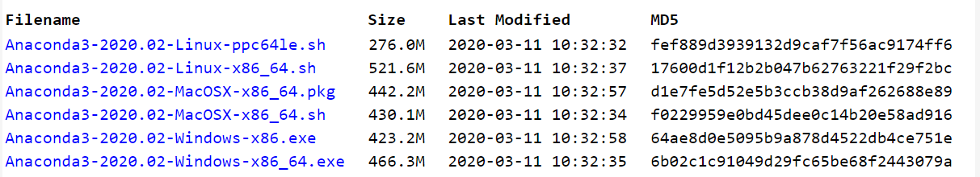
1.安裝Anaconda環境
https://repo.continuum.io/archive/

Slide 4
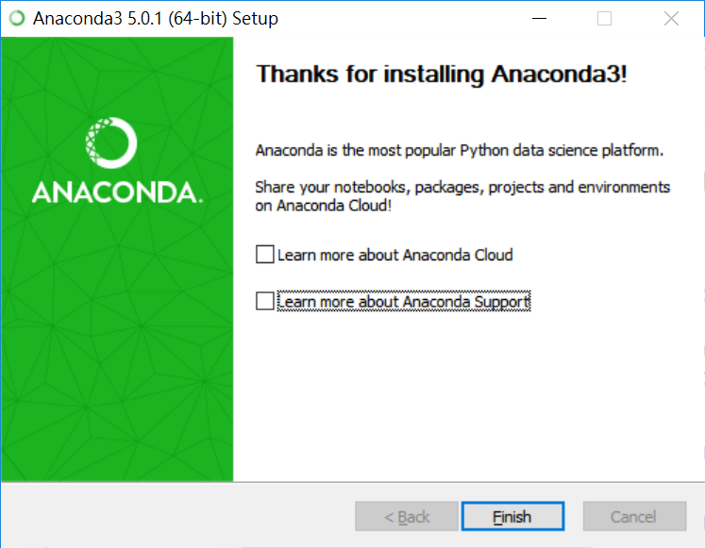
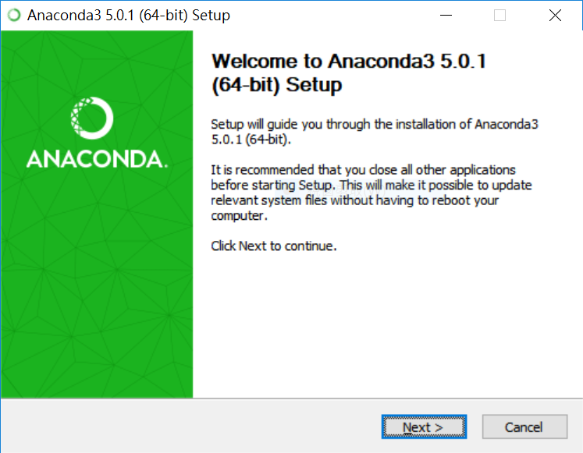
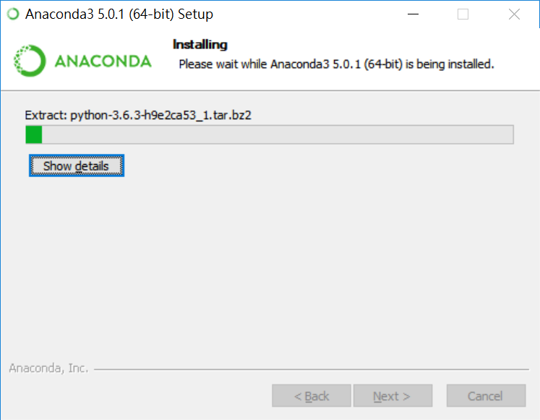
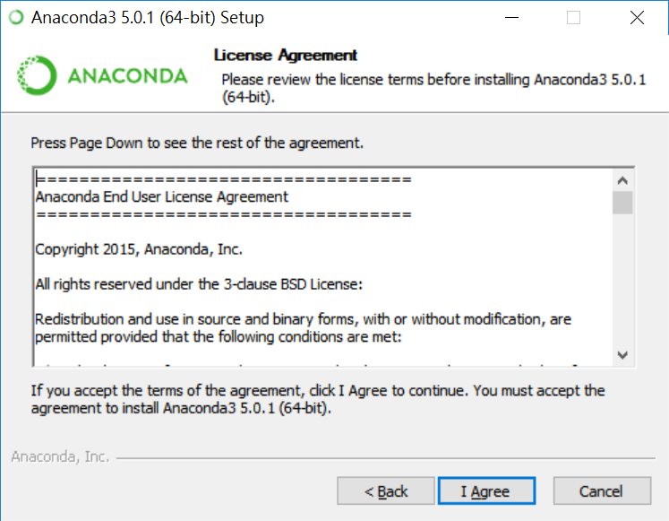
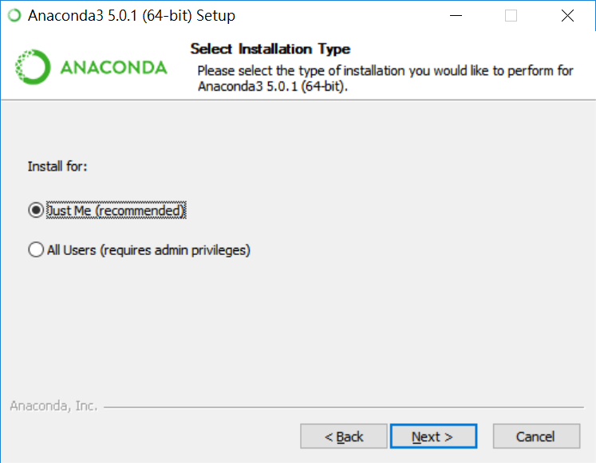
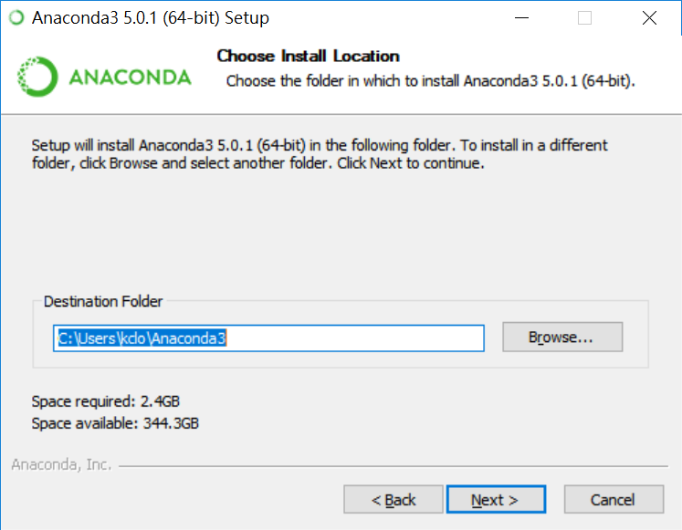
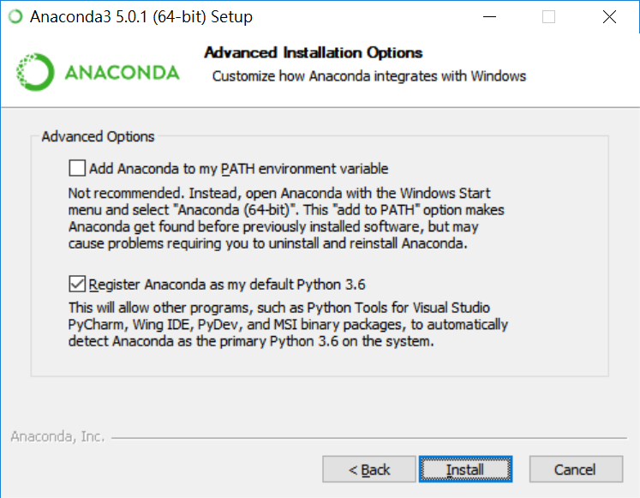
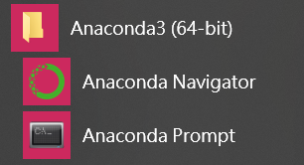
1.安裝Anaconda環境
Notes:
不要裝在C槽
所有軟體都要裝同一個槽
加入環境變數要打勾

Slide 5
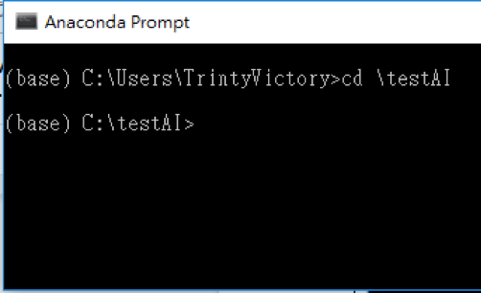
2.建立虛擬環境
conda create --name testAI python=3.6 anaconda
conda create：建立虛擬環境
–-name testAI：環境名稱，取名為testAI
python=3.6：Python的版本為3.6

Slide 6
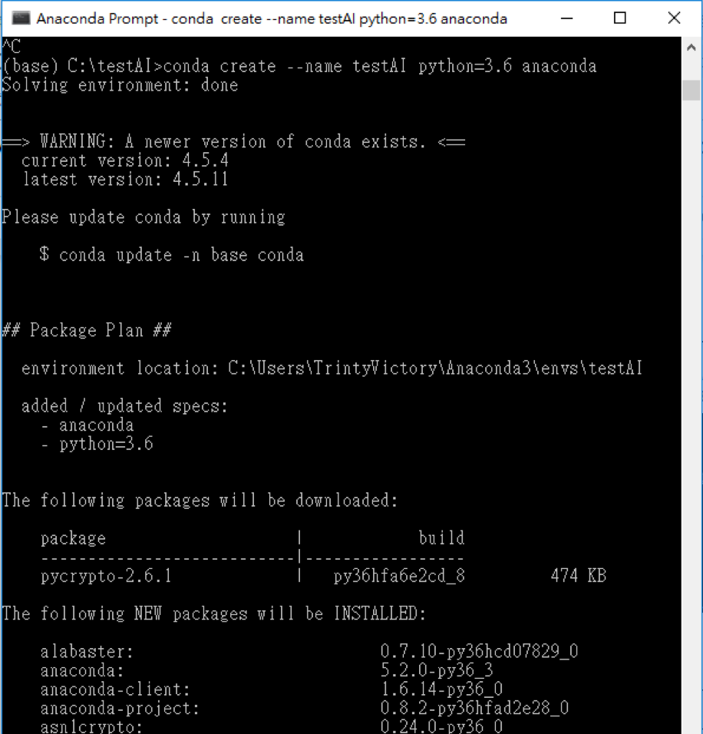
2.建立虛擬環境
# 在windows環境下激活：activate testAI
# 在windows環境下關閉：deactivate
# 在Linux & Mac中激活：
source activate testAI
# 在Linux & Mac中關閉：source deactivate
#刪除環境：conda remove -n testAI --all

Slide 7
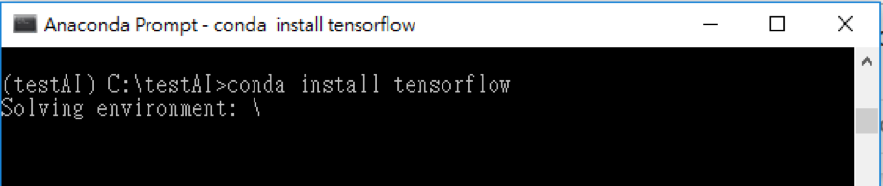
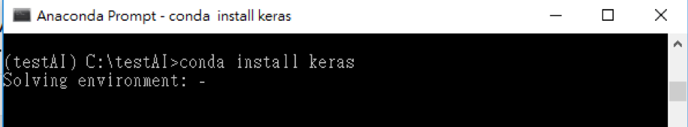
3.安裝TensorFlow 、 Keras
conda install tensorflow
conda install keras

Slide 8


4.手寫辨識範例-Keras版本

Slide 9
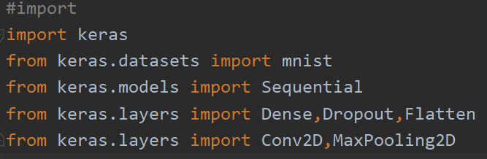
4.1 Import
Notes:
載入套件

Slide 10
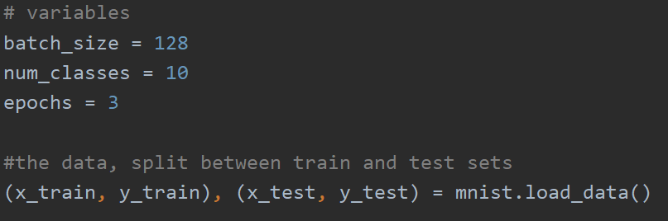
4.2 變數

Slide 11
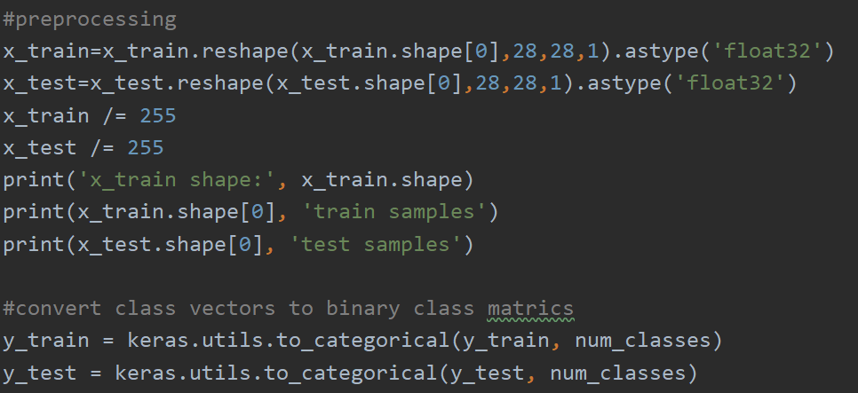
4.3 Preprocessing

Slide 12
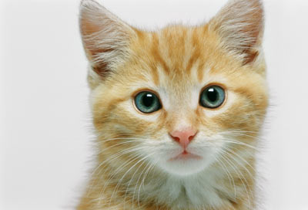
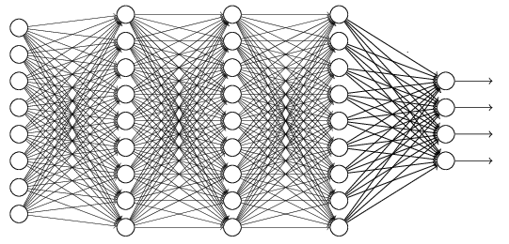
The whole CNN
cat dog ……
Convolution
Max Pooling
Can repeat many times
Fully Connected Feedforward network
Convolution
Max Pooling
Flatten

Slide 13
CNN – Convolution
Those are the network parameters to be learned.
1 | -1 | -1
-1 | 1 | -1
-1 | -1 | 1
1 | 0 | 0 | 0 | 0 | 1
0 | 1 | 0 | 0 | 1 | 0
0 | 0 | 1 | 1 | 0 | 0
1 | 0 | 0 | 0 | 1 | 0
0 | 1 | 0 | 0 | 1 | 0
0 | 0 | 1 | 0 | 1 | 0
Filter 1
Matrix
-1 | 1 | -1
-1 | 1 | -1
-1 | 1 | -1
Filter 2
Matrix
……
6 x 6 image
Each filter detects a small pattern (3 x 3).

Slide 14
CNN – Convolution
1 | -1 | -1
-1 | 1 | -1
-1 | -1 | 1
Filter 1
stride=1
1 | 0 | 0 | 0 | 0 | 1
0 | 1 | 0 | 0 | 1 | 0
0 | 0 | 1 | 1 | 0 | 0
1 | 0 | 0 | 0 | 1 | 0
0 | 1 | 0 | 0 | 1 | 0
0 | 0 | 1 | 0 | 1 | 0
3
-1
-3
-1
-3
1
0
-3
-3
-3
0
1
3
-2
-2
-1
6 x 6 image

Slide 15
CNN – Convolution
-1 | 1 | -1
-1 | 1 | -1
-1 | 1 | -1
Filter 2
stride=1
Do the same process for every filter
1 | 0 | 0 | 0 | 0 | 1
0 | 1 | 0 | 0 | 1 | 0
0 | 0 | 1 | 1 | 0 | 0
1 | 0 | 0 | 0 | 1 | 0
0 | 1 | 0 | 0 | 1 | 0
0 | 0 | 1 | 0 | 1 | 0
3
-1
-3
-1
-1
-1
-1
-1
-3
1
0
-3
-1
-1
-2
1
Feature
Map
-3
-3
0
1
-1
-1
-2
1
3
-2
-2
-1
6 x 6 image
-1
0
-4
3
4 x 4 image

Slide 16
CNN – Max Pooling
1 | -1 | -1
-1 | 1 | -1
-1 | -1 | 1
-1 | 1 | -1
-1 | 1 | -1
-1 | 1 | -1
Filter 1
Filter 2
3
-1
-3
-1
-1
-1
-1
-1
-3
1
0
-3
-1
-1
-2
1
-3
-3
0
1
-1
-1
-2
1
3
-2
-2
-1
-1
0
-4
3

Slide 17
CNN – Max Pooling
New image
but smaller
1 | 0 | 0 | 0 | 0 | 1
0 | 1 | 0 | 0 | 1 | 0
0 | 0 | 1 | 1 | 0 | 0
1 | 0 | 0 | 0 | 1 | 0
0 | 1 | 0 | 0 | 1 | 0
0 | 0 | 1 | 0 | 1 | 0
Conv
3
0
-1
1
Max
Pooling
3
1
0
3
2 x 2 image
6 x 6 image
Each filter
is a channel

Slide 18
Flatten
3
0
1
3
0
-1
1
3
3
1
-1
0
3
Flatten
1
Fully Connected Feedforward network
0
3

Slide 19
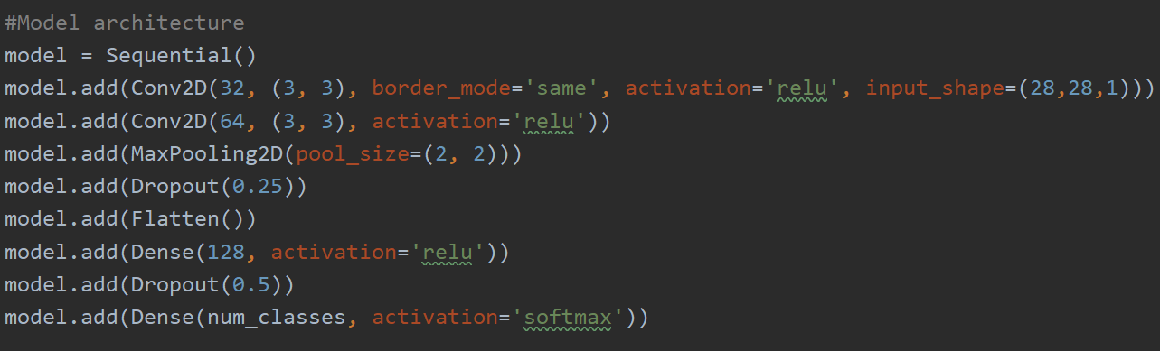
4.4 Model architecture

Slide 20
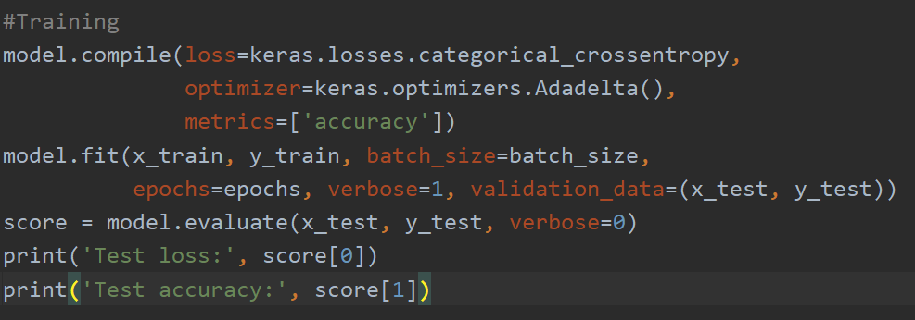
4.5 Training

Slide 21
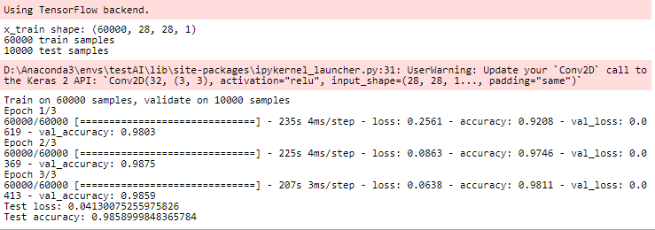
4.6 訓練結果

Slide 22
4.5 著名的CNN Model
•AlexNet
•VGGNet
•Inception Net
•ResNet
https://www.leiphone.com/news/201802/31oWxcSnayBIUJhE.html

Slide 23
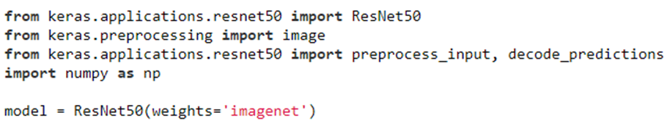
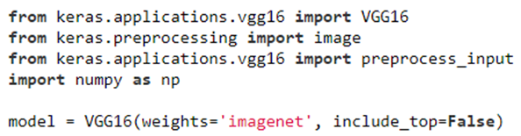
4.5 How to call

Slide 24
5.作業-train a model
1. 使用Keras的CNN example 進行訓練
2. 資料集 : cifar10
3. 繳交 : 程式碼(python檔)、心得(3~5頁)、訓練結果截圖
Notes:
epoch、filter、batch size大小、dropout rate、learning rate...都能

Slide 25
6.作業繳交資訊
上傳LMS(繳交壓縮檔>學號_姓名.zip)
期限：5/3 23:59前
助教Email : a9272521@gmail.com
b251940@gmail.com

Slide 26
資料來源
https://keras.io/
http://speech.ee.ntu.edu.tw/~tlkagk/courses_MLDS18.html
https://www.leiphone.com/news/201802/31oWxcSnayBIUJhE.html

