Slide 1
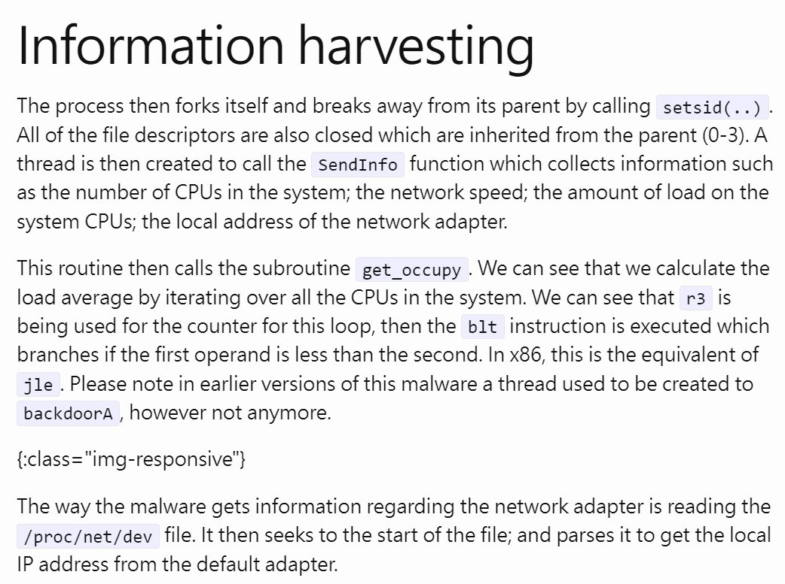
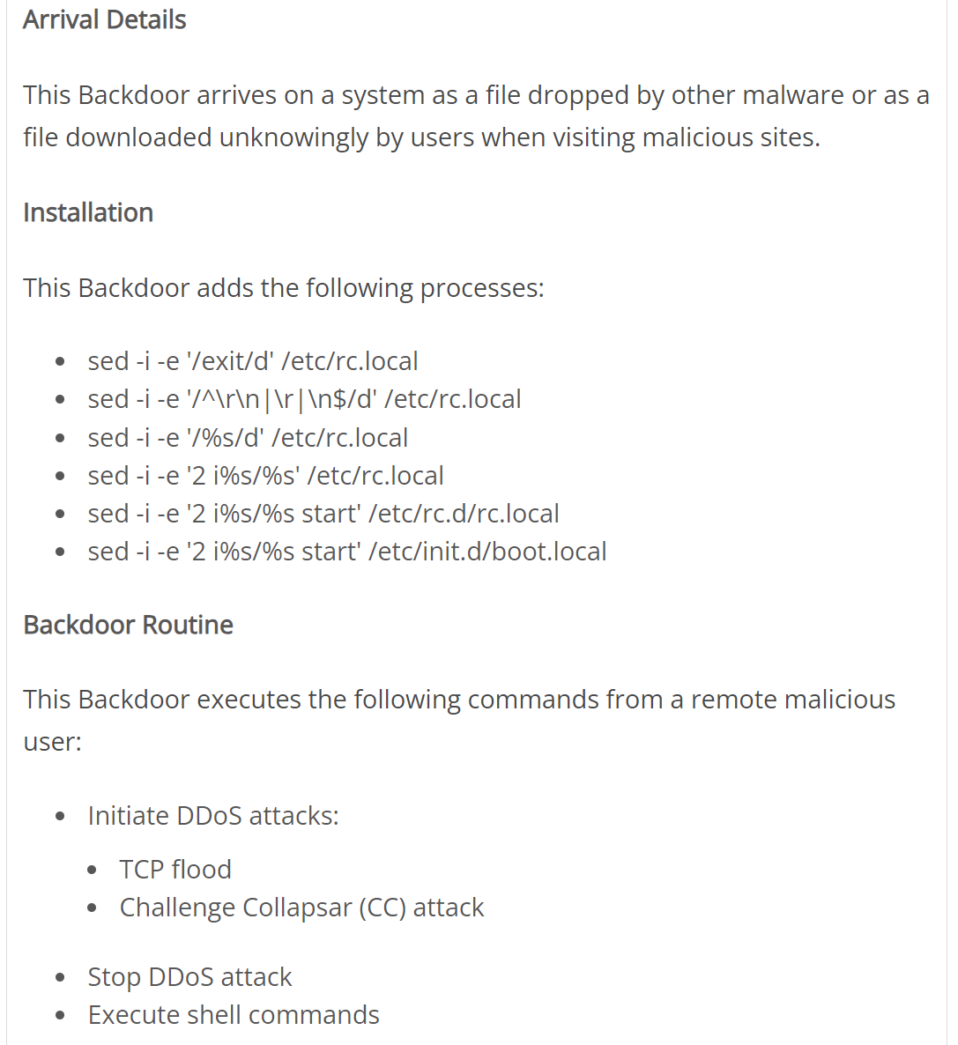

Analysis Report
Technical Report
List only IoCs
Provides less context
Provide a more complete context
Used reverse analysis tools

