Slide 1
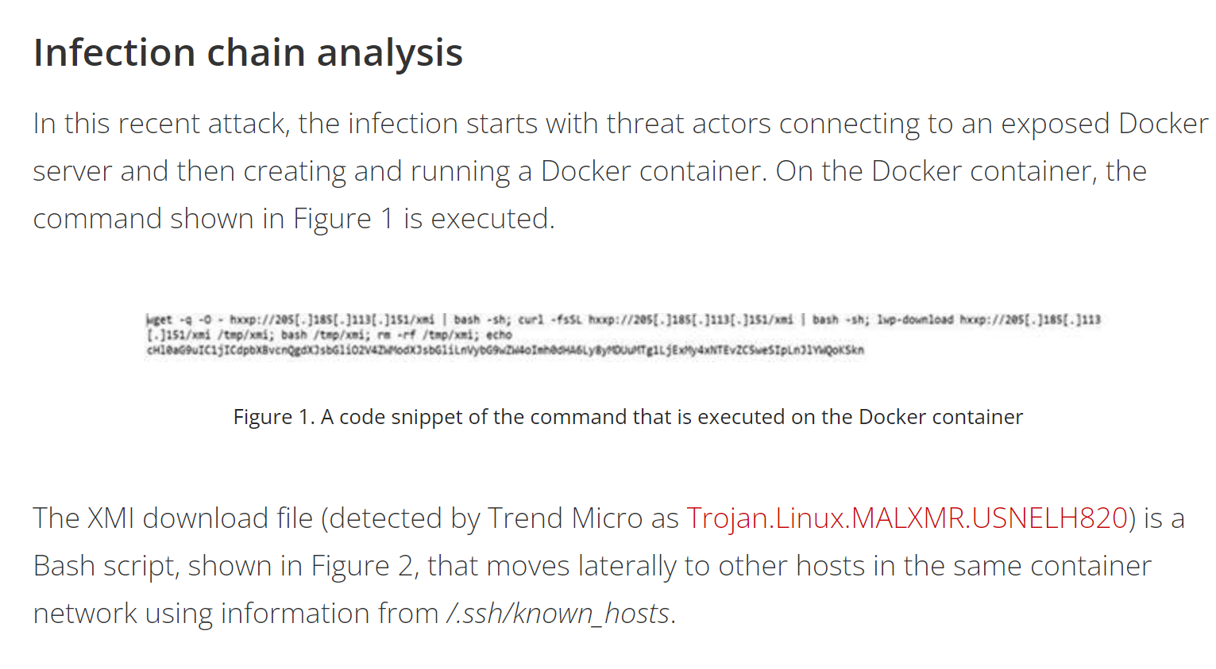
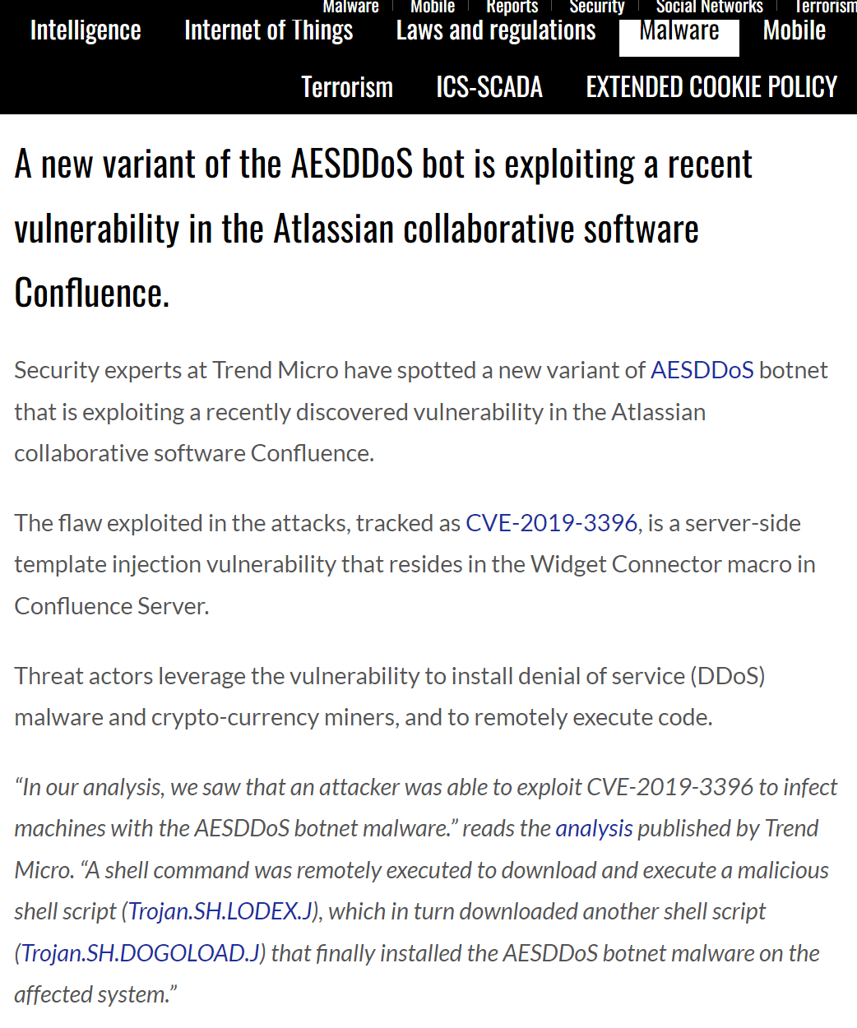



Campaign Report
News Report
(1) Downloaded Trojan
Cite and state events from
(2) Persistence & Dropper
another report
(3) Coinminer
(4) DDoS bot

