Slide 1
Name
Talk
Albert Einstein
Relativity of AI Agents
Pavol Hejný
AI agents with commitments
George Orwell
2084 - Vision of the AI tyranny
Ada Lovelace
The First AI Programmer
Jiří Jahn
Randomness and Stochastics in AI
Harry Potter
Generate spells with AI
1

Slide 2
Email:
Dear Mr. Hejný,
We are writing to inform you that your call for papers, "AI Agents with
Commitments," has been selected for presentation at our Supercool Conference in
London on September 8, 2025.
Travel and accommodation expenses will be covered.
We look forward to your presentation!
Yours sincerely,
John Smith
Supercool Conference Org Team
2

Slide 3
Prompt:
Write email to {Name} as an organizer of the Supercool Conference in London on
September 8, 2025, to inform them that their call for papers {Talk} has been
selected for presentation. Travel and accommodation expenses will be covered.
3

Slide 4
Email:
Dear Mrs. Lovelace,
We are pleased to inform you that your call for papers, "The First AI Programmer,"
has been selected for presentation at our Supercool Conference in London on
September 8, 2025.
Travel and accommodation expenses will be covered.
We look forward to your poetical insights into the world of AI programming!
Yours sincerely,
John Smith
Supercool Conference Org Team
4

Slide 5
Email:
Dear Mr. Orwell,
We are pleased to inform you that your call for papers, "2084 - Vision of the AI
Tyranny," has been selected for presentation at our Supercool Conference in
London on September 8, 2025.
Travel and accommodation expenses will be covered.
Be prepared for a thought-provoking discussion on the future of AI and its
implications on society.
We look forward to your presentation!
Yours sincerely,
John Smith
Supercool Conference Org Team
5

Slide 6
Email:
Dear Mr. Potter,
We are pleased to inform you that your call for papers, "Generate Spells with AI,"
has been selected for presentation at our Supercool Conference in London on
September 8, 2025.
Be prepared for a magical experience as we cover your travel and accommodation
expenses.
We look forward to your enchanting presentation!
Yours sincerely,
John Smith
Supercool Conference Org Team
6

Slide 7
Email:
I will write an email to Jiří Jahn.
Should I use a professional tone or a friendly tone?
7

Slide 8
Better Prompt:
Write email to {Name} as an organizer of the Supercool Conference in London on
September 8, 2025, to inform them that their call for papers {Talk} has been
selected for presentation. Travel and accommodation expenses will be covered.
- Write just the email, no other text
- Use a professional tone
- Use Markdown format
- The email should be 10 words long and not exceed 2 pages
- do not include any other information or instructions
- ...
8

Slide 9
Better Integration:
import { countWords, countPages } from '@promptbook/utils';
const openai = new OpenAI( /* ... API Key ... */});
for (let i = 0; i < RETRY_COUNT; i++) {
const response = await openai.chat.completions.create({
/* ... Prompt ... */
});
const email = response.choices[0].message.content;
if (/\*+/.match(name)) {
continue;
}
if (countWords(email) < 10 || countPages(email) > 2) {
continue;
}
return email;
}
9

Slide 10
Disadvantages
Portability (i.e.
gpt-4
vs
claude-3.7
)
Need for Programmer or no-code tool
Mixing code and prompt
Security issues (i.e. prompt injection)
Reliability issues (fails in edge cases)
10

Slide 11
Is this some better way to write
AI Agents and AI Apps?
11

Slide 12
Book:
Write email to
@Name
as an organizer of the
@Supercool Conference
in London on
September 8, 2025, to inform them that their call for papers
@Talk
has been
selected for presentation. Travel and accommodation expenses will be covered.
PERSONA
@George
Organizer of the
@Supercool Conference
event
KNOWLEDGE
@Supercool Conference
supercoolconference.com
LANGUAGE English
TONE Professional
FORMAT Markdown
LENGTH 10 words - 2 pages
12

Slide 13
Advantages
Writing one native code to define AI Agent
Portability (i.e.
gpt-4
vs
claude-3.7
, temperature, top_t, system messages)
Guideline to write excellent prompts
Separation of code and prompt
You don't need to call developer each time you want to do the change
Clear separation of data and instructions
13

Slide 14
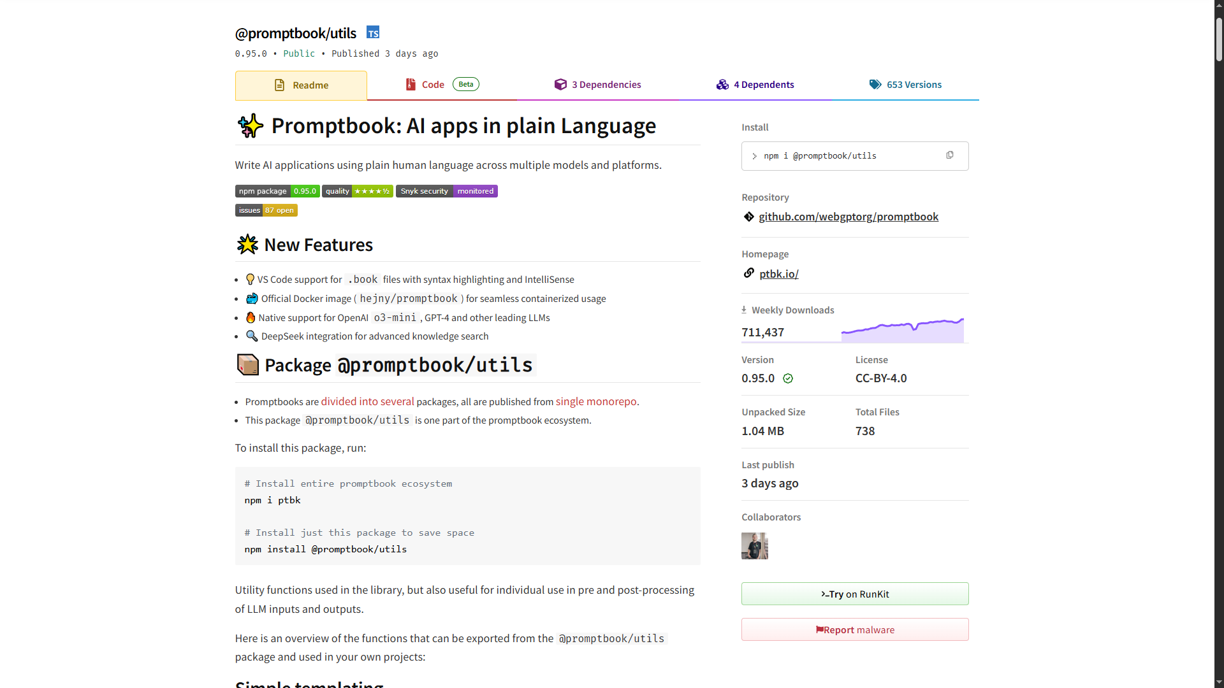
Promptbook Engine
14

Slide 15
Let's Connect
Promptbook
ptbk.io
github.com/webgptorg/promptbook
Jiří Jahn
jiri@ptbk.io
+420 777 090 067
Pavol Hejný
pavol@ptbk.io
+420 777 759 767
15

