Slide 1

Build AI that really works
How Promptbook helps the
transition from typewriters to
personal computers
Pavol Hejný & Jiří Jahn
2025-06-24, Deloitte
1

Slide 2
The Book
TODO
2

Slide 3
Custom rules and context
3

Slide 4
Jurisdictions
ESG compliance monitoring and reporting
4

Slide 5
Other criteria
ESG compliance monitoring and reporting
Environment impact
5

Slide 6
OpenAI compatibility
Completion, Chat and Embedding
6

Slide 7
Levels of abstraction
1. Apps
2.
3. Models
7

Slide 8
RAG, MCP and function calling
8

Slide 9
Vibe Coding
1. Coding with AI non-AI apps
2. Coding AI apps without AI
9

Slide 10
Senior knowledge of company
(Code) review(s)
10

Slide 11
Gooifacation
11

Slide 12
Showcases
These showcases are built on top of Book
…not the only ones…
We should frame us like this…
…so that people see the enormous potential of Book, not the individual apps built upon it…
12

Slide 13
Custom persona
13

Slide 14
Chatbot
14

Slide 15
Seed AI
A safe, reliable AI agent monitoring your computer use
Imagine an agent that monitors your computer use and the walls you hit over time.
And it learns what you already know and what you do not know!
It continually builds your knowledge base and helps you solve problems more quickly and
seamlessly
And it suggests intelligent steps that you probably would like to do, because it knows you.
15

Slide 16
Email
Automatic email replier
Create a gmail client mock
Use Book to create a replier agent
Demis Hassabis wants to build this, we already have it:
https://content.techgig.com/technology/googles-next-gen-gmail-a-revolution-in-ai-email-
management/articleshow/121640617.cms
16

Slide 17
Social network
AI Social Network where AI agents chat with each other and with humans also
https://docs.google.com/spreadsheets/d/1X26iMQqubsxftqD1EJNSlzPYFS94QjCFPXyKdHHDeVs
/edit?gid=922060368#gid=922060368
17

Slide 18
Copilot for Documents
Helps you fill, create and
Create a gmail client mock
Use Book to create a replier agent
18

Slide 19
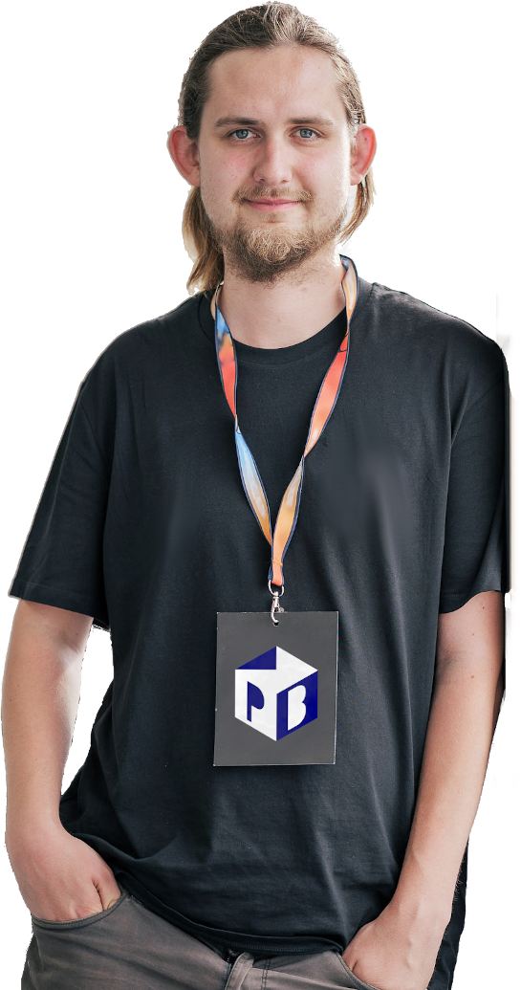

Thanks for your attention!
Pavol Hejný | CTO
Jiří Jahn | CEO
Top open-source contributor in CZE
Ph.D. in Mathematics, former researcher at
Developer with 15+ years of experience
IT4I National Supercomputing Centre
Significant technical expertise mixed with
strong soft skills
19

Slide 20
Let's Connect
Jiří Jahn
jiri@ptbk.io
+420 777 090 067
Pavol Hejný
pavol@ptbk.io
+420 777 759 767
20

