Slide 1
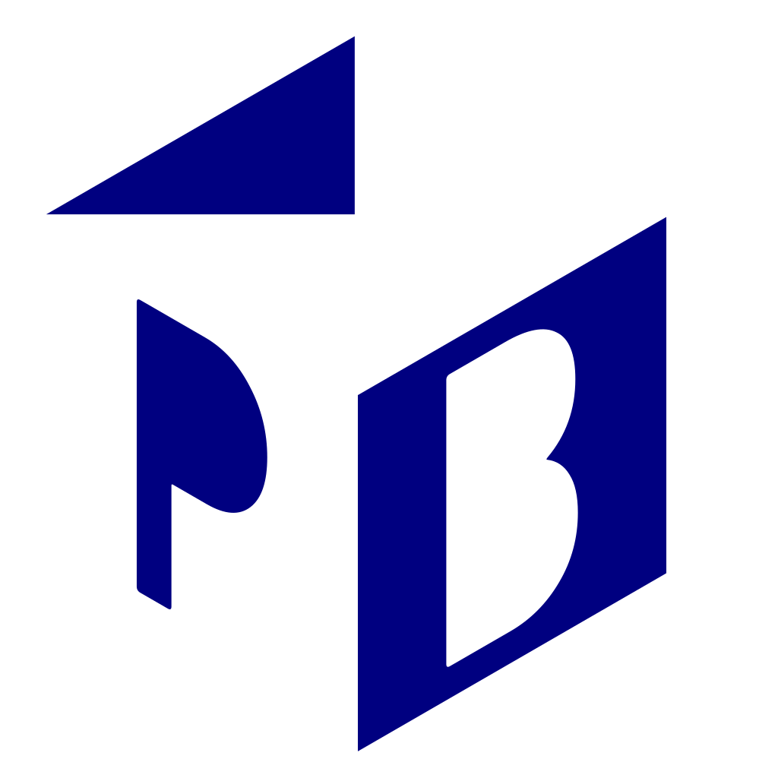
Promptbook
Ship Reliable AI in No Time, Build
Your Company From Within
Pavol Hejný & Jiří Jahn
2025-04-17
1

Slide 2
Why the Book?
Promptbook eliminates AI complexity completely—no choosing models, implementing
RAG, or technical decisions and low level details. Simply write what you need in plain
language, and we'll deliver enterprise-ready AI applications that scale with your business,
reducing development time from months to minutes.
We turn your business expertise into working applications with 'Business as Code' paradigm
in mind – write in plain language, execute like software, and transform your enterprise from
within.
People—whether they’re end‑users or even ML engineers—are overwhelmed by the flood of
new technologies. We’ll spare them the stress and decision paralysis and deliver an AI
application that simply works.
2

Slide 3
What the Book?
Book transforms your business expertise into executable instructions - while other
companies struggle to implement AI, Book lets anyone create powerful business automation
without technical knowledge:
#
Email to customer
- PERSONA George, experienced AI consultant
- KNOWLEDGE https://yourcompany.com/
- KNOWLEDGE https://ptbk.io/
## Write the email
> Write an email to {customerName} about opportunities in
> AI consulting and new trends in the industry.
> Include a link to the {company} website and also mention
> the Promptbook platform.
-> {email}
3

Slide 4


Example: the Chatbot App
With minimal effort, you can experience right
now how Promptbook enables rapid AI
application prototyping.
The live preview on the left demonstrates a
real miniapp built with our Book language.
<
4

Slide 5
OneBrain, LLC: The Self-Building
Enterprise (case study)
A journey through AI transformation with Promptbook
5

Slide 6
The Challenge
Meet OneBrain, LLC - a forward-thinking professional services firm struggling with:
Partners spending 40% of time on repetitive client reports
Knowledge siloed in departments, recreating solutions already built elsewhere
AI experiments that never scale beyond pilots
Compliance risks increasing with each AI implementation
6

Slide 7
Phase 1: Blueprint Creation
Finance partners draft a
book
executable blueprint for automated audit report generation
Without coding, they define exactly what domain expertise needs capturing
Blueprint tested with select clients, refined based on feedback
Zero infrastructure, zero ML expertise required
#
Audit Report Generator
- PERSONA Experienced audit professional
- KNOWLEDGE {client_regulatory_requirements.pdf}
- KNOWLEDGE {deloitte_audit_methodology.pdf}
## Generate Executive Summary
> Create a concise executive summary for {client_name}'s
> audit based on {financial_data} and {compliance_findings}.
> -> {executive_summary}
7

Slide 8
Phase 2: Scaling Across Functions
Tax division adapts the audit blueprint for tax advisory reports
Consulting modifies it for industry research briefings
HR customizes it for talent assessment
The compounding effect: Each adaptation is 80% faster than building from scratch
8

Slide 9


The Self-Building Enterprise: Results
A firm that evolves from within - exactly how Henry Ford or Tomáš Baťa would approach AI
transformation:
Business experts create blueprints without coding
Knowledge compounds across departments without silos
Compliance is standardized at the blueprint level
AI transformation accelerates with each new implementation
Results multiplier: 5x more AI solutions with the same resources
Our Team
9

Slide 10
Our Unique Insights
1. We are not NO CODE platform
For devs these platforms lack control
For non/devs they are still programming with a crutch
2. Anticipating futute trends
Mixing prompts with code will lead to technical debt
We are separating things that should be separated
3. Models are commodity, we make the personalized applications
Models are like Intel processors in Apple
You can replace Intel with Arm, but you cannot replace Apple
10

Slide 11
Frequently Asked Questions
Is Promptbook secured against data leakage?
End-to-end encryption for all data in transit and at rest
On-premises deployment option for sensitive environments
Granular access controls and audit logging of all system interactions
No data storage by default - process and forget architecture
How does Promptbook add controllability and reliability?
Transparent AI decision paths through sophisticated logging
Built-in versioning of all blueprints for governance
Controlled testing environment with simulation capabilities
Clear separation between business logic and AI execution
11

Slide 12
Frequently Asked Questions
Why use Promptbook instead of established no-code tools?
True flexibility beyond drag-and-drop constraints
Seamless transition path from prototype to production
No technical debt - solutions remain maintainable as they scale
Designed for enterprise complexity, not just simple automations
How quickly can we implement and see results?
First blueprint creation: 1-2 days
Initial production implementation: 2-4 weeks
Full enterprise integration: Phased approach over 3-6 months
ROI typically visible within first month of deployment
12

Slide 13
Frequently Asked Questions
How does Promptbook integrate with our existing systems?
Platform-agnostic, API-first architecture connects to any modern system
Pre-built connectors for enterprise platforms
Custom connectors can be developed for legacy systems
Gradual integration approach - no "rip and replace"
13

Slide 14
Let's Connect
Jiří Jahn
jiri@ptbk.io
+420 777 090 067
Pavol Hejný
pavol@ptbk.io
+420 777 759 767
14

