Slide 1
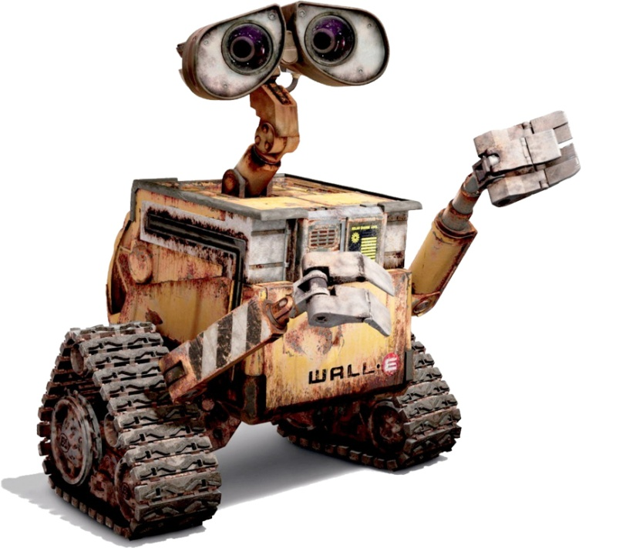
Bounded Verification of Discretized REACT Programs
Event-driven
Asynchronous
Concurrent
Turing-complete
Students: Will Noble,
Aleksandar Milicevic
Damien Zufferey
Supervisor: Stelios Sidiroglou PI: Prof. Martin Rinard

Slide 2
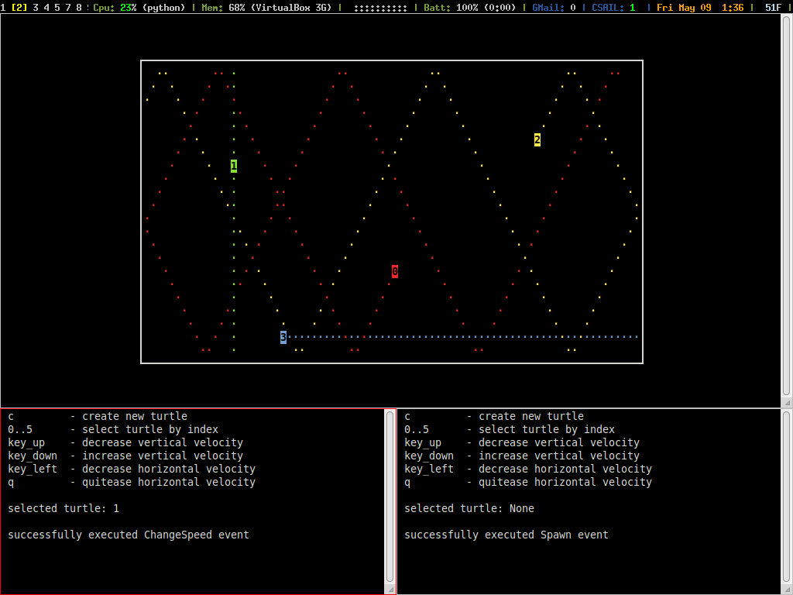
BeaveSim app in REACT

Slide 3
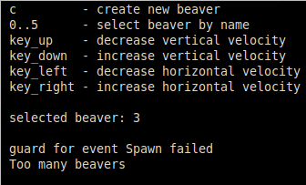

Implementation challenges
concurrent access to (shared) beaver data
from multiple remote controllers
from timer events
from GUI threads
1
0
2
3 4

Slide 4
Example: BeaverSim
model: a beaver has position (x,y) and speed (vx, vy)
constraint: no more than 5 beavers allowed
every 1s positions are updated according to speed
whenever a beavers hits a wall, its speed is reversed

Slide 5
REACT: domain-specific features
model
periodic events
every(1000) {
for b in beavers {
b.x += b.vx;
b.y += b.vy
}
}
record Beaver [
name: str,
x, y: int,
vx, vy: int
]
context BeaverSim [
beavers: listof(Beaver)
]
every(interval) {
[code to execute every interval ms]
}
conditional events
whenever(some b in beavers |
b.x < 0) {
# bounce off the left wall
b.x = 0;
b.vx = -b.vx
}
whenever(condition) {
[code to execute whenever the condition is true]
}
invariants
invariant {
beavers.size() < 5
}
invariant {
[condition that must hold at all times]
}

Slide 6
New: Collision detection for BeaverSim
new feature
beavers autonomously detect & avoid collisions
feature implementation
modify how positions are updated
safety goal
verify that the above implementation is correct

Slide 7

Approach to Verification
model REACT programs in alloy
about alloy
fully automated relational constraint solver
high-level datatype abstractions
convenient for modeling REACT records/contexts
has an event-idiom
used to analyze all interleavings of REACT events
drawback: bounded analysis
REACT programs must be discretized and finitized

Slide 8
Alloy Model of BeaverSim
sig Time {}
sig Beaver {
x, y: Int(1..4) -> Time,
vx, vy: Int(-1..1) -> Time
}
{
all t: Time {
one x.t and one y.t
one vx.t and one vy.t
(vx.t = 0 or vy.t = 0)
}
}
fact initiallyNotPiledUp {
no disj b1, b2: Beaver | let t = Time/first |
b1.x.t = b2.x.t and b1.y.t = b2.y.t
}
position and speed can change over time
beaver invariants: - exactly one value for each time step
- may only move up-down or left-right
system invariants: - initial positions don’t overlap

Slide 9
Event-Idiom in Alloy
// with each event a ‘pre’ and ‘post’ time step is associated
abstract sig Event { t, t': Time }
fact {
// at each time step exactly one event has to happen
all tx: Time - Time/last | one e: Event | e.t = tx and e.t' = tx.next
}
sig UpdatePosition extends Event {}{
// Approach1: no collision detection
all b: Beaver {
// update position according to speed
b.x.t' = b.x.t.plus[b.vx.t] and b.y.t' = b.y.t.plus[b.vy.t]
// speed stays the same
b.vx.t' = b.vx.t and b.vy.t' = b.vy.t
}
}

Slide 10
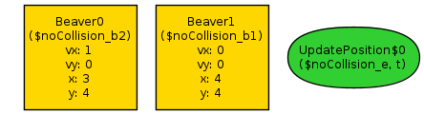
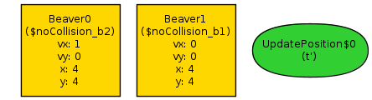
Checking Safety Properties
check noCollision {
no t: Time |
some disj b1, b2: Beaver |
b1.x.t = b2.x.t and b1.y.t = b2.y.t
} for 2 but 2 Beaver, exactly 2 Time, exactly 1 Event
at each time step, no two beavers occupy the same position
Counterexample found
 | 1 | 2 | 3 | 4
1
2
3
4 |  |  | B0 | B1
X
y

Slide 11
Avoid collisions: Attempt 1
sig UpdatePosition extends Event {}{
all b: Beaver | let x' = b.x.t.plus[b.vx.t], y' = b.y.t.plus[b.vy.t] {
// if no other beaver is headed to the same position
(no b2: Beaver - b |
samePos[x', y', b2.x.t.plus[b2.vx.t], b2.y.t.plus[b2.vy.t]]
) implies {
// proceed according to speed
b.x.t' = x' and b.y.t' = y'
} else {
// otherwise, turn right: R(90) = [ 0, -1; 1, 0 ]
let vx = b.vx.t, vy = b.vy.t {
b.x.t' = b.x.t.plus[vx.mul[0].plus[vy.mul[-1]]]
b.y.t' = b.y.t.plus[vx.mul[1].plus[vy.mul[0]]]
} }
// speed doesn’t change
b.vx.t' = b.vx.t and b.vy.t' = b.vy.t
}
}

Slide 12
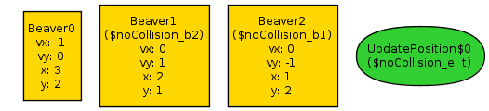
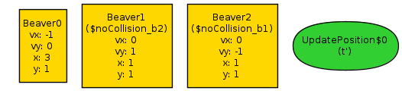
Analysis Results
scope: up to 2 beavers → no counterexample
scope: up to 3 beavers → counterexample found
 | 1 | 2 | 3 | 4
1 |  | B1
2 | B2 |  | B0
3
4
X
B2 didn’t expect B2 to turn right (in order to avoid colliding with B0)
y

Slide 13
Avoid collisions: Attempt 2
sig UpdatePosition extends Event {}{
all b: Beaver | let x' = b.x.t.plus[b.vx.t], y' = b.y.t.plus[b.vy.t] {
// if no other beaver is headed to the same position
(no b2: Beaver - b |
samePos[x', y', b2.x.t.plus[b2.vx.t], b2.y.t.plus[b2.vy.t]]
) implies {
// proceed according to speed
b.x.t' = x' and b.y.t' = y'
} else {
// otherwise, don’t move
b.x.t' = b.x.t and b.y.t' = b.y.t
}
// speed doesn’t change
b.vx.t' = b.vx.t and b.vy.t' = b.vy.t
}
}

Slide 14
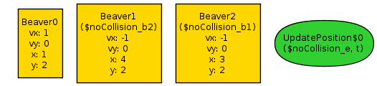

Analysis Results
scope: up to 3 beavers → counterexample still found
 | 1 | 2 | 3 | 4
1
2 | B0 |  | B2 | B1
3
4
X
B1 didn’t expect B2 to stop (in order to avoid colliding with B0)
y

Slide 15
Avoid collisions
sig UpdatePosition extends Event {}{
all b: Beaver | let x' = b.x.t.plus[b.vx.t], y' = b.y.t.plus[b.vy.t] {
// if no other beaver is headed to the same position OR is currently there
(no b2: Beaver - b |
samePos[x', y', b2.x.t.plus[b2.vx.t], b2.y.t.plus[b2.vy.t]] or
samePos[x', y', b2.x.t, b2.y.t]
) implies {
// proceed according to speed
b.x.t' = x' and b.y.t' = y'
} else {
// otherwise, don’t move
b.x.t' = b.x.t and b.y.t' = b.y.t
}
// speed doesn’t change
b.vx.t' = b.vx.t and b.vy.t' = b.vy.t
}
}
Passes the check!

Slide 16
Pros
Automated analysis
Easy to model REACT programs
Flexibility to represent different event models

Slide 17
Cons
Too coarse abstraction for some robots
Everything discretized
Bounded analysis
Next
how to address these issues

Slide 19
BeaverSim in REACT: contexts
context BeaverSim [
beavers: listof(Beaver)
] {
# update position according to speed
every(1000) {
for b in beavers {
b.x += b.vx;
b.y += b.vy
}
}
# bounce back whenever hit the left wall
whenever(some b in beavers | b.x < 0) {
b.x = 0;
b.vx = -b.vx
}
}

Slide 20
BeaverSim in REACT: model
context BeaverSim [
beavers: listof(Beaver)
] {
invariant {
beavers.size() < MAX_BEAVERS
} # ...
}
MAX_BEAVERS = 5
MAX_X, MAX_Y = (10, 10)
record Beaver [
name: str,
x: int,
y: int,
vx: int,
vy: int
]

Slide 21
REACT: domain-specific features
conditional events
periodic events
whenever(condition) {
[code to execute whenever the condition is true]
}
every(interval) {
[code to execute every interval ms]
}
typed events
invariants
on EventType {
[code to execute when an event of the above type occurs]
}
invariant {
[condition that must hold at all times]
}

Slide 22





Distributed, Interactive, Heterogeneous
Concurrent and distributed architecture
data races
atomicity
deadlocks
shared data inconsistency
Implementation complexity
hard to analyze, test, ensure correctness
22

Slide 23
Proposed Solution
Model-based, event-driven paradigm
global model of the entire distribute system
simple sequential semantics
expressive programming language
Runtime environment
manages accesses to shared state
no data races by construction
Analyses
amenable to formal analyses (e.g., testing, security, …)

Slide 24
REACT: Records, Contexts, Events
Records
simple data structures
used to represent the core data model of the system
Contexts
encapsulate different processes (nodes)
can store records
Events
allow robots to dynamically react to their environments
triggered by the user, timer, whenever a condition holds, …

Slide 25
Example: BeaverSim
Implement a beaver simulator: (inspired by the ROS turtlesim example)
model: a beaver has position (x, y) and speed (vx, vy)
constraint: no more than 5 beavers allowed
every 1s positions are updated according to speed
whenever a beavers hits a wall, its speed is reversed
one simulator node displays current positions of all beavers
arbitrary number of remote controller nodes

Slide 26
Traditional approach to timer events
fragmented implementation of whenever actions
whenever conditions can turn true at various code points
e.g., (1) when position is auto-updated based on speed and (2) when position is explicitly set by a remote controller
fragmented implementation of constraint checks
have to make sure that invariants hold after every update

Slide 27
BeaverSim in REACT: model
context BeaverSim [
beavers: listof(Beaver)
] {
invariant {
beavers.size() < MAX_BEAVERS
}
# ...
}
context RemoteCtrl {
# ...
}
MAX_BEAVERS = 5
MAX_X, MAX_Y = (10, 10)
record Beaver [
name: str,
x: int,
y: int,
vx: int,
vy: int
]

Slide 28
BeaverSim in REACT: events
event Spawn [
receiver: BeaverSim,
name: str
] {
guard { name.length() == 1 }
handler {
receiver.beavers += Beaver.new(name: name,
x: 0, y: 0,
vx: 1, vy: 0)
}
}

Slide 29
BeaverSim in REACT: events
event Spawn [
receiver: BeaverSim,
name: str
] {
guard { name.length() == 1 }
handler {
receiver.beavers += Beaver.new(name: name,
x: 0, y: 0,
vx: 1, vy: 0)
}
}

Slide 30
BeaverSim in REACT: events
event ChangeSpeed [
receiver: BeaverSim,
idx: int,
dx: int,
dy: int
] {
guard { 0 <= idx < receiver.beavers.size() }
handler {
receiver.beavers[idx].vx += dx
receiver.beavers[idx].vy += dy
}
}

Slide 31
BeaverSim in REACT: contexts
1
0
2
3 4
context BeaverSim [
beavers: listof(Beaver)
] {
on start { @gui = MyGui.new; @gui.start() }
on exit { @gui.stop() }
every(1000) {
@gui.draw_beavers(beavers)
for b in beavers { b.x += b.vx; b.y += b.vy }
}
whenever(some b in beavers | b.x < 0) {
b.x = 0; b.vx = -b.vx
}
}

Slide 32
BeaverSim in REACT: contexts
context RemoteCtrl {
on start { @selected = -1 }
on KEY_0 { @selected = 0 }
on KEY_4 { @selected = 4 }
on KEY_c { trigger Spawn.new(name: ‘B’) }
on KEY_UP { trigger ChangeSpeed.new(idx: @selected
dx: 0, dy: -1)}
on KEY_DOWN { trigger ChangeSpeed.new(idx: @selected
dx: 0, dy: 1) }
on KEY_LEFT { trigger ChangeSpeed.new(idx: @selected
dx: -1, dy: 0)}
on KEY_RIGHT { trigger ChangeSpeed.new(idx: @selected
dx: 1, dy: 0) }
}

Slide 33
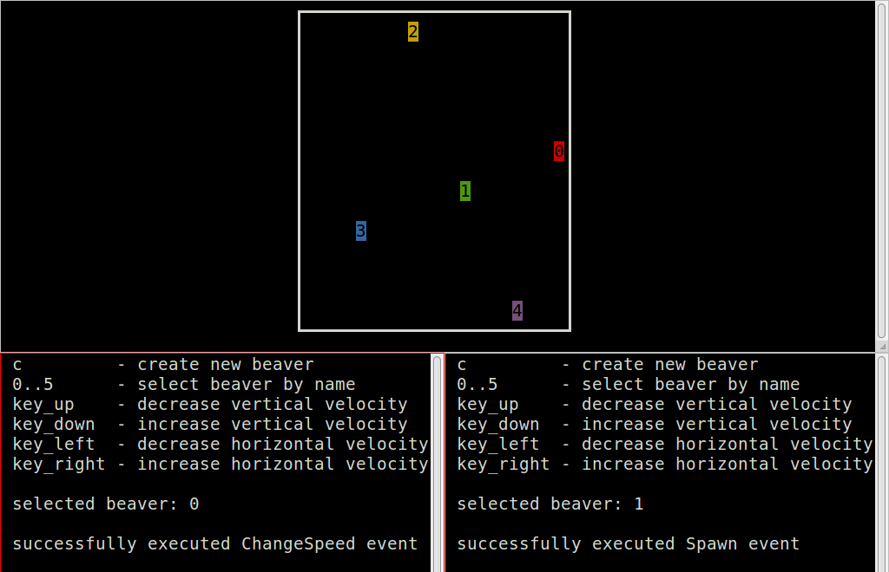
Demo (implemented on top of ROS)

Slide 34
Original TurtleSim Spawn event
spawn_srv_ = nh_.advertiseService("spawn", &TurtleFrame::spawnCallback, this);
bool TurtleFrame::spawnCallback(turtlesim::Spawn::Request& req, turtlesim::Spawn::Response& res) {
std::string name = spawnTurtle(req.name, req.x, req.y, req.theta);
if (name.empty()) { ROS_ERROR("A turtled named [%s] already exists", req.name.c_str()); return false; }
res.name = name;
return true;
}
std::string TurtleFrame::spawnTurtle(const std::string& name, float x, float y, float angle) {
std::string real_name = name;
if (real_name.empty()) {
do {
std::stringstream ss;
ss << "turtle" << ++id_counter_;
real_name = ss.str();
} while (hasTurtle(real_name));
} else { if (hasTurtle(real_name)) { return ""; } }
TurtlePtr t(new Turtle(ros::NodeHandle(real_name), turtle_images_[rand() % turtle_images_.size()], QPointF(x, y), angle));
turtles_[real_name] = t;
update();
ROS_INFO("Spawning turtle [%s] at x=[%f], y=[%f], theta=[%f]", real_name.c_str(), x, y, angle);
return real_name;
}

Slide 35
Original TurtleSim model class
class Turtle {
public:
Turtle(const ros::NodeHandle& nh, const QImage& turtle_image, const QPointF& pos, float orient);
private:
void velocityCallback(const geometry_msgs::Twist::ConstPtr& vel);
bool teleportRelativeCallback(turtlesim::TeleportRelative::Request&, turtlesim::TeleportRelative::Response&);
bool teleportAbsoluteCallback(turtlesim::TeleportAbsolute::Request&, turtlesim::TeleportAbsolute::Response&);
ros::Subscriber velocity_sub_;
ros::Publisher pose_pub_;
ros::ServiceServer teleport_relative_srv_;
ros::ServiceServer teleport_absolute_srv_; }
namespace turtlesim {
Turtle::Turtle(const ros::NodeHandle& nh, const QImage& turtle_image, const QPointF& pos, float orient)
: nh_(nh), turtle_image_(turtle_image), pos_(pos), orient_(orient), lin_vel_(0.0), ang_vel_(0.0), pen_on_(true), pen_(QColor(DEFAULT_PEN_R, DEFAULT_PEN_G, DEFAULT_PEN_B)) {
velocity_sub_ = nh_.subscribe("cmd_vel", 1, &Turtle::velocityCallback, this);
pose_pub_ = nh_.advertise<Pose>("pose", 1);
teleport_relative_srv_ = nh_.advertiseService("teleport_relative", &Turtle::teleportRelativeCallback, this);
teleport_absolute_srv_ = nh_.advertiseService("teleport_absolute", &Turtle::teleportAbsoluteCallback, this);
}

Slide 36
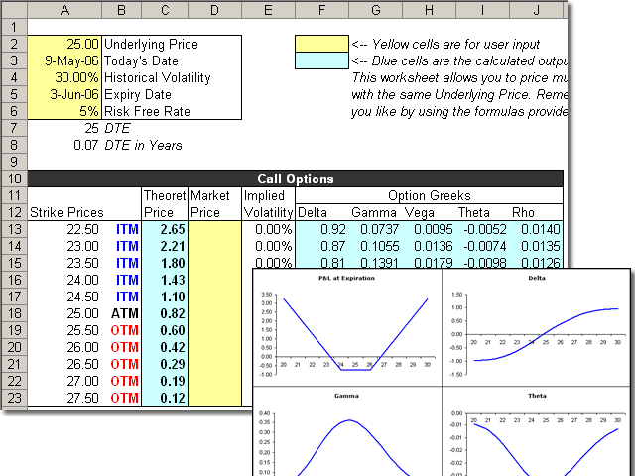

Big Idea
Generic platform for programming event-driven systems
covers a whole class of programs
interactive event-driven apps
spreadsheets
REACT
similar to
cms
End-user programming of interactive apps
examples: social web apps, robots
makes simple tasks easy and difficult ones possible

Slide 37



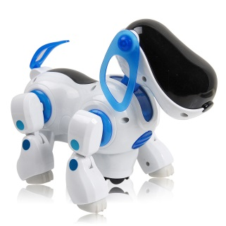
Status
Prototype for client/server applications
implemented in Java
Prototype for web applications
implemented for Ruby on Rails
Prototype for ROS
Next: look for concrete robot examples
robots are event driven, often mission critical
adapt our paradigm to programming robots
verify functional correctness

Slide 38




Benefits and Future Goals
Rich programming platform
speeds up development process
eliminates a whole class of concurrency bugs by construction
Application in the security domain
every field access is managed by the runtime system
security policies can be defined independently and automatically enforced at runtime
Robot programming for end-users
Thank You!

Slide 39
The End

Slide 40
Hello World example
context Main {
/* trigger-event */
on Main:enter {
/* action call w/ argument */
Sys.print! msg:“Hello, world!”
/* built-in action call */
Main.exit!
}
}
Outputs: Hello, world!

Slide 41
A more complex example
context Headbanger {
banging = 0
bangSpeed = 0
action bangHead! forTime:dur:5000 withEnthusiasm:enth {
banging = Clock.time + dur
bangSpeed = enth
}
whenever (banging > Clock.time) {
#spinhead(bangSpeed)
}
}
context Main {
on Main:enter {
Headbanger.enter!
Headbanger.bangHead! withEnthusiasm:10 forTime:10000
}
every (20000) {
Headbanger.bangHead! withEnthusiasm:20
}
}

Slide 42
Variables
Syntax:
(public) (active) name = value
where name is the variable identifier, value is a numerical expression
public modifier allows variable to be visible outside of its own context
active modifier creates an active variable: read-only once defined, and re-evaluate their assigned expression every time they are referenced. They are implemented as in-line function calls

Slide 43
In-depth: ‘whenever’ vs. ‘every’ events
Whenever
Every
Syntax:
whenever (condition) {
[code to execute]
}
condition: boolean expression to check
for direct reactions to changes in the robot’s environment
Syntax:
every(interval) {
[code to execute]
}
interval: numerical expression for time interval
requires some method of retrieving clock ticks
Implementation:
last_call = 0
whenever (last_call + interval
< clock_time) {
last_call = clock_time
[code to execute]
}

Slide 44
In-depth: ‘on’ events vs. actions
‘on’ event
Action
Syntax:
on cntxt_name:event_name {
[code to execute]
}
Called explicitly with:
trigger cntxt_name:event_name
for reactions to user-defined circumstances
only execute if context is live
Syntax:
action name! <arguments> {
code
}
Argument syntax:
ext_name:int_name(:def_val)
Use system of constraints to ensure safety
Take dynamic arguments
Calling syntax:
context_id.action_id!
<arguments to pass>

Slide 45
Embedded C
Special “C context” construct for creating libraries of C-code interfaceable with REACT, use _c_context keyword
C contexts can contain active variables or actions.
_c_context Foo {
public active c_val = “<C expression>”
action c_act! withArg:arg:50 “
[code...]
”
}
Code copied verbatim from within quotes
In order to implement APIs for particular robots in REACT, platform-specific code will surely be needed. Embedding native C-code into REACT source can facilitate this.

Slide 46


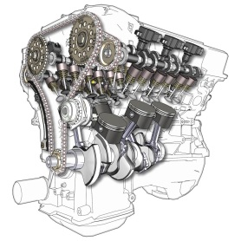
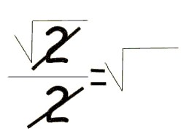
Technical contributions
Expressive power & programming efficiency
Programming language close to the problem domain
think in terms of simple data structures
don’t worry about concurrency and distributed architecture
declarative programming: say what not how
Runtime environment + code generation
no explicit synchronization, queues, message passing
no data consistency issues
synthesized clients for different platforms
Amenable to tools, testing, and formal analyses
core aspect of the system are kept succinct and formal
important for safety/security critical systems

Slide 47

REACT
Designed to be intuitive and easy to learn
Powerful expressiveness
Widespread applications

Slide 48
Proposed Solution
Model-based, event-driven programming paradigm
provides a simple declarative conceptual model
expressive power & programming efficiency
programming language close to the problem domain
Runtime environment
manages access to single shared global state
keeps everyone updated
programs free of concurrency bugs by construction
Rich tool set
amenable to formal analyses and automated testing
enabled by the succinct and formal event model

Slide 49
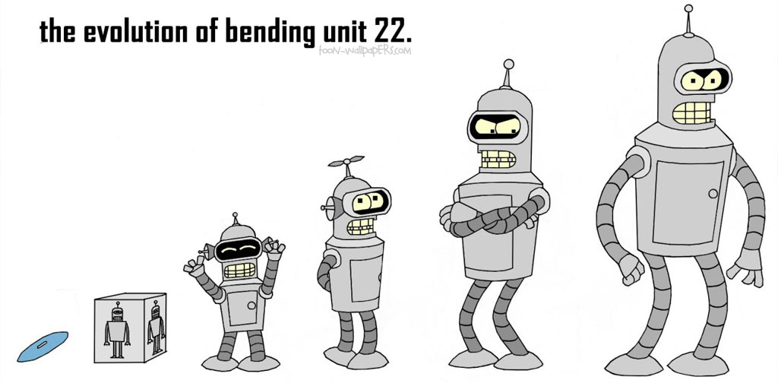
REACT summary
Pros
Highly abstract → easy to learn & portable
Flexible → can interface with native C code
Accessible → robotics programming requires extensive technical knowledge; REACT abstractions eliminate the need for hobbyists to acquire such knowledge.
Expressive → programs written faster, robots developed more easily
Cons
Centralized (not designed for distributed systems)
Sequential implementation (no concurrent events)
No explicit data model
data conflated with contexts

