Slide 1

REACT
REACT:
Event-driven
Asynchronous
Concurrent
Turing-complete
Students: Will Noble,
Aleksandar Milicevic
Supervisor: Stelios Sidiroglou PI: Prof. Martin Rinard

Slide 2

Robotics Programming
Abstraction gap
high-level problem, low-level implementation primitives
Typically steep learning curve, especially for hobbyists
Programming in terms of low-level primitives is tedious and error-prone
Largely non-standardized

Slide 3

REACT
Designed to be intuitive and easy to learn
Powerful expressiveness
Widespread applications

Slide 4
Task-oriented: Contexts, Events, Actions
Contexts encapsulate the processes used during a particular state in program execution
Events allow robots to dynamically react to their environments
can be triggered by a variety of means
by the user, timer, whenever a condition holds, …
Actions are like helper functions

Slide 5
Events example
Implement a robot that
performs some action every 5 seconds
periodically reads data from a sensor (e.g., sonar)
performs some action whenever the data from the sensor is below some threshold

Slide 6
Events example
context Main {
on Main:something_happened {
Sys.print! msg:“Something happened...”
}
every (5000) {
trigger Main:something_happened
Sys.print! msg:“It’s been five seconds!”
}
whenever (Sonar.distance < 500) {
trigger Main:something_happened
Sys.print! msg:“Something’s close!”
}
}

Slide 7
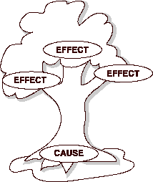
Events
‘on’ events for user-defined event types
‘every’ events for periodic or time-based tasks
‘whenever’ events for responding to certain conditions
Only execute if the context in which they are defined is currently live.
Events are the core of REACT programming
used to design program control flow

Slide 8
Actions
Standalone functions
May execute outside the parent context
Take arguments in any order, with optional default values
Support simple boolean constraints
Syntax for constraints:
constraint (condition)
Returns immediately unless all constraints are met
Actions are the REACT equivalent of methods in Java or C++, help provide modularity, dynamicity, organize code.

Slide 9
C function calls & embedded C
C functions can be called from within react code.
#fn_name(<C arguments>)
Can be called for side-effects, or as a sub-expression
Special “C context” construct for embedding C code
_c_context Foo {
public active c_val = “<C expression>”
action c_act! withArg:arg:50 “
<C code>
”
}
Code copied verbatim from within quotes

Slide 10
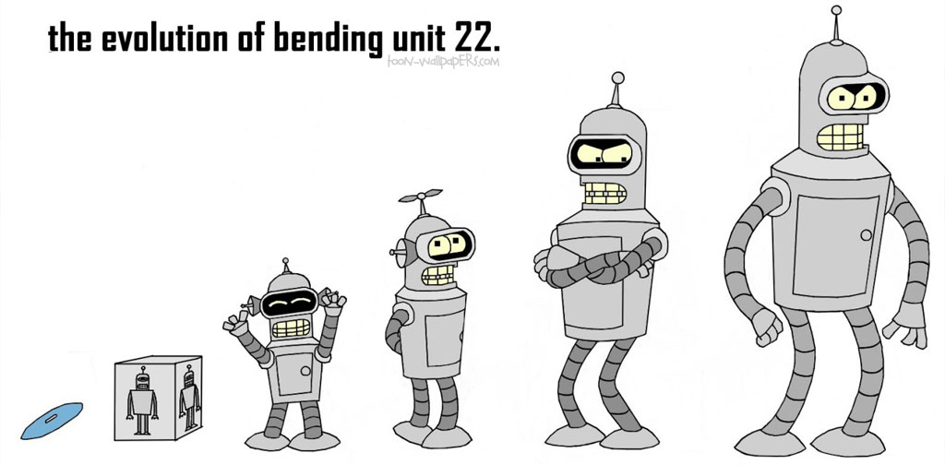
REACT summary
Pros
Highly abstract → easy to learn & portable
Flexible → can interface with native C code
Accessible → robotics programming requires extensive technical knowledge; REACT abstractions eliminate the need for hobbyists to acquire such knowledge.
Expressive → programs written faster, robots developed more easily
Cons
Centralized (not designed for distributed systems)
Sequential implementation (no concurrent events)
No explicit data model
data conflated with contexts

Slide 11





Distributed, Interactive, Heterogeneous
Abstraction gap
problem domain: high-level, event-driven
code level: queues, locks, async messages,…
Concurrent and distributed architecture
data races
atomicity
deadlocks
shared data inconsistency
Implementation complexity
hard to analyze, test, ensure correctness
11
Notes:
Now, this is what a cloud-based software system looks like. Think a social app; there’s typically a server-side, running in the cloud, and there are many heterogeneous clients the app should be able to run and look good on. What makes these apps different from static web pages, or traditional web applications, is the interactive component: as soon as something happens in should be propagated in real time to all connected clients.
On the other hand, functionality-wise, it always seems to me that most of such apps implement a really simple program: just store some state on the server, keep track of who’s doing what, and keep everyone informed; no rocket science programming there. So it seems that such apps ought to be easy to make. In practice, however, a lot of both tedious and technically challenging work is required, even for experienced programmers.
Here are some reasons for that.
- abstraction gap: when developing such an app, I would like to think in terms of conceptual objects, data structures and events, instead of low-level primitives like queues and async messages that I as a developer have to deal with instead
- these apps are inherently concurrent, which brings all the known concurrency issues. Even if I don’t require my application to be super fast and highly optimized, and despite knowing the common programming idioms that ensure absence of some of those issues, it is still a lot of tedious work to actually go ahead and implement all those idioms
- finally, being bogged down with low-level implementation details almost inevitably leads to cluttered and very complex code, that is hard to understand, debug and maintain.
----------------------------
Small social highly interactive apps are quite ubiquitous nowadays, from multiplayer games to organizers. To implement such an app, there is typically some sort of server (running in the cloud, preferably easily scalable and parallelizable), and then there are a number of clients that we would like to be supported: desktop, web, mobile, etc. Now, these apps really seem like fun little programs, and it would be great if even recreational programmers could easily play with building, testing, deploying and running them. The truth is, however, building an interactive cloud app is still a challenging and time consuming task even for professional programmers. These are some of the reasons:

Slide 12
Proposed Solution
Model-based, event-driven programming paradigm
provides a simple declarative conceptual model
expressive power & programming efficiency
programming language close to the problem domain
Runtime environment
manages access to single shared global state
keeps everyone updated
programs free of concurrency bugs by construction
Rich tool set
amenable to formal analyses and automated testing
enabled by the succinct and formal event model

Slide 13

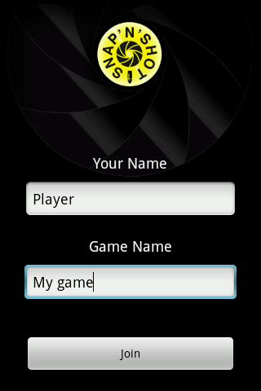
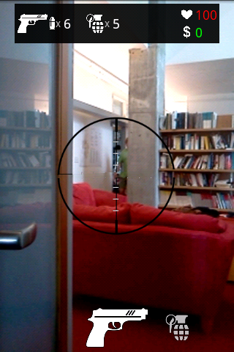
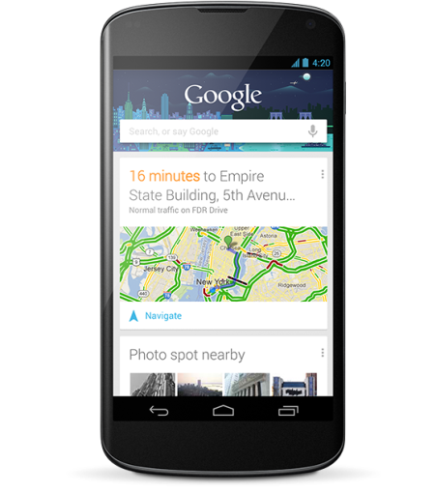

Example: Multiplayer Real-Time Game
Paintball with phones no guns
Joined in: My game
Daniel
Player
Darko

Slide 14
Design & Behavior
Current approach:
developers cannot focus solely on the domain
platform dependent code
manual synchronization, communication, data consistency
join event + boilerplate ~300+4000 LOC in Java
class User {
String name;
String gameName;
void join() {
// connect to server
// send data
// add event to update list
}
}
class Game {
String name;
User owner;
Set<User> players;
void acceptJoin() {
// accept connection
// read data
// synchronize and check name
// reply (to all)
}
}

Slide 15
Design & Behavior
Design from the user’s perspective
data model, network model, and events
automate synchronization, communication, data consistency
data model + join event: ~30 LOC
event JoinEvent, {
from client: Client
to server: Server
params {{
user: User,
game: String
}}
requires {
server.
*(Game)[:name=>game].
*(User)[:name=>user.name].
size = 0
}
ensures { game.players += user
}
}
record User, {
name: String }
record Game, {
name: String,
owner: User,
players: (set User)
}
machine Client, {
server: Server,
user: User
}
machine Server, {
clients: (set Client),
games: (set Game)
}

Slide 16
Security and Privacy Policies
Currently:
hard to keep track of all security rules
rules intermingled with core functionalities
REACT: invariants and policies
defined declaratively and independently
automatically checked/enforced by the system
class Game {
String name;
User owner;
Set<User> players;
void acceptJoin() {
// accept connection
// read data
// synchronize and check name
// reply (to all)
}
}
invariant “Prevent duplicate player name” {
all g: Game, {
g.*(User)[:name => user.name].size <= 1
} }

Slide 17
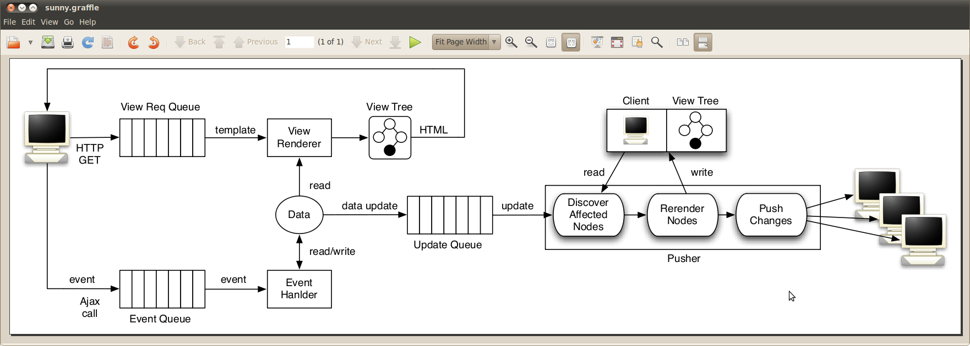
Architecture

Slide 18
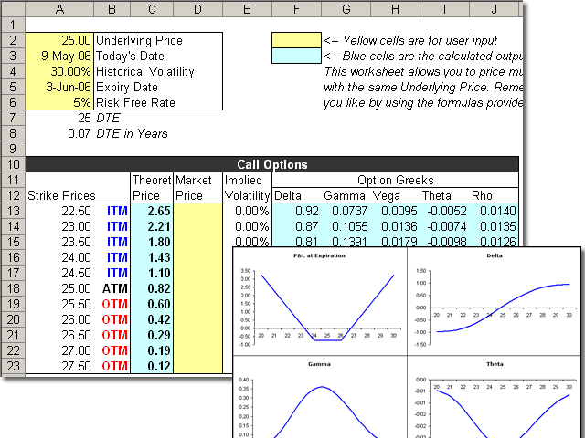

Big Idea
Generic platform for programming event-driven systems
covers a whole class of programs
interactive event-driven apps
spreadsheets
REACT
similar to
cms
End-user programming of interactive apps
examples: social web apps, robots
makes simple tasks easy and difficult ones possible

Slide 19




Status
Prototype for client/server + mobile apps
implemented in Java
event handling and synchronization back-end
automatic data propagation
Prototype for web applications
implemented for Ruby on Rails
Next: look for concrete robot examples
robots are event driven, often mission critical
adapt our event paradigm to programming robots
verify functional correctness
Notes:
We are confident that our ideas are realizable in practice. We have developed prototypes for …

Slide 20




Benefits and Future Goals
Rich enough platform for industry
speeds up development process
eliminates a whole class of concurrency bugs by construction
allows fine-grained customization
Application in the cyber-security domain
every field access is managed by the runtime system
security policies defined independently and formally checked
Robot programming for end-users
Thank You!
Notes:
To wrap up, we proposed a generic solution for programming event-driven cloud apps. We focused mostly on the end-user programming side of it, but our platform is rich enough for companies to use, both for their internal development, as well as building products, for the same reasons mentioned before, which ultimately increase productivity and also lead to more correct software.
Cyber security domain is very hot now, a lot of attention is paid to making sure that certain properties are never violated for security and safety critical systems, and this is yet another domain of application of our platform, exactly because of our system for specifying policies declaratively and independently, as well as the formal core of our models which is amenable to all sort of formal analyses.
Finally, we already mentioned the end-user programming side of it, but what is also cool is that a company could easily host an online app builder kind of web site, were the users can go to, write their models, and get running applications automatically synthesized and deployed on a real cloud server.
Danke very mucho.

Slide 21
The End

Slide 22
Hello World example
context Main {
/* trigger-event */
on Main:enter {
/* action call w/ argument */
Sys.print! msg:“Hello, world!”
/* built-in action call */
Main.exit!
}
}
Outputs: Hello, world!

Slide 23
A more complex example
context Headbanger {
banging = 0
bangSpeed = 0
action bangHead! forTime:dur:5000 withEnthusiasm:enth {
banging = Clock.time + dur
bangSpeed = enth
}
whenever (banging > Clock.time) {
#spinhead(bangSpeed)
}
}
context Main {
on Main:enter {
Headbanger.enter!
Headbanger.bangHead! withEnthusiasm:10 forTime:10000
}
every (20000) {
Headbanger.bangHead! withEnthusiasm:20
}
}

Slide 24
Variables
Syntax:
(public) (active) name = value
where name is the variable identifier, value is a numerical expression
public modifier allows variable to be visible outside of its own context
active modifier creates an active variable: read-only once defined, and re-evaluate their assigned expression every time they are referenced. They are implemented as in-line function calls

Slide 25
In-depth: ‘whenever’ vs. ‘every’ events
Whenever
Every
Syntax:
whenever (condition) {
[code to execute]
...
}
condition: boolean expression to check
for direct reactions to changes in the robot’s environment
Syntax:
every(interval) {
[code to execute]
}
interval: numerical expression for time interval
requires some method of retrieving clock ticks
Implementation:
last_call = 0
whenever (last_call + interval
< clock_time) {
last_call = clock_time
[code to execute]
}

Slide 26
In-depth: ‘on’ events vs. actions
‘on’ event
Action
Syntax:
on cntxt_name:event_name {
[code to execute]
}
Called explicitly with:
trigger cntxt_name:event_name
for reactions to user-defined circumstances
only execute if context is live
Syntax:
action name! <arguments> {
code
}
Argument syntax:
ext_name:int_name(:def_val)
Use system of constraints to ensure safety
Take dynamic arguments
Calling syntax:
context_id.action_id!
<arguments to pass>

Slide 27
Embedded C
Special “C context” construct for creating libraries of C-code interfaceable with REACT, use _c_context keyword
C contexts can contain active variables or actions.
_c_context Foo {
public active c_val = “<C expression>”
action c_act! withArg:arg:50 “
[code...]
”
}
Code copied verbatim from within quotes
In order to implement APIs for particular robots in REACT, platform-specific code will surely be needed. Embedding native C-code into REACT source can facilitate this.

Slide 28


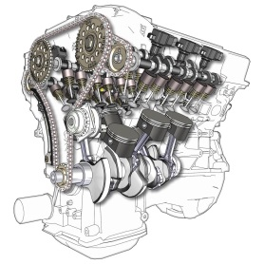
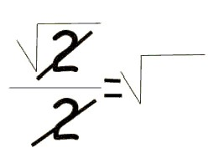
Technical contributions
Expressive power & programming efficiency
Programming language close to the problem domain
think in terms of simple data structures
don’t worry about concurrency and distributed architecture
declarative programming: say what not how
Runtime environment + code generation
no explicit synchronization, queues, message passing
no data consistency issues
synthesized clients for different platforms
Amenable to tools, testing, and formal analyses
core aspect of the system are kept succinct and formal
important for safety/security critical systems

Slide 29

Challenges and Team Strength
Number of challenges lie ahead
parallelizable runtime environment
data consistency in a distributed system
efficient engine for enforcing declarative security policies
analyses for ensuring functional system correctness (e.g., testing, verification, model-checking, etc.)
Notes:
However, there are still research challenges lying ahead, which are necessary to carry out to fully evaluate our approach and see how effective it will be in practice.
We are super smart and we published a fair amount.

